Slide 1


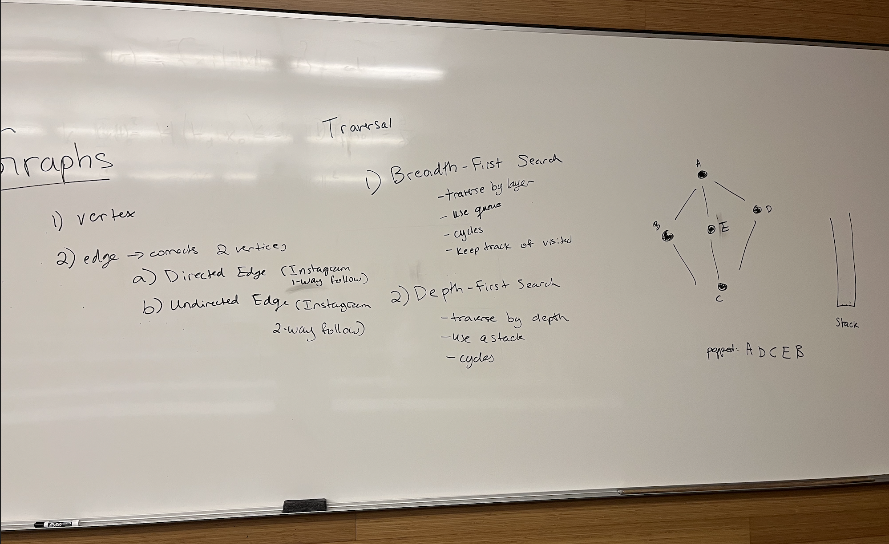
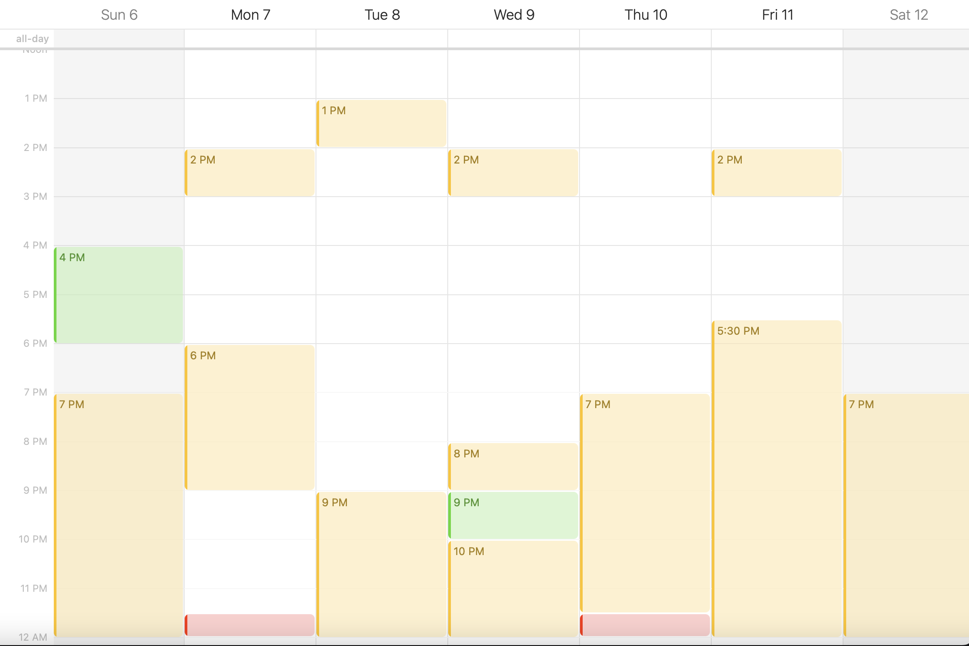
Bridge-Group: An Opt-In Recitation Section to Facilitate the Transition from CS1 to CS2
Emma Gurcan, James Bowden, Adam Blank
California Institute of Technology, Department of Computing and Mathematical Sciences
Background
Results
Establishing a supportive community while learning computer science is beneficial for students’ material retention and encourages collaboration.
CS2 is a demanding intermediate algorithms course where no recitations are offered outside of bridge-group.
Objective: To provide a collaborative and positive support system to aid in disadvantaged students' transition from CS1 to CS2 while promoting DEI.
Implementation: During CS2, students were monitored during the firsts weeks of the term and offered a spot in bridge-group, giving them the opportunity to attend one hour of specialized recitations and two hours of exclusive office hours.
“When the projects took like 20+ hours for me before bridge group, they ended up being much more manageable at 10ish hours, and
I felt more confident in how I approached each task because of the help during recitation.”
Methods
“Bridge group made it easier to work with a partner ‘cause we would have to meet at bridge group and bridge group OH and it kept us on the same page. (…) Bridge group really helped with collaboration and discussing ideas of implementation.”
Population: Demographically, the selected students were primarily women, and some were racial minorities. Students all came from disadvantaged backgrounds with little to no Computer Science experience prior to attending university.
Structure: Bridge-group offered one hour of recitation and two hours office hours (Figure 1).
Pair programming on projects between members of bridge-group was encouraged during recitation by dedicating time for the students to collaborate to develop various algorithm implementations.
Quantification: At the end of term, a survey with rating and short answer components was sent to the bridge students evaluating bridge-group’s impact on their programming confidence, comfort asking questions and collaborating, and feelings of acceptance in the larger academic community.
Figure 3: Photograph from a Recitation Whiteboard 3/3/2022
Summary
Lecture
Lab
Lecture
Lecture
Qualitatively, we saw that students showed an increase in concept retention, desire for understanding course materials, and developed a cohort-environment.
Quantitatively, 100% of surveyed students felt more confident in their programming skills, felt more comfortable asking questions they felt their peers might already knew the answer to during office hours and were empowered to pursue CS outside of the course. (Figure 4)
Time spent on homework decreased by up to 50%, despite Bridge-Group’s time commitment.
Students reflected that because they felt accepted in the collaborative community created by bridge-group, they were more confident in their identities as computer scientists (Figure 4)
Bridge-Group created an environment where students were encouraged to collaborate, and work in partners or small groups to formulate pseudocode and algorithms. Bridge-Group promoted students’ accessibility to working in teams and encouraged an accepting community.
Bridge-Group helped create skills in collaborative coding that is essential for industry.
Bridge-Group Office Hours
General
Office Hours
General
Office Hours
General
Office Hours
General
Office Hours
Bridge-Group Recitation
General
Office Hours
General
Office Hours
General
Office Hours
Project Due
General
Office Hours
Lab Due
Figure 1: CS2 Weekly Course Structure
Figure 4: Students’ Percent Agreement on a 1-5 Scale of Survey Statements
Reviewing Data Structures
Exploring Weekly Project Specs
Collaborating to Develop Pseudo-Code
“Coming into CS2, I was very intimidated (…) but because of the bridge group, I was able to grow at a relatively fast pace. So much so that CS2 has been a noticeably less struggle for me than CS1, and more fun as well.”
“As a novice programmer, I felt like [Bridge-Group] gave me the support I needed for both
Conclusion
understanding Java and how to visualize these data
Cultivating a positive cohort environment to offer an additional support system to students of disadvantaged backgrounds facilitated their transition from CS1 to CS2. Students felt more confident in their programming abilities, were encouraged to collaborate, and were empowered in their identities as computer scientists. In the future, we plan on implementing this system with larger student cohorts with varied backgrounds.
20 mins
20 mins
20 mins
structures.”
Figure 2: Recitation Structure
egurcan@caltech.edu | 1200 E. California Blvd, Pasadena, CA, 91126
C

