Slide 1

CH2200 Quantum Mechanics
Lecture 1: Origins of Quantum Mechanics

Slide 2
Classical Mechanics
Classical mechanics describes macroscopic objects.
Newtons Laws and the Laws of Thermodynamics are examples of classical laws – based on experimental observation.
In the late 19th century, advanced experiments were showing that some of these classical laws didn't hold up under close scrutiny...

Slide 3
Black-Body Radiation
All objects emit electromagnetic (EM) radiation, depending on their temperature. This is called Black Body Radiation.
The Sun is a good example of a black-body. Scientists have tried to model the spectral radiance of the sun, which is how much radiation it emits at different parts of the EM spectrum.
Classically, this model was called the Rayleigh-Jeans Law.

Slide 4
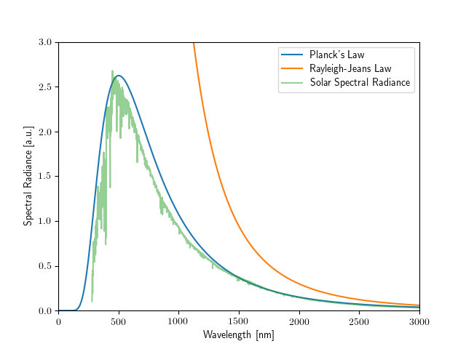
Black-Body Radiation
As you can see below, the Rayleigh-Jeans Law is a bit rubbish! Planck's Law looks a lot better..

Slide 5
Black-Body Radiation
Planck's Law modelled the same thing, but assumed that energy could only be emitted in discrete amounts. This was at odds with classical mechanics, and suggested something new was at play.
This was among the first evidence that energy is quantised – that is, particles can only exist with certain energies (not any energy they want).

Slide 6
The Photoelectric Effect
Even more evidence came from Albert Einstein's description of the Photoelectric Effect.
He showed that when you shone light on metal, electrons were emitted, but the energy of the emitted electrons only depended on the colour, not the brightness, of the light.
Einstein realised that the light consisted of photons with an energy hν related to the frequency (ν) of the light.

Slide 7
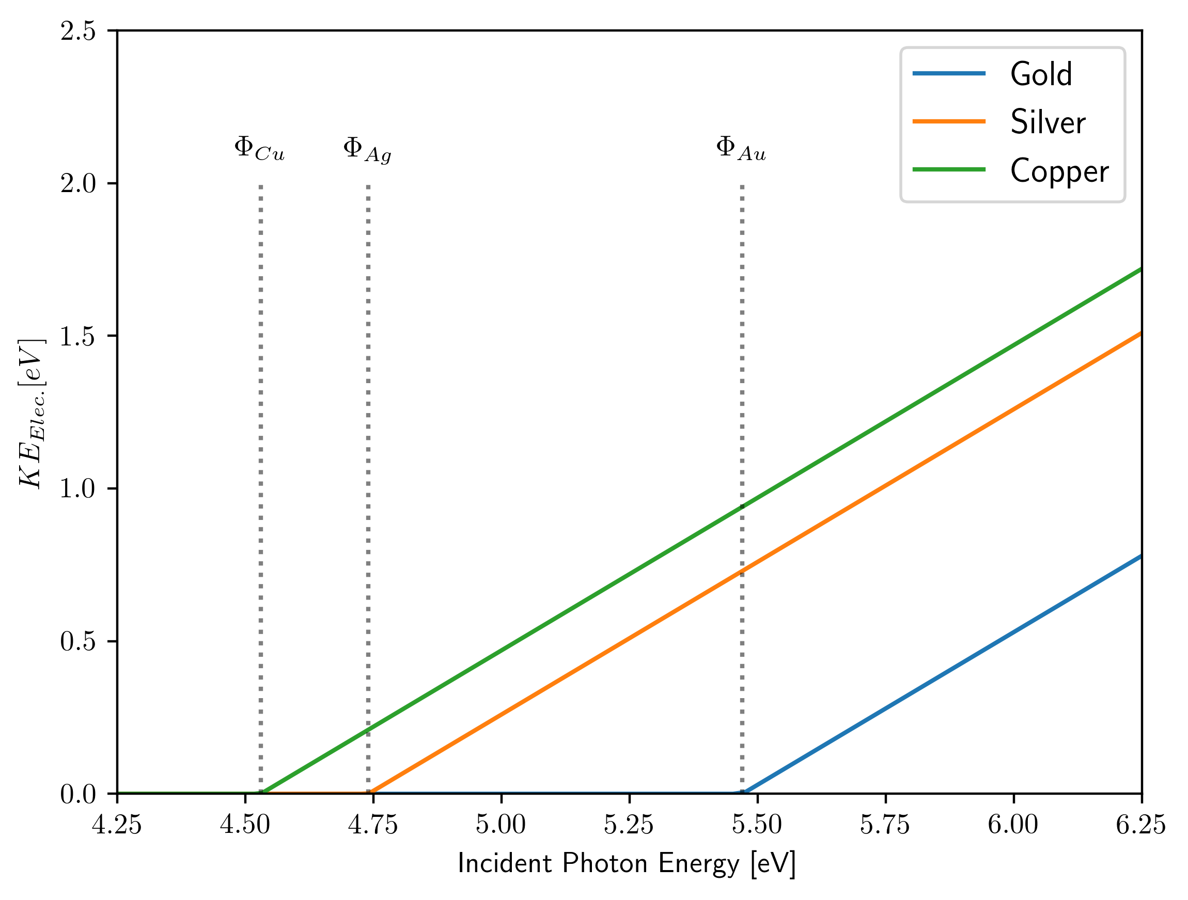
The Photoelectric Effect
KE = hv - Φ where Φ is the work function.
This suggested light could be thought of as a particle – the photon.

Slide 8
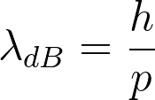
Wave-Particle Duality
But people always thought of light as waves! This was a big problem for scientists. Is it a wave or a particle?
Einstein realised that it is both a wave and a particle!
This is called wave-particle duality. Recall the de Broglie Wavelength:

Slide 9
Wavefunctions
Very small particles don't travel along well defined trajectories, they are spread out in space as waves.
The function that describes their trajectory is called a wavefunction (symbol normally Ψ or ϕ).
The wavefunction contains all the dynamical information about the system that it describes (where it is and where it is going).

Slide 10

Wavefunctions
We can find the wavefunction for any system by solving the Schrödinger Equation.
Unfortunately this isn't very easy, and is the point of this whole lecture course!
Before we dive into this, let's consider what the wavefunction can actually tell us, and what kinds of wavefunctions are allowed.

Slide 11
Acceptable Wavefunctions
Acceptable wavefunctions have to have the following properties (see handout for details):
They cannot be zero everywhere, or infinite anywhere.
They must be single-valued.
They must be continuous.
These are quite strict constraints and will have profound implications later on!

Slide 12

The Born Interpretation
The Born Interpretation of the wavefunction says that:
"The probability of finding the particle at any point in space is proportional to the square of the wavefunction at that point"
Where dx is the width of the region you're looking in – larger region = higher probability!

Slide 13
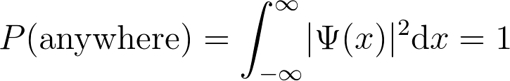
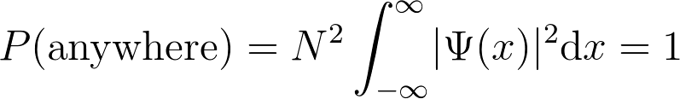
Normalisation
The probability of finding the particle anywhere must be 1 (the particle has to be somewhere!)
We can make any wavefunction fulfil this criteria via normalisation:
Just pick N such that the equation is satisfied!

Slide 14

The Schrödinger Equation
is the Hamiltonian Operator and E is the total energy.
An operator is just a mathematical instruction sheet. The Hamiltonian Operator tells the wavefunction to produce the observable total energy.
We can find the total energy of any system if we know the Hamiltonian and the wavefunction!
This is a type of eigenvalue equation.

Slide 15
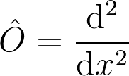
Eigenvalues and Eigenfunctions
An eigenvalue equation has the following form:
In our case, the operator is the Hamiltonian, the eigenfunction is the wavefunction, and the eigenvalue is the energy.
Confirm that sin(ax) is an eigenfunction of:
With an eigenvalue of a squared!

Slide 16
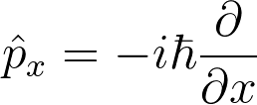
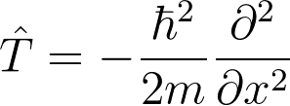
Operators and Observables
Generally, we can find operators that correspond to specific observables.
We've seen that the Hamiltonian operator produces the observable total energy.
We can calculate any physical observable by finding the appropriate operator! For example, momentum, or kinetic energy.

Slide 17
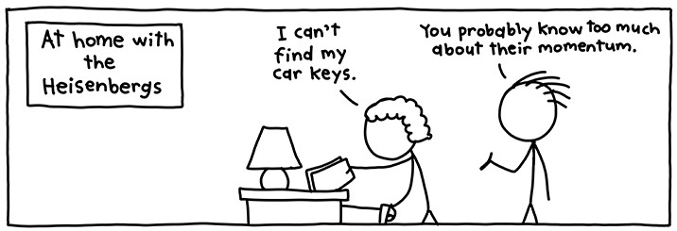
The Uncertainty Principle
Heisenberg's Uncertainty Principle states that:
"It is impossible to simultaneously measure the exact position and momentum of a particle"
As momentum corresponds to kinetic energy, this means if we know the exact energy of a particle, we have no idea where it is – and vice-versa!
www.xkcd.com/824

Slide 18
Summary – Postulates of QM
Some of the results we have arrived at are known as the Postulates of Quantum Mechanics.
There is a (non-exhaustive) more detailed list in the lecture handout.
The postulates are regarded as self-evident – there is no point trying to argue with them!
Next lecture: applying the mathematics we have covered here to a real system – The Particle in a 1D Box

