Slide 1

CH2200 Quantum Mechanics
Lecture 2: Translational Motion

Slide 2
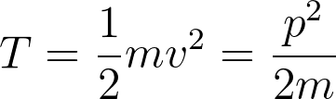

Classical Translations
Translational motion is just motion through space.
Classically, the translational kinetic energy (symbol T) is given by a familiar formula.
Where m is the mass, v is velocity, and p is linear momentum.

Slide 3

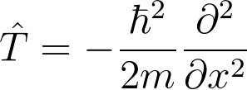
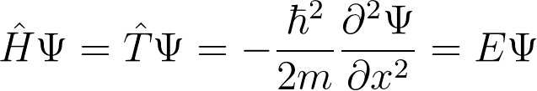
Quantum Translations
How do we find quantum mechanical translational energy?
If we assume no potential energy, need to find an operator for translational kinetic energy,
We can then construct our SE as follows:

Slide 4
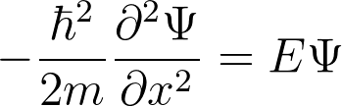
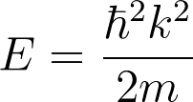
Solving the SE?
The equation below is a second-order differential equation.
A general solution to this equation is:
Where A and B are constants, and k will be examined later. Plugging this solution in gives the energy:

Slide 5

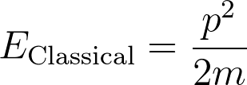
Quantum Translational Energy
Comparing the formula below to the classical formula, it should be clear that the value is related to the momentum.
So far, there are no restrictions on what k can be – we can have any energy we want! This is because our potential energy was zero.
What if we make our potential energy non-zero?

Slide 6
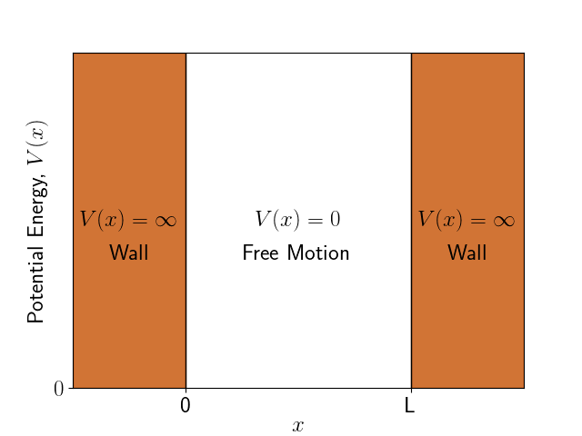
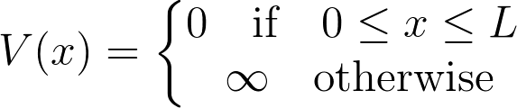
Particle in a 1D Box
Imagine our particle is trapped in the box below:
Our particle is free to be in the box, but cannot exist outside the box due to infinite potential.

Slide 7
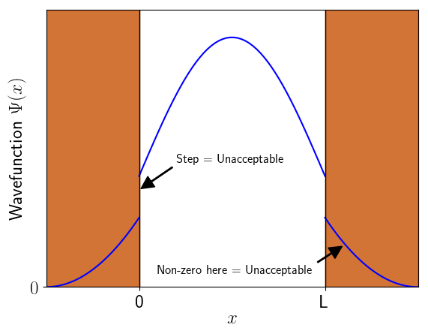

Boundary Conditions
How does this affect our energy? We now have boundary conditions.
Wavefunction must be zero at the walls!
Otherwise unacceptable!
Define walls at x=0 and x=L, so:

Slide 8


Emergent Quantisation
How do the boundary conditions change our maths? Remember our wavefunction:
Now we require that:
This leads to us needing:
Only true when kL is an integer multiple of pi!

Slide 9
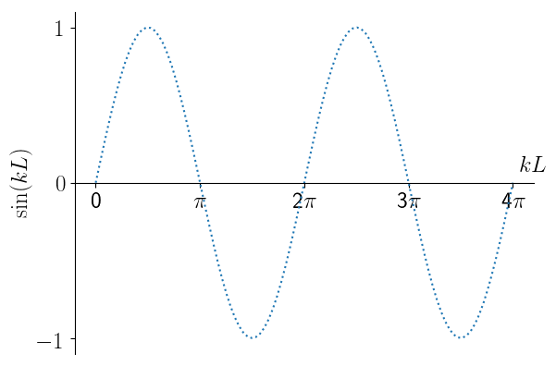

Emergent Quantisation
This graph shows that (for integer n)
Which means that (for integer n)

Slide 10
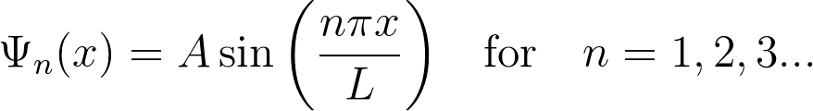
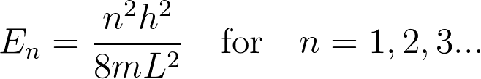
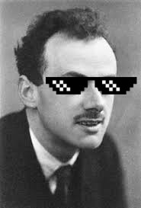
Emergent Quantisation
The only acceptable wavefunctions occur when n is an integer!
This also puts contraints on the acceptable energies.
We call n the quantum number – it tells us which state we are in.
Our energies are now quantised!

Slide 11
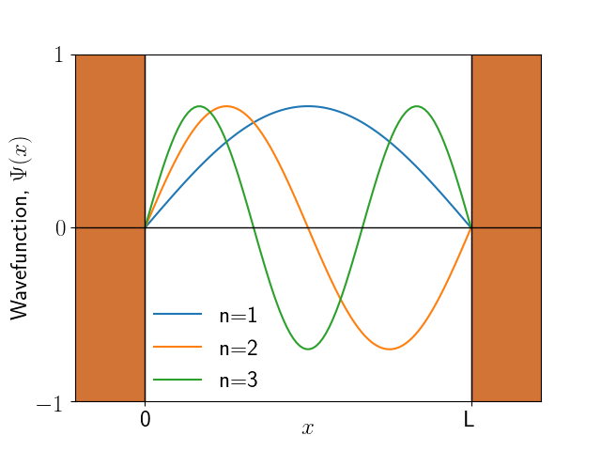
Properties of the Solutions
What do these solutions actually look like?
Higher n = shorter wavelength = higher energy

Slide 12
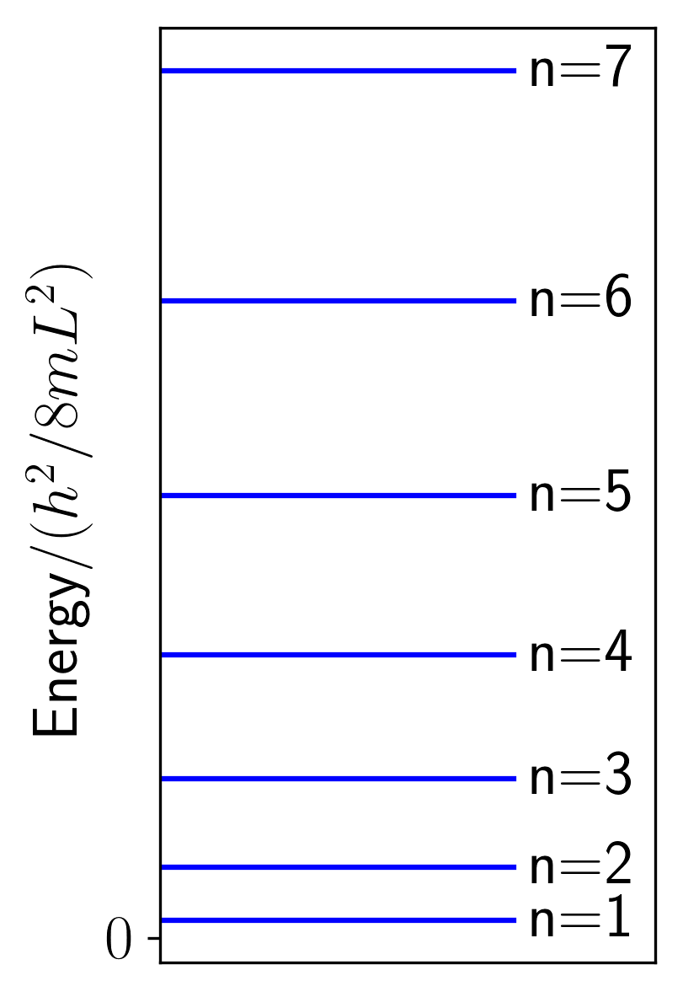
Properties of the Solutions
What about the energies?
Spacing increases as n increases.
Energy of n=1 level is not zero.
This is the zero-point energy and is a quantum phenomenon.
Because the particle is confined to the box, it cannot have zero energy.

Slide 13

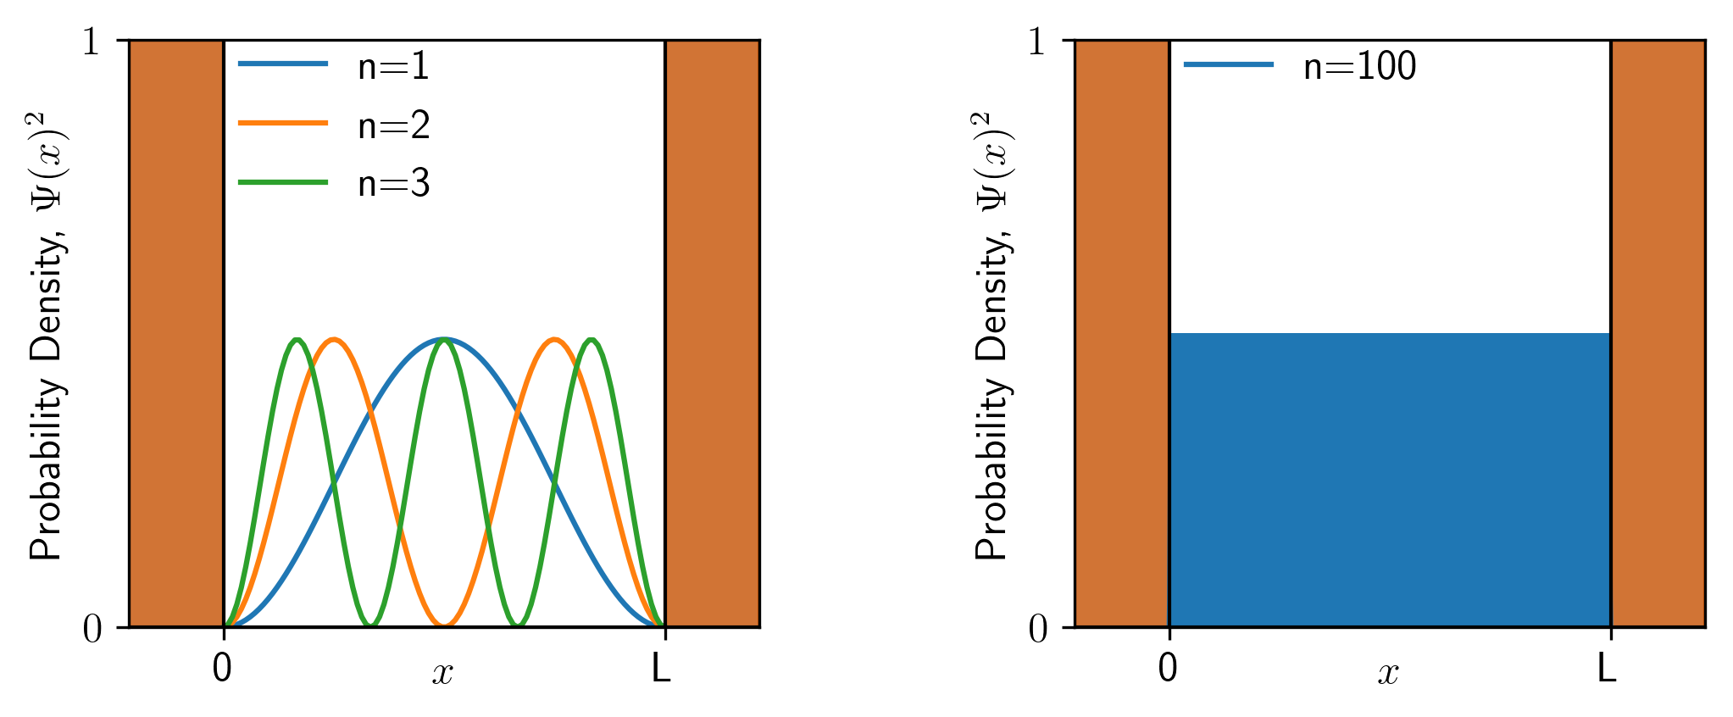
Where is the Particle?
Where would we find the particle in the box?
The Born Interpretation

Slide 14
The Correspondence Principle
What if we went to massive quantum numbers?
Probability is uniform!
Classical behaviour.
Example of the Quantum-Classical Correspondence Principle

Slide 15
Summary – Translational Motion
The motion of a free particle is not quantised.
Quantisation emerges when we add boundary conditions.
The quantum number tells us which state we are in.
At high quantum numbers, quantum mechanics turns into classical mechanics – this is called the Correspondence Principle.
Next Lecture – Vibrations!

