Slide 1

CH2200 Quantum Mechanics
Lecture 3: Vibrational Motion

Slide 2
Last Lecture
We saw how to treat translational motion quantum mechanically.
We saw that motion of a free particle was not quantised, and the quantisation emerged when we added in boundary conditions.
We met the concept of a quantum number, which is a way of labelling what quantum state our system is in.
Today we look at vibrational motion!

Slide 3
Classical Harmonic Oscillator
Imagine a particle attached to a wall by a spring. If we pull the particle, the spring pulls back.
The particle experiences a restoring force, that depends on how much we pull it. If you pulled and released the particle, it would start oscillating back and forth.
This oscillation is like the vibrations that occur in molecules, and the system is called a 'harmonic oscillator'.

Slide 4


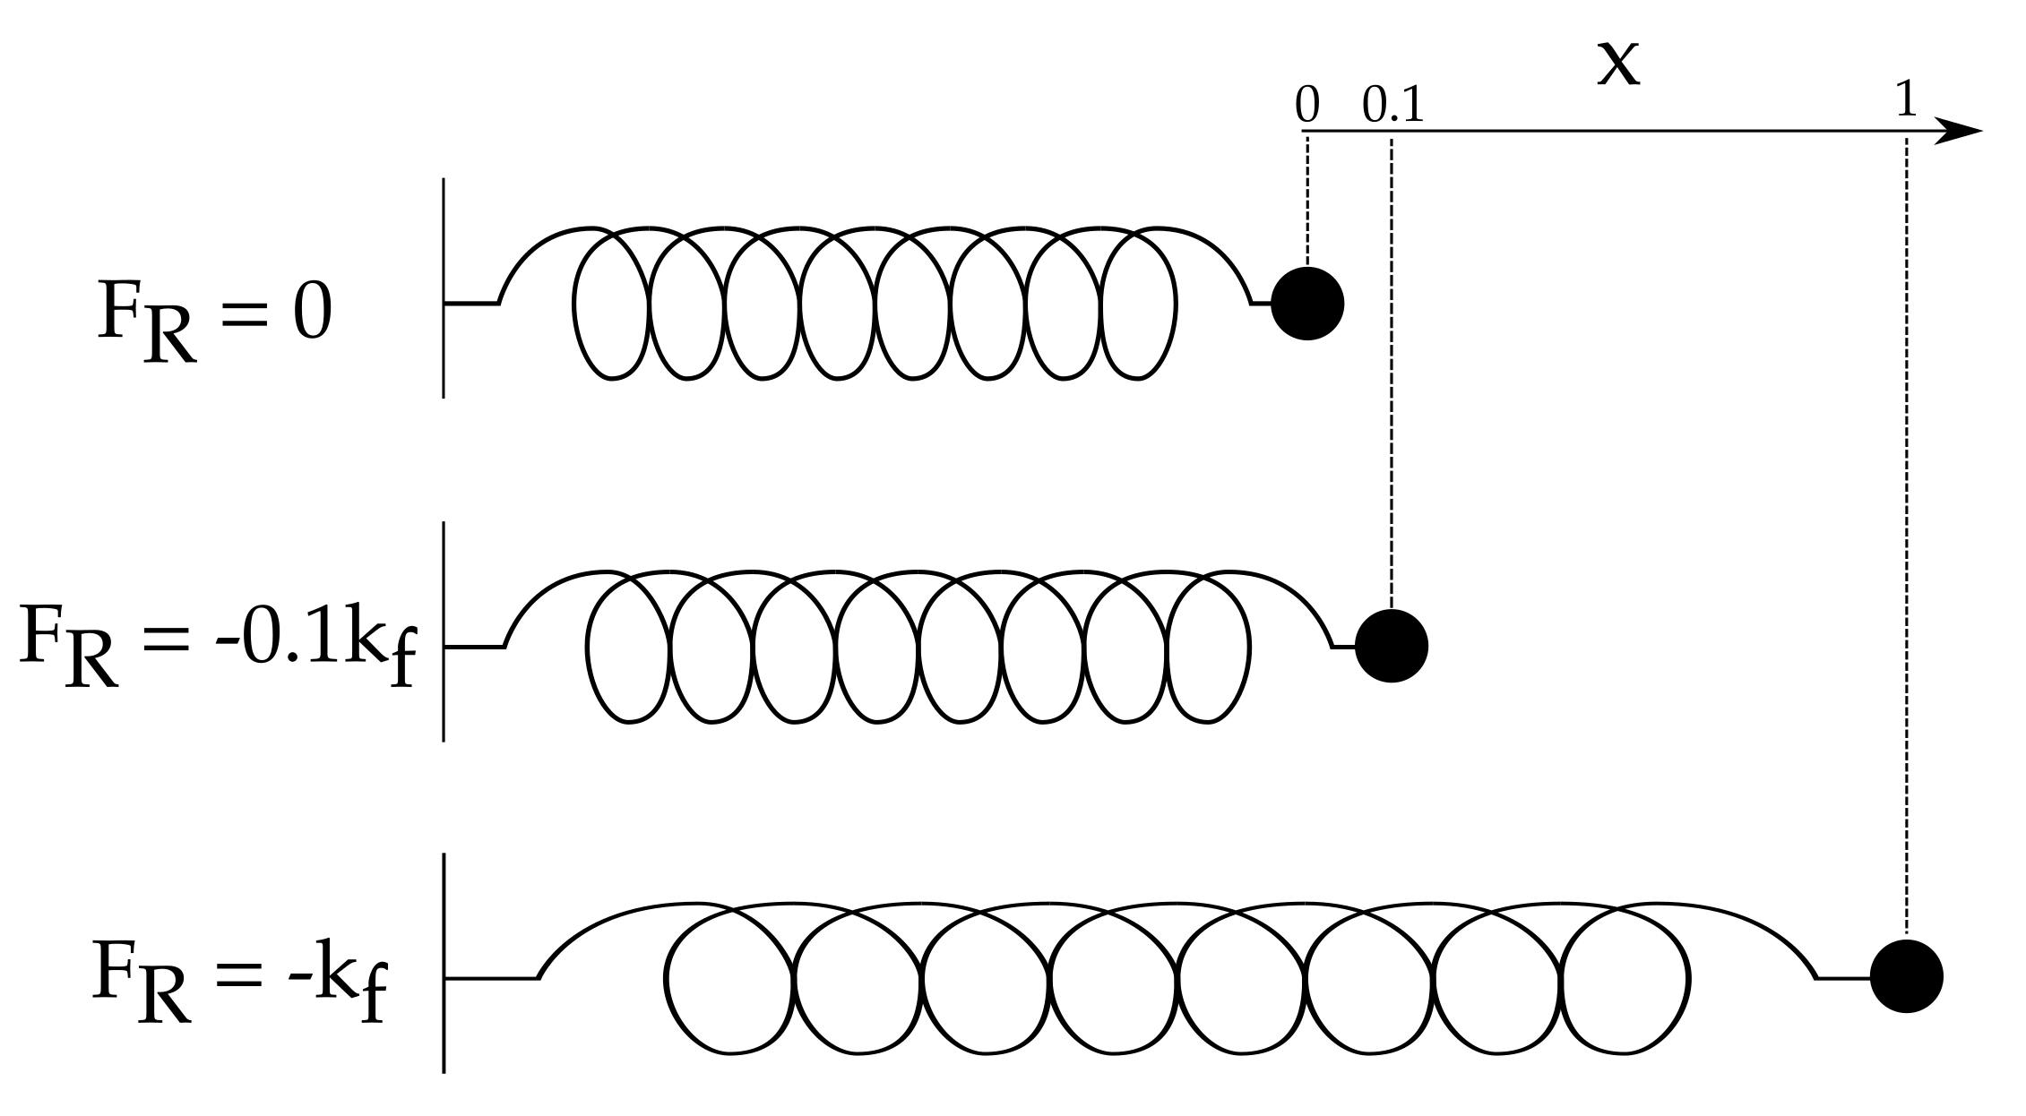
Classical Harmonic Oscillator
The restoring force is given by Hooke's Law.
Here is called the force constant. Extending the spring more increases the restoring force.

Slide 5
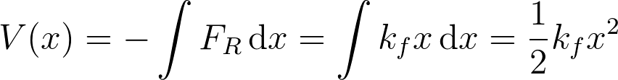
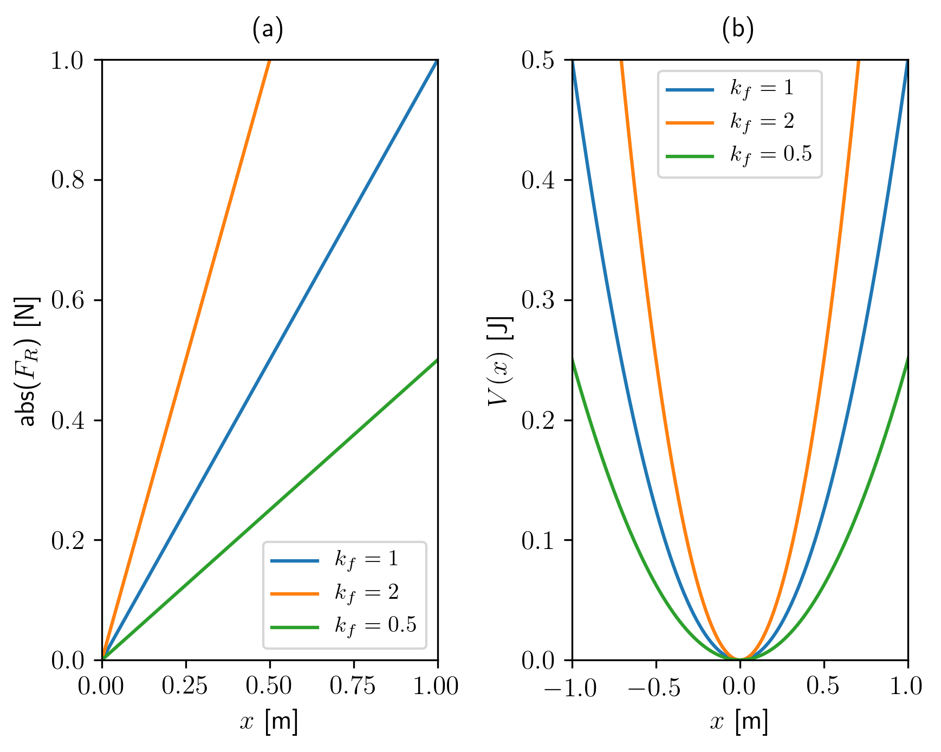
Classical Harmonic Oscillator
We need to know the potential energy of this system to add to our Schrödinger Equation.
Increased gives a tighter potential.
Imagine rolling a ball down the sides – like a pendulum!

Slide 6
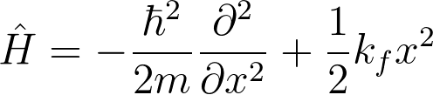
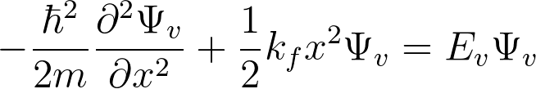
Quantum Harmonic Oscillator
We now subsitute our expression for V(x) into our overall Hamiltonian (kinetic energy is the same).
Overall Schrödinger Equation is therefore:
This is analytically solvable but too complex for here and now!
The subscript v's denote that these are vibrational energies and wavefunctions.

Slide 7
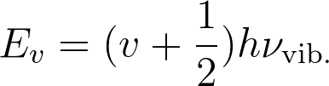
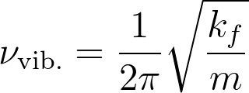

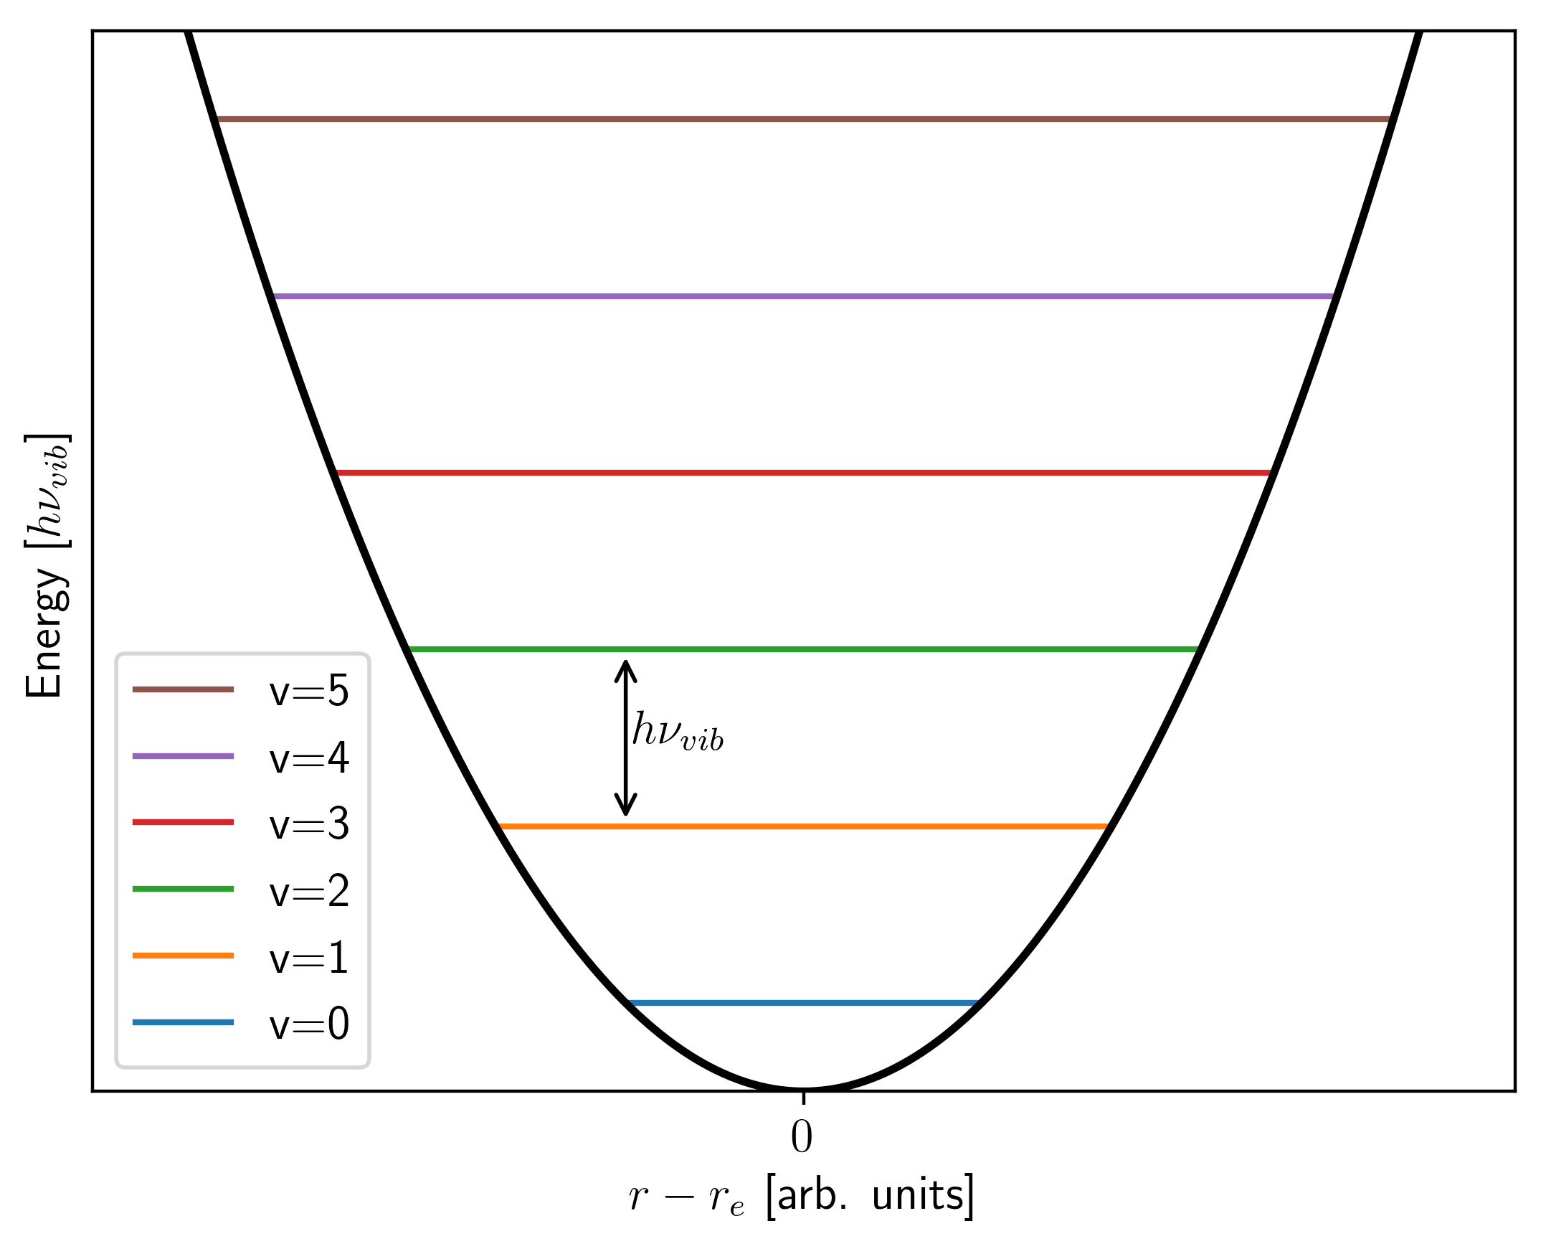
Vibrational Energies
It can be shown that the vibrational energies are:
Where v is the vibrational quantum number.
The energy spacing is now constant.
We also have a ZPE.
What happens when the spring constant is zero?

Slide 8
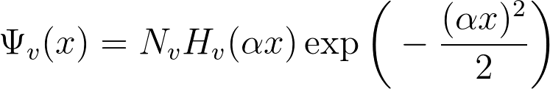
Vibrational Wavefunctions
What do the wavefunctions look like? (Horrible!)
Consists of (from left to right), a normalisation constant, Hermite Polynomial, and Gaussian Function.
Alpha is just a parameter related to the mass and force constant of the oscillator.
The more interesting question - what do the wavefunctions actually look like in real life?

Slide 9
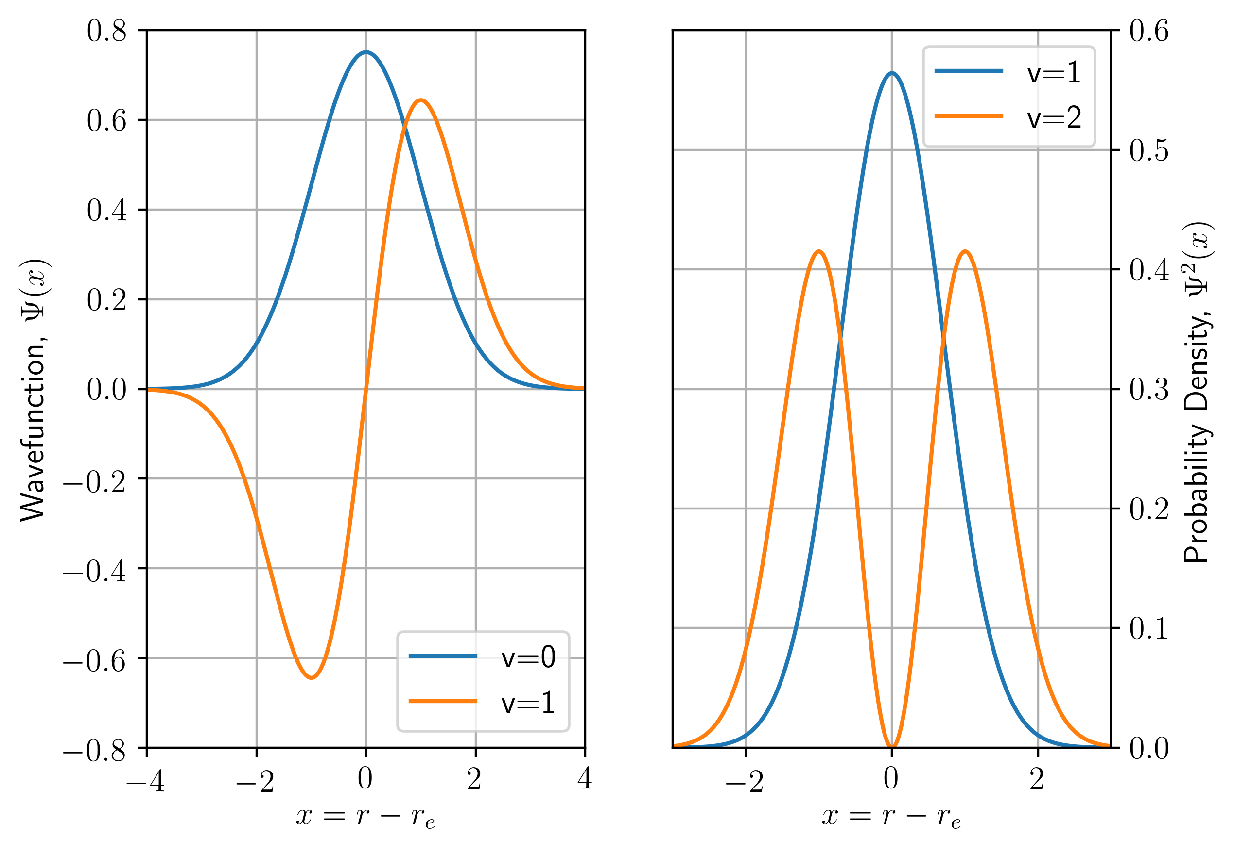
Vibrational Wavefunctions
Similar to a particle in a box! Do the probability densities make sense classically?

Slide 10
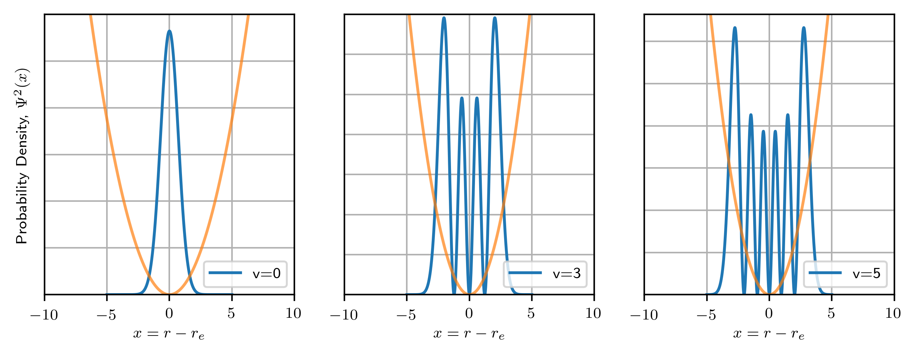
Harmonic Oscillator Probabilities
A swinging (classical) pendulum spends most time at the edges of it's travel. So what do we expect to happen at high quantum numbers?
Correspondence Principle again!

Slide 11
Harmonic Oscillator Summary
A harmonic oscillator experiences a restoring force proportional to how far it is from it's rest position.
We can make a quantum harmonic oscillator using:
This has the following allowed energies:
For v=0,1,2,3...

Slide 12
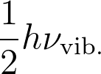
Harmonic Oscillator Summary
The level spacing doesn't change as we increase v.
Smaller spring constants reduce the spacing – zero spring constant turns into a free particle.
ZPE of when v=0.
Next lecture(s): rotations!

