Slide 1

CH2200 Quantum Mechanics
Lecture 5: More Rotational Motion!

Slide 2
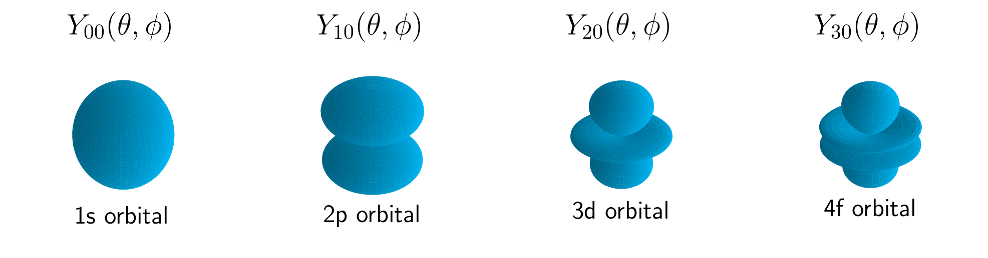
Last Lecture
We discussed classical rotation and met the concept of angular momentum.
We solved the particle on a ring system, and found the first rotational quantum number
We will now consider rotation in two dimensions – and see how it links to some chemistry!

Slide 3
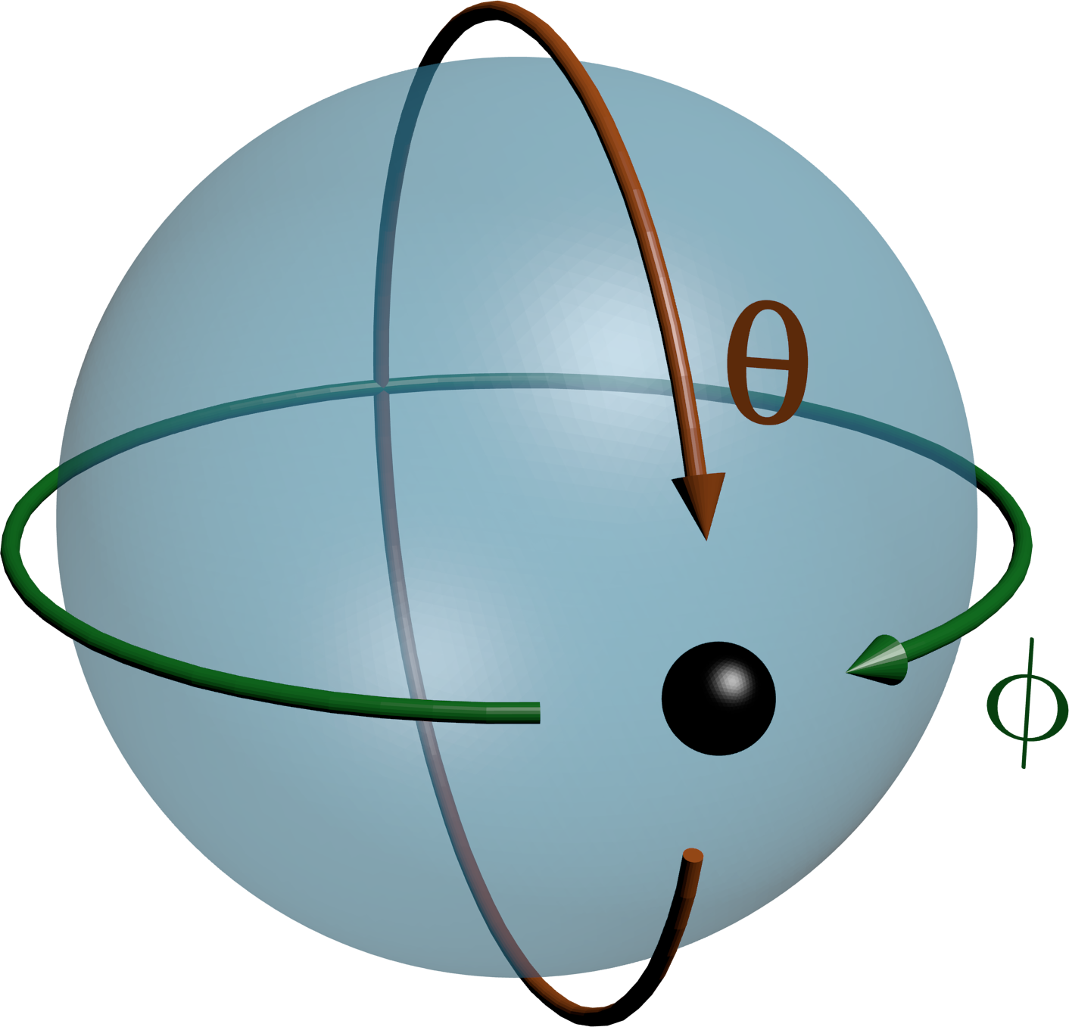
The Particle on a Sphere
Imagine that instead of a ring, our particle is confined to the surface of a sphere.
There are now two angles about which we can rotate.
The angle ϕ is as before, but we can now rotate with θ too.

Slide 4
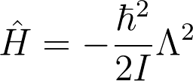
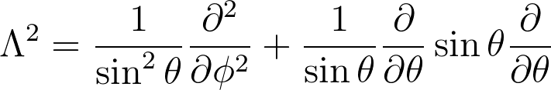

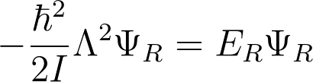
The Particle on a Sphere
Still no potential energy – so what does our Hamiltonian look like?
Complicated – we have 3D rotation now. After a bit of mathematical fun, we can arrive at:
This is horrible, but it gives our Schrödinger Equation:

Slide 5


The Particle on a Sphere
Handily, we can just recognise that this is a standard equation and just look up the solution in a book!
If we assume that our radius is fixed (we are trapped on the surface), then our solutions are:
Where are the Spherical Harmonics
Which you have met before, without realising it..

Slide 6
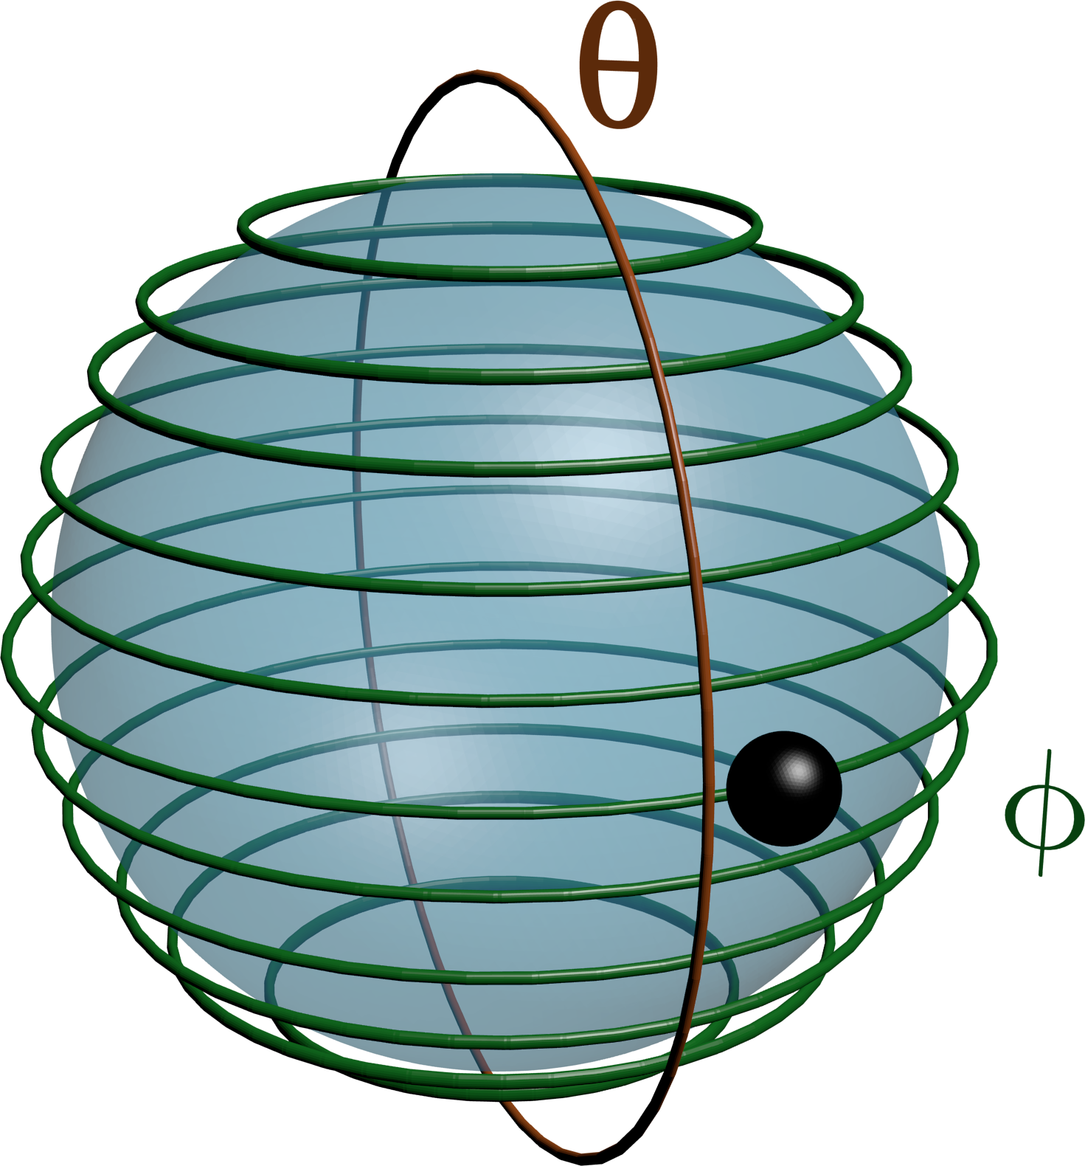
The Spherical Harmonics
The Spherical Harmonics are a set of important functions in the natural sciences.
They depend on two angles, and can be written as:
This separability means we can think of our sphere as a set of rings that we can 'hop' between.

Slide 7
The Spherical Harmonics
The rotating particle that they describe could be an electron in an atom. The spherical harmonics would then tell us where the electron was likely to be.
Plotting the first few spherical harmonics shows that these are just the atomic orbitals! The atomic orbitals are just the shapes of the wavefunctions!

Slide 8

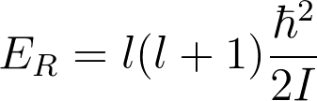
The Particle on a Sphere
Our aim was to solve this equation:
We know the solutions are the spherical harmonics, and we can find out that the spherical harmonics satisfy the following equation:
Comparison of the two equations above shows that:
We have a new quantum number! What does it mean?

Slide 9

Quantum Numbers
We already met the quantum number .
Now we have a new quantum number, .
We have two because we have rotation around two angles, and so have two boundary conditions to satisfy.
The allowed values of the two numbers are:

Slide 10

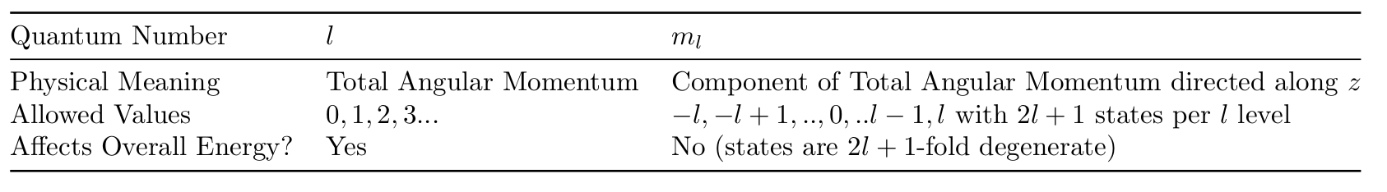
Quantum Numbers
These new quantum numbers must both be related to angular momentum in some way.
We've already seen that is related to the amount of angular momentum on the z axis.
We can also show that the magnitude of the total angular momentum is given by

Slide 11
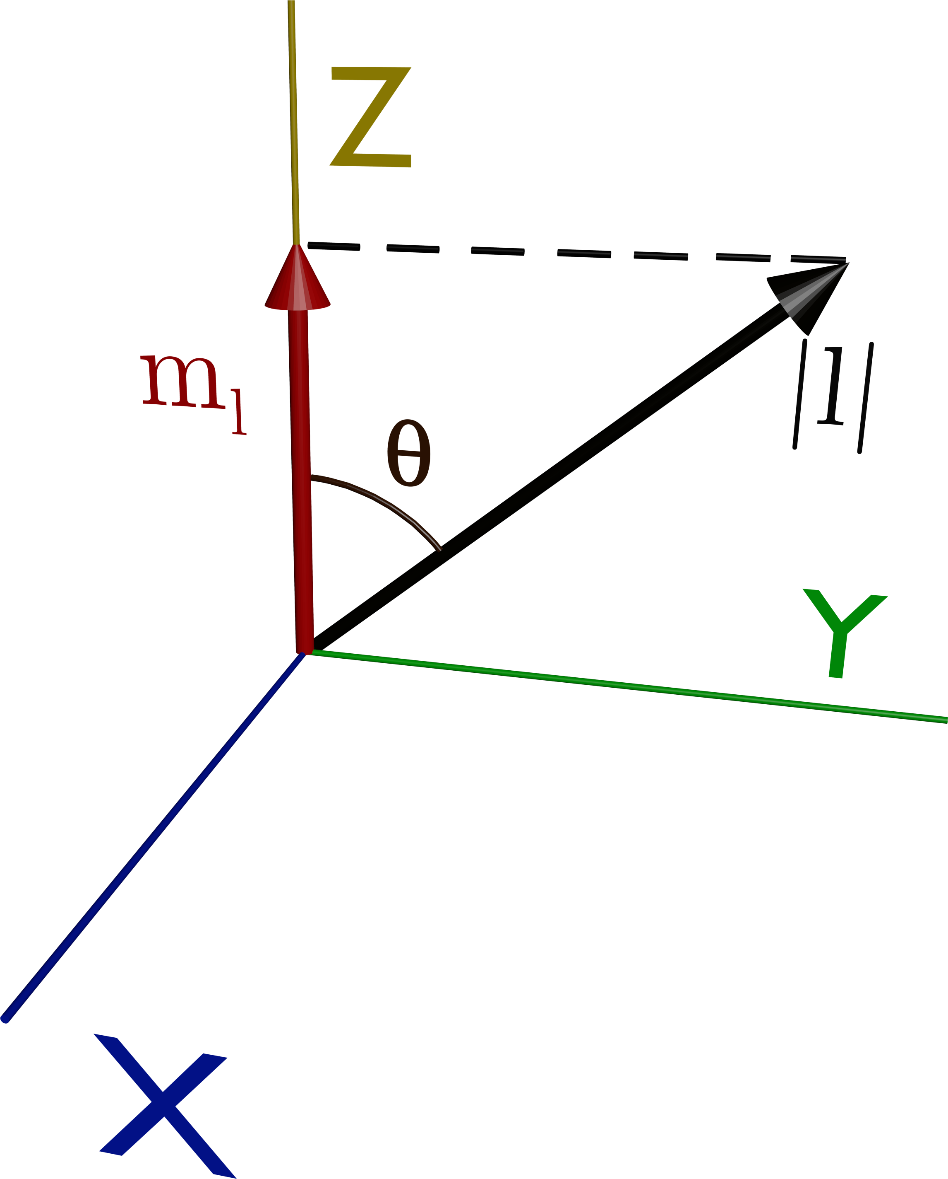
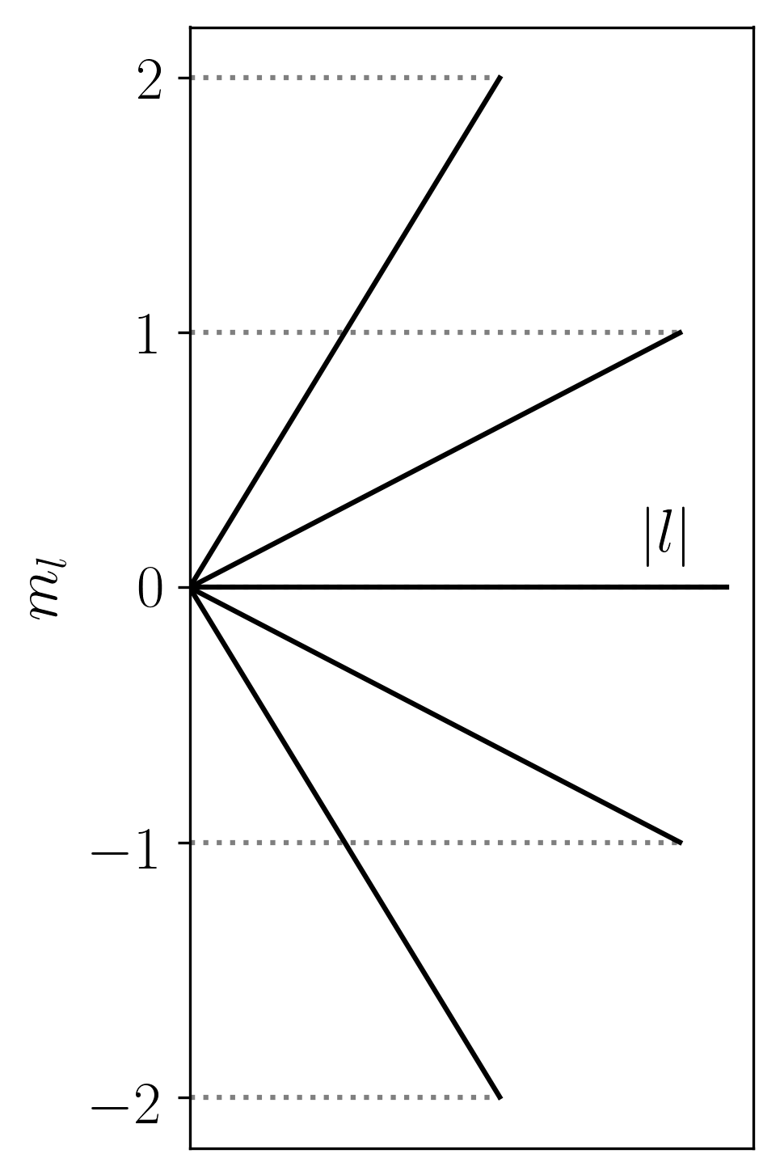
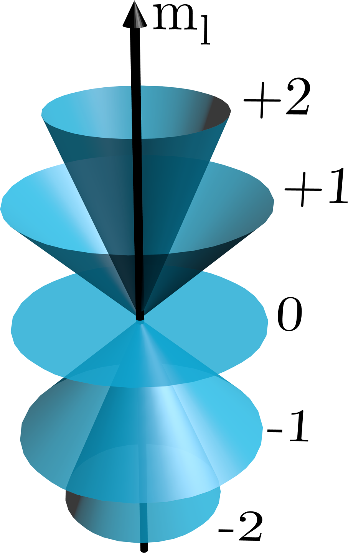
The Vector Model
Before we continue, a helpful way to visualise this is through 'The Vector Model'.
It allows you to visualise the angular momentum quantum numbers more easily. See handout for more detail.

Slide 12
Allowed Energies
We've gone a fairly circuitous route, but we have already seen that we have quantised rotational energies in 3D!
So again we have quantisation – we have no ZPE now either as a wavefunction with l=0 is acceptable.
Each l level is (2l+1) fold degenerate.
We will see the spacings in the context of real molecules in the next lecture.

Slide 13
Allowed Energies
We've gone a fairly circuitous route, but we have already seen that we have quantised rotational energies in 3D!
So again we have quantisation – we have no ZPE now either as a wavefunction with l=0 is acceptable.
Each l level is (2l+1) fold degenerate.
We will see the spacings in the context of real molecules in the next lecture.

Slide 14
Rotational Motion Summary
We've seen how to find the allowed energy levels of a particle rotating in 3D.
We now have two quantum numbers, rather than one, as we have two boundary conditions to satisfy.
The Vector Model is a way in which we can understand the two angular momentum quantum numbers.
Next lecture – putting it all together and looking at molecules!

