Slide 1

CH2200 Quantum Mechanics
Lecture 6: Putting it all together – quantisation of molecules!

Slide 2
The Born-Oppenheimer Approximation
The Born-Oppenheimer Approximation is one of the most important approximations in science.
It allows us to solve otherwise unsolvable problems.
The key is to notice that nuclei are much much heavier than electrons, and so move much much more slowly.
This means we can assume that the nuclei are stationary, on the timescale that electrons move.

Slide 3
The Born-Oppenheimer Approximation
Where we would have a wavefunction that depends on both nuclear and electronic movement, we can factorise it into two separate parts.
As chemists, we can go even further, and separate translational, rotational, and vibrational parts.
This means we can also separate the energies.

Slide 4
The Born-Oppenheimer Approximation
We are justified in this separation because each type of motion has a very different characteristic energy.
In general:
This means we can consider rotations without worrying that they will induce vibrations, and so forth.
It breaks down under certain circumstances, but is pretty good most of the time! Now onto the main topic...

Slide 5
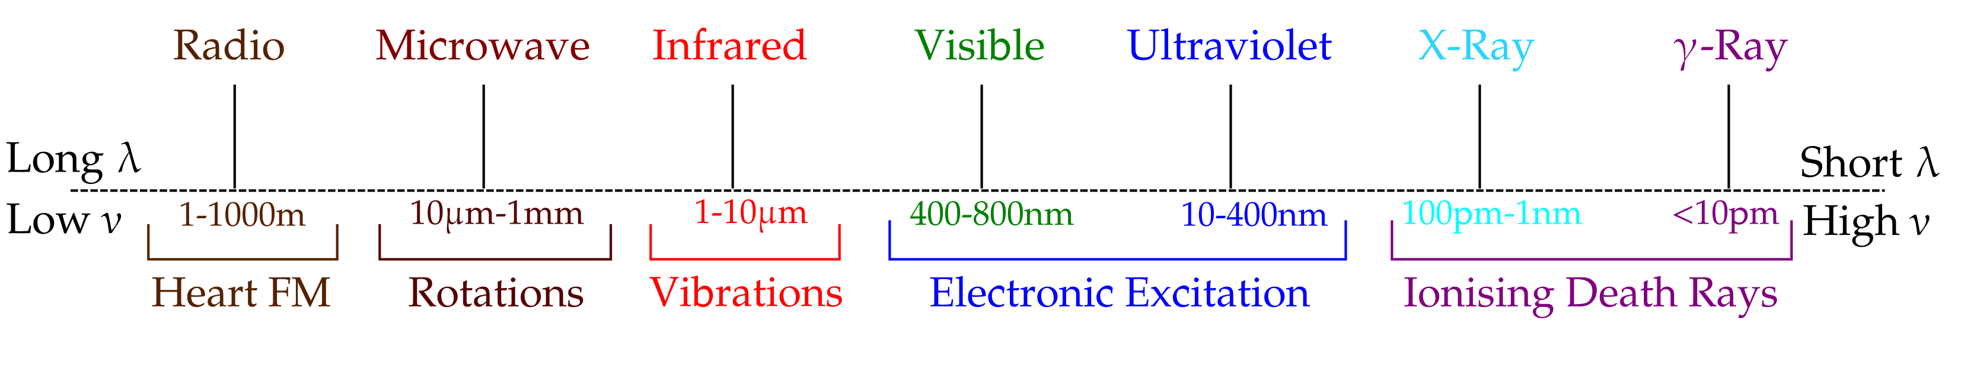
Spectroscopy
Spectroscopy is when we shoot EM radiation at molecules and watch what happens.
We might fire a laser beam at a collection of molecules and see if they start to vibrate or not.
Different types of EM radiation are useful for different things, and for different types of molecular energies.

Slide 6
Spectroscopy
The key here is that molecular energy levels depend on molecular properties.
If we can measure the energy levels, we can calculate the properties using some of the quantum mechanics of the last few lectures.
We measure the energy levels by firing radiation at the molecules and seeing what gets absorbed or emitted.

Slide 7
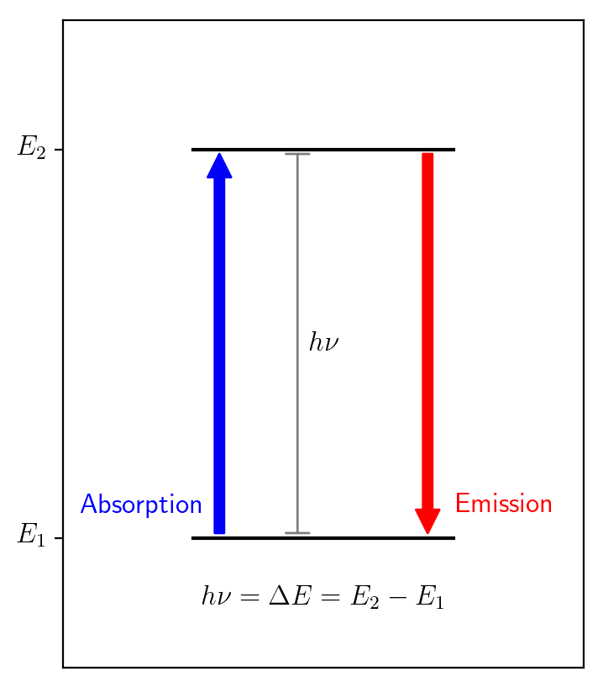
Spectroscopy
The energy of the absorbed radiation depends on the gap between two molecular energy levels.
If we can measure the amount of absorbed radiation, we can measure where the energy levels lie.
We can then use this info to calculate molecular properties, like bond lengths.

Slide 8
Molecular Energy Levels
We can use this technique to calculate rotational, vibrational, and electronic energy levels.
Translational energy levels are far too closely spaced for us to be able to measure, so we will ignore them.
Electronic energy levels don't follow any kind of predictable pattern like rotations or vibrations, so we will ignore them for now too.
We will find useful expressions for rotational and vibrational energy levels.

Slide 9


Rotational Energy Levels
We saw in Lectures 4 and 5 how we could find the energies of a particle rotating in 3D on the surface of a sphere.
A molecule behaves in exactly the same way! There are just a couple of differences.
Because we're talking about total angular momentum, not just orbital angular momentum.
Because we want to measure things in wavenumbers, not Joules. See handout for an explanation!

Slide 10
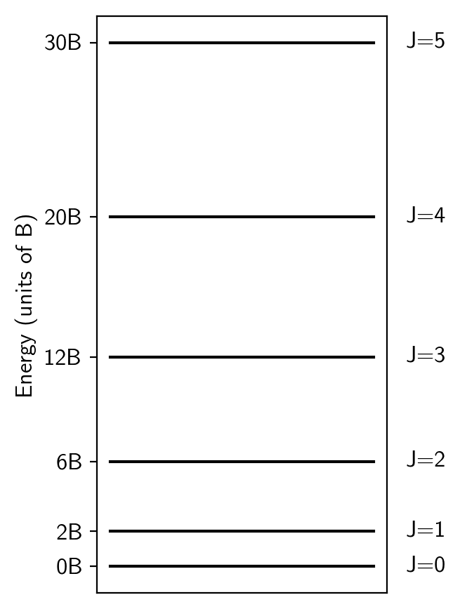

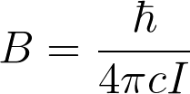
Rotational Energy Levels
When make these changes, we find out that the rotational energy levels are:
B is the rotational constant.
B depends on molecular properties.
The spacing between adjacent levels increases with J.

Slide 11
Rotational Energy Levels
But can we do any transition between any J states on any molecule?
We need to know the selection rules to know which transitions are allowed.
There are two kinds of selection rules:
Gross Selection Rules
Tell us the general properties that a molecule must have in order to produce a spectrum.
Specific Selection Rules
Tell us which specific transitions are actually allowed or not.

Slide 12

Rotational Selection Rules
Gross Selection Rule:
The molecule must have a permanent dipole moment to produce a rotational spectrum.
Specific Selection Rule:
J can only increase by one or decrease by one.
This puts some limitations on what we can do!
See the handout for a detailed explanation of the origin of these rules.

Slide 13
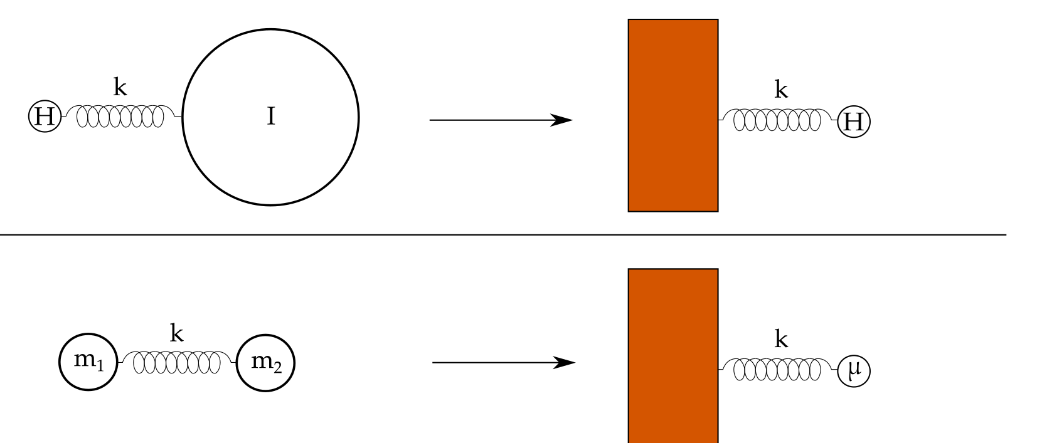
Vibrational Energy Levels
We can also apply the quantum mechanics from Lecture 3 to help us understand vibrations.
We can model a vibrating diatomic as a harmonic oscillator using the reduced mass, µ.

Slide 14
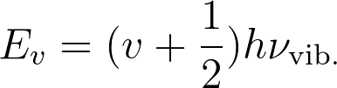
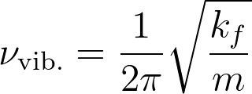
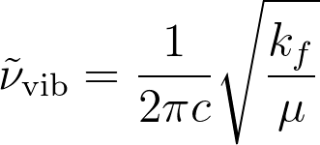
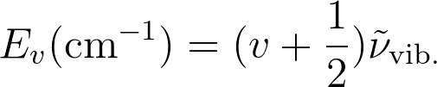
Vibrational Energy Levels
We can then use the expressions for energy from Lecture 3!
But we still need to turn it from Joules into wavenumbers. To do this, we define a new constant and write:
Note we have replaced m with µ!

Slide 15
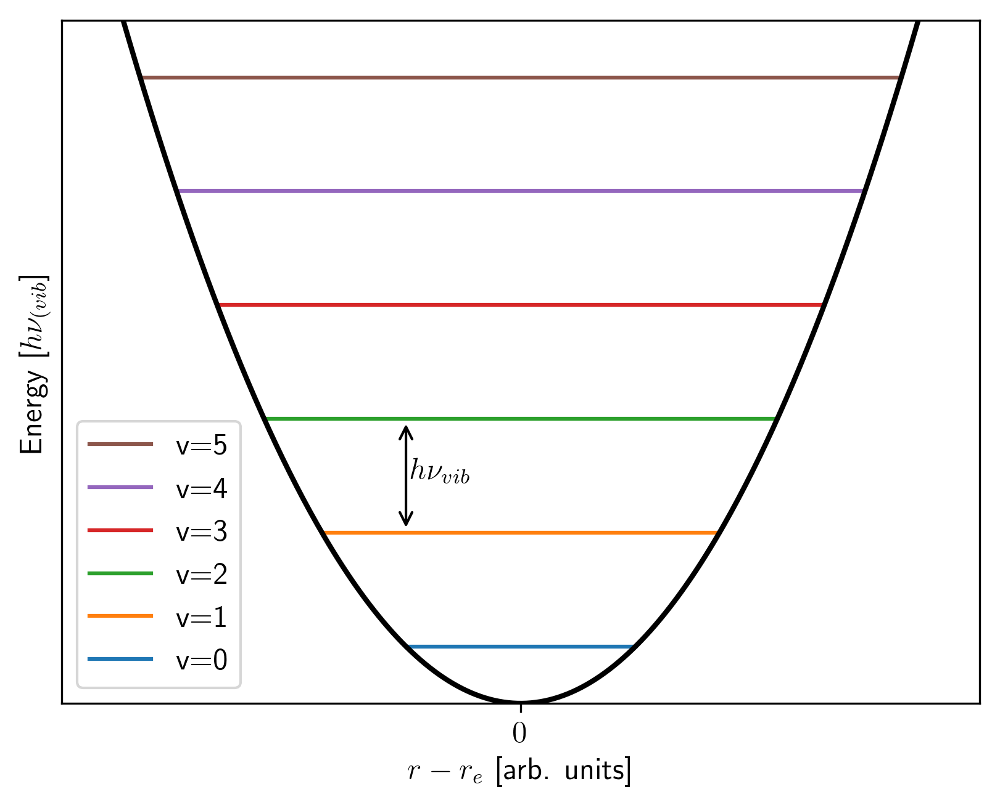
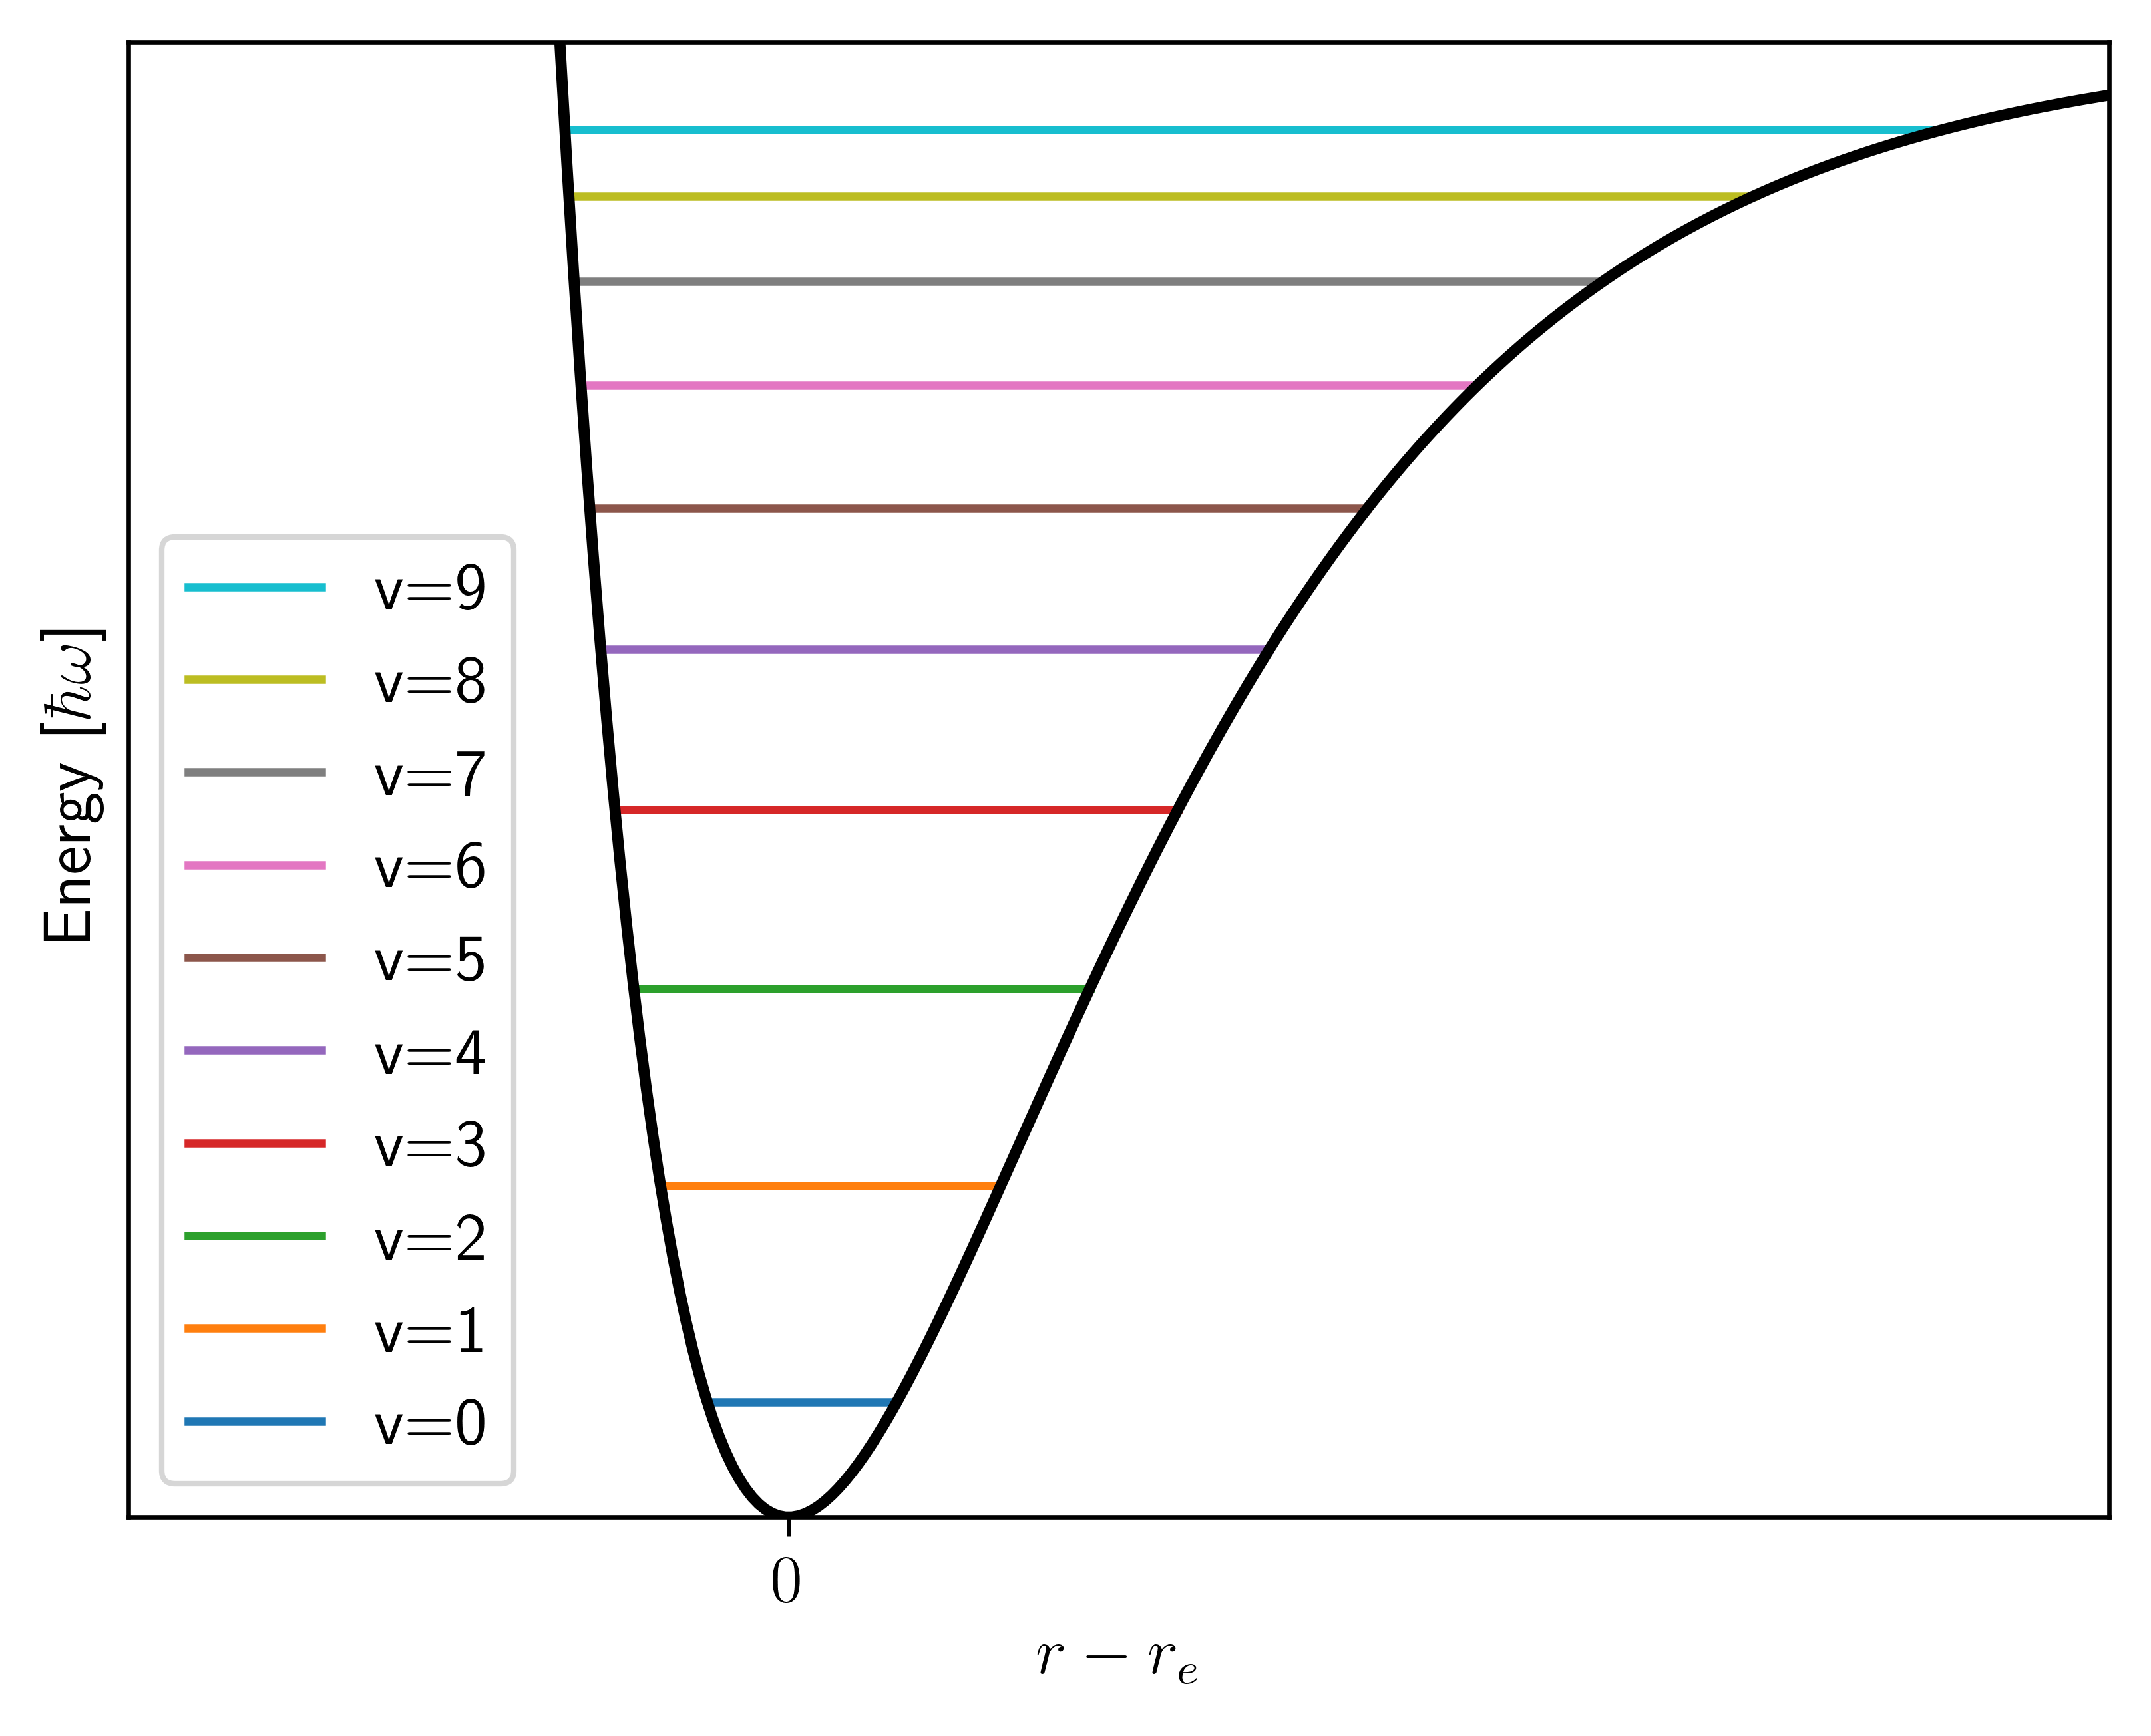
Vibrational Energy Levels
The allowed energies form a vibrational ladder again.
This is a serious shortcoming of the harmonic oscillator model - it doesn't allow a bond to break!
One improvement is anharmonicity...

Slide 16

Vibrational Selection Rules
We have a gross and specific selection rule again.
Gross Selection Rule:
The dipole moment of the molecule must change during the vibration.
Specific Selection Rule:
The vibrational quantum number can only go up by one or down by one.

Slide 17
Summary
That's it! Starting from basic quantum mechanics we have ended up with expressions for molecular energy levels. We will use these all the time in spectroscopy.

