Slide 1


Slide 2
The Challenge
“Using multimedia resources found online, develop a virtual experience that would allow someone to experience a past or upcoming rocket launch as if they were observing it from a few miles away
If possible, convey the impact that local/global/space weather has on a launch.”

Slide 4
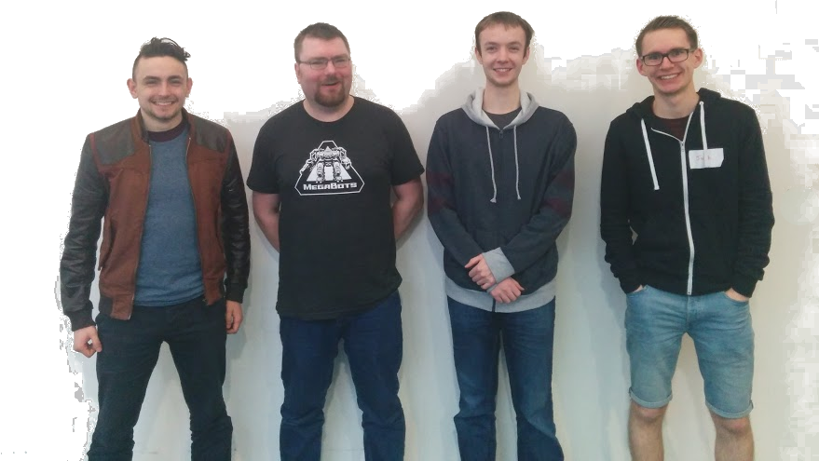
The Team
Ben Jackson
Jack Holt
James Dewes
Gavin Wheeldon

Slide 5
Our Solution
Google Cardboard
360 video
Lots of physical feedback
App control

Slide 6
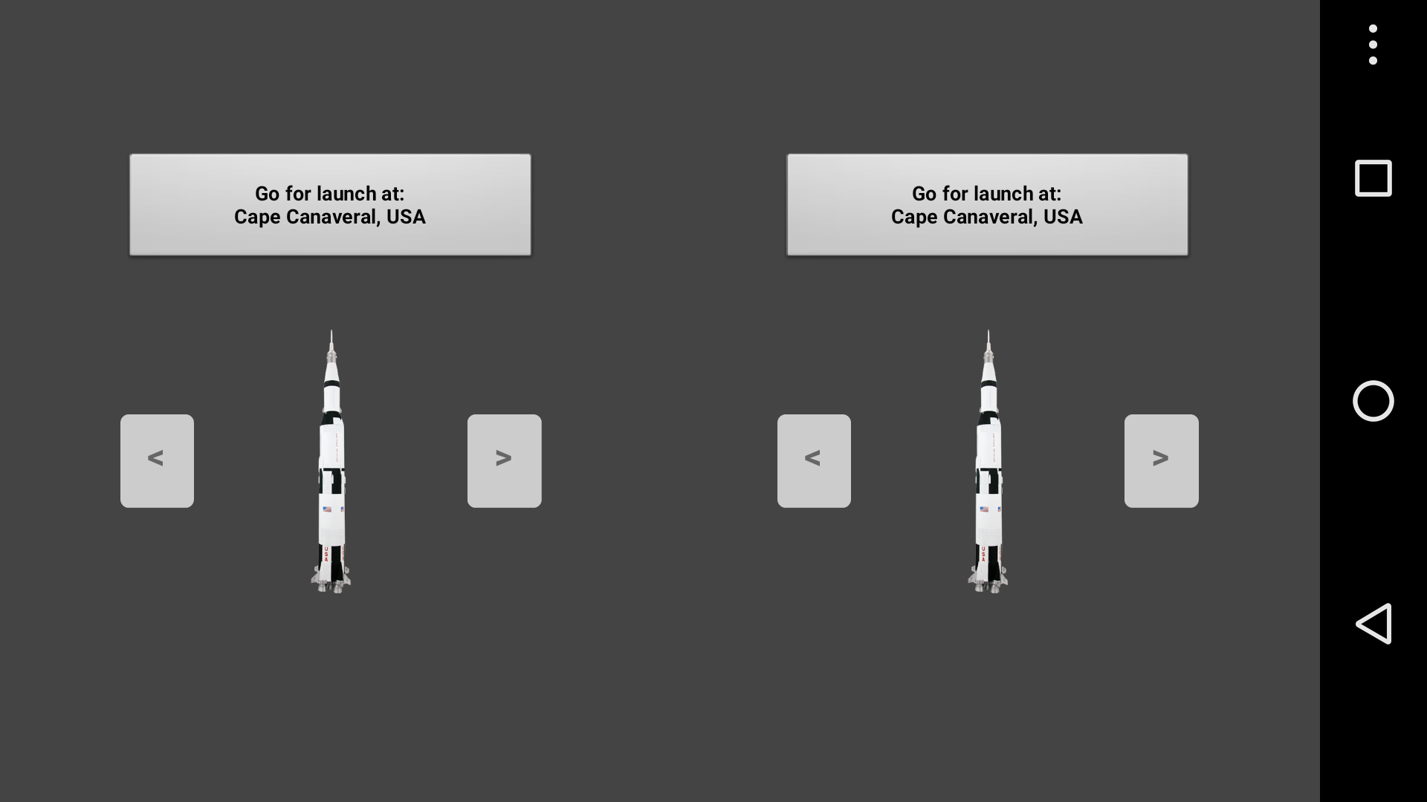

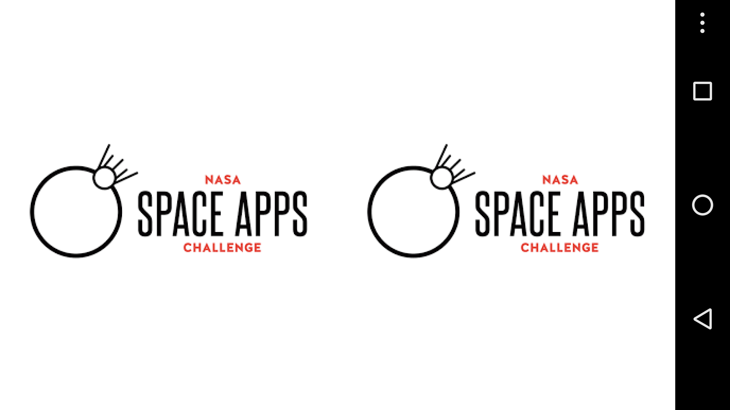
The App

Slide 7
Splash Screen

Slide 8
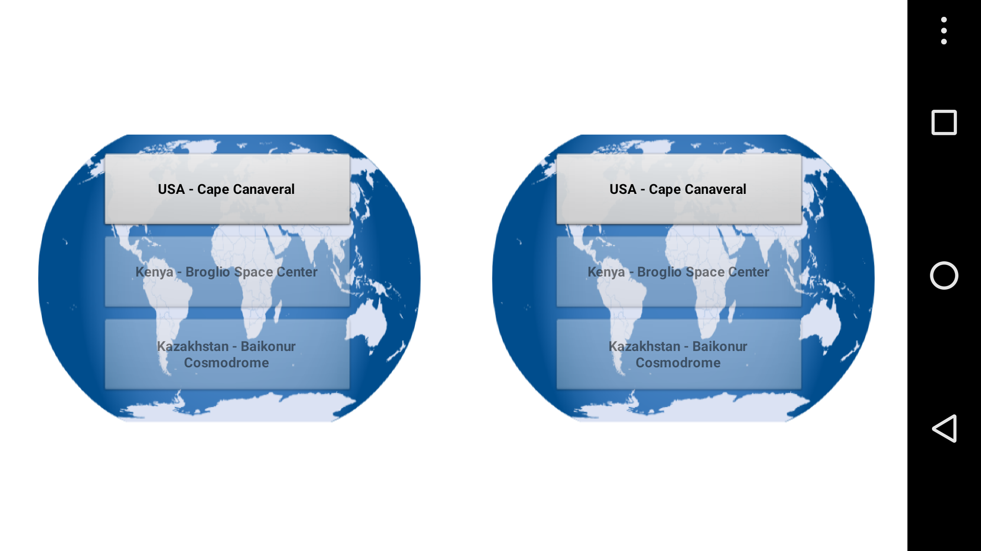
Global Launch Sites

Slide 9
Choice of Rocket

Slide 10
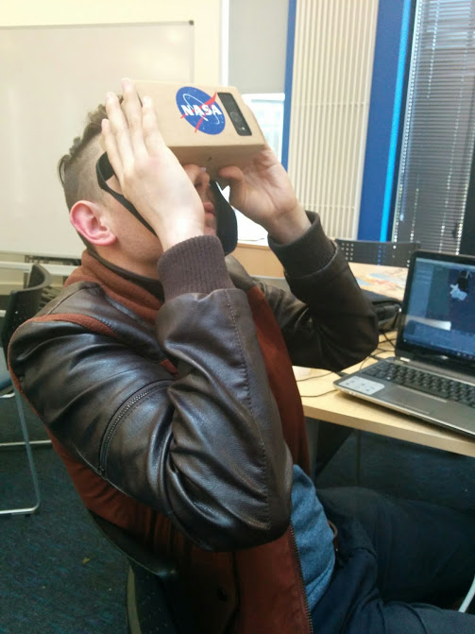
Hardware

Slide 11
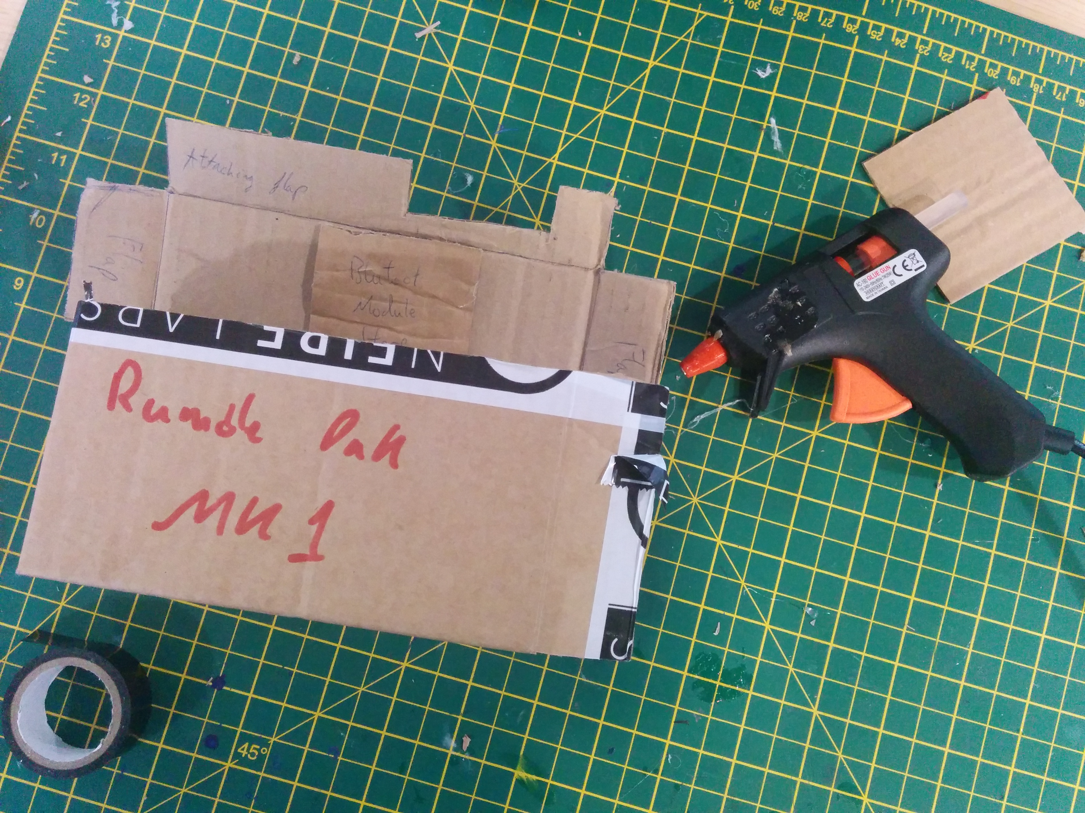

Slide 12
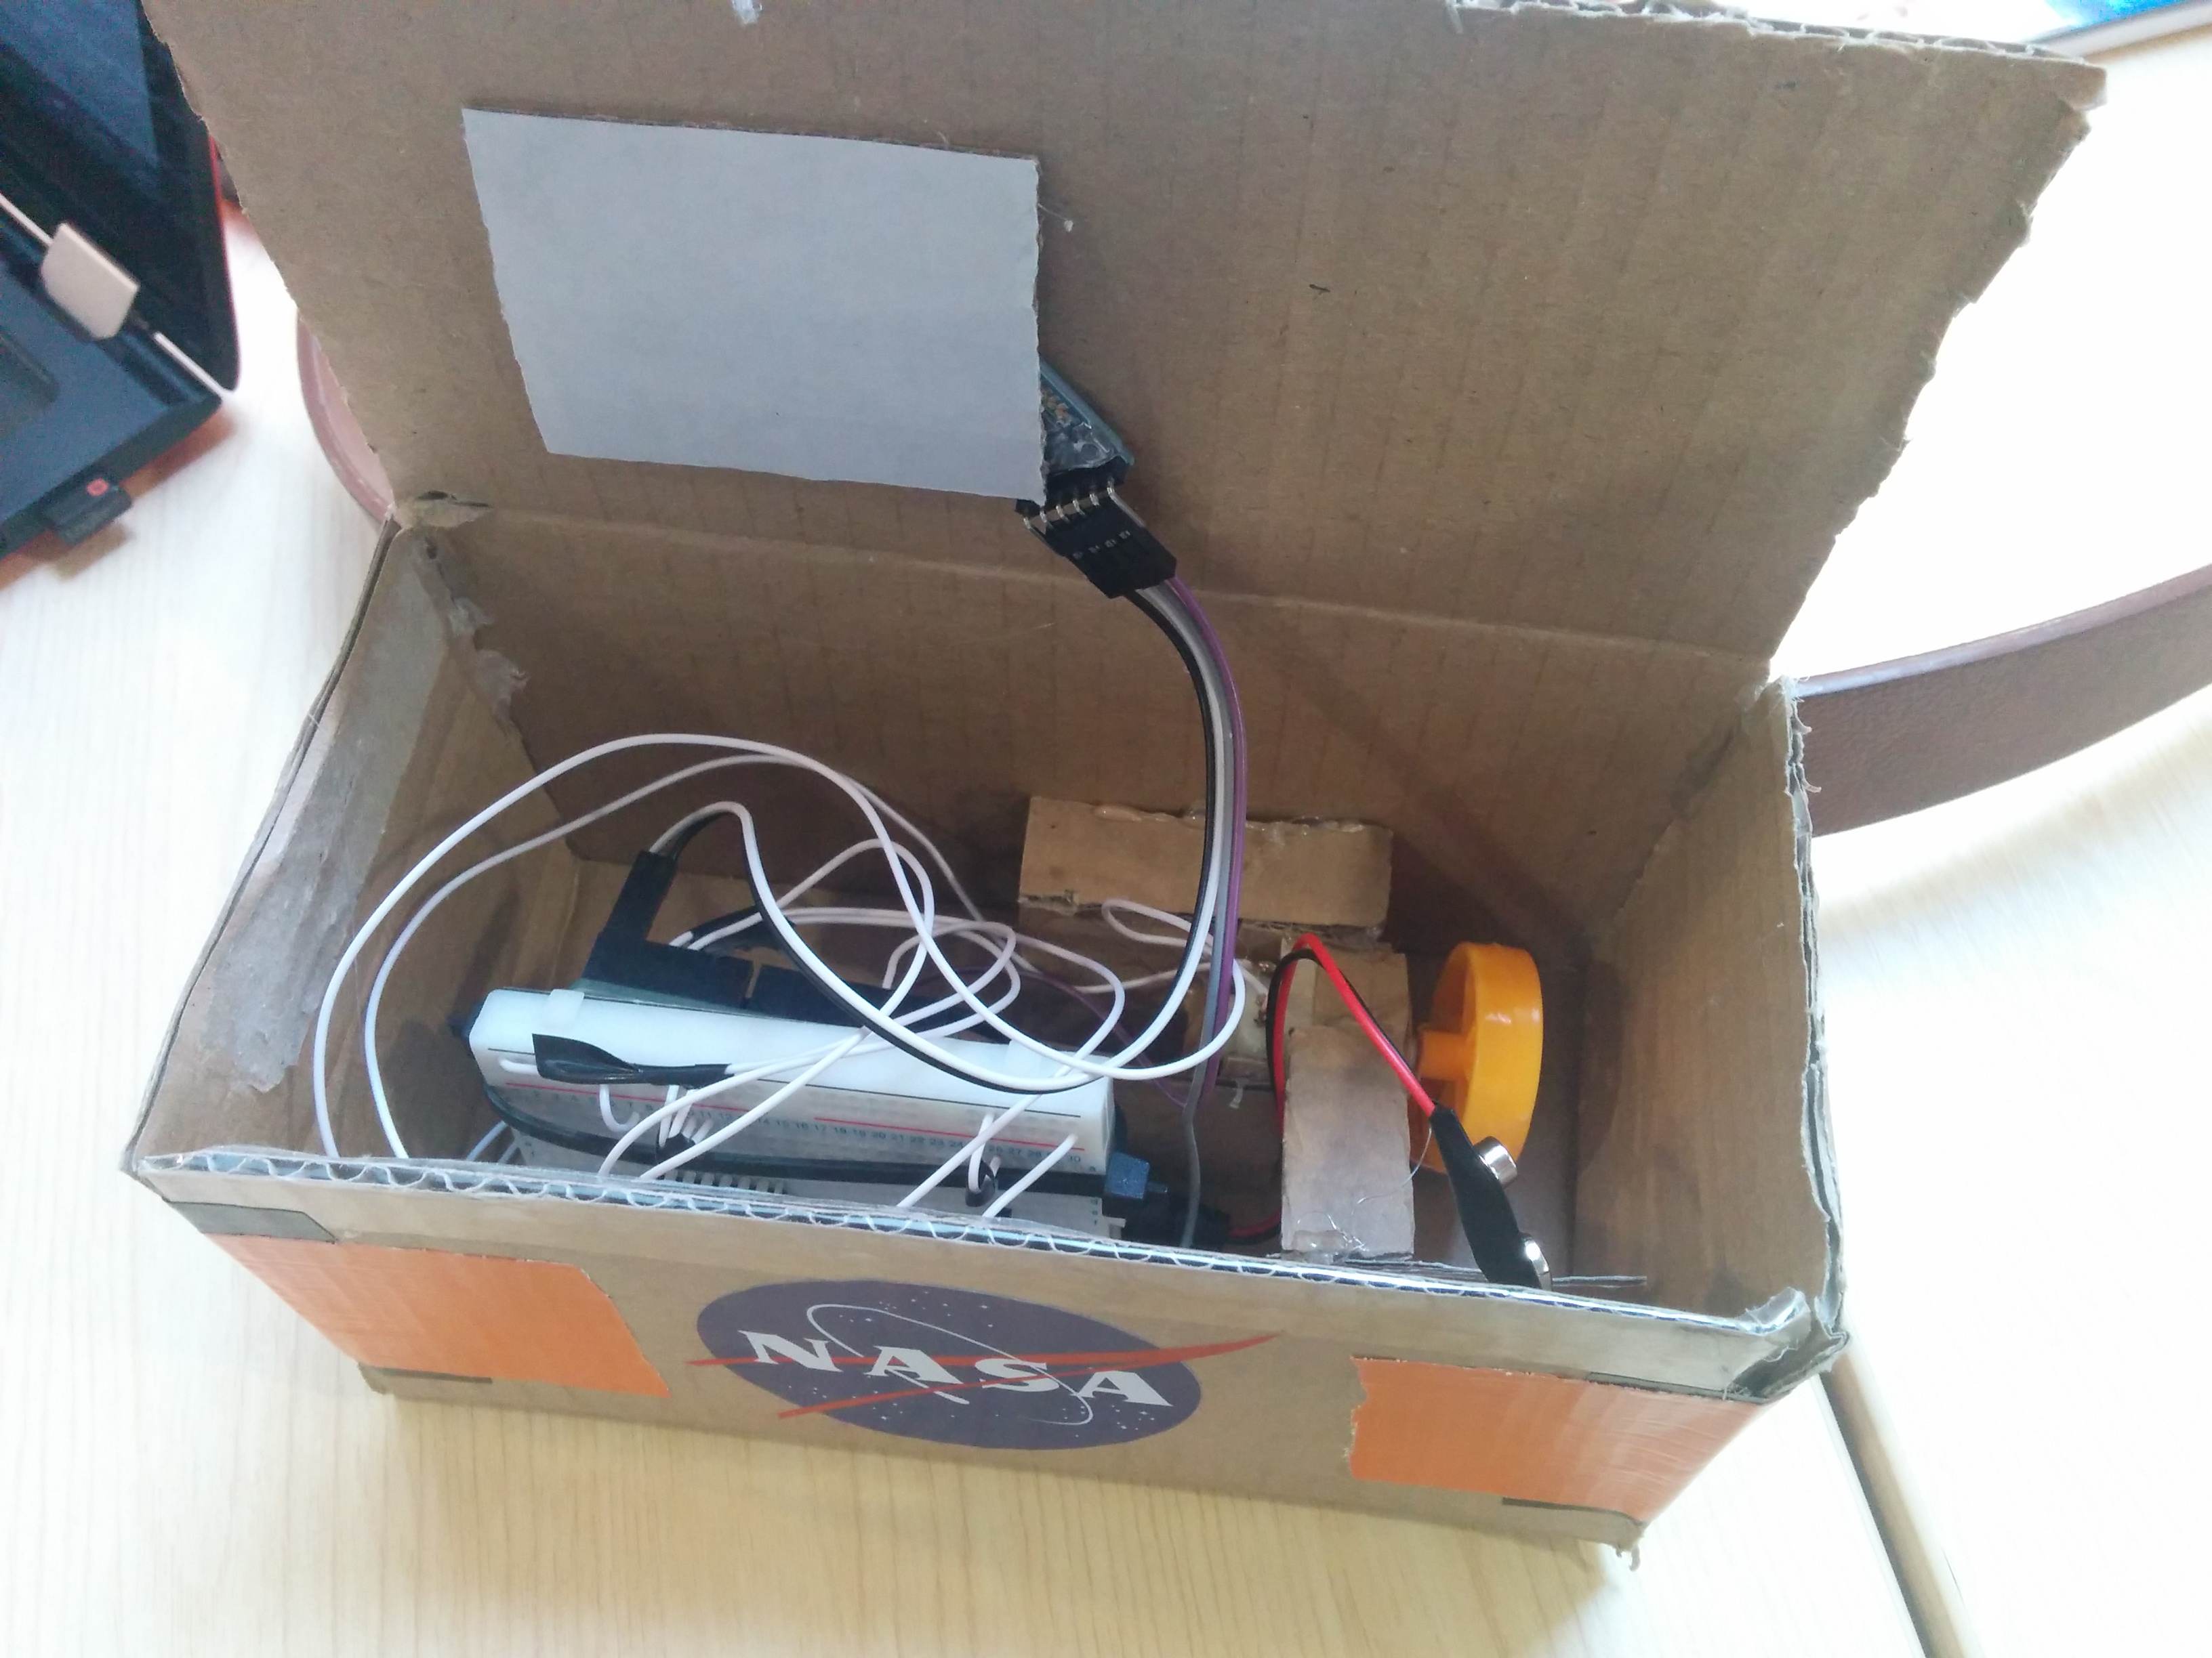
Rumble pack

Slide 13
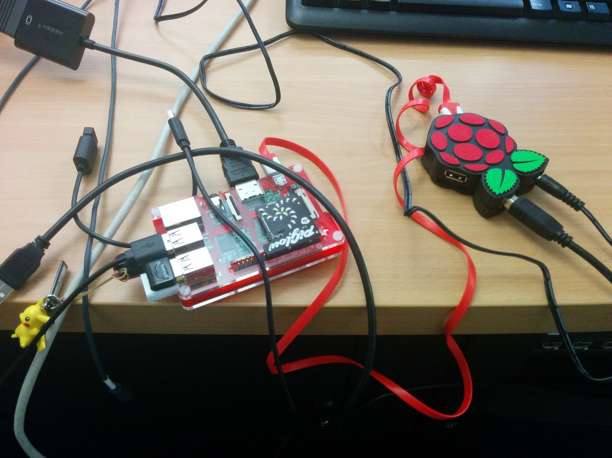
Raspberry Pi

Slide 14
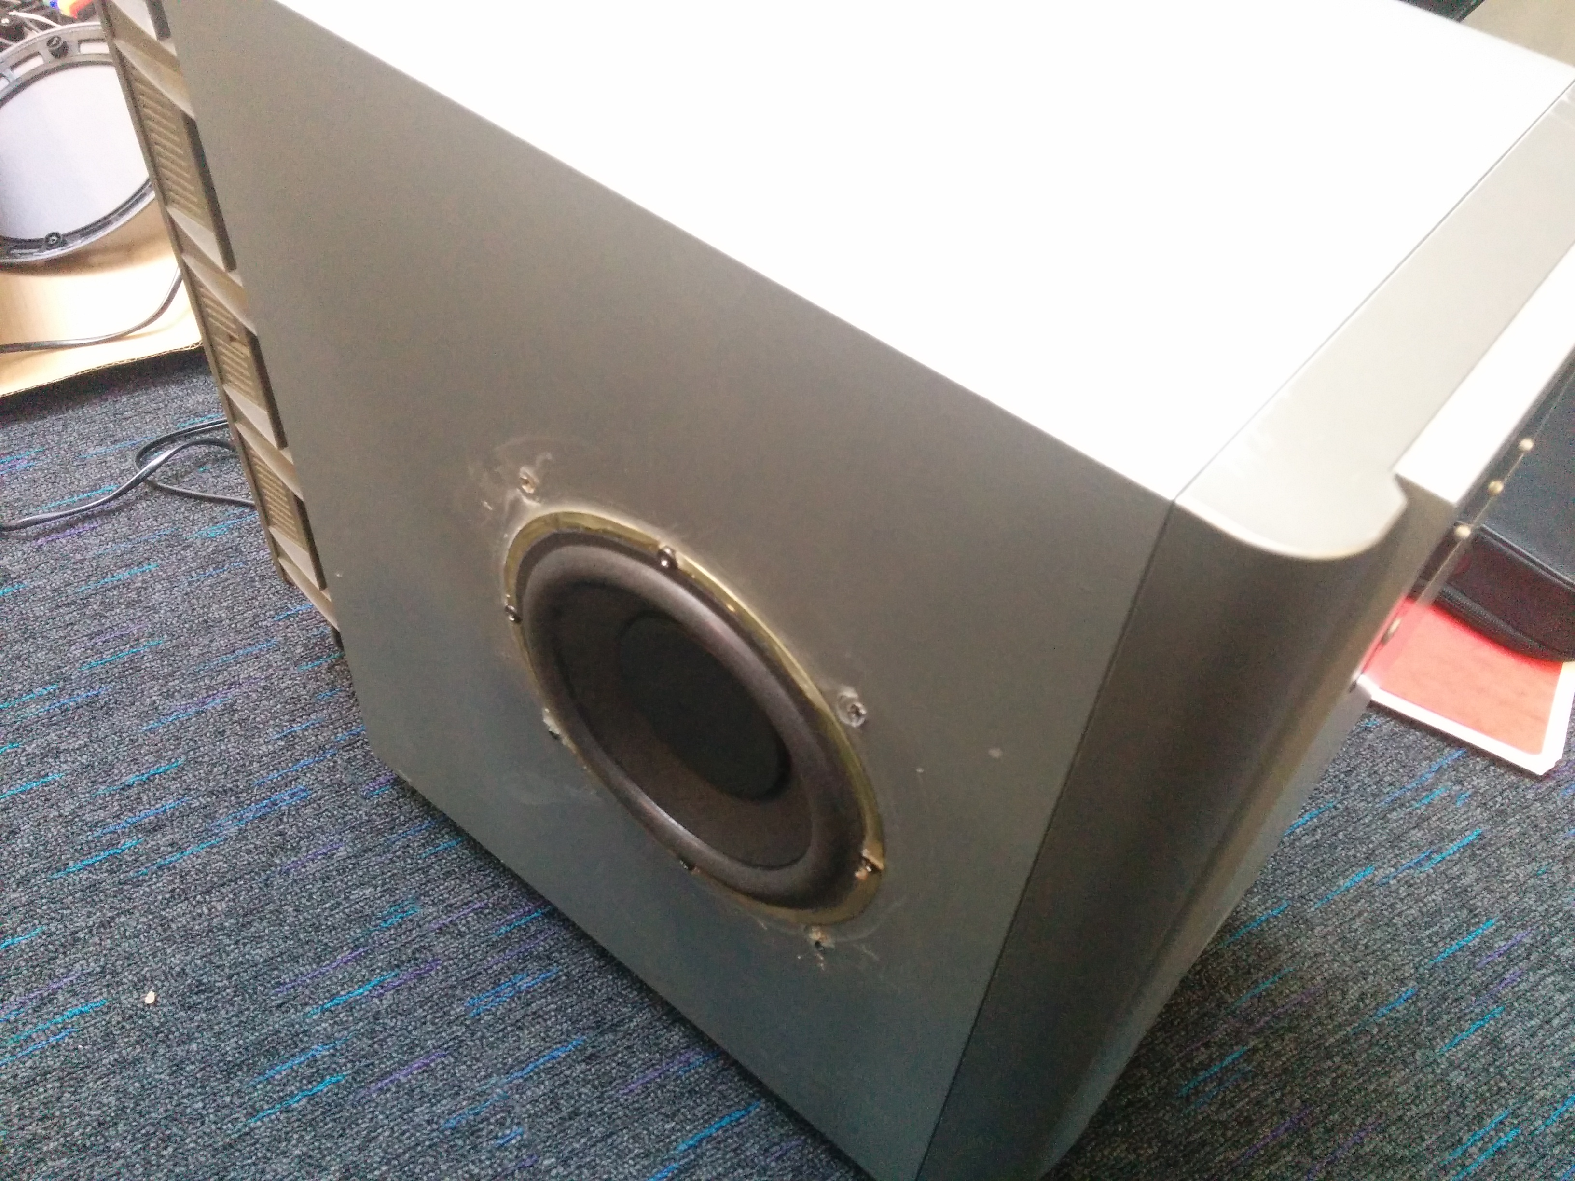
subwoofer

Slide 15
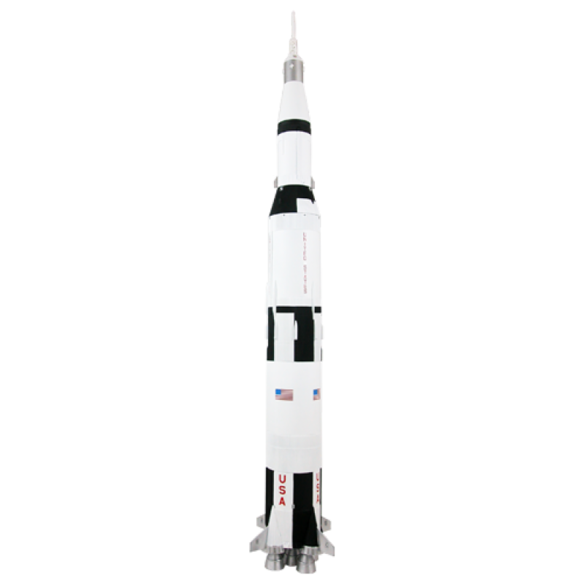
VR

Slide 16
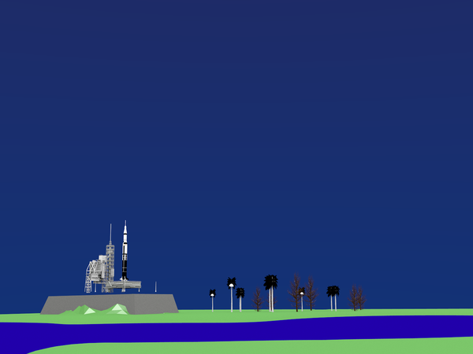
An Early Example

Slide 17
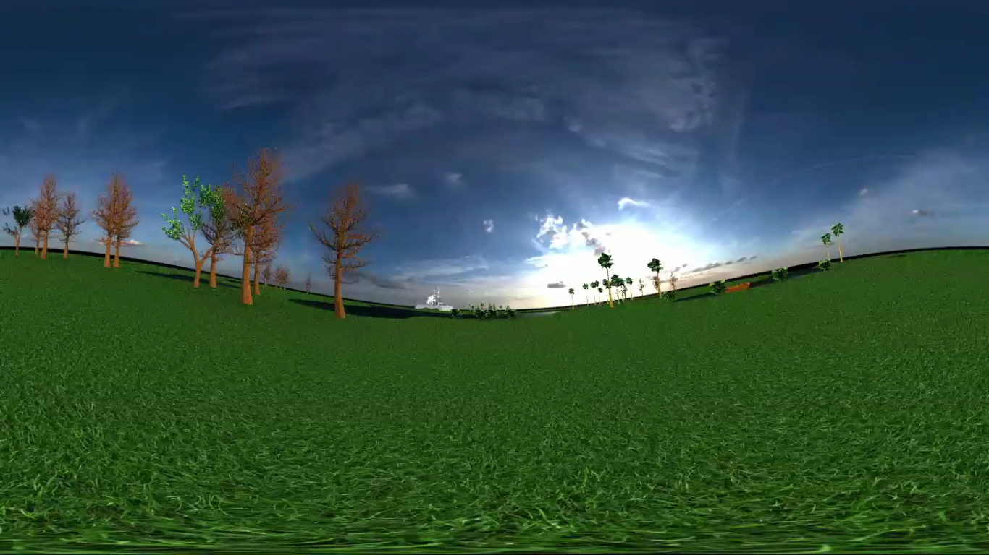
Late Stage Render

Slide 18
Tools, Resources & Any Questions?
Java
App Inventor
Python
BluTooth
Arduino
Raspberry Pi
Remote
Motors
Adobe After Effects
Audacity
NASA Resources
Subwoofr
Google Cardboard
YouTube
Blender
Breadboards
Text editors
NFC
A lot of cardboard

