Slide 1
Final Project Alexa
James Francis
Deep Azure@McKesson
Dr. Zoran B. Djordjević

Slide 2


Introduction
Problem Statement
Consumers are making a tectonic shift away from “Brick-and-Mortar” stores to online shopping using various technologies: Intelligent Personal Assistants, Web Apps, Phone Apps, etc. Pharmacies have been lagging in this new frontier and are beginning to understand that it is no longer a question of if their industry will be transformed but it is a question of who will lead this transformation and when it will happen. In this project, we will leverage Alexa as an interactive assistant to a Pharmacy Management System hosted in Azure to automate the process of filling prescriptions for consumers.
Disruptive Technologies affecting “Brick-and-Mortar” Pharmacies
Artificial Intelligence (A.I.) and Robotics
Autonomous Vehicles and Drones
Cloud Technologies
Disruptive Competitive Forces
Amazon
Amazon/Berkshire Hathaway/J.P. Morgan Health Care Company
CVS–Aetna Deal

Slide 3
Enter PharmAid: a cloud-based Alexa-Enabled Pharmacy front-end
PharmAid is a Pharmacy Solution which pharmacies can leverage as an adjunct to their existing “Brick-and-Mortar” stores or aid in consolidating pharmacies to a central fill site to reduce costs and increase customer satisfaction.
How?
Leverages Cloud Technologies to reduce infrastructure costs and improve reporting and analytics.
Integration with Alexa to ease ordering of prescriptions and to allow tracking of prescriptions.
Use robotics and central fill technologies to automatically fill prescriptions.
Integration with a Pharmacy Application API to perform pharmacy functions such as DUR (Drug Utilization Review), PPI (Pharmacy Prescriber Interface), CSR (Controlled Substance Reporting) and other pharmacy functions.
Leverage A.I. to perform common pharmacy functions.
Deliver products to customers more efficiently.
Increases customer satisfaction by eliminating the need to call or travel to a pharmacy.

Slide 4
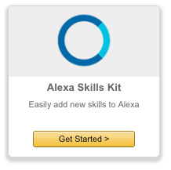


Azure and Amazon Technologies
Alexa Skills Kit
Alexa Skills Kit is used to develop the interface to be used
with Alexa. It uses an Invocation word to invoke your app
service and an utterance (what you want the service to do).
Azure Web API Application Service
An Azure Web API is used to establish an https endpoint
for Alexa to use. It is responsible for servicing the requests.
Azure Functions
An Azure HTTP Get Function was used to simulate a Pharmacy
Management System API.
Visual Studio .NET Application
The entire Azure Application was developed in Visual Studio. The excellent
AlexaSkillsKit.NET package was used for Alexa interface compatibility.

Slide 5
PharmAid Data Flow

Slide 6
Data Description
Since I was developing an Alexa integration, I did not have or need a large data set.
PharmAid was the Application Invocation Phrase that I selected. Alexa is invoked with a simple “Ask PharmAid”.
A JSON Object which defines the intents that Alexa can use when the application is invoked.
Utterances which define the phrases that can be serviced by PharmAid. I only implemented four phrases for this project but this could easily be extended.
Intent | Utterance
FillRxIntent | to fill my prescription
WhereRxIntent | to find my prescription
RxReadyIntent | when will my prescription arrive
CallDoctorIntent | to call my doctor

Slide 7
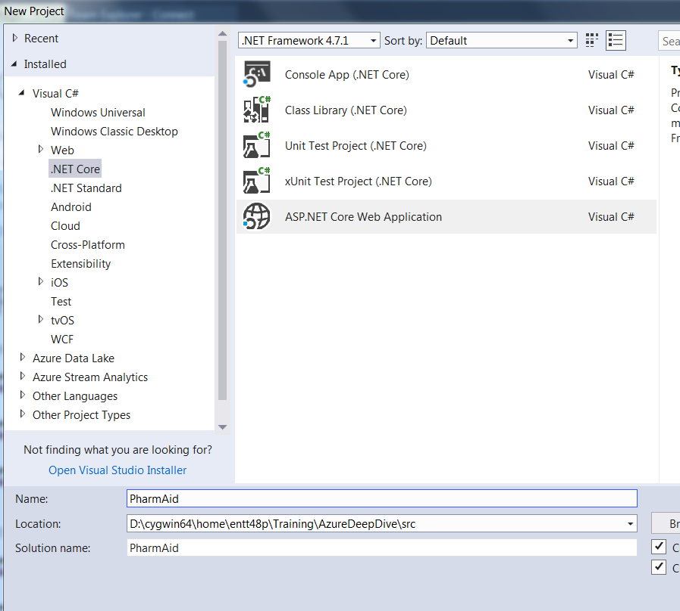
PharmAid Configuration
Start by creating and ASP.NET Core Application in Visual Studio 2017

Slide 8
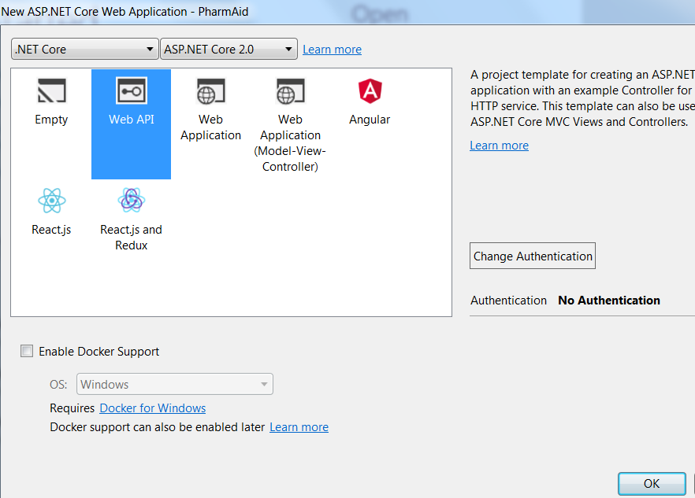
PharmAid Configuration (cont)
Select the Web API template which will function as the Alexa Skill API

Slide 9
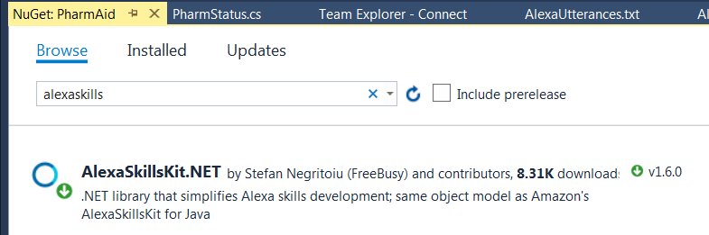
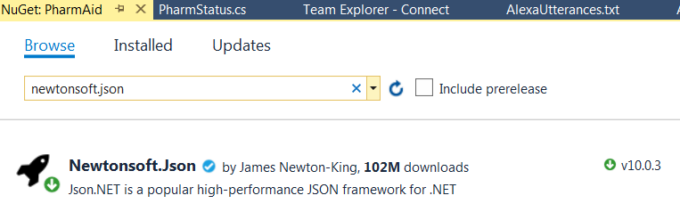
PharmAid Configuration (cont)
Install the AlexaSkills.NET package and Newtonsoft.JSON package

Slide 10
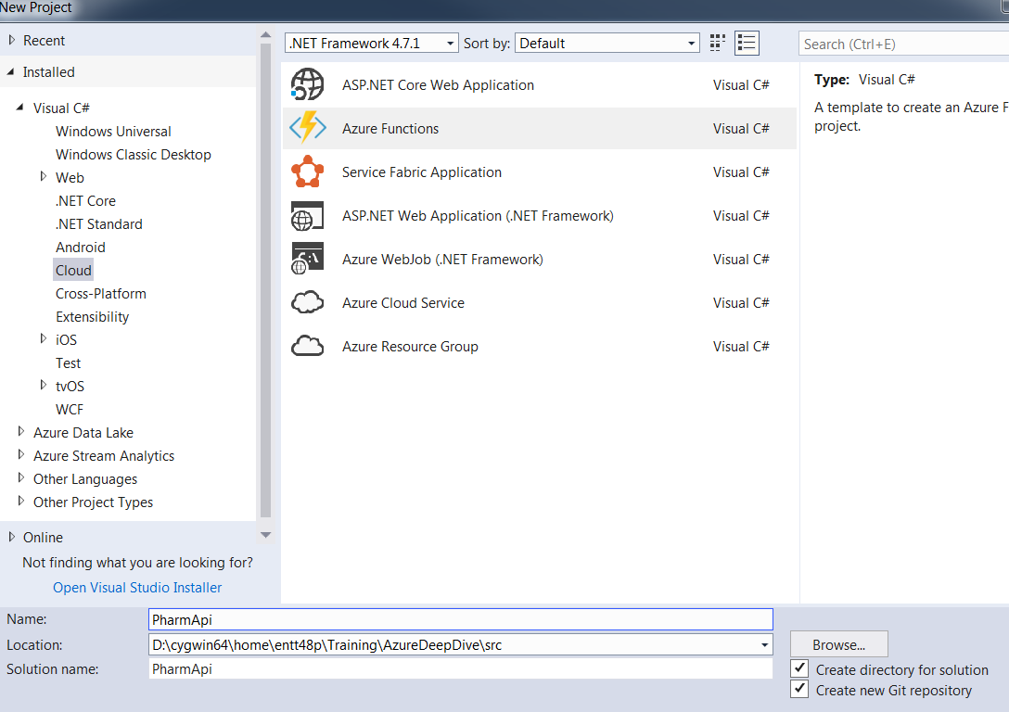
PharmApi Configuration
Create an Azure Function (simulated pharmacy management system) in Visual Studio 2017 to respond to my PharmAid application.

Slide 11
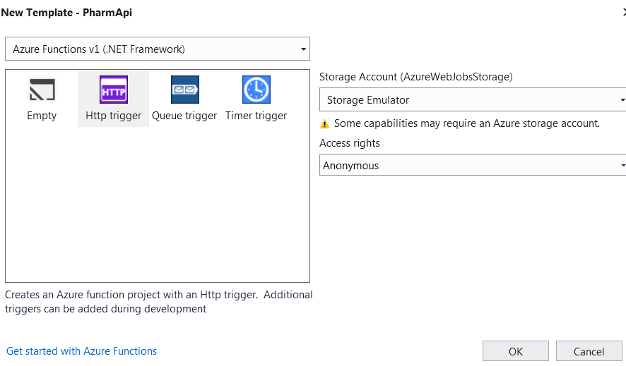
PharmApi Configuration (cont)
Use Http trigger template so PharmApi responds to Get requests from PharmAid.

Slide 12
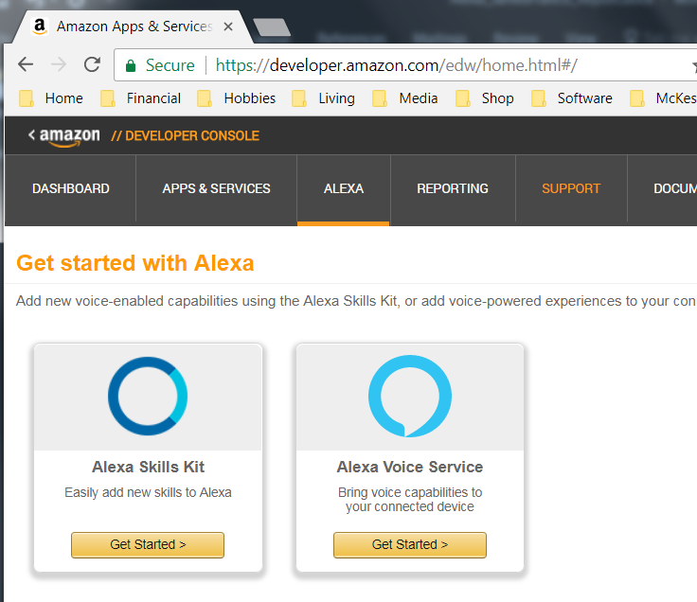
Alexa Skills Configuration
To create an Alexa Skill, you must have an Amazon Developer Account which is free. After registering, you can login to the Alexa Skills Developer Portal to create your skill. Click on Alexa Skills Kit to get started.

Slide 13
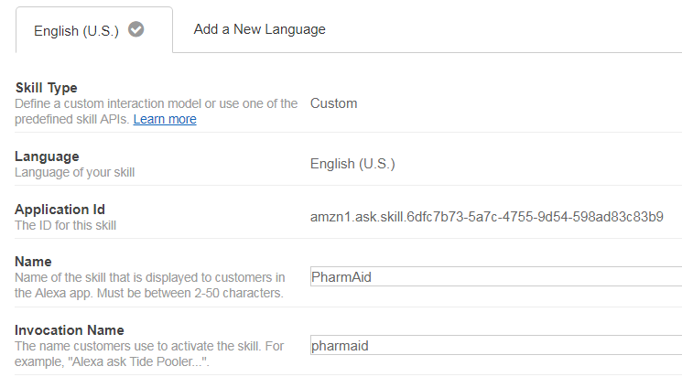
Alexa Skills Configuration (cont)
Enter your skill information. My skill will be invoked by “Ask PharmAid…”.

Slide 14
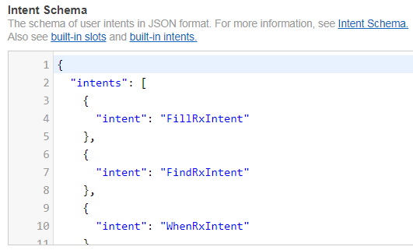
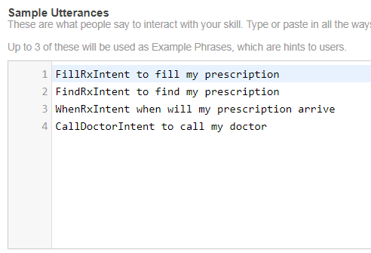
Alexa Skills Configuration (cont)
Create an interaction model which is a combination of an Intent Schema in JSON format and Utterances. Utterances are phrases you say after invoking your application.

Slide 15
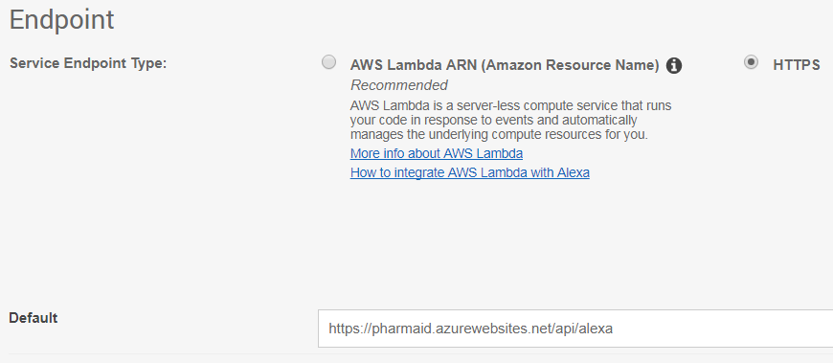
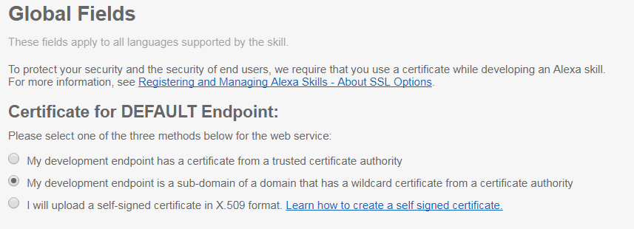
Alexa Skills Configuration (cont)
The next step is critical to connect to Azure. Select an HTTPS endpoint, not AWS Lambda, and enter the Azure endpoint.
Make sure to enter the correct certificate for the DEFAULT Endpoint.

Slide 16
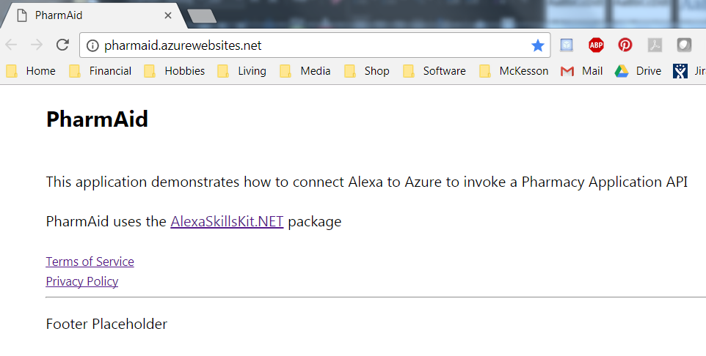
PharmAid Visualization
Enter pharmaid.azurewebsites.net in a browser and verify it works.

Slide 17
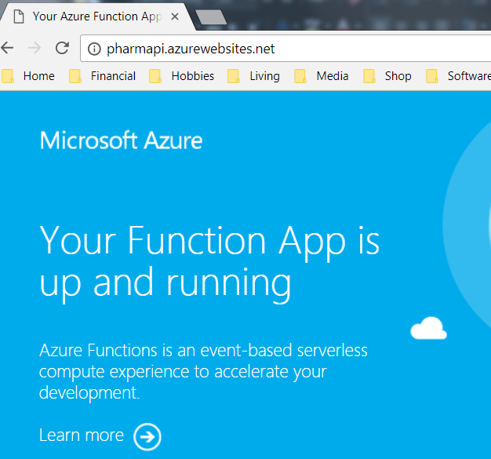
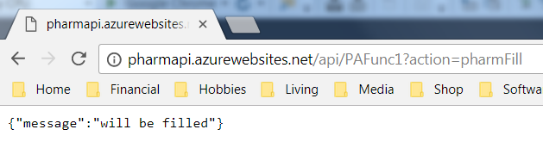
PharmApi Visualization (cont)
Enter pharmapi.azurewebsites.net in a browser and verify it works.
Verify that the function returns JSON code.

Slide 18
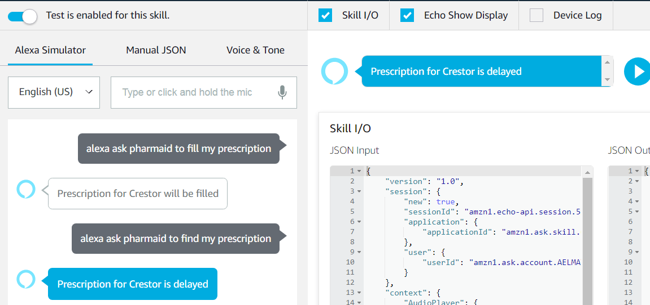
Alexa Skills Results
The first way to test your skill end-to-end is to enter the Beta Test Simulator. Hold down the microphone and speak your invocation word and your utterance. The dark grey is my voice input and the Alexa response is spoken as well as displayed.

Slide 19
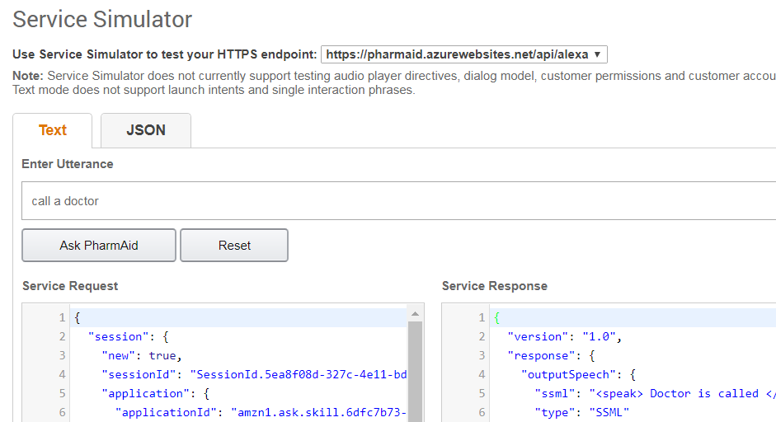
Alexa Skills Result (cont)
The second way to test your skill is to use the Developer Console. Enter your invocation and utterance to display the response.

Slide 20
Summary
Lessons Learned
Likes
The AlexaSkillsKit.NET package was excellent. It made implementing the Alexa calls very easy.
Visual Studio is simply great to program in when building Azure applications due to its tight integration. It also works seamlessly with github. It is simply a matter of a few mouse clicks to compile, test, and publish the application.
The Alexa Skills portal was very nice. After becoming an Alexa developer, you login and create your skill in a matter of minutes. You give it an invocation word, a JSON schema, and your utterances. From there, you pass an https endpoint to Azure and you are done. The portal makes it easy to test your application. You can test it via verbal commands and listening to the response or by typing in your commands and seeing the response.
Alexa has a concept of slots where you can define preset values. For example, you could use slots to hold the 10 most common medications to make it easier to order them.

Slide 21
Summary (cont)
Lessons Learned
Benefits/Pros
The entire application is server-less using Azure App Services so there is no infrastructure to maintain. The application should also scale rather easily.
Alexa is already prevalent in a lot of households and is leading in market share so it would be useful for individuals that are comfortable with the technology.
It shouldn’t be too hard to extend Alexa to work with an existing Pharmacy Application Management System that has a decent API using this structure. You could easily implement as many intents as you wanted and retrieve valid information for the consumer.

Slide 22
Summary (cont)
Lessons Learned
Dislikes
The verbal commands are tricky. Alexa is pretty good at understanding speech but it doesn’t always get it right which can be frustrating.
It would be nice if Azure was more tightly integrated with Amazon Alexa. The AlexaSkillsKit is nice but it feels like it should be easier to integrate your Alexa skill.
Issues/Cons
Security/PHI would be a big concern. We would have to be very careful about what data is being submitted to Alexa.
Privacy is another concern. Users might not want to be shouting out prescriptions they are taking to an active listening device.
I’m not sure how easy this would be to port to other voice assistants. I just don’t know enough about them.
There are a lot of medications and I don’t think Alexa would get them right most of the time.

Slide 23
What Next?
Alexa and other digital assistants are here to stay. The devices will become more and more prevalent. I also am pretty confident that the pharmacy industry will look dramatically different a few years from now than it does today.
In a few years, the millennial generation, whom are very comfortable with technology, will demand that their prescriptions are delivered to them. It is no longer a question of when this transformation will happen but it is simply a matter of when and whom will lead it.
We are at a cross-roads with technology. ..
The cloud has proven an effective strategy to reduce and eliminate infrastructure costs.
The cloud is evolving rapidly with technology such as machine learning, analytics, server-less functions, etc. which hosted applications could ever afford to manage or support.
IOT (Internet of Things) has arrived and will connect everything. Medications will have RFID devices that track their distribution and ensure they are being taken.
A.I. (Artificial Intelligence) has arrived. A.I. will replace a lot of pharmacy functions.
Autonomous Vehicles/Drones are coming.

Slide 24

What Next? (cont)
I could envision a world where I can simply ask Alexa to fill my prescription and a few hours later the medication is delivered via an autonomous vehicle or drone that I walk up to which verifies my identity via facial recognition and then opens a door to allow me to retrieve it.
Tomorrows pharmacy will look dramatically different than the
pharmacy of today.
PharmAid was written as a proof-of-concept to see if I could
integrate Alexa with Azure. The idea could be extended for
pharmacy-to-doctor communications, pharmacy-to-pharmacy,
pharmacy-to-distributor, and pharmacy to consumer.
I would like to see what would happen if Alexa was integrated with a real Pharmacy Management System. This would be interesting and could help lead pharmacies into the future.

Slide 25
YouTube URLs, GitHub URL
2 minute (short): https://youtu.be/QwHZInw3xYE
15 minutes (long): https://youtu.be/KFFh9k4tmng
GitHub Repositories with all artifacts:
https://github.com/james-francis/DeepAzure-FinalProject
Separate GitHub URLs for cloning
PharmAid (includes Alexa JSON): https://github.com/james-francis/PharmAid
PharmApi: https://github.com/james-francis/PharmApi

