Slide 1
[220 / 319] Database 1
Meena Syamkumar
Andy Kuemmel
Cole Nelson

Slide 2
220 Progress
Languages learned
Python [Programming Language]
HTML [Markup Language]
Data storage
CSV files
JSON files

Slide 3
220 Progress
Languages learned
Python [Programming Language]
HTML [Markup Language]
SQL [Query Language]
Data storage
CSV files
JSON files
SQL databases
structured query language

Slide 4
Learning Objectives
Explain how a database is different from a CSV file or a JSON file
Use SQLite to connect to a database and pandas to query the database
Write basic queries on a database using SELECT, FROM, WHERE, ORDER BY, and LIMIT

Slide 5
CSV
SQL Database
capitals
populations
State | Capital
WI | Madison
… | …
State | Population
WI | 5795000
… | …
State | Capital | Population | Area
WI | Madison | 5795000 | 65498
… | … | … | …
counties
areas
County | Pop | un_emp
Dane | 536416 | 0.02
… | … | …
State | Area
WI | 65498
… | …
Characteristics
one table
Characteristics
collection of tables, each named

Slide 6
CSV
SQL Database
capitals
populations
State | Capital
WI | Madison
… | …
State | Population
WI | 5795000
… | …
State | Capital | Population | Area
WI | Madison | 5795000 | 65498
… | … | … | …
counties
areas
County | Pop | un_emp
Dane | 536416 | 0.02
… | … | …
State | Area
WI | 65498
… | …
Characteristics
one table
columns sometimes named
Characteristics
collection of tables, each named
columns always named

Slide 7
CSV
SQL Database
capitals
populations
State | Capital
text | text
text | text
text | text
text | text
State | Population
text | integer
text | integer
text | integer
text | integer
State | Capital | Population | Area
string | string | string | string
string | string | string | string
string | string | string | string
string | string | string | string
string | string | string | string
string | string | string | string
string | string | string | string
counties
areas
County | Pop | un_emp
Dane | 536416 | 0.02
… | … | …
State | Area
WI | 65498
… | …
Characteristics
one table
columns sometimes named
everything is a string
no text allowed
Characteristics
collection of tables, each named
columns always named
types per column (enforced)

Slide 8
Why use a database?
1. More Structure
Database
CSV
JSON
A | B | C
text | integer | real
text | integer | real
text | integer | real
text | integer | real
A,B,C
string,string,string
string,string,string
string,string,string
string,string,string
[{"A":"val", "B":10, "C":3.14},
{"A":"val"},
{"A":"v2", "B": 9, "C":False},
same fields and same
types in every column
everything is a string
types, but…
missing values
types may differ across columns

Slide 9
Why use a database?
1. More Structure
2. Sharing
regular file
yikes!
yikes!
writes
writes
program 1
program 2
Database
writes
writes
this is OK

Slide 10
Why use a database?
1. More Structure
2. Sharing
3. Queries
which actor appeared
in the most movies?
Python code to find
actor who appeared
in most movies
Christopher Lee
regular file
Database

Slide 11
Why use a database?
1. More Structure
2. Sharing
3. Queries
question formulated in SQL
(structured query language)
Python code to find
actor who appeared
in most movies
Christopher Lee
regular file
Database

Slide 12
Why use a database?
1. More Structure
2. Sharing
3. Queries
4. Performance
Let's play a game where we pretend to be a database!

Slide 13
names | age | score
Parker | ? | ?
Heidy | ? | ?
Shirly | ? | ?
Arla | ? | ?
Bella | ? | ?
Bill | ? | ?
Hollis | ? | ?
Maurita | ? | ?
Milda | ? | ?
Pearline | ? | ?
Teresa | ? | ?
Ceola | ? | ?
Milford | ? | ?
Alisha | ? | ?
Antonetta | ? | ?
Ryan | ? | ?
Karma | ? | ?
Lashandra | ? | ?
Breana | ? | ?
Sara | ? | ?
Question 1:
How many people are 23 or younger?
Question 2:
How many people scored 23 or less?

Slide 14
names | age | score
Parker | 26 | ?
Heidy | 22 | ?
Shirly | 27 | ?
Arla | 21 | ?
Bella | 22 | ?
Bill | 28 | ?
Hollis | 26 | ?
Maurita | 22 | ?
Milda | 22 | ?
Pearline | 29 | ?
Teresa | 25 | ?
Ceola | 30 | ?
Milford | 25 | ?
Alisha | 30 | ?
Antonetta | 28 | ?
Ryan | 25 | ?
Karma | 23 | ?
Lashandra | 24 | ?
Breana | 22 | ?
Sara | 28 | ?
Question 1:
How many people are 23 or younger?
Question 2:
How many people scored 23 or less?

Slide 15
names | age | score
Parker | ? | 21
Heidy | ? | 22
Shirly | ? | 22
Arla | ? | 22
Bella | ? | 22
Bill | ? | 22
Hollis | ? | 23
Maurita | ? | 24
Milda | ? | 25
Pearline | ? | 25
Teresa | ? | 25
Ceola | ? | 26
Milford | ? | 26
Alisha | ? | 27
Antonetta | ? | 28
Ryan | ? | 28
Karma | ? | 28
Lashandra | ? | 29
Breana | ? | 30
Sara | ? | 30
Question 1:
How many people are 23 or younger?
Question 2:
How many people scored 23 or less?

Slide 16
names | age | score
Parker | 26 | 21
Heidy | 22 | 22
Shirly | 27 | 22
Arla | 21 | 22
Bella | 22 | 22
Bill | 28 | 22
Hollis | 26 | 23
Maurita | 22 | 24
Milda | 22 | 25
Pearline | 29 | 25
Teresa | 25 | 25
Ceola | 30 | 26
Milford | 25 | 26
Alisha | 30 | 27
Antonetta | 28 | 28
Ryan | 25 | 28
Karma | 23 | 28
Lashandra | 24 | 29
Breana | 22 | 30
Sara | 28 | 30
Question 1:
How many people are 23 or younger?
Question 2:
How many people scored 23 or less?
Which question took longer to answer? Why?

Slide 17
names | age | score
Arla | 21 | 22
Heidy | 22 | 22
Bella | 22 | 22
Maurita | 22 | 24
Milda | 22 | 25
Breana | 22 | 30
Karma | 23 | 28
Lashandra | 24 | 29
Teresa | 25 | 25
Milford | 25 | 26
Ryan | 25 | 28
Parker | 26 | 21
Hollis | 26 | 23
Shirly | 27 | 22
Sara | 28 | 30
Bill | 28 | 22
Antonetta | 28 | 28
Pearline | 29 | 25
Alisha | 30 | 27
Ceola | 30 | 26
names | age | score
Parker | 26 | 21
Heidy | 22 | 22
Shirly | 27 | 22
Arla | 21 | 22
Bella | 22 | 22
Bill | 28 | 22
Hollis | 26 | 23
Maurita | 22 | 24
Milda | 22 | 25
Pearline | 29 | 25
Teresa | 25 | 25
Ceola | 30 | 26
Milford | 25 | 26
Alisha | 30 | 27
Antonetta | 28 | 28
Ryan | 25 | 28
Karma | 23 | 28
Lashandra | 24 | 29
Breana | 22 | 30
Sara | 28 | 30
DBs can keep multiple copies of the same data
which organizations to use are configured (indexing)
which copy to use is used is automatically determined based on the question being asked
copy 1
copy 2

Slide 18
Why use a database?
1. More Structure
2. Sharing
3. Queries
4. Performance
Why not use a database?
It’s often overkill. For many situations, a simple JSON or CSV is easier to use.

Slide 19
Outline
Tabular Data: CSVs vs. Databases
Common SQL Databases
Example: Madison bus-route data
SQL: Structured Query Language
Demos

Slide 20
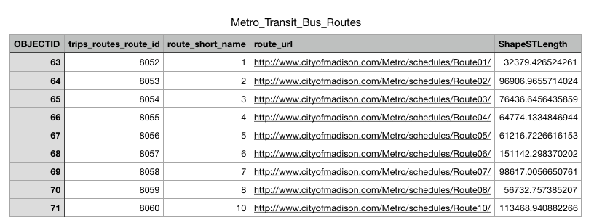
routes
Table
SQLite Database
File: bus.db

Slide 21
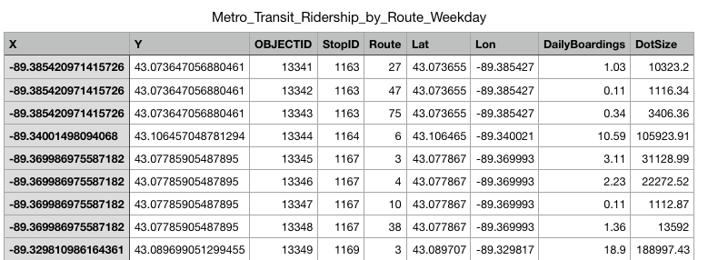
routes
Table
boarding
Table
SQLite Database
File: bus.db

Slide 22
how do we use this data?
routes
Table
boarding
Table
SQLite Database
File: bus.db

Slide 23
sqlite3
import sqlite3
conn = sqlite3.connect("file.db")
connect for databases is analogous to open for files
database filename
represented as a string
will create if doesn’t already exist (no "w" necessary)

Slide 24
sqlite3
import sqlite3
conn = sqlite3.connect("file.db")
a connection object for databases is analogous to file object for files

Slide 25
sqlite3
import sqlite3
conn = sqlite3.connect("file.db")
conn.close()
close it at the end

Slide 26
sqlite3
import sqlite3
import pandas as pd conn = sqlite3.connect("file.db")
df = pd.read_sql("select ???? from ????", conn)
conn.close()
ask this question query

Slide 27
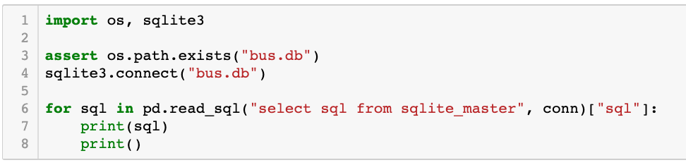
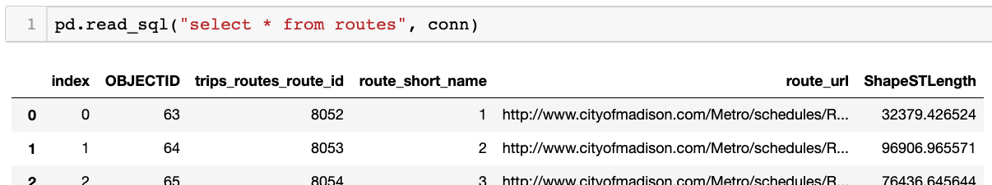
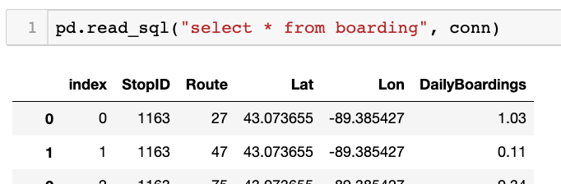
demo: poke around DB
(will explain more soon)

Slide 28
SQL Queries: How to ask a DB questions
Syntax for SELECT (case and spacing don’t matter):
SELECT
FROM
;

Slide 29
SQL Queries: How to ask a DB questions
Syntax for SELECT (case and spacing don’t matter):
select
from
;

Slide 30
SQL Queries: How to ask a DB questions
Syntax for SELECT (case and spacing don’t matter):
select
from
optional stuff
;

Slide 31
SQL Queries: How to ask a DB questions
Syntax for SELECT (case and spacing don’t matter):
select
from
table name
;

Slide 32
SQL Queries: How to ask a DB questions
Syntax for SELECT (case and spacing don’t matter):
select
from boarding;

Slide 33
SQL Queries: How to ask a DB questions
Syntax for SELECT (case and spacing don’t matter):
select
which columns
from boarding;

Slide 34
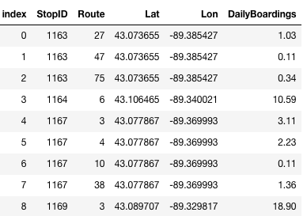
SQL Queries: How to ask a DB questions
Syntax for SELECT (case and spacing don’t matter):
star means all of them
select *
from boarding;
Result:
…

Slide 35
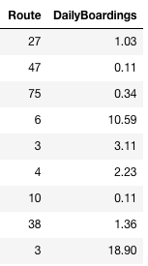
SQL Queries: How to ask a DB questions
Syntax for SELECT (case and spacing don’t matter):
select Route, DailyBoardings
from boarding;
Result:
…

Slide 36
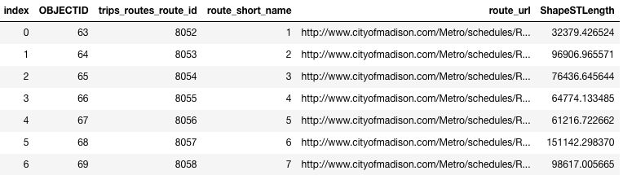
SQL Queries: How to ask a DB questions
Syntax for SELECT (case and spacing don’t matter):
select *
from routes;
Result:
…

Slide 37
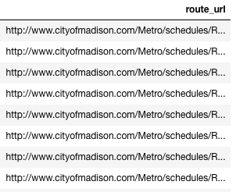
SQL Queries: How to ask a DB questions
Syntax for SELECT (case and spacing don’t matter):
select route_url
from routes;
Result:
…

Slide 38
SQL Queries: How to ask a DB questions
Syntax for SELECT (case and spacing don’t matter):
select
from
optional stuff
;
where
order by
limit

Slide 39
SQL Queries: How to ask a DB questions
Syntax for SELECT (case and spacing don’t matter):
select *
from boarding;
Result:
…

Slide 40
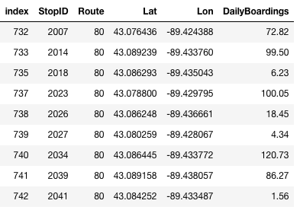
SQL Queries: How to ask a DB questions
Syntax for SELECT (case and spacing don’t matter):
select *
from boarding
where Route = 80;
Note: SQL only has one
equal sign for equality!
But == does work
Result:
…

Slide 41
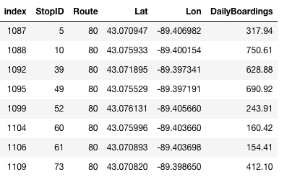
SQL Queries: How to ask a DB questions
Syntax for SELECT (case and spacing don’t matter):
select *
from boarding
where Route = 80
order by StopID;
Result:
…

Slide 42
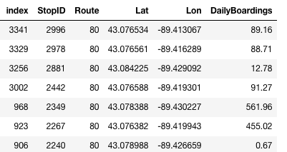
SQL Queries: How to ask a DB questions
Syntax for SELECT (case and spacing don’t matter):
select *
from boarding
where Route = 80
order by StopID DESC;
descending means
biggest first
Result:
…

Slide 43
SQL Queries: How to ask a DB questions
Syntax for SELECT (case and spacing don’t matter):
select *
from boarding
where Route = 80
order by StopID ASC;
ascending means
smallest first
Result:
…

Slide 44
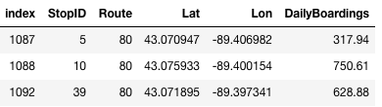
SQL Queries: How to ask a DB questions
Syntax for SELECT (case and spacing don’t matter):
select *
from boarding
where Route = 80
order by StopID ASC
limit 3;
only show the top N results
Result:
3 results

Slide 45
SQL Queries: How to ask a DB questions
Syntax for SELECT (case and spacing don’t matter):
select *
from boarding
where Route = 80
order by StopID ASC
limit 3;
Result:

Slide 46
SQL Queries: How to ask a DB questions
Syntax for SELECT (case and spacing don’t matter):
select *
from boarding
where Route = 80
order by StopID ASC
limit 3;
Result:
You can use any combination of where, order by, and limit.
But whichever you use, they must appear in that order!

