Slide 1


Supercomputing Wales
Mark Dawson
Senior Research Software Engineer
Swansea Academy of Advanced Computing, Swansea University

Slide 2





Project Overview
£15m investment to deliver a step-change in HPC-enabled research
Part-funded (£9m) by European Regional Development Fund via Welsh Government
Consortium of Welsh universities (Cardiff, Swansea, Aberystwyth and Bangor)
Suppliers to provide training and opportunities through a programme of ‘Community Benefits’

Slide 3
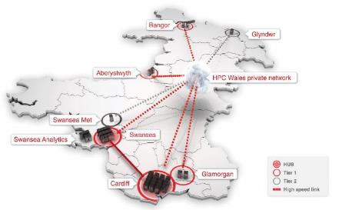
HPCW (Sandy Bridge) Hubs
Swansea Capability system:
256 x CX250S1 E5-2690 dual processor 16-core nodes
240 nodes with 64GB memory
16 nodes with 128GB memory
4096 × 2.9 GHz cores with 4/8 GB memory / core
Infiniband non-blocking QDR network
95 Tflops peak performance
400 TB Lustre file storage and 100 TB storage for permanent filestore
×
Cardiff Capacity system:
384 × CX250S1 e5-2670 dual processor 16-core nodes
6144 × 2.6 GHz cores with 4 GB memory / core
Infiniband non-blocking QDR network
128 TFlops peak performance
Filestore shared with HTC sub-system
×
‡
×
×
×
Site | System | Number of Cores | Peak Tflops
Cardiff | HTC + Capacity | 8216 | 149.6
Swansea | Capability + Capacity | 6144 | 137.6
Both Hubs | GP-GPU systems | 512 | 10.6
Tier-1 site | 1 × Medium | 648 | 6.9
All Sites | All Systems | 15,520 | 304.7
Novel Architecture Sub-systems (at each Hub):
16 x CX270 nodes with GP-GPU capability
256 x 2.6 GHz cores with 4 GB memory/ core
each node with a M2090 GP-GPU card
Infiniband non-blocking QDR network
Swansea Capacity system:
128 x CX250S1 E5-2670 dual processor 16-core nodes
2048 × 2.6 GHz cores with 4 GB memory / core
Infiniband non-blocking QDR network
43 Tflops peak performance
Filestore shared with Capability sub-system
‡
4 September 2018

Slide 4
Utilisation
Institution | Number of active HPCW Projects | Number of SCW Projects | Number of Dormant Projects | Usage (elapsed hours) | % - utilisation
Aberystwyth | 4 | 8 | 3 | 5,390,885 | 3.1%
Bangor | 8 | 24 | 8 | 7,113,236 | 4.1%
Cardiff | 5 | 25 | 1 | 77,317,803 | 44.6%
Swansea | 10 | 16 | 5 | 66,577,574 | 38.4%
Other | 12 | 1 | - | 17,088,665 | 9.9%
Total | 39 | 73 | 17 | 173,488,163 | 100.0%
07/2015 – 11/2017
4 September 2018
4

Slide 5


Timeline
Awarded January 2017
6-month consultation across the consortium to identify research requirements and develop technical reference design
May 2017 - Consortium agreements and SLA
May 2017 – ITT published with 3 Lots: Cardiff hub, Swansea hub and HPDA element
6 bids for each Lot received in September 2017
Awarded to ATOS IT Services end 2017
Currently nearing the end of an acceptance testing phase
Currently funded until 2020

Slide 6
Route to programme delivery until 2020
2017: 15 Research Software Engineers and technical support staff recruited
2018: New HPC hubs at Cardiff and Swansea (12,000 cores in total) with resiliency and common software
Target for income captured to Welsh universities for HPC-enabled research
Step change in HPC-enabled scientific research in Wales
Improved competiveness of Welsh universities
Development of the knowledge economy in Wales
Pan Wales wrap-around services that are greater than sum of parts
New R&D with access to cutting-edge HPC facilities
New industrial and other collaborations

Slide 7


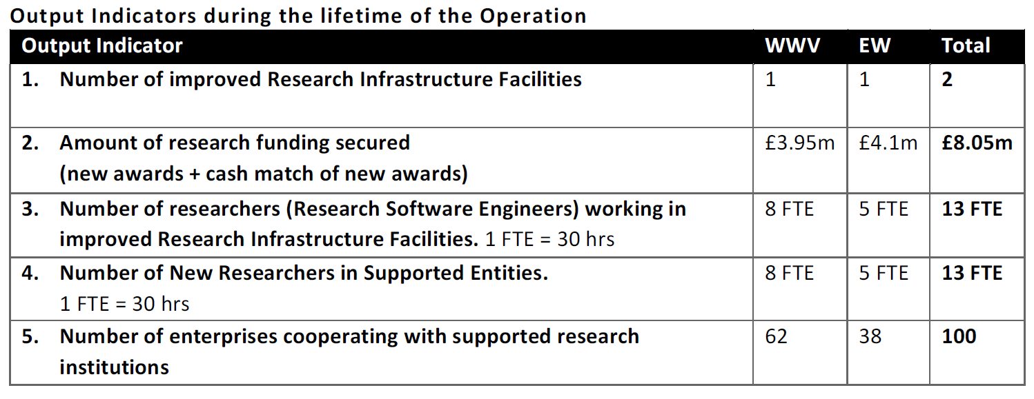
Outputs

Slide 8

SUNBIRD
Located in Swansea
122 nodes total and 4,880 cores
CPU:
2x Intel(R) Xeon(R) Gold 6148 CPU @ 2.40GHz with 20 cores each
RAM:
122 nodes @ 384 GB
4 nodes @ 384GB with 2x nVidia V100 GPUs
1PB Lustre filesystem
100Gbs Mellanox Interconnect
Bullion OpenStack

Slide 9

HAWK
Located in Cardiff
201 nodes total
8,040 cores
46 TBytes memory
CPU:
2x Intel(R) Xeon(R) Gold 6148 CPU @ 2.40GHz with 20 cores each
RAM:
134 nodes @ 192 GB
26 HTC nodes
26 high-memory nodes @ 384GB
13 nodes @ 32GB with 2x nVidia P100 GPUs
Storage:
692TB (usable) scratch on a Lustre filesystem
420TB of home directory space over NFS

Slide 10
HPDA Facility
6 x dual 22 core, 512 GB Ram Bull Sequana S200 servers.
18 storage arrays giving a total of 128TB useable storage.

Slide 11

Staffing and Resources
Research Software Engineers – 13 of target of 13 recruited across Wales
Technical Staff – 5 staff members in post
Project Management – core project management staff in post

Slide 12
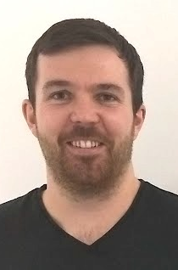
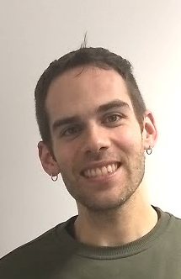
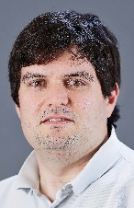
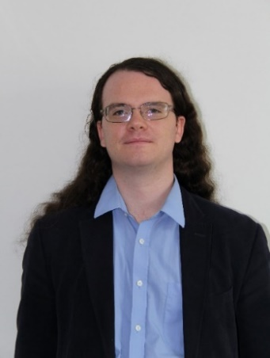
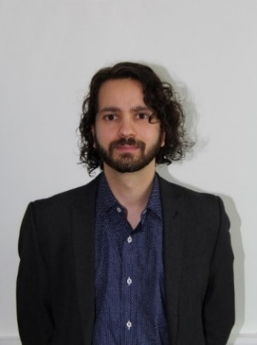
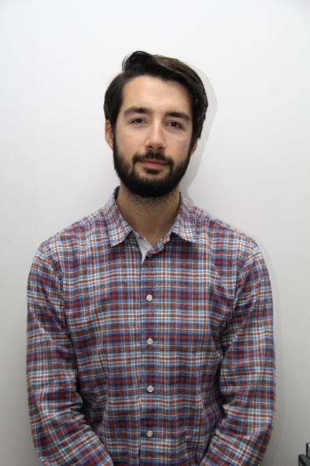
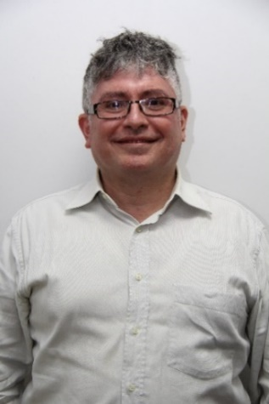

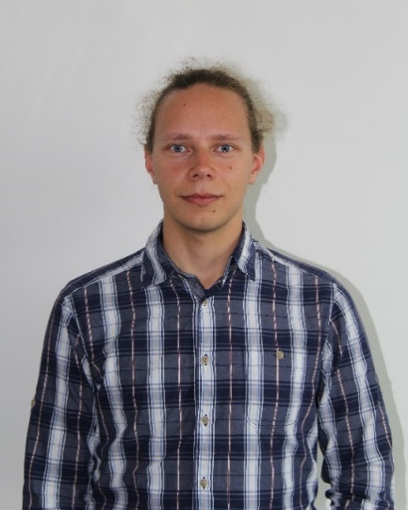
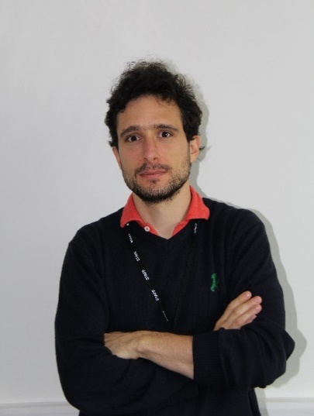
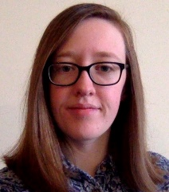
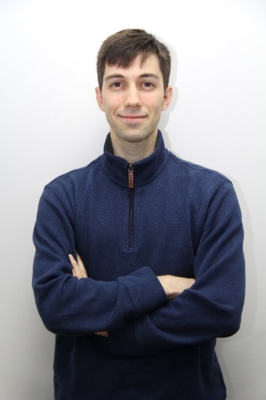

Supercomputing Wales RSEs
Aaron Owen
Rafael Bargiela
Colin Sauze
Pablo Ouro Barba
Walter Colombo
Sachin Nanavati
Kieran Phillips
Anna Price
Iakov Polyak
Ed Bennett
Mark Dawson
Michele Mesiti
Jarno Rantaharju
Chenna Kadapa

Slide 13
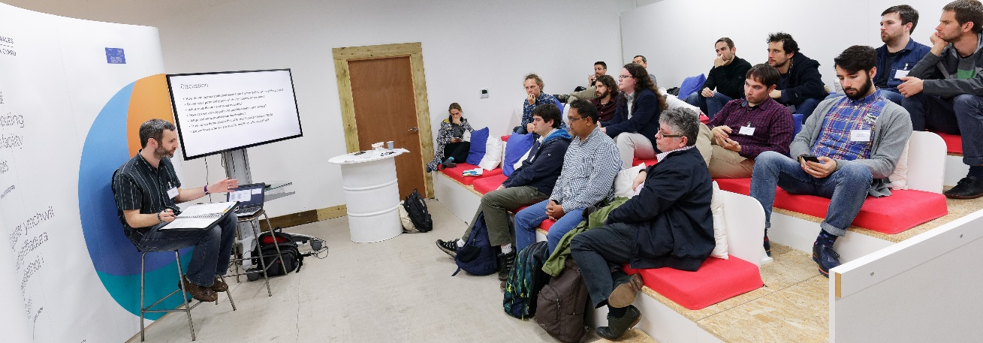
RSEs – leveraging the power of the HPC hubs
15 Research Software Engineers working as a cohort across Wales
Provide expertise required to leverage the power of the HPC facilities – not about raw ‘core count’, but about efficient, optimised use of the resources
Supporting delivery of major projects and scientific breakthroughs
Increase capacity to attract competitive research funding
Support world-leading outputs and build an international reputation

Slide 14
RSEs in post at Cardiff by January 2018
6 RSEs embedded in research disciplines within specific Schools
RSEs support established investigators by enabling research to be further enhanced by HPC resources, collaborations and proposals for funding
RSE | Academic School | Primary Research Group
Pablo Ouro Barba | Engineering | Computational Engineering
Walter Colombo | Computer Science and Informatics | Biosocial Computing/Crime & Security URI
Sachin Nanavati | Chemistry | Computational Chemistry
Kieran Phillips | Physics and Astronomy | Gravitational Waves
Iakov Polyak | Chemistry | Computational Chemistry
Anna Price | Biosciences/Medicine | Biological Sciences/Medicine

Slide 15

Collaboration between RSEs at Cardiff
Coordination of RSE activities through the Data Innovation Research Institute (DIRI) to share knowledge and best-practice
Supercomputing Wales project team now hosted at DIRI to ensure better alignment with the RSE community
Coordination and alignment of internal activities for SCW/DIRI RSEs and ARCCA staff e.g. fortnightly RSE “lunch and learn” sessions

Slide 16

RSEs at Bangor
2 RSEs serving a large number of academic units
RSEs support research activities by
improving code,
introducing new researchers to HPC,
establishing new collaborations
and contributing to proposals

Slide 17
RSEs at Bangor
Future expansion at BU
Centre for Environmental Biophysics
£7.7m ERDF project on extremophile research and related bioanalytics
Strong genomics, proteomics and metabolomics activities
Nuclear Futures Institute
£6.5m Sêr Cymru programme
Modelling of nuclear reactors

Slide 18
RSEs at Swansea
Five RSEs working in the Academy of Advanced Computing (SA2C)
Provide support to HPC projects at Swansea University
RSE | Original Science Domain
Mark Dawson | Computational Mechanics
Ed Bennett | Computational Physics
Michele Mesiti | Computational Physics
Chenna Kadapa | Computational Mechanics
Jarno Rantaharju | Computational Physics
TBC

Slide 19
Activities
Short-term project-based
Free/competitive
Perf characterisation and optimisation
Enabling grant income
User engagement activities
HPC User Forum
Training
Specialised/technical seminars
Development of software of wide interest for HPC

Slide 20
Challenges
Sustainability
Engage local community
Scalability
Attribution
Involvement in wider community

Slide 21

Thank you!

