Slide 1
HPC Champions Past, Present and Future 5 September 2018
Dr Alan D Simpson
ARCHER CSE Director
EPCC Technical Director

Slide 2
Overview
Past: Background and Aims
Present: Current Status
Future: Plans
Summary
Discussion Session

Slide 3
Background
Original concept for ARCHER Champions grew out of discussions between EPCC, Clare Gryce (UCL) and EPSRC
Activity funded by EPSRC as part of an additional ARCHER Outreach Research Grant
Targeting RSEs working in the area of HPC support
When initiating the series of workshops, we also had very useful interactions with key members of HPC-SIG
Important that Workshops are very interactive allowing positive sharing of ideas and knowledge

Slide 4
ARCHER Champions
Aim: To create a network of HPC Champions that will:
Provide a support network between staff members whose role involves advising users on access to local, regional and national HPC resources
Help to promote a coherent access structure to HPC resources across the UK, with coordination between tiers
Support and promote activities designed to provide career development to research software engineers seeking a career in HPC
Support and promote activities to broaden the UK HPC user base to new disciplines and communities
Promote common training material and techniques
Originally supported by ARCHER Outreach funding from EPSRC
Funding has recently finished
Though we are trying to keep key activities ongoing

Slide 5
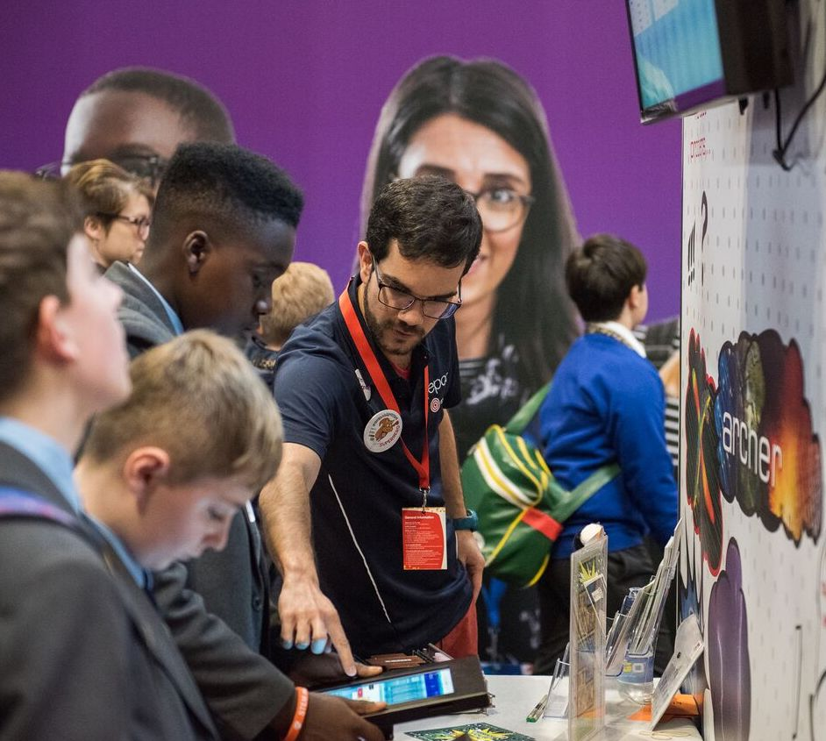
ARCHER Outreach
ARCHER Outreach grant has recently ended
4 key areas of activity
Diversity
Women in HPC
Faces of HPC website
http://www.hpc-diversity.ac.uk/
Best practice guide on "Improving Accessibility to HPC training"
ARCHER training material updated to accessible slide format
Engagement
Hand-on workshops
ARCHER Champions
Outreach
Events (Big Bang Fair, New Scientist Live, IET EngFest,…)
Demos on Wee Archie
Outreach Ambassadors’ pack
Teachers’ pack
Impact
Case Studies
Image competition and calendar

Slide 6
What is a Champion?
An HPC RSE who may be:
working at a regional or national centre (or equivalent institution) and is engaged in: advising users on the access of appropriate computational resources; and in supporting these users to access and exploit these resources appropriately.
located within a consortium or equivalent group of HPC users. They would act as a champion within their consortium - providing advice on support mechanisms, obtaining training in appropriate HPC technologies and HPC career development skills and engaging in outreach activities.
Or anyone interesting in promoting the use of HPC

Slide 7
Integration with Tier 2
Champions became even more valuable with the advent of the new Tier-2 systems
Cirrus, Thomas, CSD3, Jade, Isambard, HPC Mid+
Users across the UK now have a broader choice of systems and architectures
GPU, KNL, ARM64, various Intel x86
Champions has had Tier-2 sessions at every workshop since the start of 2017
Originally coordinated by Christopher Woods (Bristol)
Now will be coordinated by James Grant (Bath)

Slide 8
Champions Workshops
Edinburgh (March 2016)
Oxford (September 2016)
Leeds (February 2017; co-located with HPC-SIG)
Hartree (June 2017)
Manchester (April 2018; co-located with SSI event)
Information, including slides and summaries are available at:
http://www.archer.ac.uk/community/champions/

Slide 9
Topics for Champions Workshops
Access routes
RSE support
Tier 2
Outreach
Training
Online training
SAFE
Porting and migration
eCSE
Benchmarking
Architectures
Diversity
Lightning talks
…

Slide 10
Typical Programme
Welcome and Introductions
ARCHER Service Update
Technical talks
Tier-2 Session
Updates from each site
Lightning Talks from Champions
Discussion Session
Social Dinner

Slide 11
Current Champions
North East
Martin Callaghan, Graham Collins, Mike Croucher, Joanna Leng, Alan Real, Paul Richmond
North West
Gerard Capes, Violeta Holmes, George Leaver, Xiaohu Guo
East Midland
Colin Bannister, Tom Daff, Paul Griffiths, Zhong-Nan Wang
West Midlands
Andrew Edmondson
Greater London
Tom Couch, Jo Lampard, Mario Orsi, Jemma Trick, Christopher Walker
South West
James Grant, Ed Ransley, Christopher Woods
South East
Alhamdu Bello, Ian Bush, Mihai Duta, Annette Osprey, Andy Richards, Richard Stanworth
Northern Ireland
Eamonn Hynes
Scotland
Michael Chung, Kenton d'Mellow, Oliver Henrich, Douglas Houston, Naveed Khan, Karina Kubiak-Ossow
Wales
Christine Kitchen
Industry
Matthew Street

Slide 12
ARCHER Service Staff @ Champions
Neelofer Banglawala
Clair Barrass
Jo Beech-Brandt
Stephen Booth
Manos Farsarakis
Daniel Gleed
Adrian Jackson
David Henty
Kieran Leach
Craig Manzi
Alan Simpson
Lorna Smith
Kevin Stratford
Andy Turner
Anne Whiting
EPCC fully committed to promoting the use of HPC through Champions
Staff from:
User Support
Systems
CSE Support
eCSE
Outreach

Slide 13
Future Plans for Champions
Now that ARCHER Outreach funding has finished, we want to make Champions a community-organised activity
ARCHER Champions → Tier-1/Tier-2 Champions → HPC Champions
Would like Champions to be as inclusive as possible
For Champions to continue to be successful, it needs to be driven by the community and interesting/useful for attendees
Topics and format have evolved and this should continue

Slide 14
Champions Organising Committee
At the workshop in Manchester, we solicited volunteers to help organise future Champions Workshops
Current Organising Committee:
Jo Beech-Brandt (EPCC)
Alan Simpson (EPCC)
Ian Bush (Oxford)
James Grant (Bath)
Tom Couch (UCL)
Andrew Edmondson (Birmingham)
[Laurence Hurst (Birmingham)]
Still very keen to have additional volunteers
If you are interested, please speak to Jo or me

Slide 15
Summary
ARCHER Champions has been a successful activity funded by EPSRC through the ARCHER Outreach Grant
5 workshops across the UK
Around 40 Champions + 15 ARCHER Service staff
Good coverage of both Tier 1 and Tier 2
Although funding has ended, want Champions to continue as a community-organised activity with a broad remit

Slide 16
Discussion Session
Polls at slido.com, event code A167
Existential
Do we as a community think that this sort of activity has value and should continue?
Scope
Should Champions cover: Tier 1; Tier 2; Tier 3; all HPC?
Lessons Learned
What is good about Champions? What could be improved?
Content
What topics would encourage you to attend? Technical, support, informational, community, …
Logistics
How should we continue the workshops? Frequency, locations, volunteers, funding, …
What links with UK RSE/HPC-SIG/SSI should there be?

