Slide 1
A Bayesian Hierarchical Model For Predicting Song Popularity
Statistics 775
James Hubbs

Slide 2
What Makes Songs Popular?
Do things like tempo, rhythm, timbre, and other qualities of the sound help drive popularity?
Or is popularity
A Bayesian Hierarchical Model For Predicting Song Popularity

Slide 3
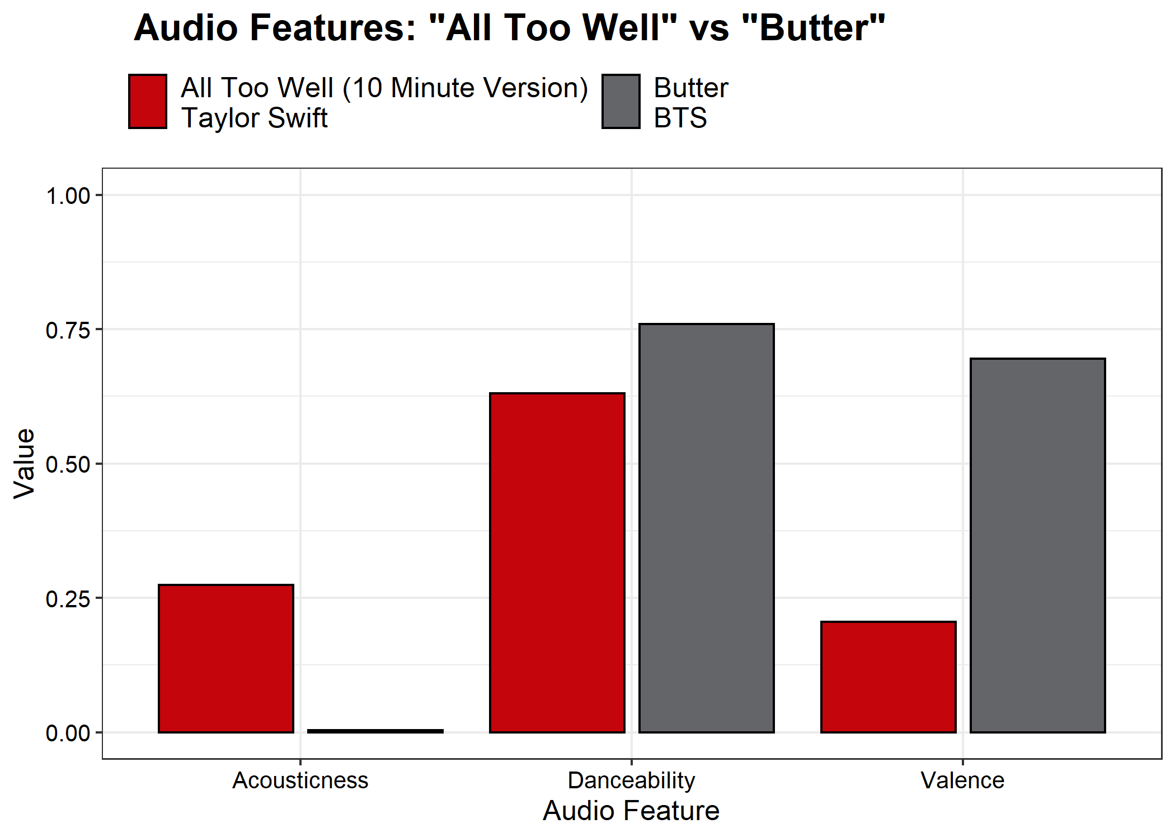
Understanding The Data
A Bayesian Hierarchical Model For Predicting Song Popularity

Slide 4
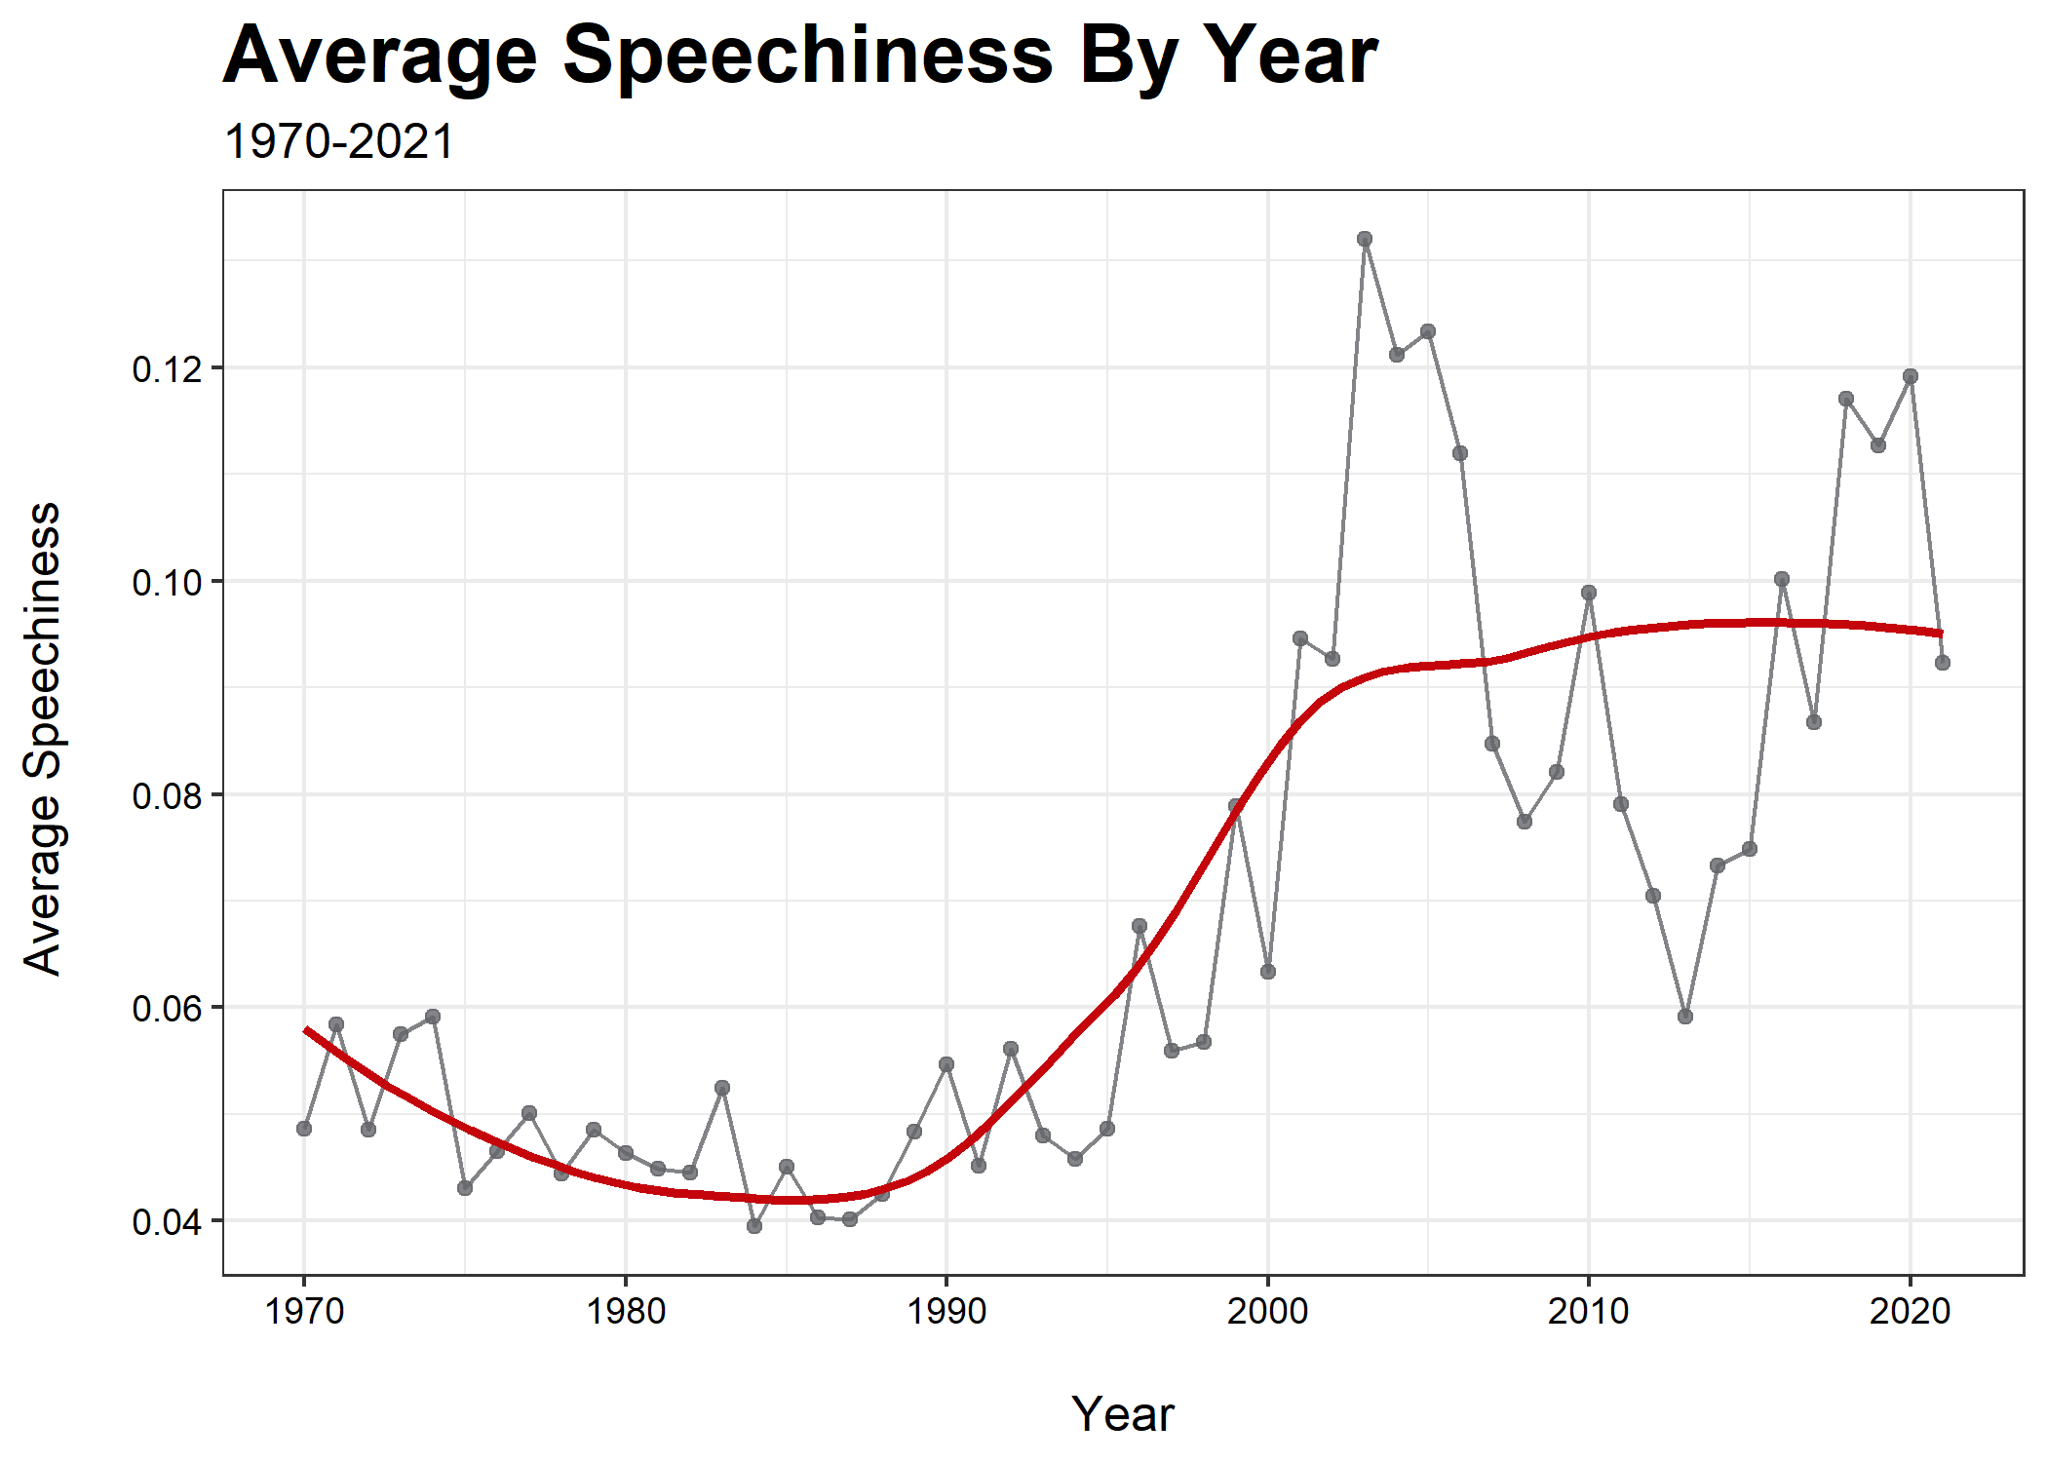
A Bayesian Hierarchical Model For Predicting Song Popularity

Slide 5
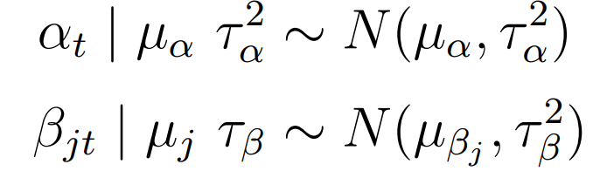
The Model
Consider 10 predictors and 6 groups (decades)
Use a standard multiple linear regression setup (layer 1)
Allow intercept and slopes to vary by decade (layer 2)
d
Set priors/hyperparameters using both prior predictive checks and prior knowledge regarding coefficient directions (layer 3)
A Bayesian Hierarchical Model For Predicting Song Popularity

Slide 6
A Bayesian Hierarchical Model For Predicting Song Popularity

