Slide 1
A Bayesian Hierarchical Model For Predicting Song Popularity
Statistics 775
James Hubbs

Slide 2
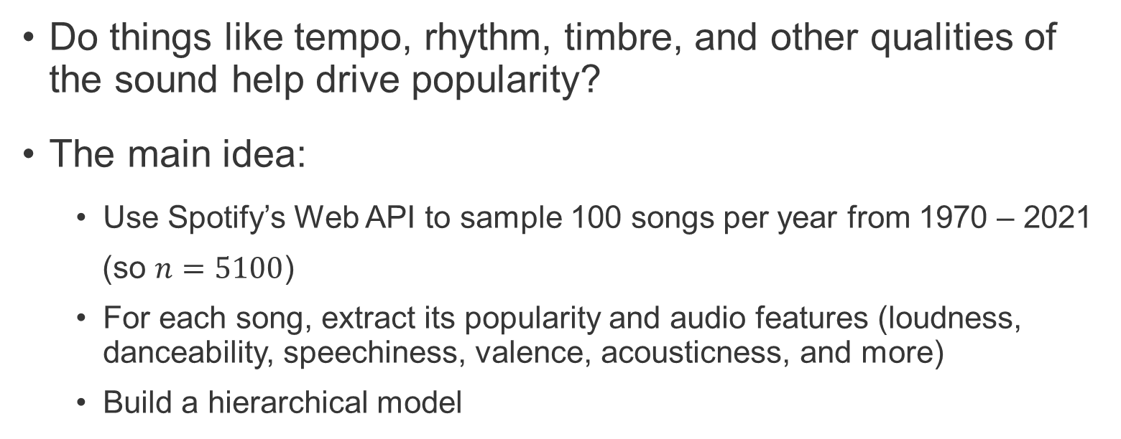
Predicting Song Popularity From Audio Features
Do things like tempo, rhythm, timbre, and other qualities of the sound help drive popularity?
The main idea:
Use Spotify’s Web API to sample 100 songs per year from 1970 – 2021
(so $n=5100$)
For each song, extract its popularity and audio features (loudness, danceability, speechiness, valence, acousticness, and more)
Build a hierarchical model
A Bayesian Hierarchical Model For Predicting Song Popularity

Slide 3
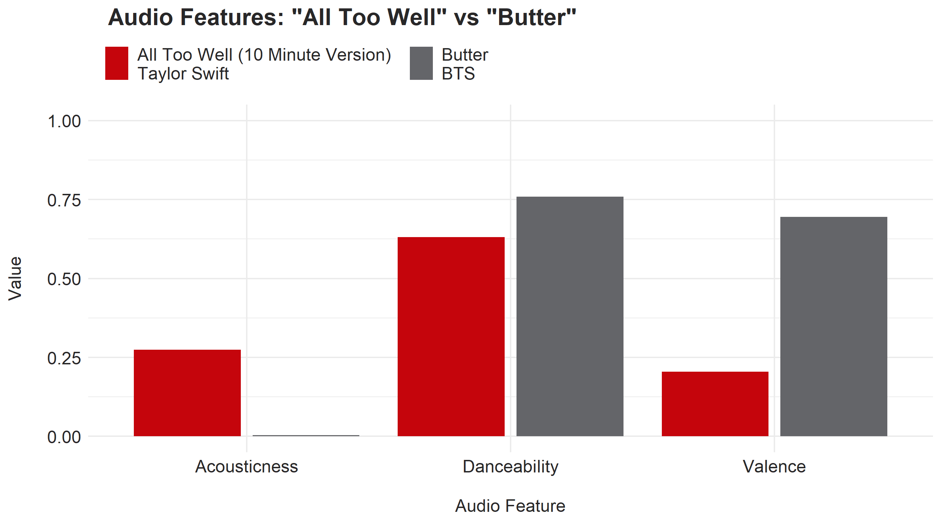
Audio Features Are (Mostly) Intuitive
A Bayesian Hierarchical Model For Predicting Song Popularity

Slide 4
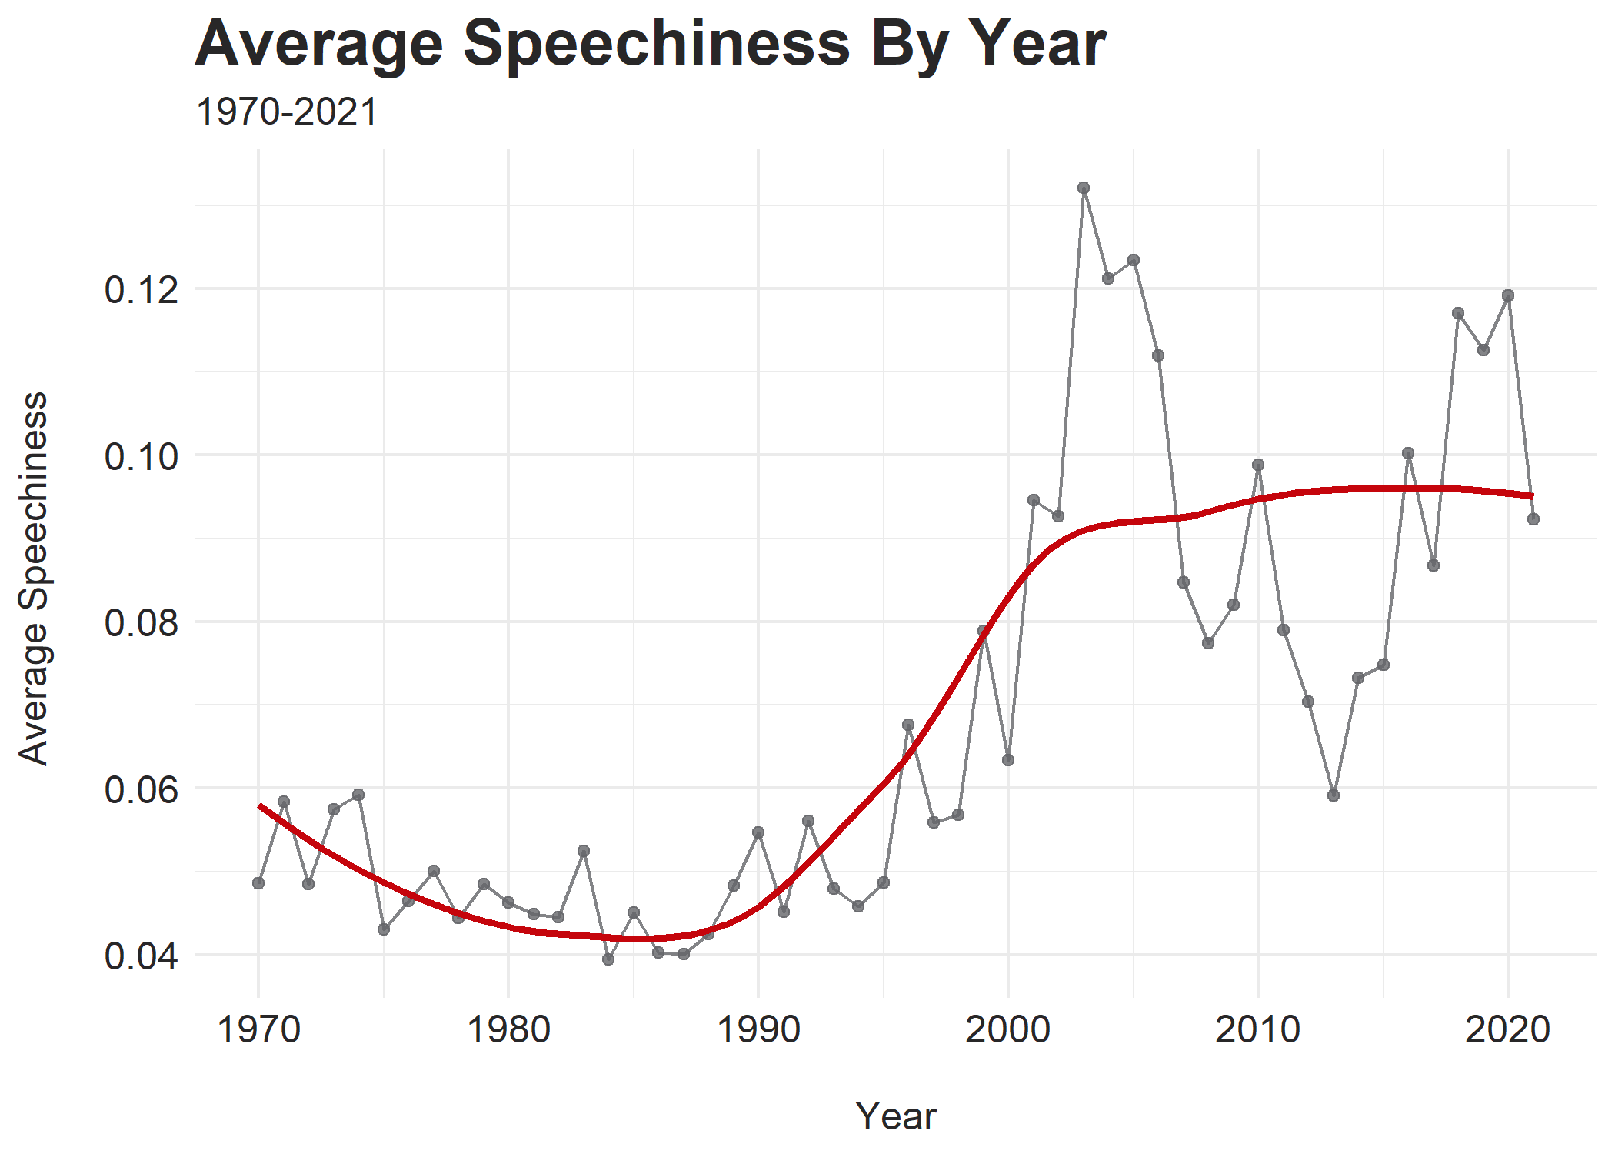
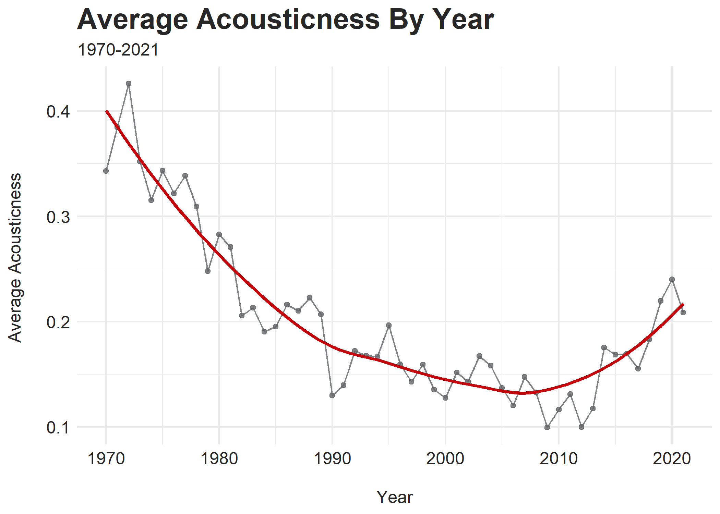
Audio Features Have Prominent Trends
A Bayesian Hierarchical Model For Predicting Song Popularity

Slide 5
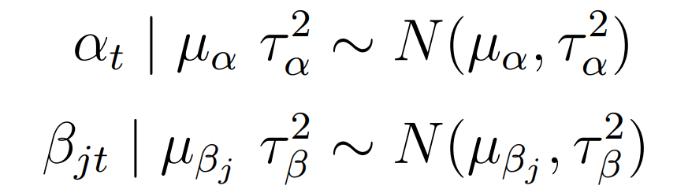
Modeling Popularity
Consider 10 predictors (audio features) and 6 groups (decades)
Use a standard multiple linear regression setup (layer 1)
Allow intercept and slopes to vary by decade (layer 2)
d
Set priors/hyperparameters using both prior predictive checks and prior knowledge regarding coefficient directions (layer 3)
A Bayesian Hierarchical Model For Predicting Song Popularity

Slide 6
Model Performance and Conclusions
In general, audio features are only weakly predictive of popularity
The model suggests danceability is most influential
Our perception of music is complicated!
Spotify’s audio features (the publicly-available ones, at least) don’t capture everything
A Bayesian Hierarchical Model For Predicting Song Popularity

