Slide 1
A Bayesian Hierarchical Model For Predicting Song Popularity
Statistics 775
James Hubbs

Slide 2
Do things like tempo, rhythm, timbre, and other qualities of the sound help drive popularity?
Use Spotify’s Web API to sample 100 songs per year from 1970 – 2021 (i.e., N=5100)
For each song, we extract its popularity as well as audio features like loudness, danceability, speechiness, valence, acousticness, and more
A Bayesian Hierarchical Model For Predicting Song Popularity

Slide 3
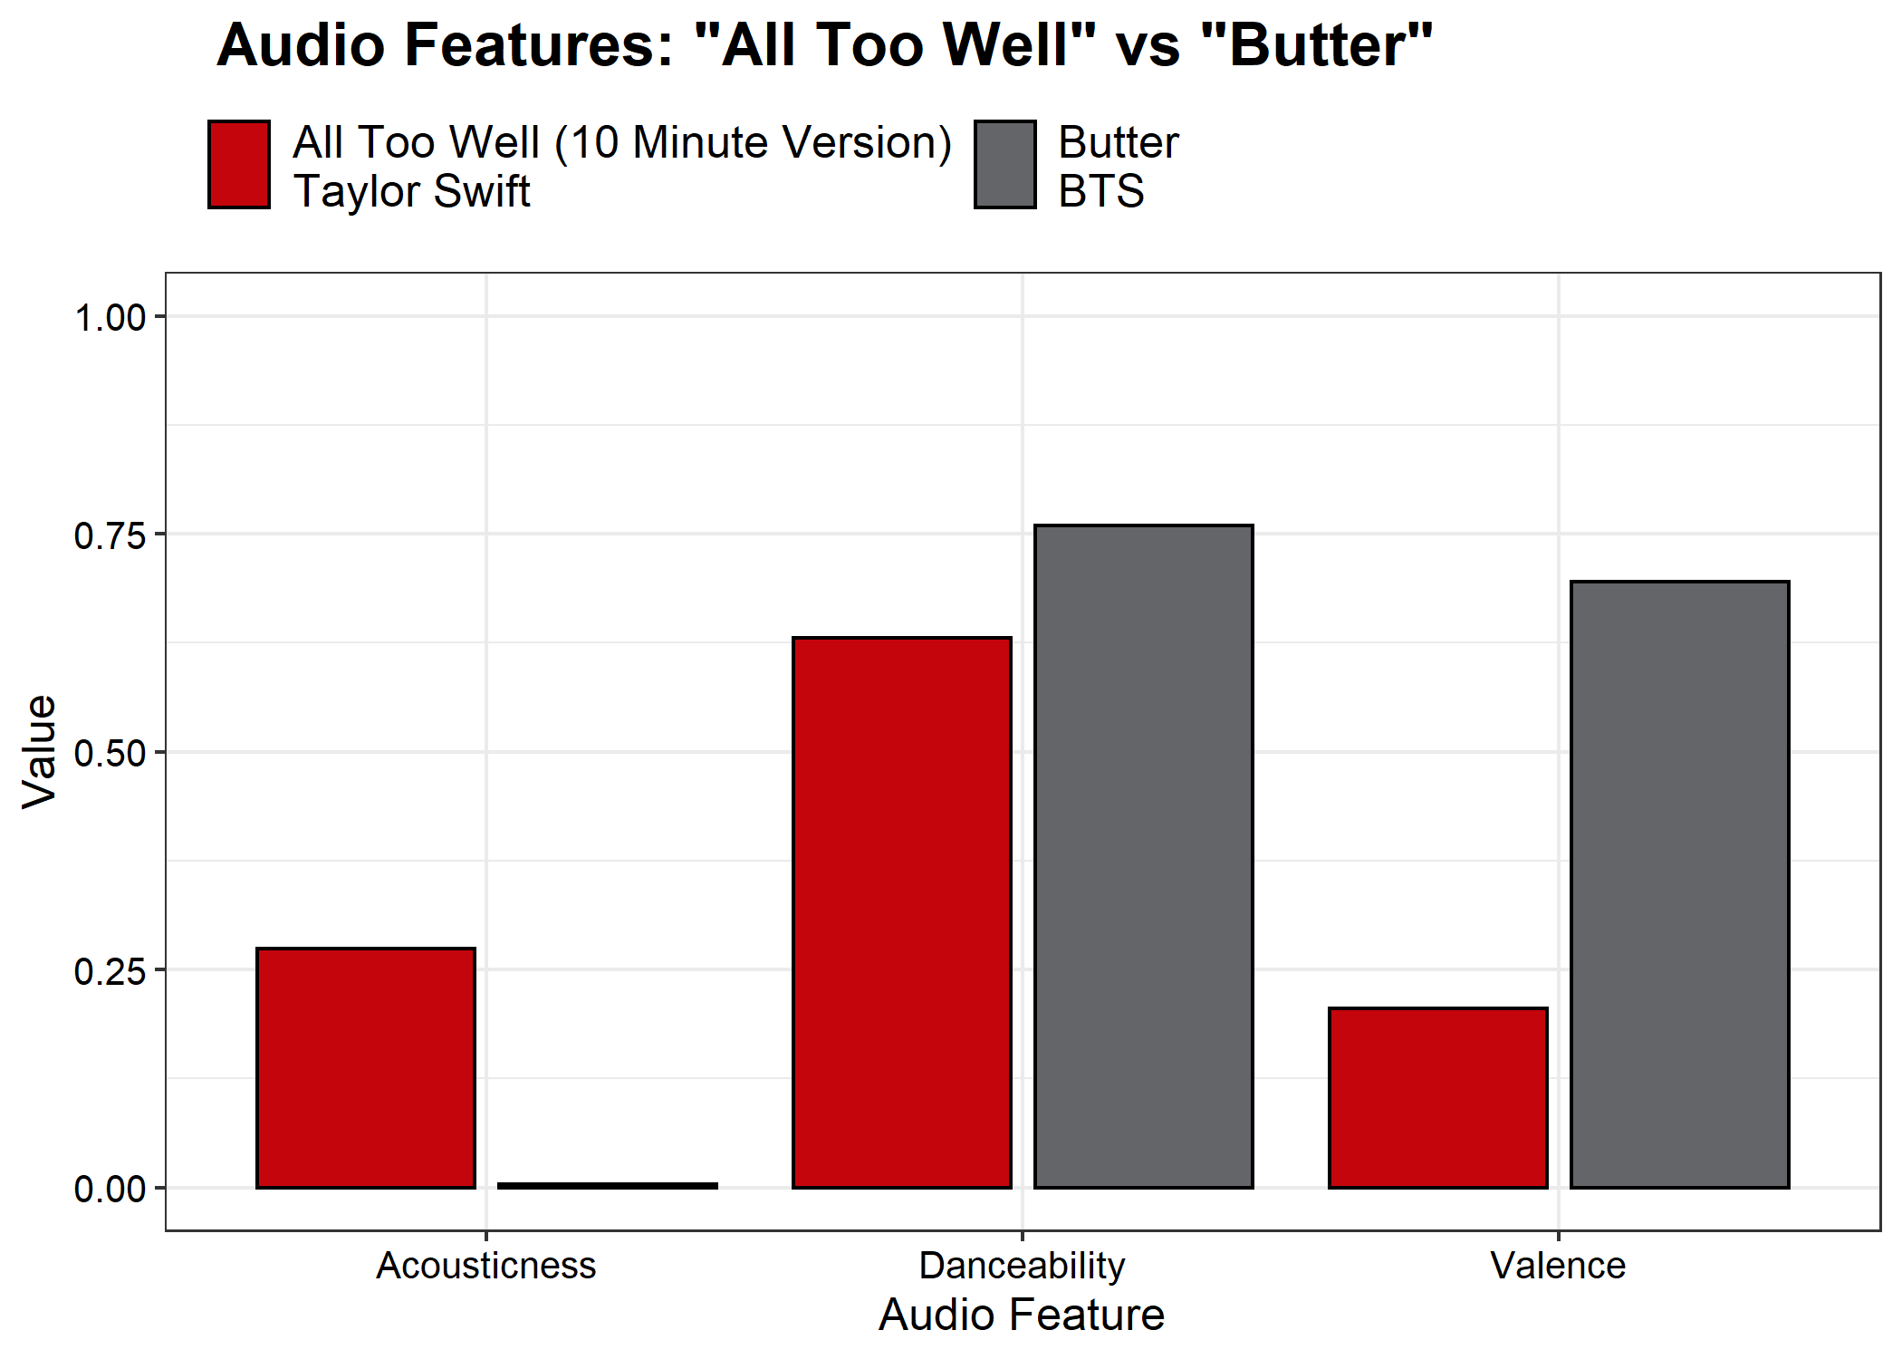
Understanding The Data: Taylor vs BTS
A Bayesian Hierarchical Model For Predicting Song Popularity

Slide 4
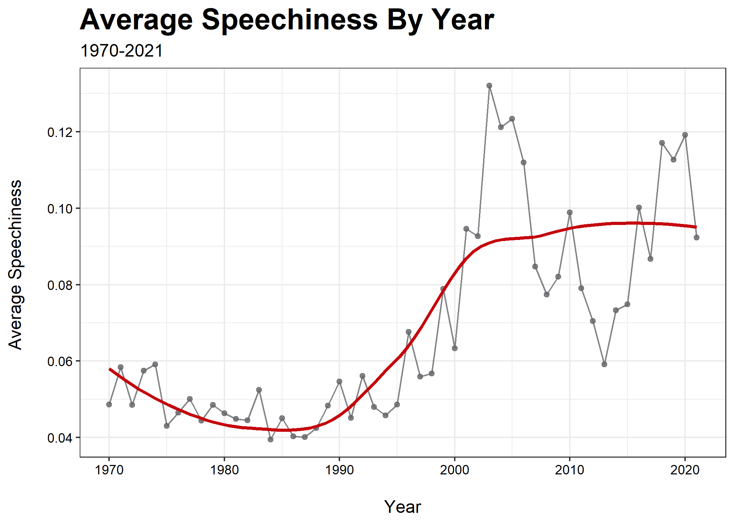
Understanding The Data: Historical Trends
A Bayesian Hierarchical Model For Predicting Song Popularity

Slide 5
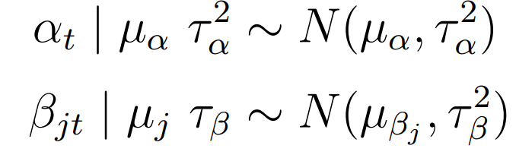
The Model
Consider 10 predictors and 6 groups (decades)
Use a standard multiple linear regression setup (layer 1)
Allow intercept and slopes to vary by decade (layer 2)
d
Set priors/hyperparameters using both prior predictive checks and prior knowledge regarding coefficient directions (layer 3)
A Bayesian Hierarchical Model For Predicting Song Popularity

Slide 6
Model Performance and Conclusions
Data suggest danceability is most influential
Though audio features alone are only weakly predictive of popularity
Our perception of music is complicated
A Bayesian Hierarchical Model For Predicting Song Popularity

