Slide 1
GLOW vs FLUX
Comparing Normalizing Flows and Flow Matching for Face Image Generation at 64×64 Resolution
Younghyeok Kim | Korea University
Generative Artificial Intelligence — Final Project

Slide 2
Motivation
Which generative paradigm offers better quality per compute at low resolution?
• Diffusion / Flow Matching: state-of-the-art quality, but require many NFEs (≥4 steps)
• Normalizing Flows (GLOW): NFE = 1 + exact log-likelihood — unavailable in diffusion
• Key question: at the same 64×64 resolution, which is better per unit compute?
• FLUX.1 designed for ≥512×512 — what happens when forced to 64×64?
• We span a full Pareto frontier: NFE ∈ {1, 4, 8, 10, 20, 28, 50, 100}
GLOW
FLUX.1
DDPM / DDIM
Normalizing Flow 76M params · from scratch NFE = 1
Flow Matching DiT ~12B params · pretrained NFE = 4 / 8 / 28
Denoising Diffusion 113M params · CelebA-HQ NFE = 10 / 20 / 50 / 100

Slide 3
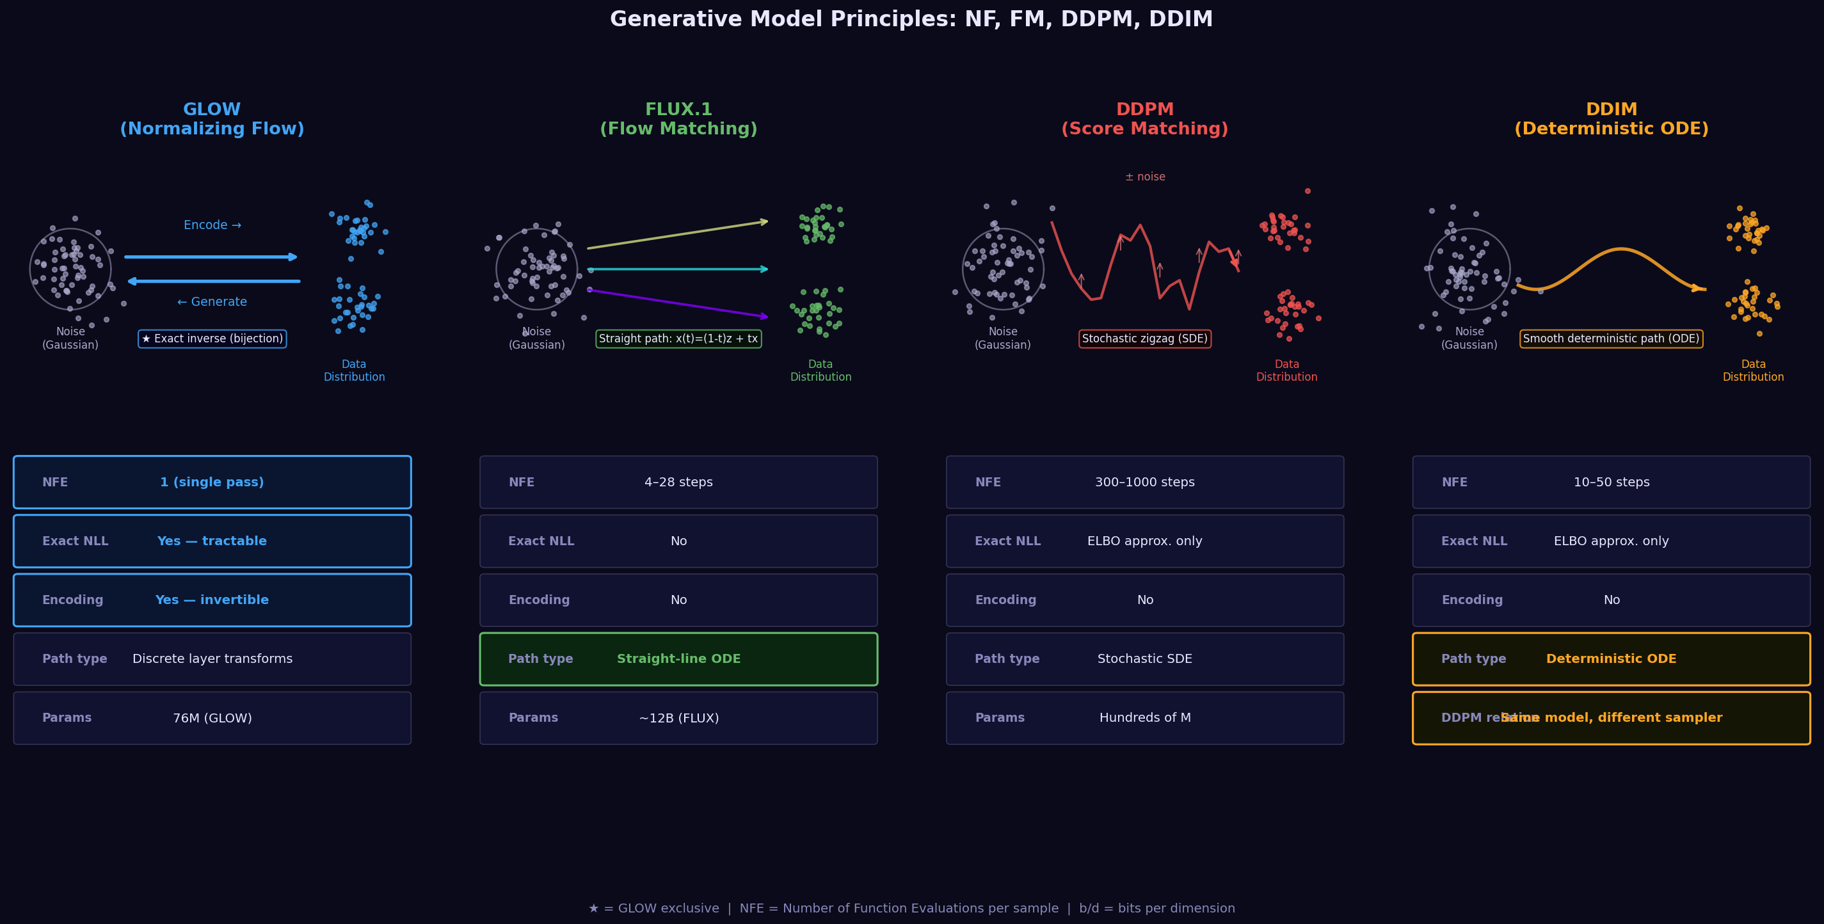
Three Generative Paradigms
How each model transports noise → data distribution

Slide 4
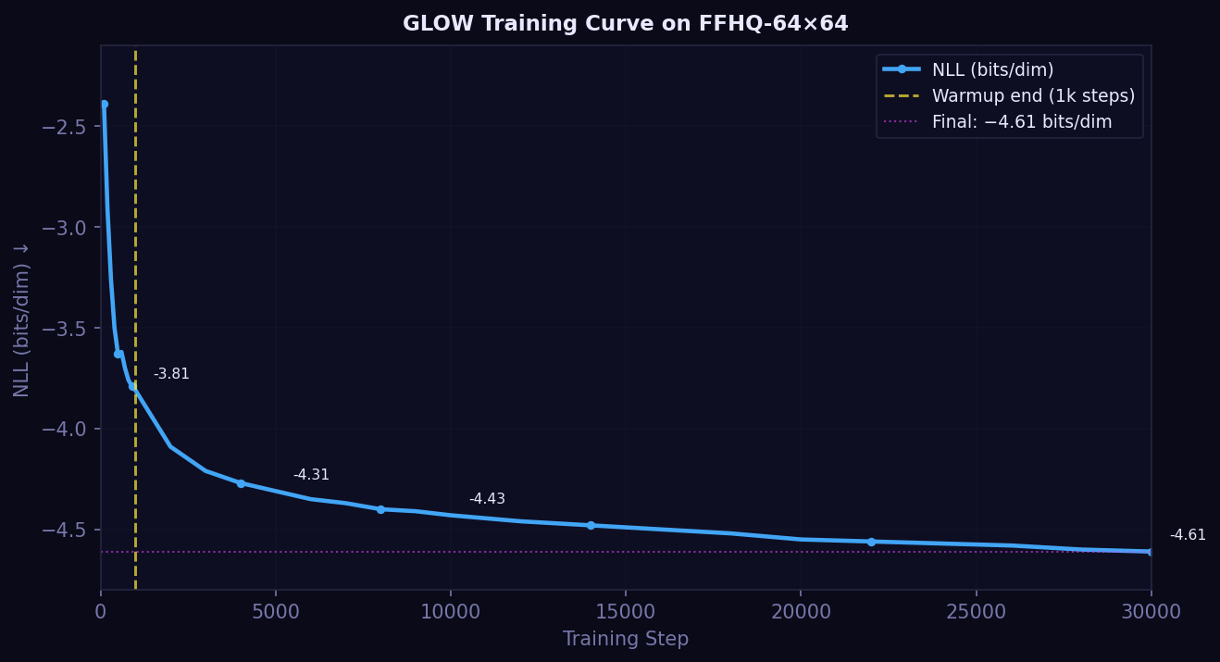
Background: GLOW (Normalizing Flow)
Kingma & Dhariwal, NeurIPS 2018
• Invertible bijection f : X → Z with exact log-likelihood:
– log p_X(x) = log p_Z(f(x)) + log |det(∂f/∂x)|
• Three components per flow step:
– ActNorm — data-driven normalization
– Invertible 1×1 Conv — learned channel permutation (LU decomp.)
– Affine Coupling — half channels predict scale & shift for other half
• Config: 4 blocks × 32 flows, hidden 512 ≈ 76M params
• Sampling: single reverse pass — NFE = 1, no iteration
• Stability fixes: clamp log-scale [−3,3] + NaN/Inf gradient guard
GLOW-exclusive →
1
✓
✓
✓
NFE
NLL
Recon.
Interp.
NLL still decreasing at 30k steps

Slide 5
Background: FLUX.1 and DDPM/DDIM
FLUX.1 (Flow Matching)
DDPM / DDIM
• Learns vector field v_θ(x,t) → ODE: noise → data
• 12B-param Diffusion Transformer (DiT)
• Pretrained on large-scale images (≥512×512)
• schnell: 4 NFE (distilled) | dev: 8 / 28 NFE
• ⚠ No exact NLL • No reconstruction
• ⚠ Resolution mismatch at 64×64 (design ≥512)
• DDPM: Markov noise chain, 1000-step stochastic reverse
• DDIM: deterministic ODE from same score (no retraining)
– NFE ∈ {10, 20, 50} vs DDPM-100
• Model: google/ddpm-celebahq-256 (113M params)
• Trained on face images → good transfer to 64×64
• Sample at 256, bicubic downsample to 64×64
• ⚠ No exact NLL • No reconstruction

Slide 6
Main Results: Complete Pareto Frontier
FID: 5k generated vs 70k FFHQ-64 real images (cleanfid)
Model
Params
NFE
FID ↓
NLL (b/d)
Time (5k)
Data
GLOW (30k)
76M
1
183.35
−4.61
137s
FFHQ-64 scratch
FLUX.1-schnell
12B
4
184.94
—
1,231s
Pretrained
FLUX.1-dev-8
12B
8
126.15
—
—
Pretrained
DDIM-10 †
113M
10
68.75
—
602s
CelebA-HQ-256
DDIM-20 †
113M
20
65.96
—
1,346s
CelebA-HQ-256
DDIM-50 †
113M
50
61.78
—
2,658s
CelebA-HQ-256
DDPM-100 †
113M
100
71.87
—
5,453s
CelebA-HQ-256
FLUX.1-dev
12B
28
117.87
—
8,617s
Pretrained
† CelebA-HQ-256 pretrained, downsampled to 64×64 Yellow = best FID Pink = Pareto-suboptimal Green = best NLL

Slide 7
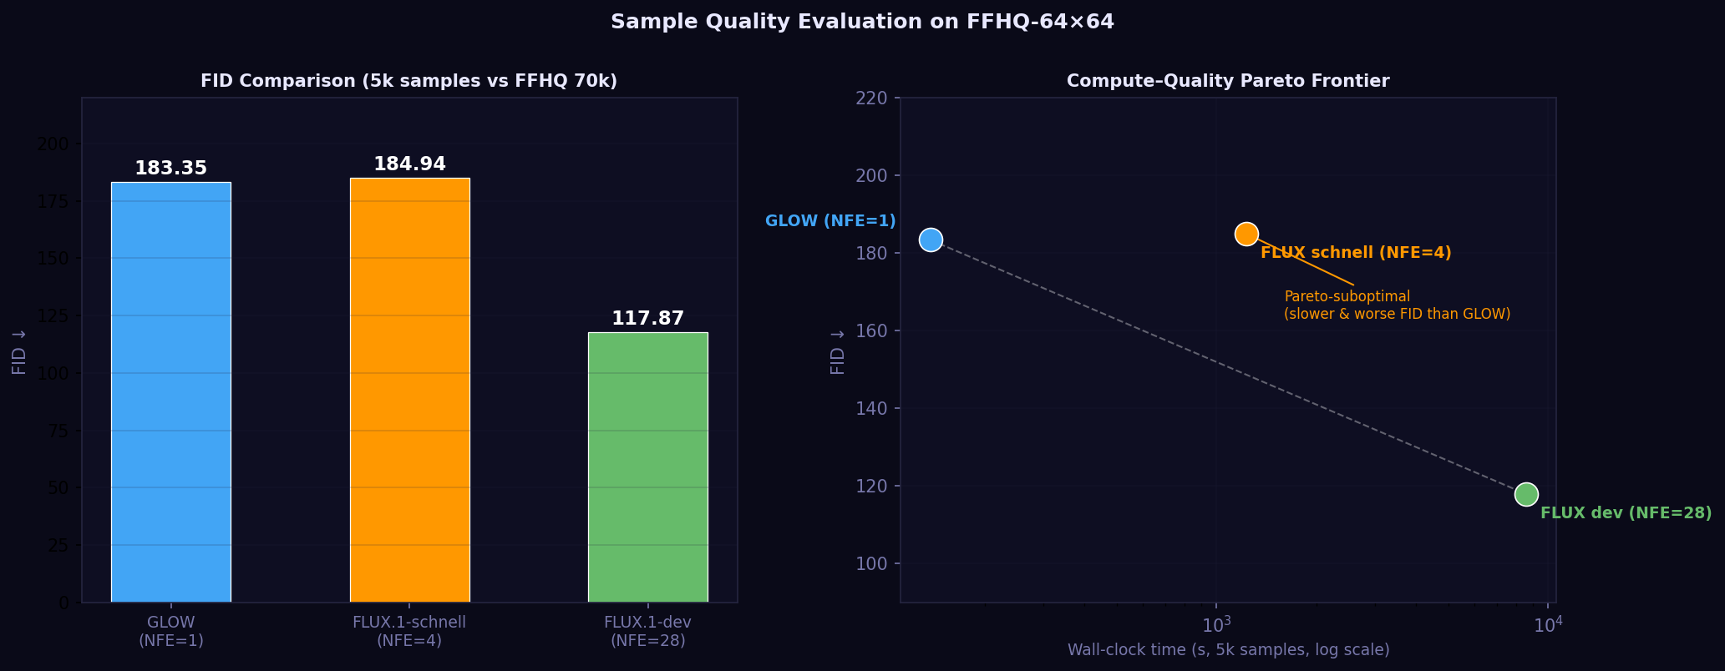
Compute–Quality Pareto Frontier
Three regimes — one dominated model
① Latency-critical NFE=1
GLOW FID 183.35 | 137s/5k
② Efficiency-optimal NFE=10–50
DDIM-50 FID 61.78 ★ | 2,658s/5k
③ High-compute NFE=28
FLUX.1-dev FID 117.87 | 8,617s/5k
✗ Pareto-suboptimal NFE=4
FLUX schnell FID 184.94 | 9× slower than GLOW

Slide 8
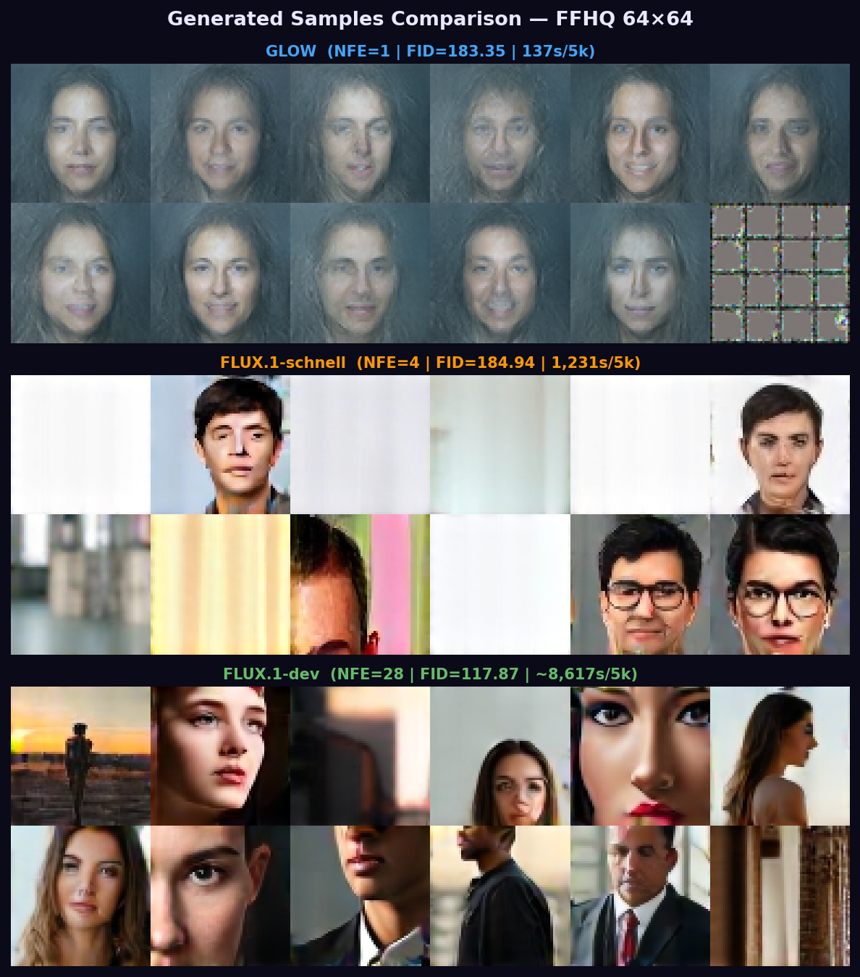
Generated Samples at 64×64
GLOW (NFE=1) · FLUX.1-schnell (NFE=4) · FLUX.1-dev (NFE=28)
GLOW: coherent faces, softer texture | FLUX schnell: diverse but can hallucinate at 64×64 | FLUX dev: best visual quality

Slide 9
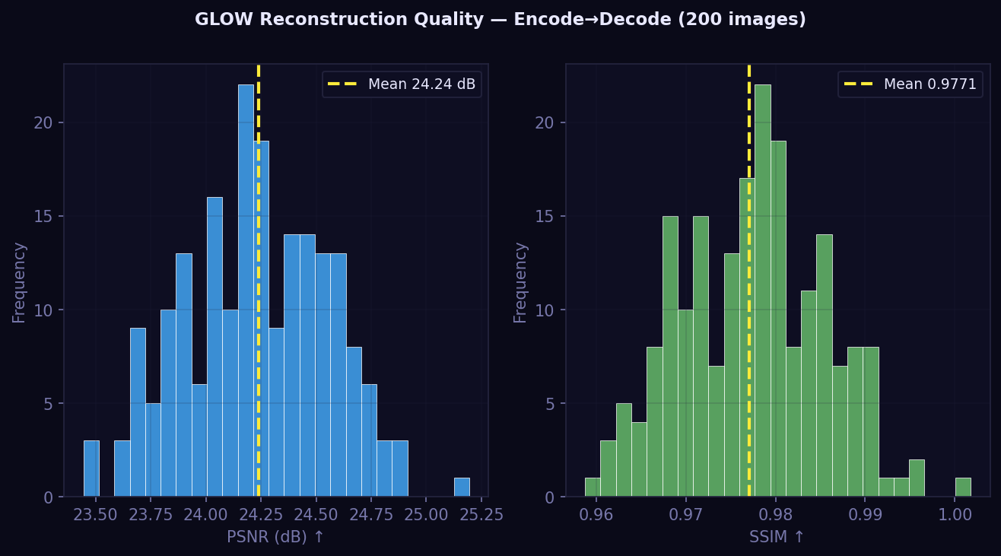
GLOW-Exclusive (1): Exact Likelihood & Reconstruction
Architecturally impossible for FLUX.1 and DDPM/DDIM
Exact Log-Likelihood
Encode → Decode Reconstruction
• NLL = −4.61 bits/dim (still decreasing at 30k steps)
• Diffusion models cannot compute exact NLL
– Would need expensive ELBO approximations
• Applications requiring tractable density:
– Anomaly / OOD detection
– Lossless data compression
– Model-based optimization
PSNR = 24.24 dB
SSIM = 0.977
High SSIM: face structure perfectly preserved | Non-∞ PSNR: float32 accumulation over 128 layers

Slide 10
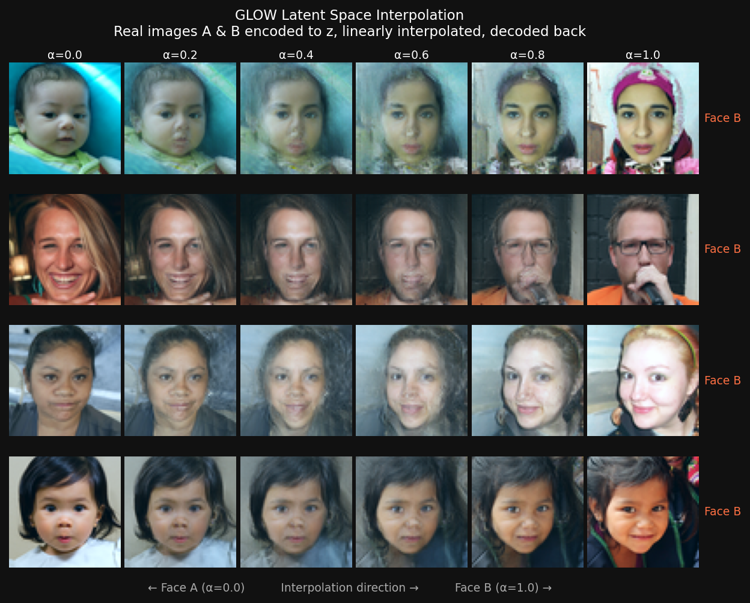
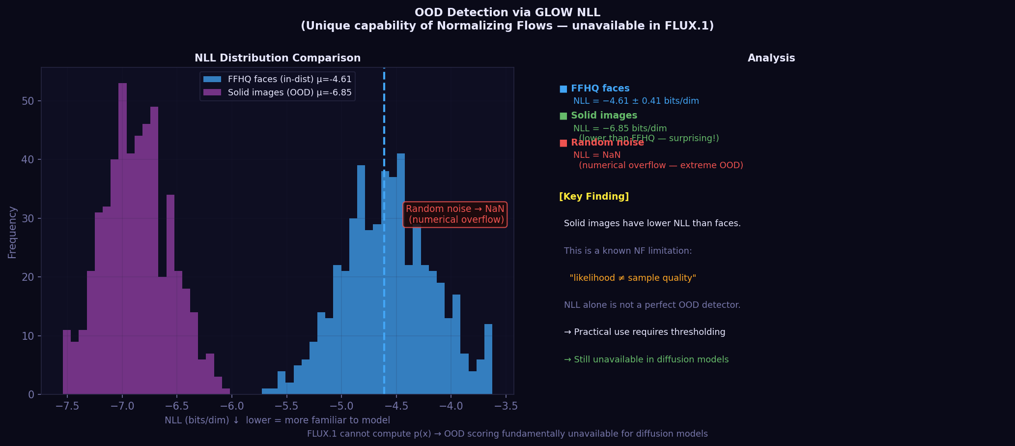
GLOW-Exclusive (2): Latent Interpolation & OOD Detection
Latent Space Interpolation
OOD Detection via NLL
z_α = (1−α)·z_A + α·z_B decoded for α ∈ {0, 0.2, 0.4, 0.6, 0.8, 1.0}
FFHQ faces (in-dist) −4.61 b/d
Solid color (OOD) −6.85 b/d
Random noise (OOD) NaN
Smooth semantic transitions — requires exact invertibility (impossible for FLUX.1 / DDPM)
⚠ Likelihood ≠ Perceptual quality

Slide 11
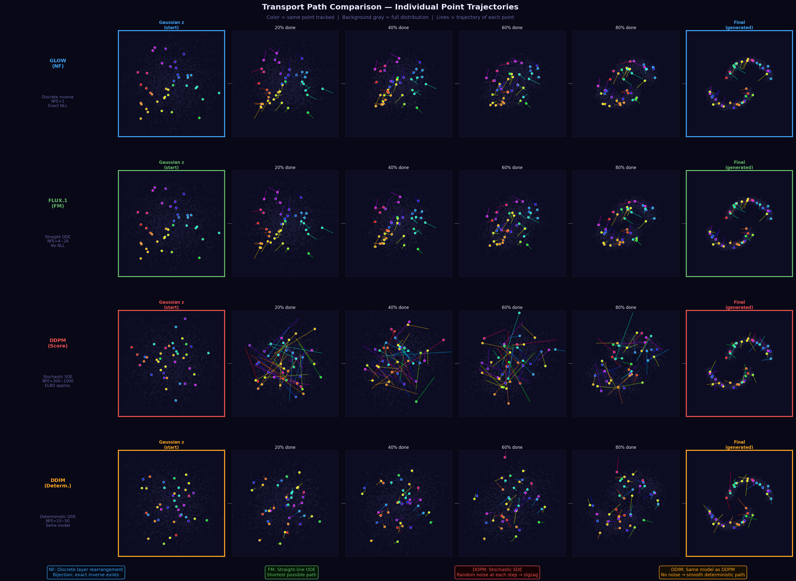
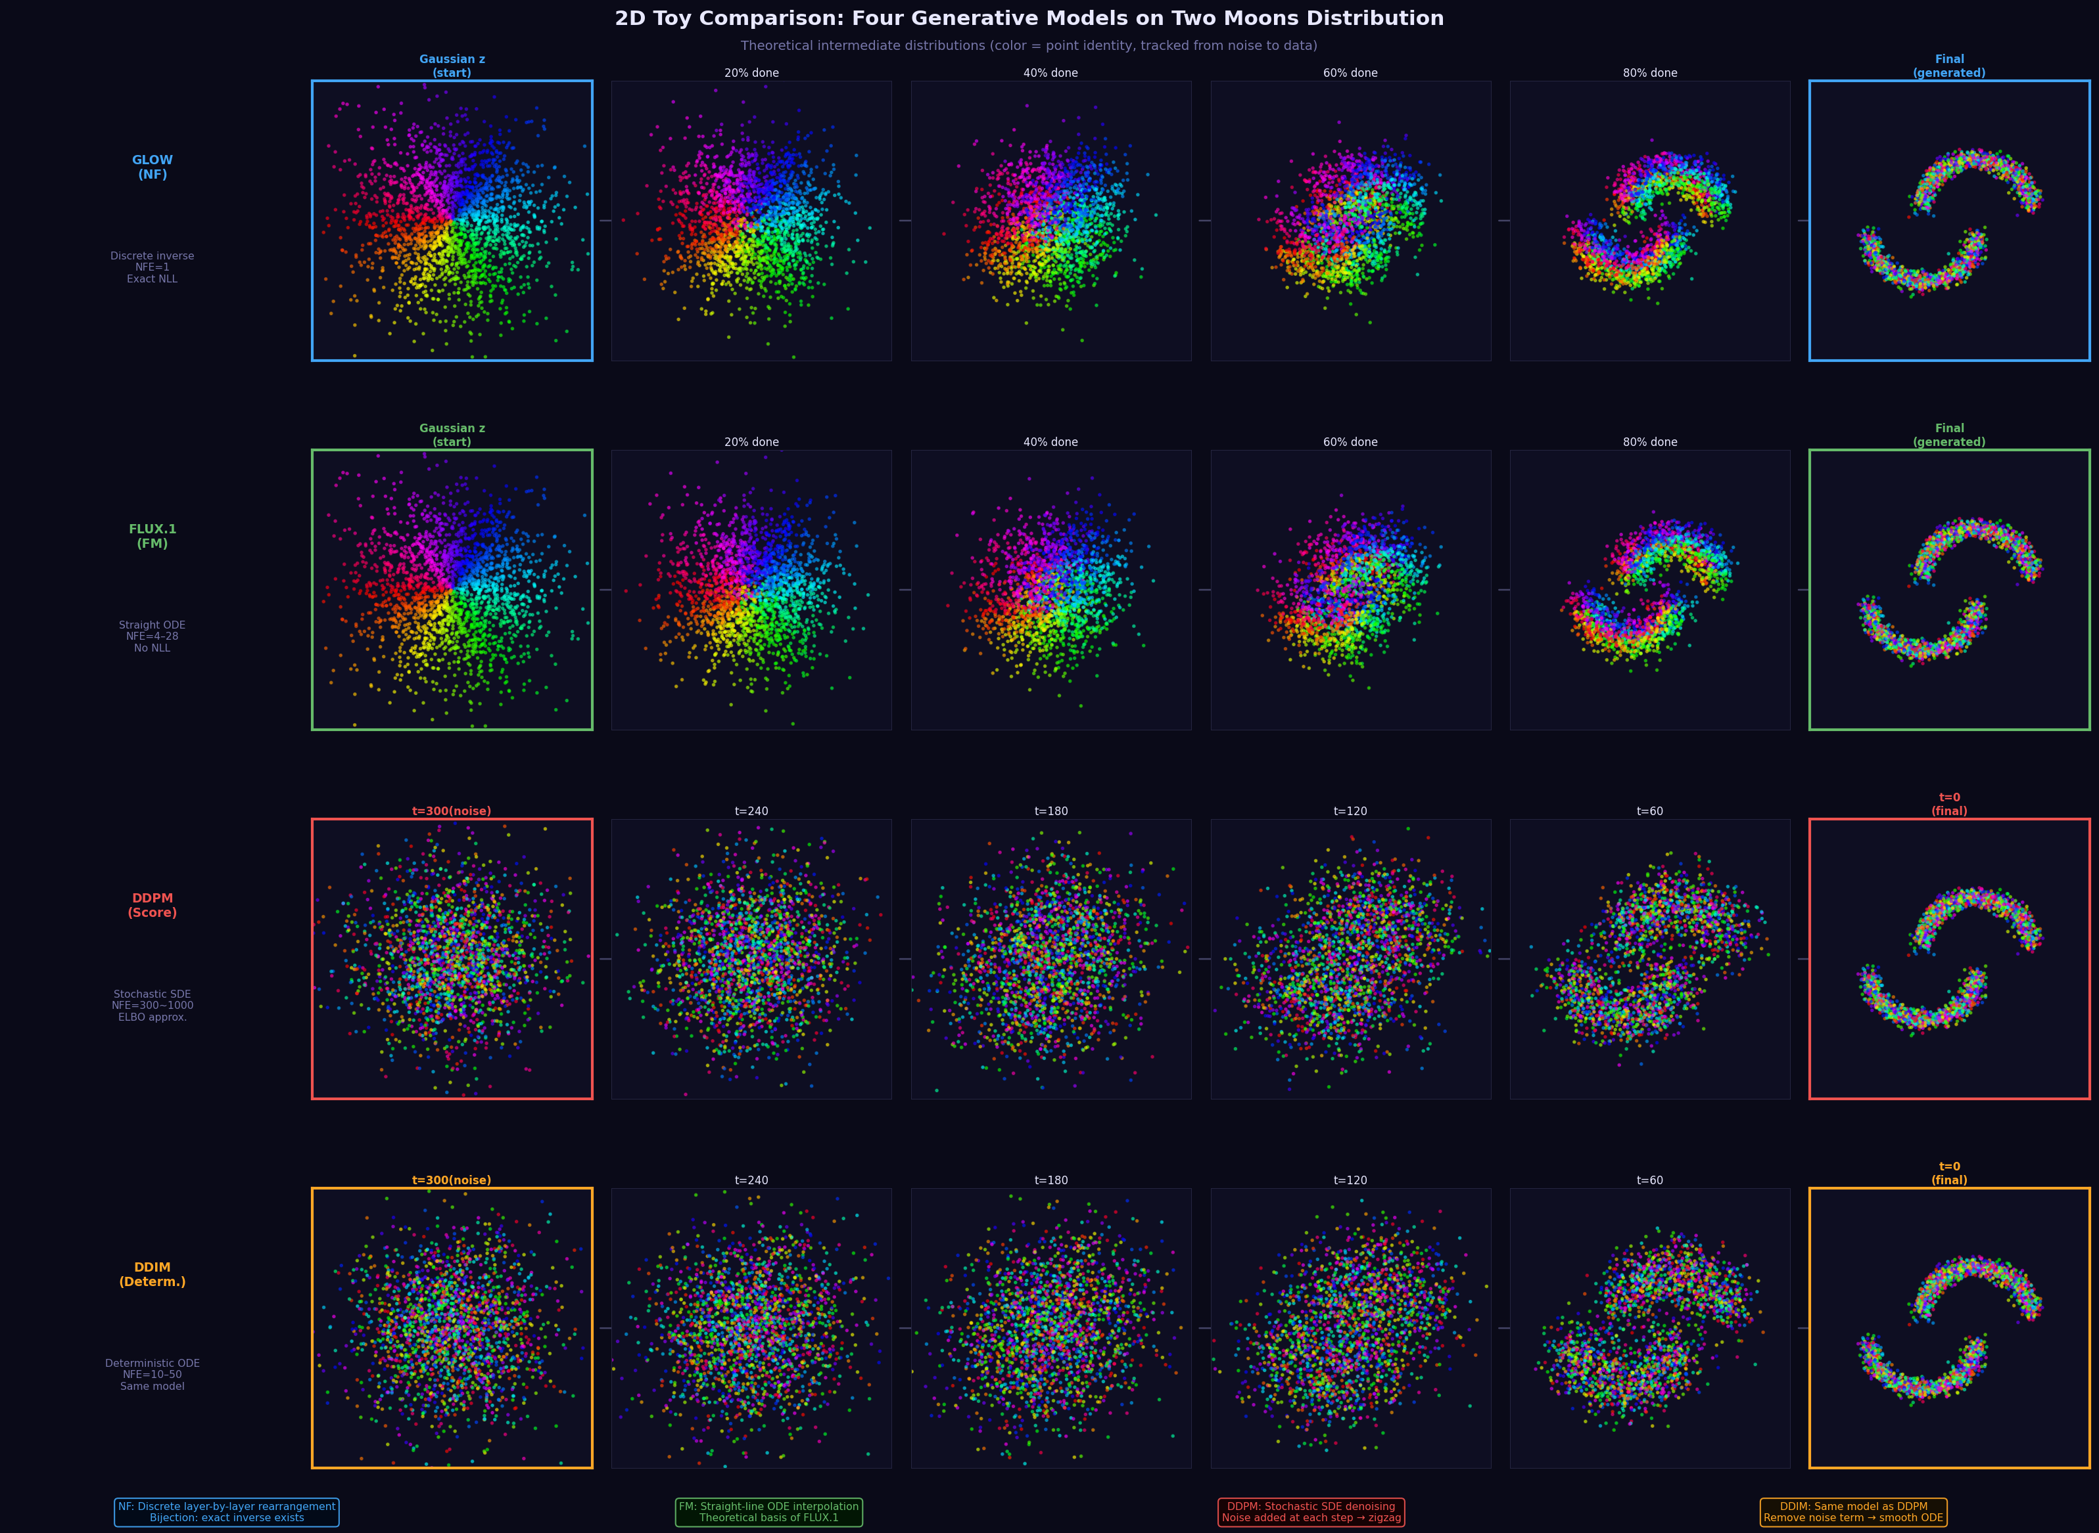
2D Transport Visualization (Two-Moons)
How each paradigm moves points from Gaussian noise to the target data distribution
Transport paths per model
Intermediate distributions (6 snapshots)

Slide 12
Discussion: Why These Results?
• Why FLUX.1-schnell fails to beat GLOW at 64×64
– VAE downsamples 64×64 → only 8×8 = 256 feature tokens
– Positional encodings calibrated for ≥512×512 → attention degraded
– Distilled 4-NFE trajectory is out-of-distribution at this resolution
• Why DDIM dominates the middle Pareto region
– google/ddpm-celebahq-256 trained on face images → clean domain transfer
– Pixel-space diffusion — no VAE bottleneck — handles downsampling well
– Deterministic ODE more sample-efficient than stochastic DDPM chain
• GLOW training sensitivity
– Required log-scale clamp [−3,3] + gradient guard to prevent divergence
– NLL still decreasing at 30k steps — more training would improve FID
• Practical model selection guide
– Need NFE=1 + exact density? → GLOW
– Best FID at moderate compute? → DDIM-50 (FID 61.78)
– Text-conditioned / high-resolution? → FLUX.1-dev

Slide 13
Conclusion
GLOW = FLUX schnell (NFE=1)
DDIM-50 wins overall ★
76M-param flow matches 12B diffusion model at 64×64 9× faster sampling
FID = 61.78 — best among all 8 operating points Face-domain pretraining transfers cleanly to 64×64
FLUX.1-schnell is Pareto-suboptimal
GLOW: exclusive capabilities
Dominated by GLOW on FID AND speed No operating point advantage at this resolution
Exact NLL · Reconstruction · Latent Interpolation Unavailable to any diffusion model by design
Resolution matters: architectural advantages of large pretrained models do not uniformly transfer outside their designed operating resolution.

