Slide 1
Getting Programming Help

Slide 2
Asking for programming help
Do not be afraid to ask
For best results:
Try something first
Write pseudocode
Always check the documentation
Google your question / error message
Start with a miniature version of the problem
Record your troubleshooting in your lab notebook
Share your overall goal

Slide 3
The Magic of Pseudocode
Pseudocode is a plain-language outline of what you want a program to do.
Simple
“count_variants.py will take a variant file as input and output the count of variants on chromosome X”
More Advanced
Open input file
Set the current_chromosome_count = 0
For each line in the file, do the following:
Get the “chromosome” column and call it chrom
Check if chrom is X
If Yes: Add one to my current chromosome count
Print the value of current chromosome count

Slide 4
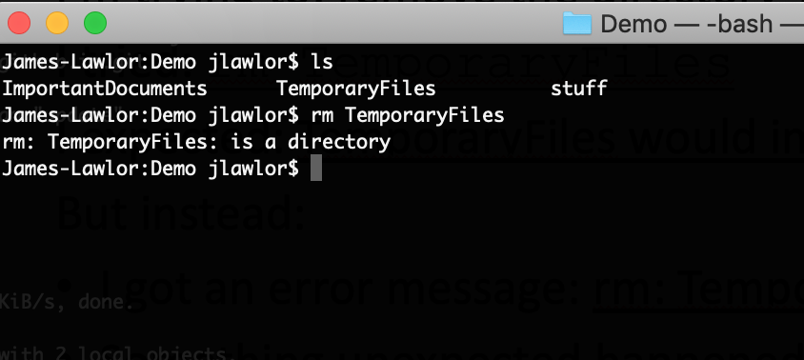
Example 1: Want to delete TemporaryFiles directory

Slide 5
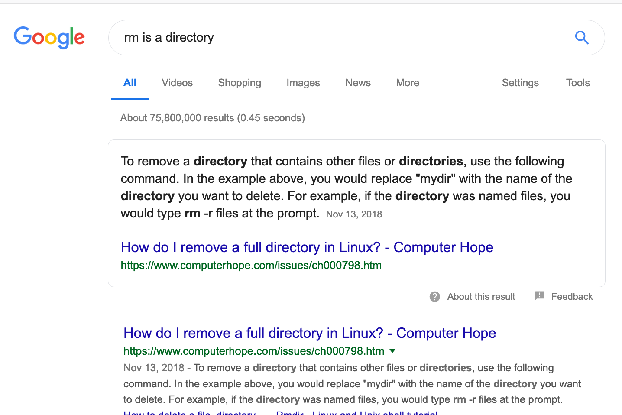
Example 1: Searching for the error message
Helpful: remove your specific file names & paths, since they’re unique to you and not your problem

Slide 6
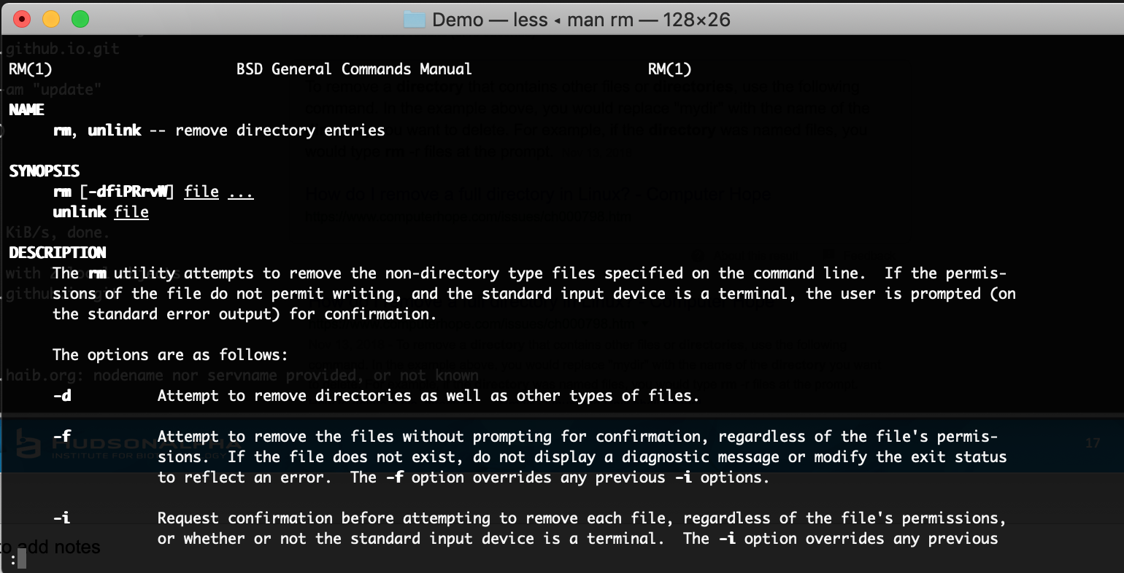
Check the man page or documentation

Slide 7
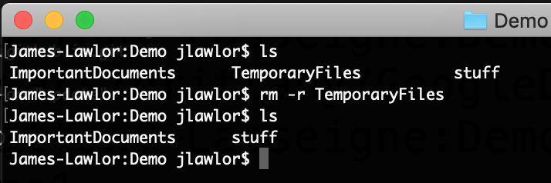
It works!

Slide 8
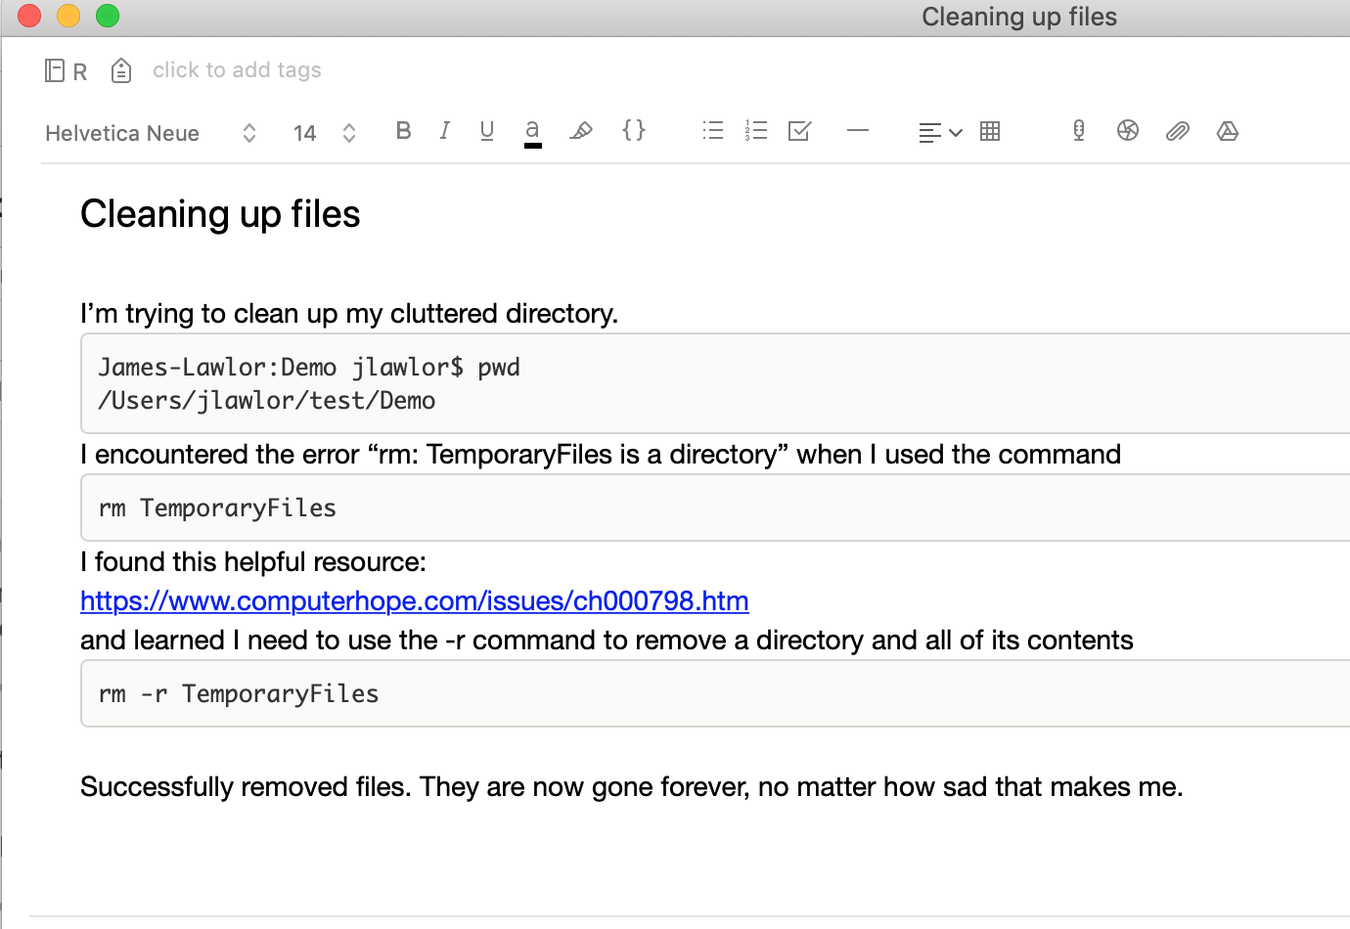
Troubleshooting makes a great lab notebook entry

Slide 9
An asking-for-help script
My overall goal is to: clean up clutter in my home directory.
I’m trying to: remove the directory TemporaryFiles.
I tried: rm TemporaryFiles
I expected: TemporaryFiles would immediately go away
But instead:
I got an error message: rm: TemporaryFiles is a directory
Something unexpected happened: ____________

Slide 10

Sometimes asking the question out loud helps you solve the problem

Slide 11
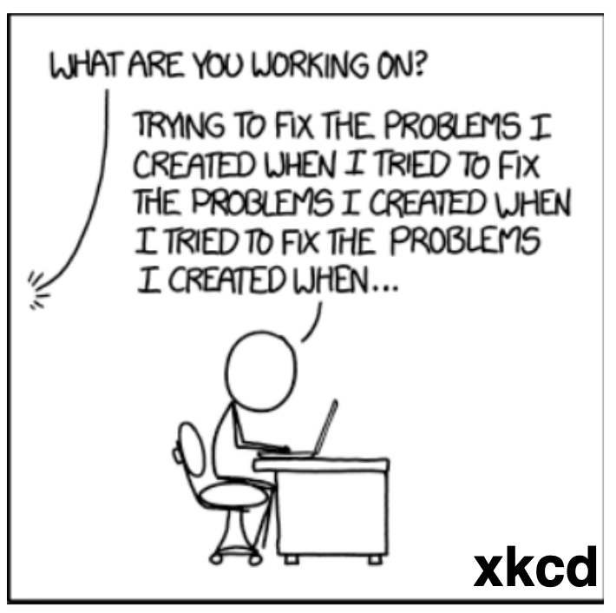
Summary
A good computational lab notebook:
Is record of your science
Is great learning tool
Will save your time & work
Ask for help early and often
For effective help, share:
Goal
Expectation
Strategy

