Slide 1
Research Overview
Bryan Moyers
Rick Myers Lab
June 03, 2019

Slide 2
What do I do?
Genetic Variation
Change in TF-DNA associations
Change in Gene Expression
Disease
eQTLs
Gene- or genome-wide association
Notes:
James talked a bit this morning about his research. I’m going to give a brief overview of some of the research I do. Generally, my research focuses on this pathway. How do you get from some change in your genome to a disease state. There are a lot of ways to do this, but I generally focus on this path– how does genetic variation lead to a change in how transcription factors associate with DNA, and how does that change in TF association lead to changes in gene expression.
You may be familiar with some of the terms I have here– there are studies sometimes done called Genome-wide association studies which will link some particular genetic variant with a disease. These can tell you that a variant is associated, but it doesn’t tell you if that variant is causal and, if it is, how it’s causing the disease.
Similarly, you can correlate genetic variation with a change in gene expression– that’s called an eQTL. But again, it doesn’t necessarily tell you anything about the mechanism. Most of my work focuses on these intermediate steps. Can we focus in on variants whose mechanism is changing TF-DNA associations?

Slide 3
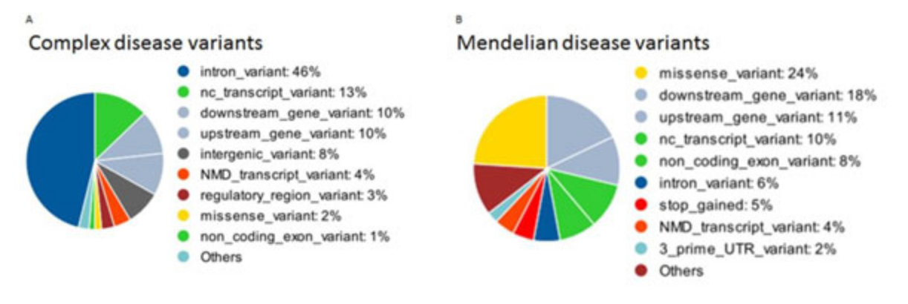
Disease variants outside of the protein-coding region
The “easiest” (still very difficult) disease variants to understand are those that occur in the protein-coding region of a gene.
But plenty of disease-associated variants do not occur in the protein-coding region.
6%
33%
https://www.ncbi.nlm.nih.gov/pmc/articles/PMC4480828/
Notes:
There are many kinds of variants associated with disease– the easiest to understand are variants which change the protein-coding region of the genome. But those kinds of variants account for a minority of the causal variants for diseases. So, for instance, if you look at Mendelian diseases– diseases where the heritability is really well understood– only about 1/3 of those diseases are caused by variants in the protein-coding regions. If you look at diseases with more complex patterns, like Cancer or Alzheimer’s disease, only about 6% of causal DNA variants are in the protein-coding region.
Most of the variation is occurring in regulatory regions.

Slide 4
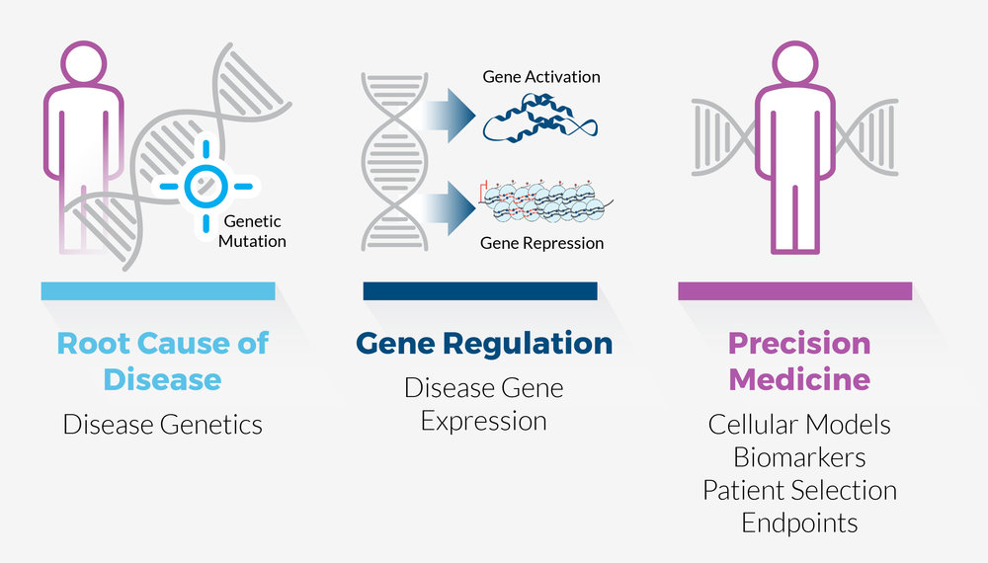
Disease often involves change in gene expression
Understanding how gene expression is regulated and changed can lead to novel insights about disease.
Notes:
The point here is that understanding how gene regulation changes can offer novel insights about how diseases emerge and progress. If we can understand the specific mechanisms for a patient’s disease, we may be able to give them more appropriate care. So that’s where I focus my research.

Slide 5
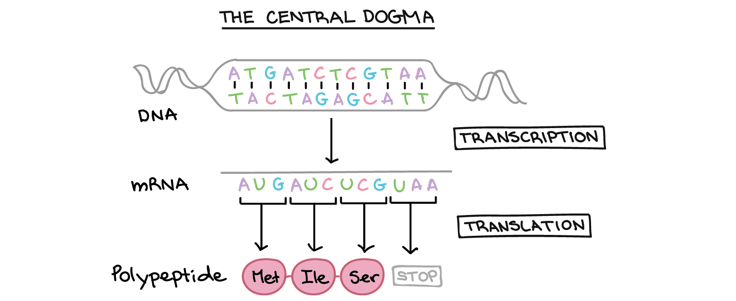
Transcription Factor Binding
The ”central dogma” of molecular biology shows the derivation of RNA from DNA and Protein from RNA.
Notes:
Any talk about gene regulation has to start at the Central dogma of molecular biology. That’s a term that most biologists really don’t like, but it’s what it was historically called, so we’re stuck with it. The central dogma is that you’ve got DNA– DNA is transcribed into RNA in a process called “Transcription”. And then RNA is translated into DNA through a process called “Translation.”
Of course, this isn’t complete– DNA is self-perpetuating through a process called replication. And RNA can sometimes be converted into DNA through a process called reverse transcription. But for our purposes, this understanding is good enough.

Slide 6
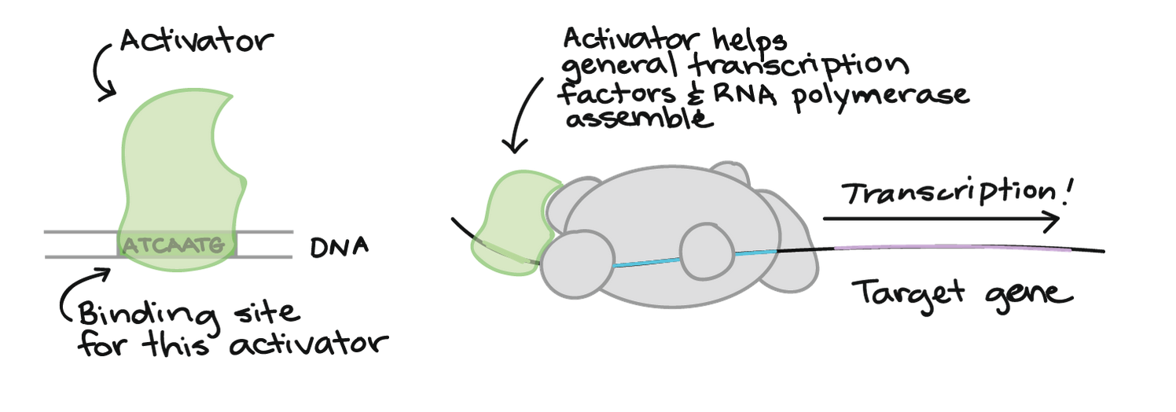
Transcription Factor Binding
One of my project focuses in on the DNA→RNA step.
For RNA to be produced from DNA, you need activating Transcription Factors (TFs) to bind to DNA.
Notes:
Let’s focus in on that transcription step.
For DNA to be processed and create RNA, you need activating transcription factors to bind. Transcription factors are proteins which recognize certain patterns in DNA and bind there. Once they’ve bound, they pull in RNA polymerase, which actually does the work of producing RNA from a DNA template.

Slide 7
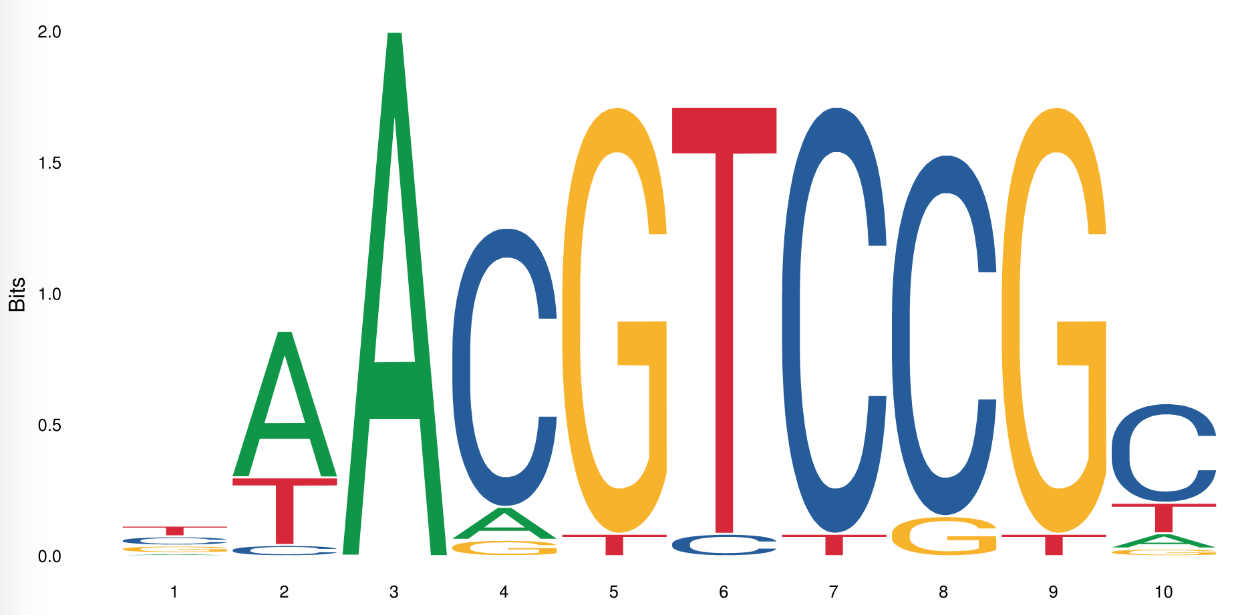
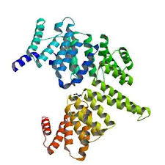
What makes TFs bind?
What makes a TF bind to some places in DNA but not other places?
Many TFs bind specific DNA sequences, which can be represented by DNA sequence motifs.
If this motif sequence is destroyed with a mutation, it may stop a TF from binding DNA
Notes:
So, what makes TFs bind to some areas of DNA but not others? Each transcription factor has some amount of preference for each sequence of DNA based on the protein’s shape (and other physical properties that we won’t get into). The protein’s shape is determined by the protein’s sequence. For some transcription factors, you can represent its preferences through a motif, shown at left. So, for this particular transcription factor, it really likes the sequence ACGTCCG. You can see that on the edges, there’s a little bit of wiggle room provided– it maybe prefers an additional “A” on the left side, and maybe prefers an additional “C” on the right side, but if it’s a T instead, maybe the TF will still bind.
So let’s say that you have this sequence in the promoter section of a gene– the TF will bind there, recruit RNA polymerase. But let’s say we introduce a mutation and change that really big “A” there to a “G”. Suddenly, this sequence is one that the transcription factor doesn’t like! Maybe the TF won’t bind there, and instead you’ll get lower expression of a gene!

Slide 8
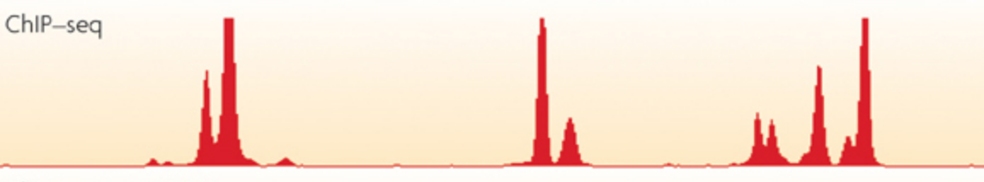
But *which* mutations?
There are an astronomical number of mutations that are possible in the genome!
How do we know which ones actually influence TF binding? How do we narrow it down?
First we identify which parts of the genome are bound by a given transcription factor: ChIP-seq.
Notes:
The problem is that there are an astronomical number of possible mutations. And to test each one for whether or not it impacts the binding of even a single transcription factor is impossible. So how do we determine which variants influence Tf binding?
Well, first we start by looking at where transcription factors are actually bound. This is determined through an experiment called ChIP-seq. In chip-seq, you determine regions of the genome where a TF seems to be bound very often. You call these “peaks” bound regions.

Slide 9
Compare bound with unbound
Next, we can compare bound sequences to unbound sequences and look for differences.
Can you determine any patterns from the data below?
>BoundSequence1
AAAAAAACGA
>BoundSequence2
AAAATAAAAA
>BoundSequence3
AAAAAAACAA
>BoundSequence4
AATAAAAAAG
…
>BoundSequence1
GGGGGGGGGG
>BoundSequence2
AAAAGAAAAA
>BoundSequence3
AGAAGGATAG
>BoundSequence4
TTAGGATTGAT
…
Notes:
Then, you can compare the sequences of bound regions to a sample of sequences that are not bound. So here’s a fake example– can you make any conclusions about what kind of sequences are bound or not bound?
Of course not! Sure, you can make some small suggestions, but manually looking through this kind of data is not intuitive for humans.

Slide 10
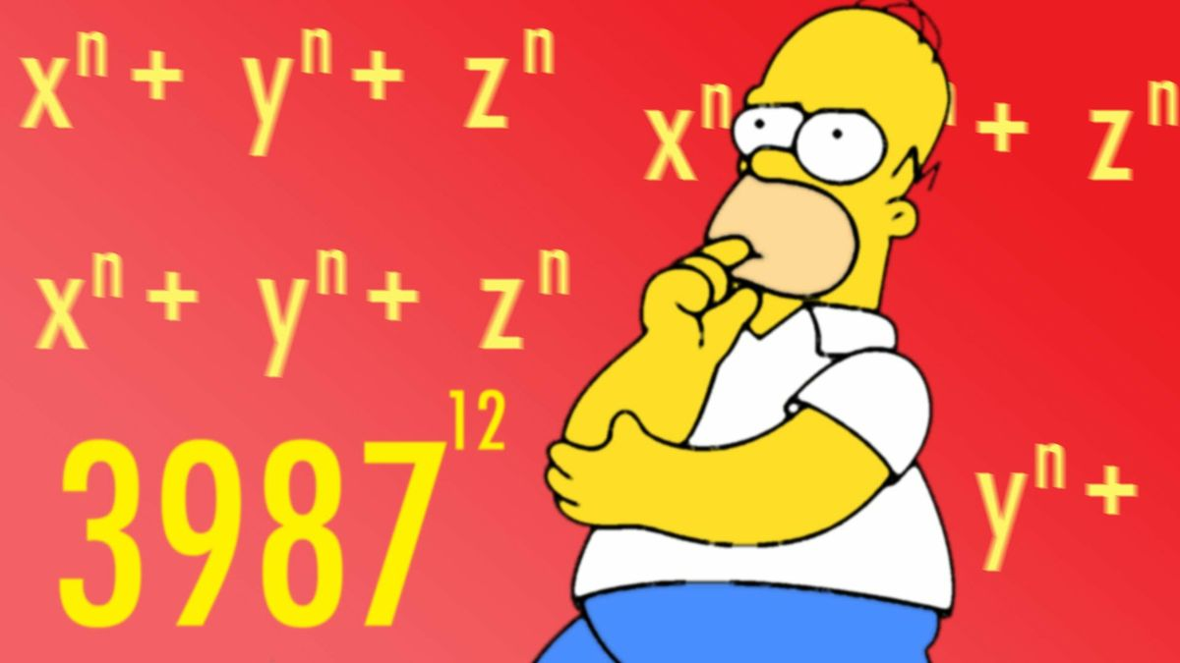
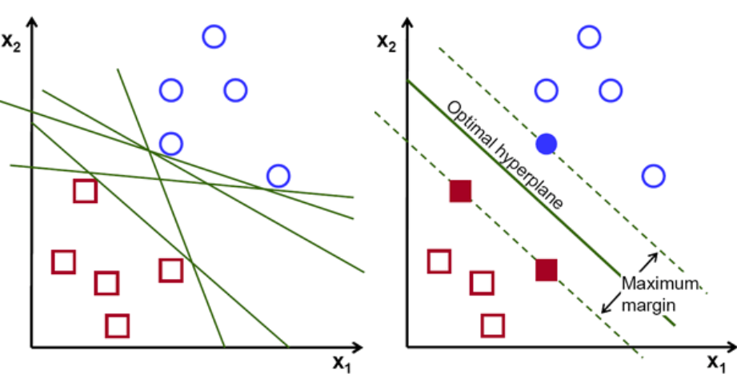
Don’t do it manually– Use Bioinformatics!
Of course, visually inspecting sequences is unlikely to detect real patterns. And if it does, it’s extremely time-consuming!
Instead, we use math!
From input data, we can create a model called a support vector machine.
Bound Sequences
Unbound Sequences
Input Data
MATH!
Support Vector Machine Model
Notes:
Even if you could just look at line after line after line of sequence and come up with some kind of pattern, the process is extremely time-consuming. Instead, you can use math and bioinformatics to create a model. You take your input data, which are bound and unbound sequences, and go through a complicated mathematical procedure which I won’t bore you with. You wind up with a mathematical model called a “Support Vector Machine” which you can use to try to identify sequences that are likely to be bound and likely to be unbound.

Slide 11
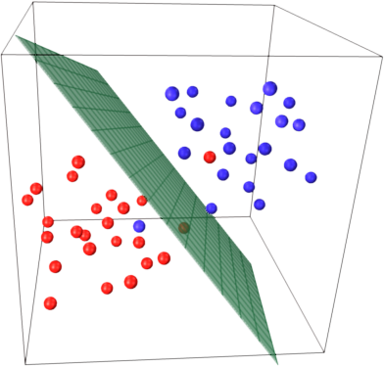
Using this model
This mathematical model can then be used to compare new sequences and determine how likely it is a TF would bind them.
This is one way of determining how a regulatory variant might play a causal role in disease.
Bound Sequences
Do these two sequences fall on different sides of the dividing line?
>NativeSequence
GATTACA
>MutantSequence
CATTACA
Unbound sequences
Notes:
Once you have this model, you can test individual mutations. You can take sequences and ask “If we mutate this one spot, is it likely to change the side of this plane the sequence falls on?”
Following this process, you can start to classify regulatory variants into those that do or do not influence Tf binding.
To call back to the beginning of this presentation, this is one way that you might understand why a given variant is playing a role in a disease.

Slide 12
Summary
Understanding how regulatory variants act is important for better understanding disease.
One way that a regulatory variant can act is by modifying transcription factor binding.
I use machine learning algorithms to identify variants likely to influence TF binding.

