Slide 1
What now? Continued Learning
Bryan Moyers
June 03, 2019

Slide 2
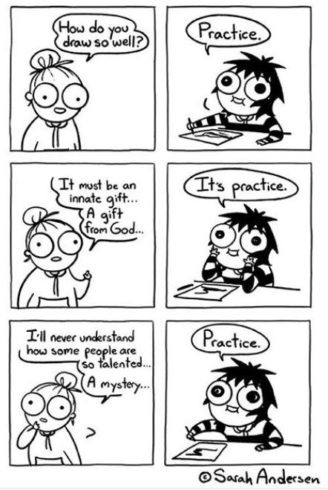
What Now?
As with anything, the best way to excel is to practice.
(But how should I practice?)
Notes:
Alright. We’ve made it to the end of the day. Horray! You’ve now gotten an introduction to coding. So, how do you get better? The same way you get better in anything. Practice! But how should you practice?

Slide 3
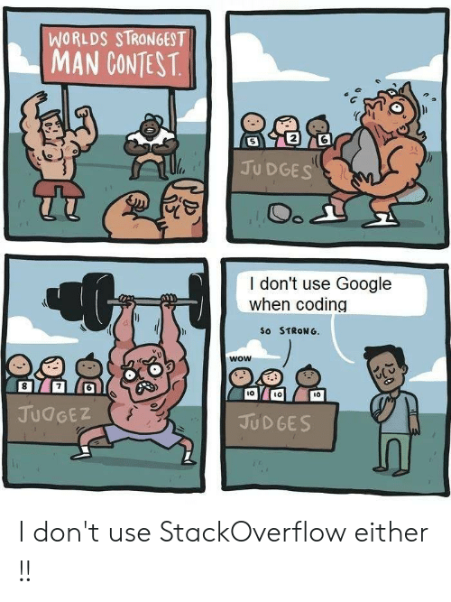
Recommendations
1) Let interesting biological problems be your guide.
2) Consider what computational and statistical approach might answer the question.
3) Learn what you need to and try to code.
We live in the future– use Google.
4) Get feedback from others– biologists, more experienced coders.
Notes:
First, I would always suggest that you let biologically interesting problems be your guide. If you have a biologically interesting problem, you can say “What would I have to do to solve this problem?...” Then, you can learn whatever code you need to approach the problem.
At every step of the way, get feedback. Ask others, “Is this an approach you think is good? Do you believe these results? Do you think there’s a better way to go about this?” Their expertise will help you figure out the best way to learn things!
And remember– we live in the future. The best way to learn many things, coding included, is to use the internet. Use Google. Use StackOverflow. Many people have tried to solve coding problems, and you can learn through their discussions!

Slide 4
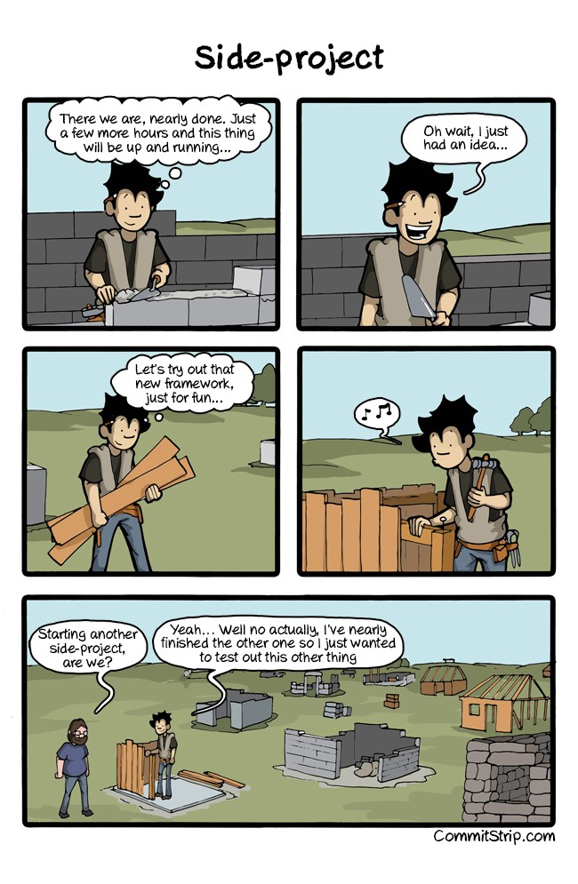
Getting distracted
It’s very easy to get distracted from your main project(s).
Don’t fall for it! Limit the number of projects you’re working on.
Keep a notebook (physical or electronic) of ideas of things to work on or try. It can become a very valuable resource.
Notes:
When you’re coding, it’s very easy to think “I can pick up this side project.” You’ll often find that you can apply a bit of code in multiple contexts. This is a very easy way to never finish a single project! In coding, as in all other areas of research, I recommend that you keep a notebook of ideas, whether physical or electronic. You can use this as your career progresses as storehouse for research ideas.

Slide 5
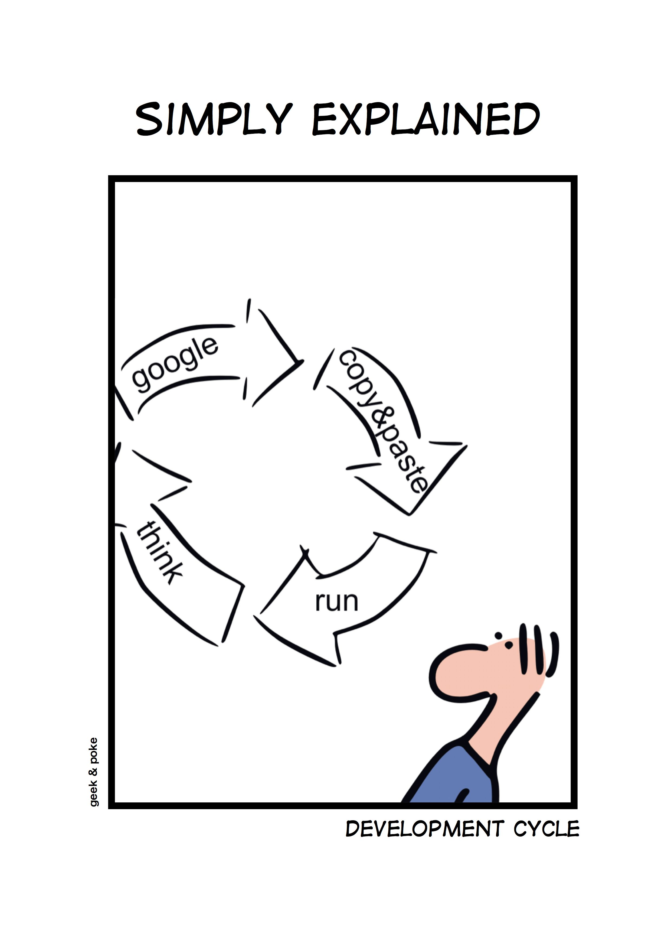
Practice, in practice
Often, you’ll learn by doing.
A problem will force you to google and learn some new computational trick.
I always recommend typing things out yourself– most code online will not run perfectly for you, and typing it out forces you to think about what each line is doing.
Notes:
I don’t want to be cruel to courses or books– they have their place! But always remember that you learn by doing. The best way to learn to code is to start coding.
Also, I always recommend typing things out yourself, rather than copy-pasting (at least when starting). It is a much better way of actually understanding what you’re writing, and why you’re writing it.

Slide 6
Unix Shell / Command Line Practice
Data Carpentry Lessons:
Combining shell commands: http://swcarpentry.github.io/shell-novice/04-pipefilter/index.html
Performing the same action on many files: http://swcarpentry.github.io/shell-novice/05-loop/index.html
Saving and reusing shell commands: http://swcarpentry.github.io/shell-novice/06-script/index.html
Codecademy “Learn the command Line” tutorial
linuxcommand.org
corsera.org “The Unix Workbench” (Johns Hopkins) course.
Notes:
For some specific recommendations, I’m including some links here of worthwhile tutorials. Some of them I’ve tried, others I haven’t. But they come highly recommended.

Slide 7
Programming with R practice
Carpentry Lessons:
More practice with the inflammation data set used during bootcamp: http://swcarpentry.github.io/r-novice-inflammation/
R programming for reproducible scientific analysis: http://swcarpentry.github.io/r-novice-gapminder/
Datacamp “Introduction to R” free course.
coursera.org has many great R courses (particularly those by Duke and Johns Hopkins) covering beginner programming, statistics, data science (including machine learning), and software development.
Notes:
For some specific recommendations, I’m including some links here of worthwhile tutorials. Some of them I’ve tried, others I haven’t. But they come highly recommended.

Slide 8
Summary
Keep practicing!
Let interesting biology be your guide
Keep a notebook and summarize what you’ve learned
Ask for help / find a mentor

