Slide 1
Research Overview
Bryan Moyers
Rick Myers Lab
June 04, 2021

Slide 2
What do I do?
Genetic Variation
Change in TF-DNA associations
Change in Gene Expression
Disease
eQTLs
Gene- or genome-wide association
Notes:
James talked a bit this morning about his research. I’m going to give a brief overview of some of the research I do. Generally, my research focuses on this pathway. How do you get from some change in your genome to a disease state. There are a lot of ways to do this, but I generally focus on this path– how does genetic variation lead to a change in how transcription factors associate with DNA, and how does that change in TF association lead to changes in gene expression.
You may be familiar with some of the terms I have here– there are studies sometimes done called Genome-wide association studies which will link some particular genetic variant with a disease. These can tell you that a variant is associated, but it doesn’t tell you if that variant is causal and, if it is, how it’s causing the disease.
Similarly, you can correlate genetic variation with a change in gene expression– that’s called an eQTL. But again, it doesn’t necessarily tell you anything about the mechanism. Most of my work focuses on these intermediate steps. Can we focus in on variants whose mechanism is changing TF-DNA associations?

Slide 3
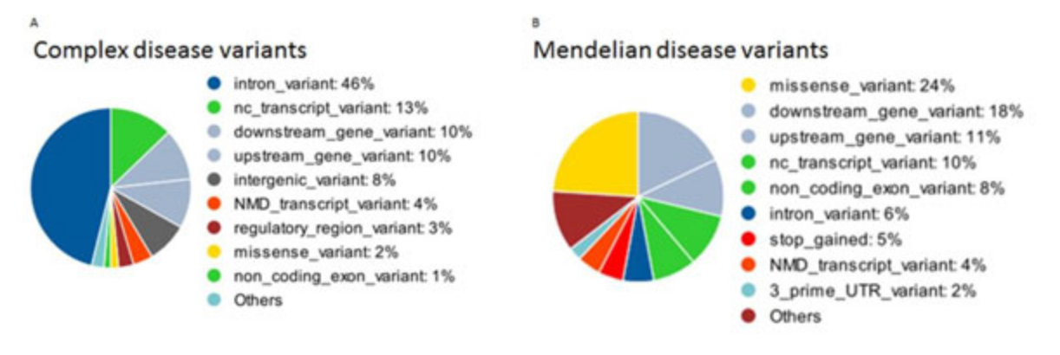
Disease variants outside of the protein-coding region
The “easiest” (still very difficult) disease variants to understand are those that occur in the protein-coding region of a gene.
But plenty of disease-associated variants do not occur in the protein-coding region.
6%
33%
https://www.ncbi.nlm.nih.gov/pmc/articles/PMC4480828/
Notes:
There are many kinds of variants associated with disease– the easiest to understand are variants which change the protein-coding region of the genome. But those kinds of variants account for a minority of the causal variants for diseases. So, for instance, if you look at Mendelian diseases– diseases where the heritability is really well understood– only about 1/3 of those diseases are caused by variants in the protein-coding regions. If you look at diseases with more complex patterns, like Cancer or Alzheimer’s disease, only about 6% of causal DNA variants are in the protein-coding region.
Most of the variation is occurring in regulatory regions.

Slide 4
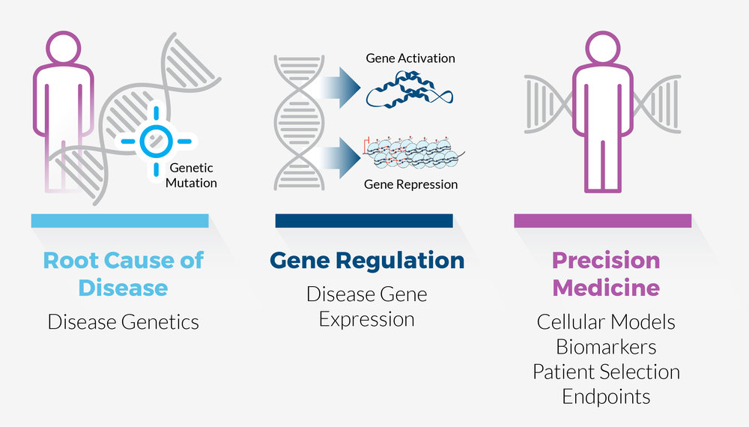
Disease often involves change in gene expression
Understanding how gene expression is regulated and changed can lead to novel insights about disease.
Notes:
The point here is that understanding how gene regulation changes can offer novel insights about how diseases emerge and progress. If we can understand the specific mechanisms for a patient’s disease, we may be able to give them more appropriate care. So that’s where I focus my research.

Slide 5
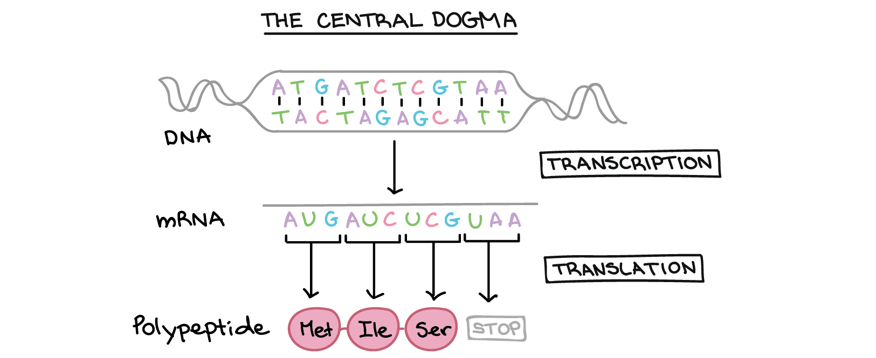
Transcription Factor Binding
The ”central dogma” of molecular biology shows the derivation of RNA from DNA and Protein from RNA.
Notes:
Any talk about gene regulation has to start at the Central dogma of molecular biology. That’s a term that most biologists really don’t like, but it’s what it was historically called, so we’re stuck with it. The central dogma is that you’ve got DNA– DNA is transcribed into RNA in a process called “Transcription”. And then RNA is translated into DNA through a process called “Translation.”
Of course, this isn’t complete– DNA is self-perpetuating through a process called replication. And RNA can sometimes be converted into DNA through a process called reverse transcription. But for our purposes, this understanding is good enough.

Slide 6
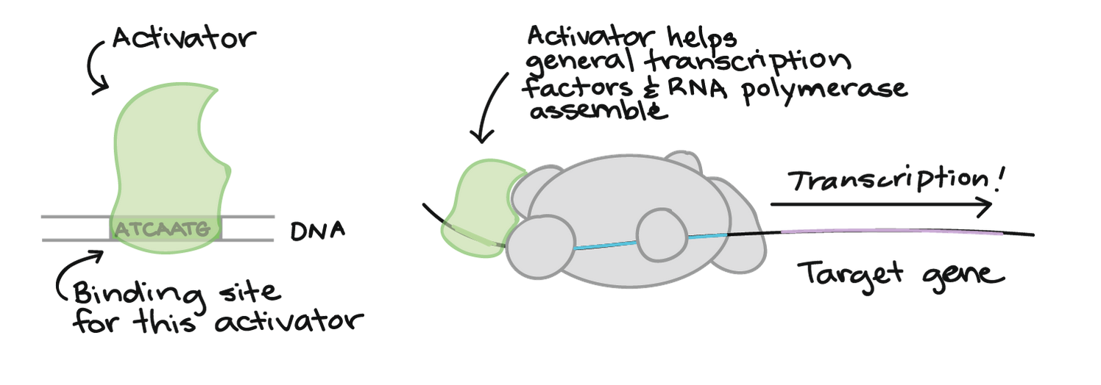
Transcription Factor Binding
One of my project focuses in on the DNA→RNA step.
For RNA to be produced from DNA, you need activating Transcription Factors (TFs) to bind to DNA.
Notes:
Let’s focus in on that transcription step.
For DNA to be processed and create RNA, you need activating transcription factors to bind. Transcription factors are proteins which recognize certain patterns in DNA and bind there. Once they’ve bound, they pull in RNA polymerase, which actually does the work of producing RNA from a DNA template.

Slide 7
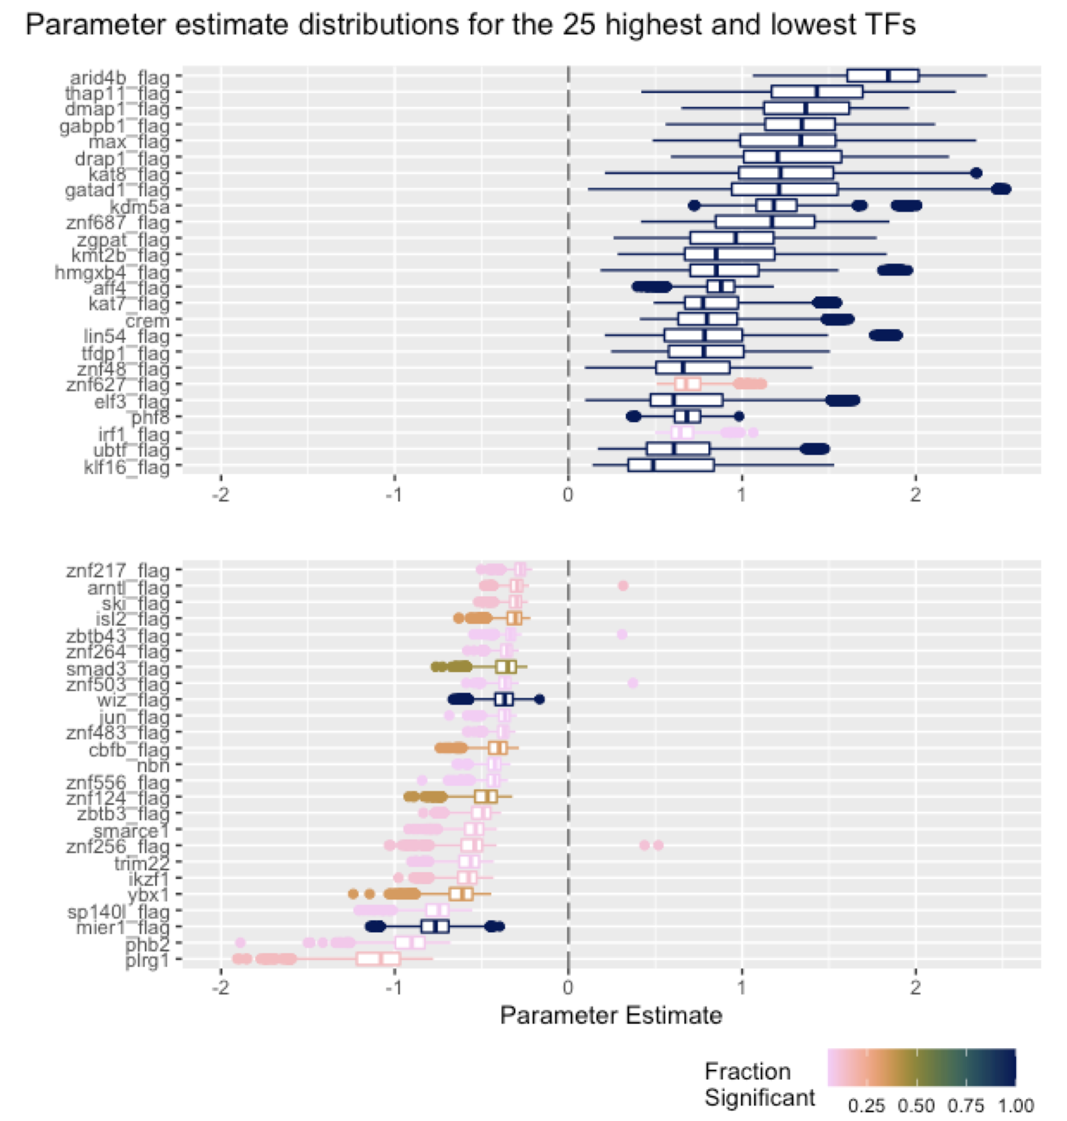
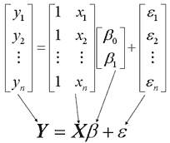
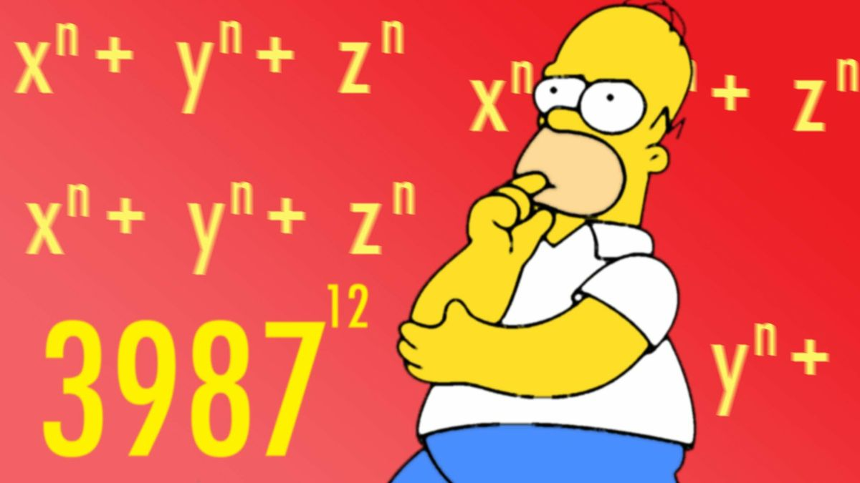
What is the function of a particular TF binding?
It can be very difficult to figure out the function of an individual TF.
There are 1600+ TFs, and their behavior can be context-dependent!
We can use linear modeling to generate hypotheses to TF function.
In more complicated models, we can compare these estimates across cell types, looking at differential binding between one cell type and another and differential expression to identify TF function.

Slide 8
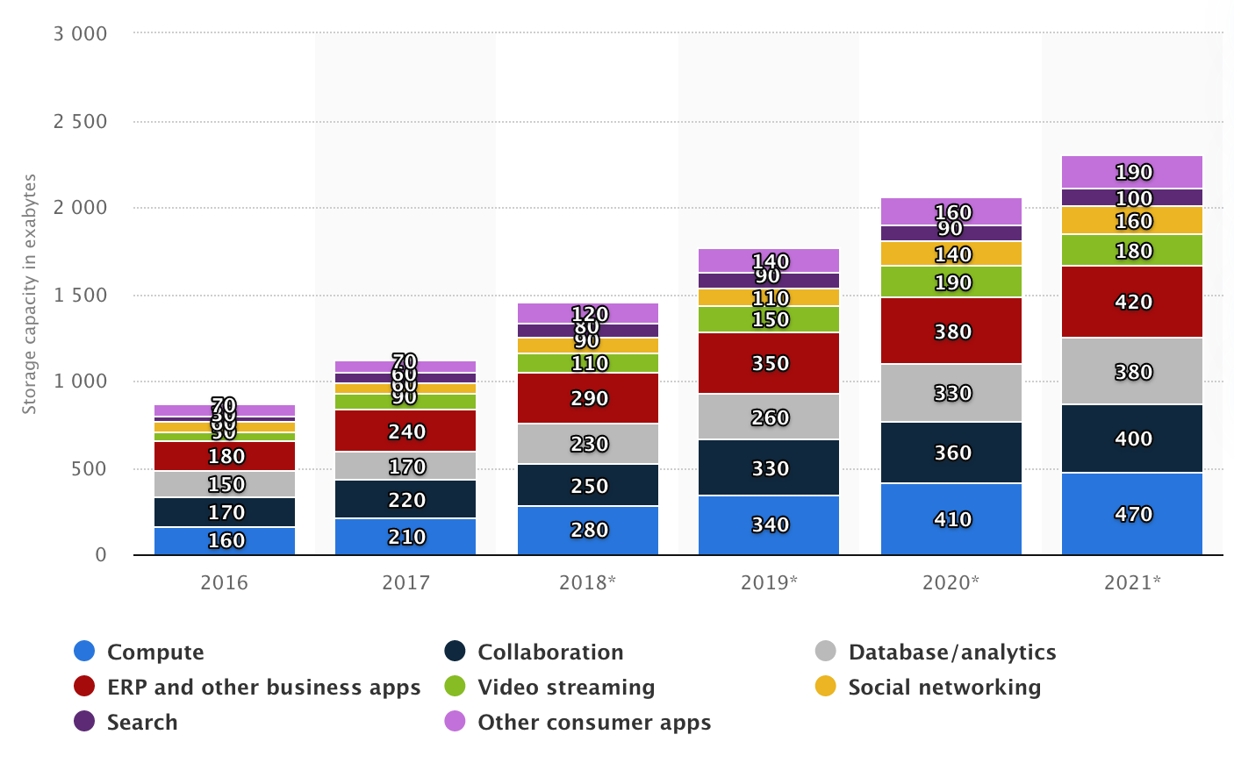
Representing genomic variation
There is variation in the genomes of humans.
Single nucleotide changes (~130 new variants per birth!)
Structural variations (inserts, inversions, deletions, etc.)
An average comparison between the genetic sequences of 2 humans will show ~99.9% similarity.
But comparing over ~8 billion humans, that 0.1% can really add up!
Currently 380 exabytes → 380 billion gigabytes.
Human genome file: 54gb.
54*8billion = 432 billion gb.
If we’re going to understand human variation, we will need a way to store data efficiently.

Slide 9
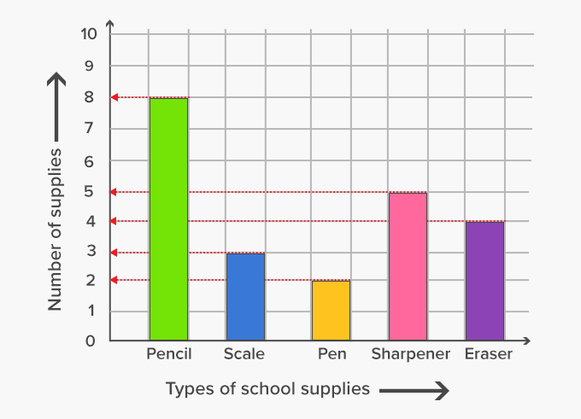
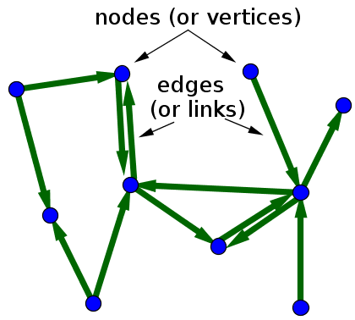
“Graphs”
A graph is a way to represent connections between objects.
In the case of genomes, the objects would be sequences, and the connections would be indications that, in at least one person in a population, two sequences (A and B) are adjacent to one another (usually in a specific, ordered way).

Slide 10
Graph Genomes
Let’s say you had a location in the genome with a SNP you want to represent as a graph.
We can break this down as:
In practice, we would not include a separate node for each nucleotide– adjacent nucleotides without variation get grouped together:
ATC(A/C)CTG
ATCACTG
Linear Representation
ATCCCTG
A
A
T
C
C
T
G
C
A
ATC
CTG
C

Slide 11
Graph Genomes
A repeat region is represented by a self-referencing node. So rather than representing a repeat region with multiple entries, like so:
ATAGACCTGAGCAGCAGCAGCAGCAGCAGCAGCAGCAGAAACATTTTCGGGAC
ATAGACCTGAGCAGCAGCAGCAGCAGCAGCAGCAGCAGCAGAAACATTTTCGGGAC
…
ATAGACCTGAGCAGCAGCAGCAGCAGCAGCAGCAGCAGCAGCAGCAGCAGAAACATTTTCGGGAC
It can be represented like this:
ATAGACCTGAG
CAG
AAACATTTTCGGGAC

Slide 12

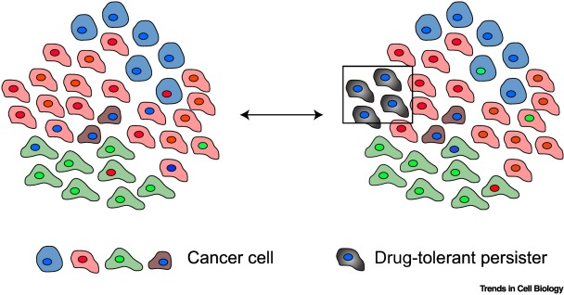
Graph Genomes
Graph genomes can represent sequences much more efficiently.
Tools exist to create graph genomes, e.g. the vg toolkit.
The challenge is in determining what sequences/variations are best to include in a given graph genome.
That is determined by your goals.

Slide 13
Summary
Understanding how regulatory variants act is important for better understanding disease.
One way that a regulatory variant can act is by modifying transcription factor binding, which changes expression.
I use machine learning algorithms to identify variants likely to influence TF binding.
I am also working on graph genome construction to approach cancer genetics and evolutionary questions.

