Slide 1
Keeping a Computational Lab Notebook and Getting Programming Help
James Lawlor
Computational Biologist, Greg Cooper’s Lab
HudsonAlpha Institute for Biotechnology
June 03, 2019

Slide 2
What is a lab notebook?
Complete record of procedures, reagents, data, and thoughts
Explanation of an experiment:
How
Why
Results
Legal document to:
Prove patents
Defend against accusations of fraud
(requirements vary depending on situation)
Lab legacy & institutional memory
Adapted by Brittany Lasseigne from ‘Keeping a Lab Notebook’, Philip Ryan, Office of Intramural Training and Education (NIH)

Slide 3
Why keep a computational lab notebook?
“One of the major hurdles I face as the head of a computational biology laboratory is convincing my research team—particularly those pursuing exclusively mathematical and computational modeling—that they need to keep a laboratory notebook. There seems to be a misconception in the computational biology community that a lab notebook is only useful for recording experimental protocols and their results. A lab notebook is much more than that. It is an organizational tool and memory aid, which serves as the primary record of scientific research and activity for all scientists. It also serves as a legal record of ownership of the ideas and results obtained by a scientist.” -S. Schnell

Slide 4
Why keep a computational lab notebook?
“Your closest collaborator is you, six months ago, and you don’t reply to email.” - Unknown
Learning tool & organizational tool:
Make to-do lists
Review thought processes
Check for errors
Draft papers / presentations / etc.
Write pseudo-code (more on this later)
We often perform computational experiments:
Tweaking models / re-running analyses / making software pipelines / etc.
Compliments other good practices:
Descriptive file names
Code comments (purpose / date / assumptions / etc.)

Slide 5
10 Simple Rules for a CompBio Notebook
Rule 1: Learn your institution’s/lab’s notebook policy
Rule 2: Select the right medium for your notebook
Physical vs. electronic
One notebook vs. separate notebooks
Notebook back-up or version control
Rule 3: Make the habit of keeping your notebook up to date by writing things down as you are working
Rule 4: Record all* scientific activities in your lab notebook—it is a chronological log of everything a scholarly scientist does

Slide 6
10 Simple Rules for a CompBio Notebook
Rule 5: Every entry should be recorded with a date, a subject, and any protocols
Purpose: Explain your thought process – the why
Mistakes: Strikethrough so still legible, enter correct information and new date
Rule 6: Keep a record of how every result was produced
Gold standard: reproducibility
E.g. raw data -> final model, figure, or statistical analysis
Rule 7: Use version control for models/algorithms/computer code
Standardize names; avoid project_analysis_final_v2_edit_v3_r1
Write down explanation of different versions
Consider version control systems like Git

Slide 7
10 Simple Rules for a CompBio Notebook
Rule 8: Keep a lab notebook that can serve as a legal record of your work
Rule 9: Make a table of contents for your lab notebook
Rule 10: Protect your lab notebook – the original belongs to your institution
Adapted by Brittany Lasseigne from ‘Ten Simple Rules for a Computational Biologist’s Laboratory Notebook.’ S. Schnell, PLOS Computational Biology, 2015.

Slide 8
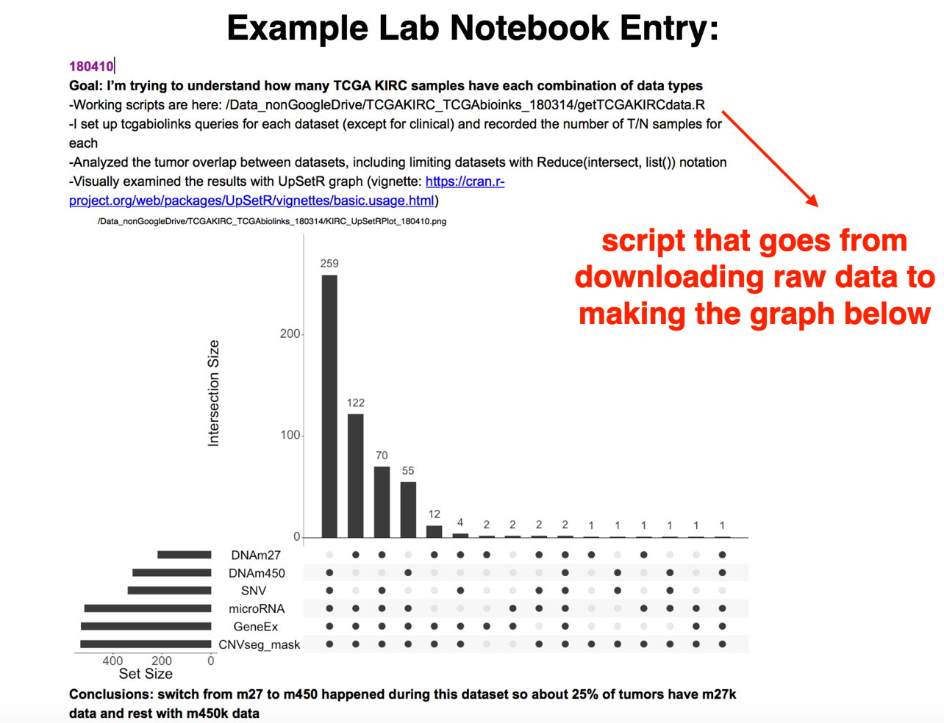
Example: From Brittany Lasseigne

Slide 9
Bonus Rules from James
You will never, ever regret putting a date on something
A good structure:
Subject / Date / Project Info
Your plan for the analysis or code
How you implemented it
The results
Repeat as necessary
Helpful to make a “wrap-up” or “summary” version of your notes that is the cohesive version you could give to someone
“If I’ve done it once I will do it again. If I’ve done it 3 times I will do it 100 times.”

Slide 10
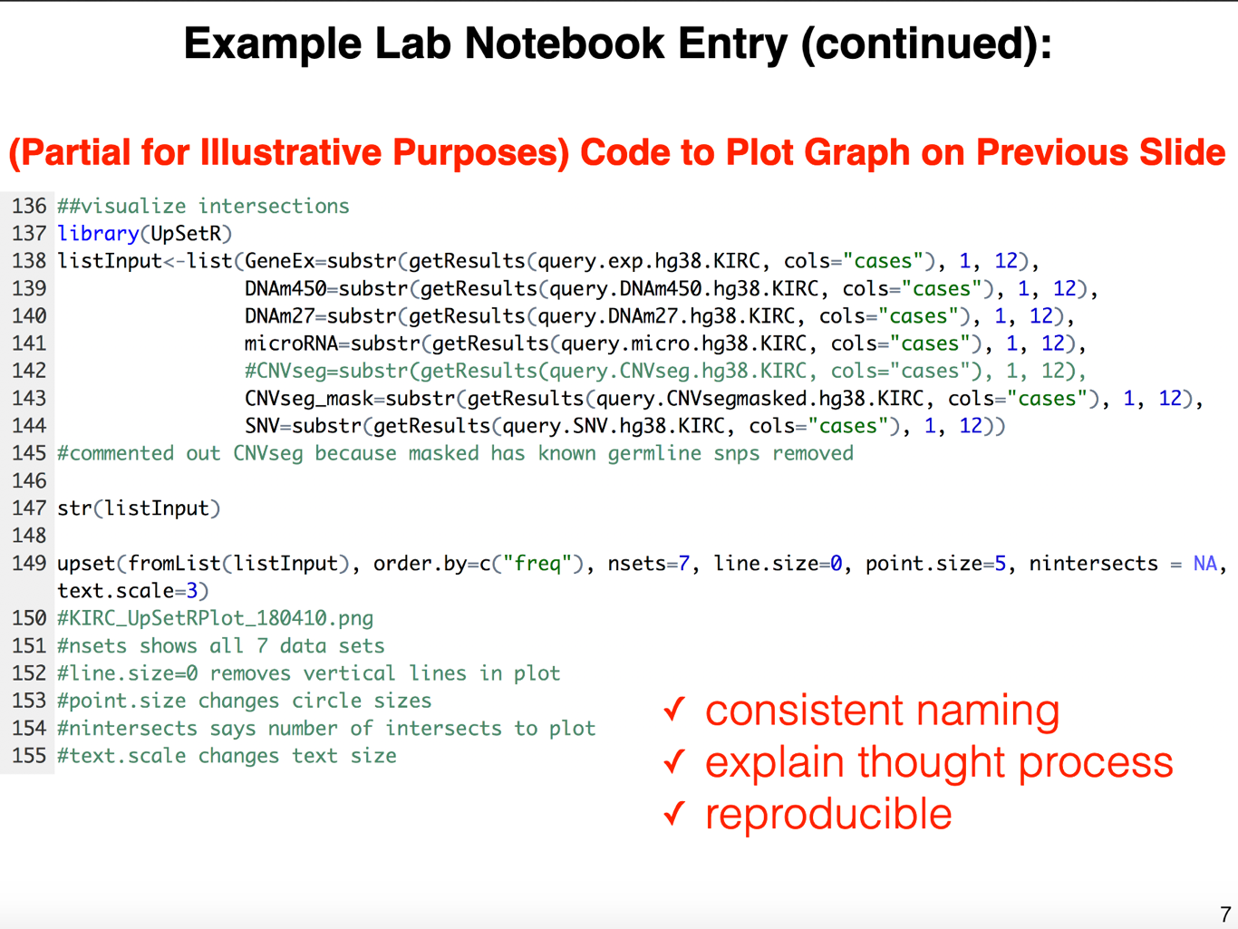
Example from Brittany Lasseigne

Slide 11
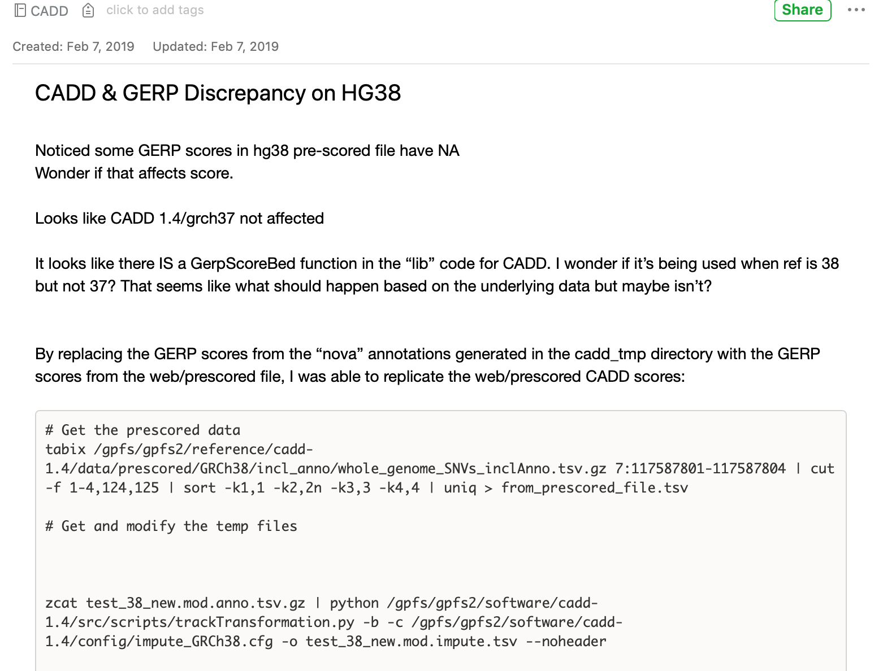
My Example
Date
Purpose
Thought process & plan
Data & processing

Slide 12
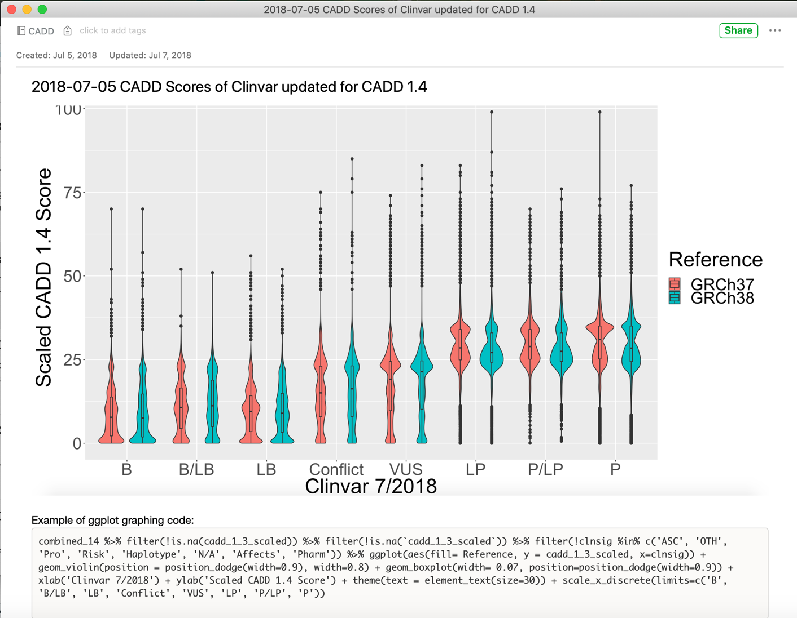
My Example

Slide 13
Getting Programming Help

Slide 14
Asking for programming help
Do not be afraid to ask
For best results:
Try something first
Write pseudocode
Always check the documentation
Google your question / error message
Start with a miniature version of the problem
Record your troubleshooting in your lab notebook
Share your overall goal

Slide 15
The Magic of Pseudocode
Pseudocode is a plain-language outline of what you want a program to do.
Simple
“count_variants.py will take a variant file as input and output the count of variants on chromosome X”
More Advanced
Open input file
Set the current_chromosome_count = 0
For each line in the file, do the following:
Get the “chromosome” column and call it chrom
Check if chrom is X
If Yes: Add one to my current chromosome count
Print the value of current chromosome count

Slide 16
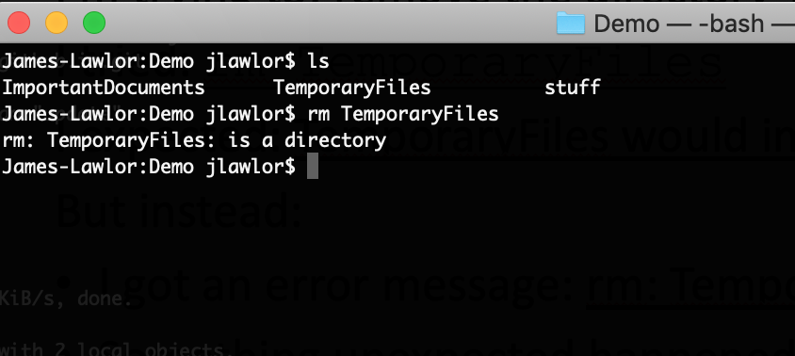
Example 1: Want to delete TemporaryFiles directory

Slide 17
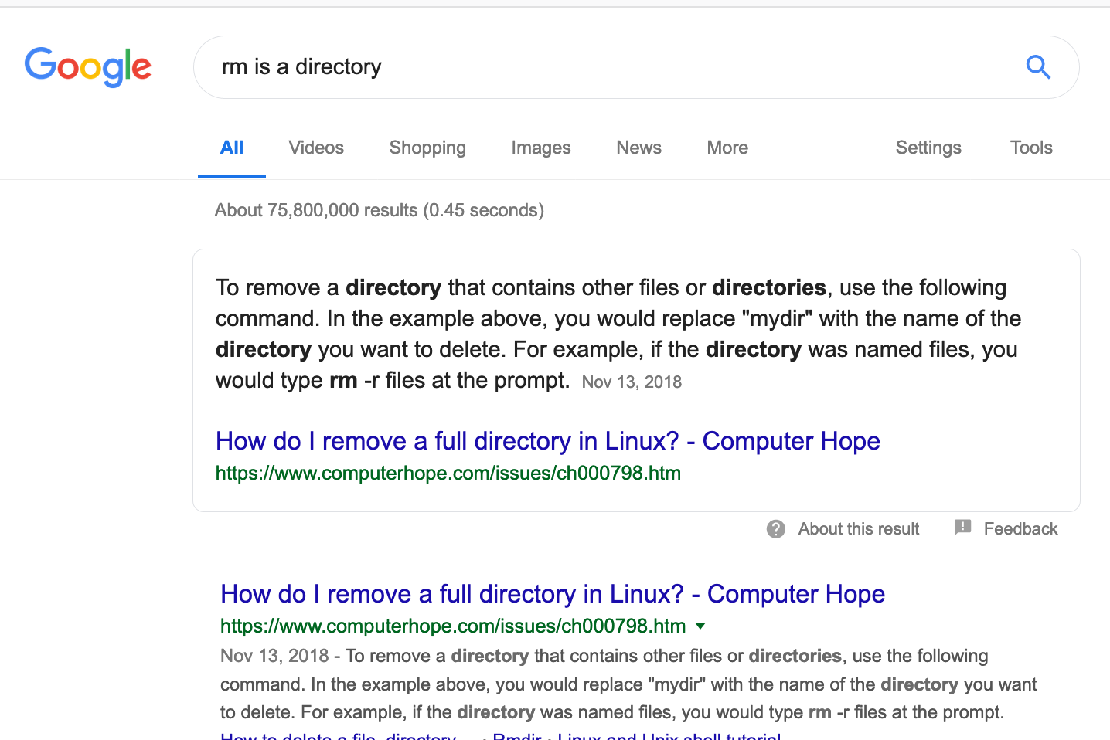
Example 1: Searching for the error message
Helpful: remove your specific file names & paths, since they’re unique to you and not your problem

Slide 18
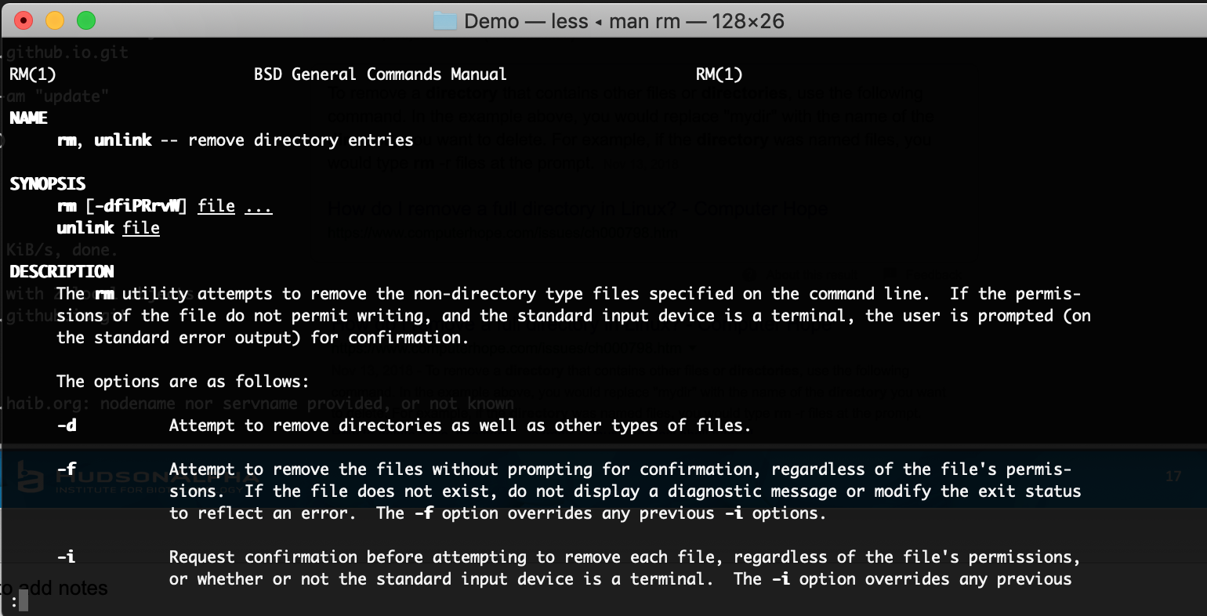
Check the man page or documentation

Slide 19
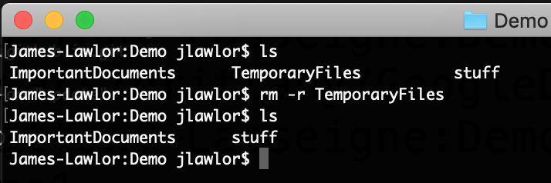
It works!

Slide 20
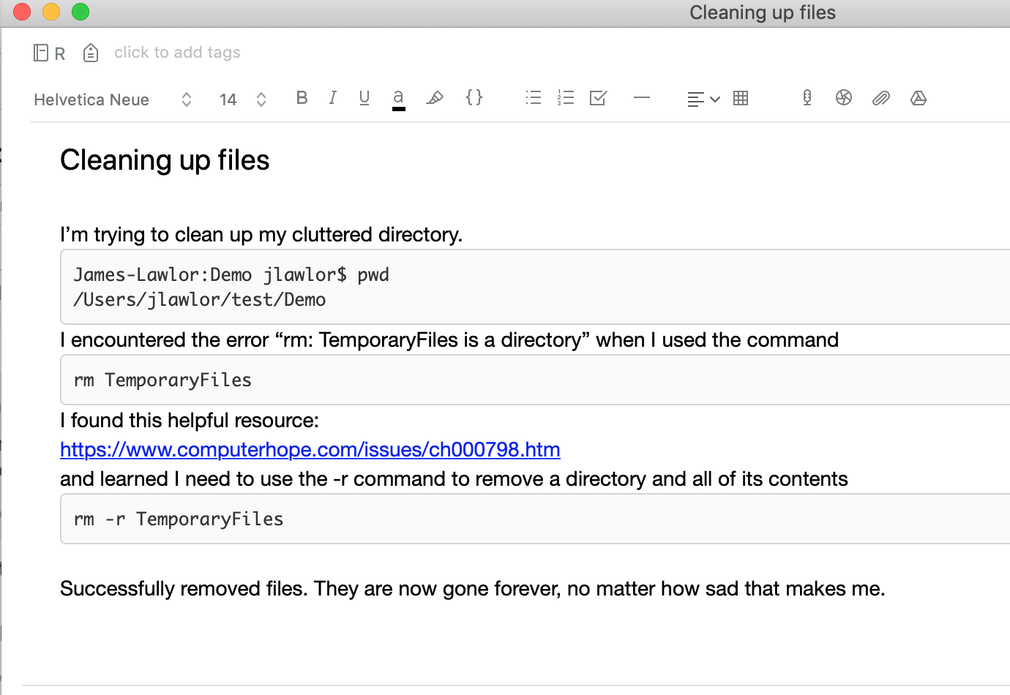
Troubleshooting makes a great lab notebook entry

Slide 21
An asking-for-help script
My overall goal is to: clean up clutter in my home directory.
I’m trying to: remove the directory TemporaryFiles.
I tried: rm TemporaryFiles
I expected: TemporaryFiles would immediately go away
But instead:
I got an error message: rm: TemporaryFiles is a directory
Something unexpected happened: ____________

Slide 22

Sometimes asking the question out loud helps you solve the problem

Slide 23
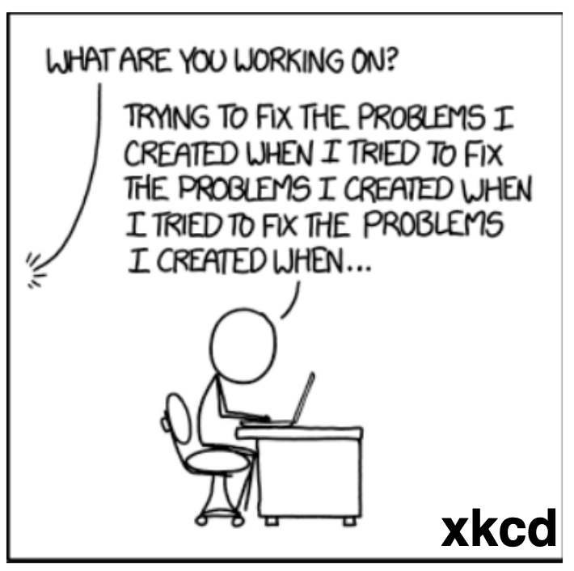
Summary
A good computational lab notebook:
Is record of your science
Is great learning tool
Will save your time & work
Ask for help early and often
For effective help, share:
Goal
Expectation
Strategy

