Slide 1
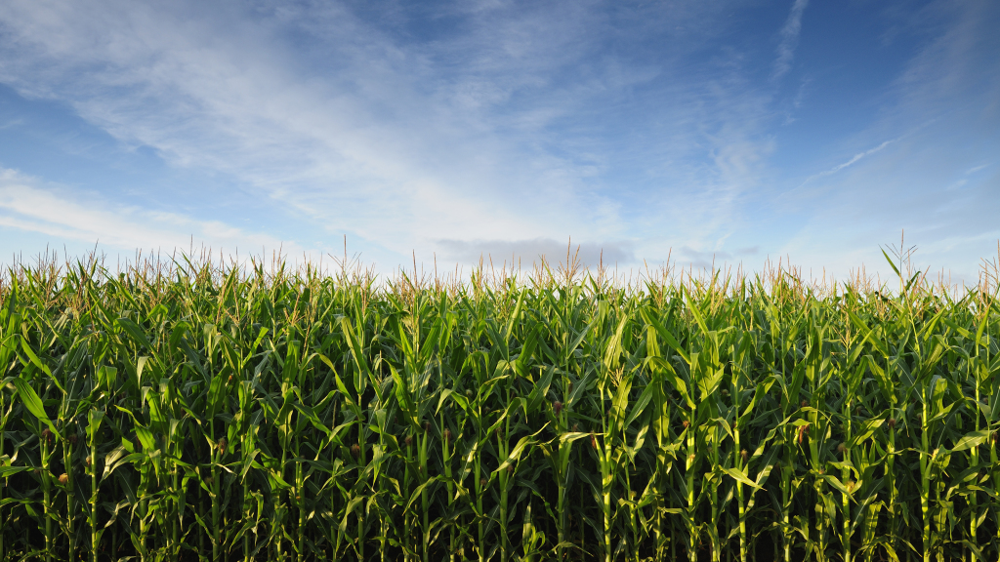
The Cornacle
Prediction of U.S. corn production using satellite images
James Lederman

Slide 2
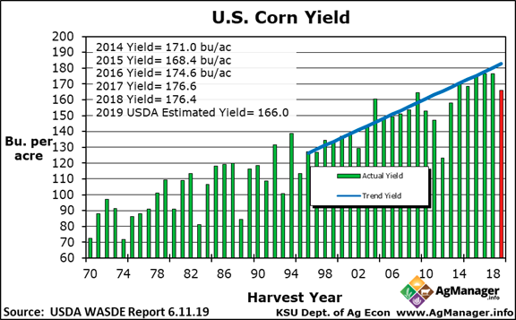
USDA World Agricultural Supply and Demand Report
(WASDE)
https://www.agmanager.info/grain-marketing/grain-supply-and-demand-wasde/us-corn-yields

Slide 3
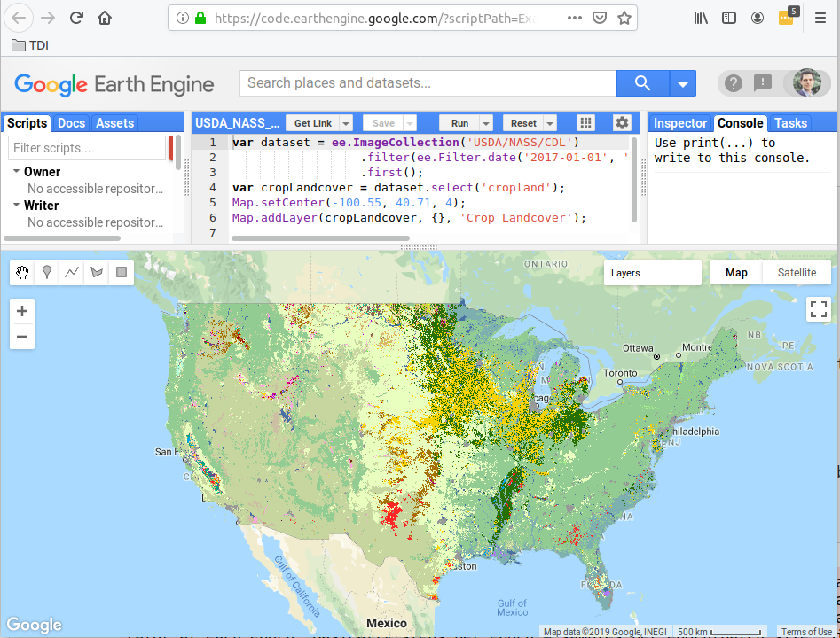

Getting Satellite Images with
Google Earth Engine API

Slide 4
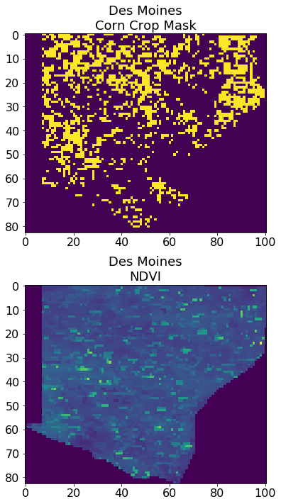

Data Sources
NASA Jet Propulsion Laboratory
Imaging data from 2 MODIS
Earth-Observing Satellites
launched in 1999 and 2002
Data:
1. Essentially, the “greenness” of
surface vegetation
- Measures crop progress and health
- Data is available every 8 days

Slide 5

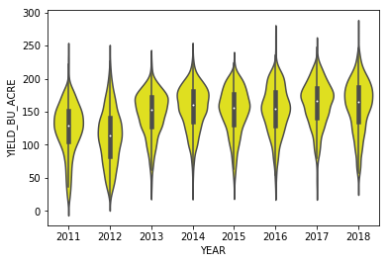
Target Data
Corn Yield per County by Year
US Department of Agriculture
National Agricultural Statistics Service
Data:
1. Corn Yield by County per Year
2. Acres Planted
- Multiply by Predicted Yield to get Total Production

Slide 6
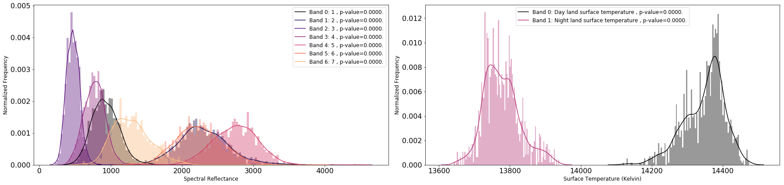
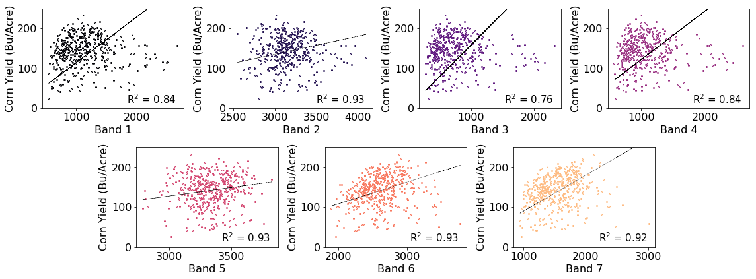
Distributions of Satellite Image Spectra from Corn Fields
Correlations of Mean Spectral Values with Corn Yield

Slide 7
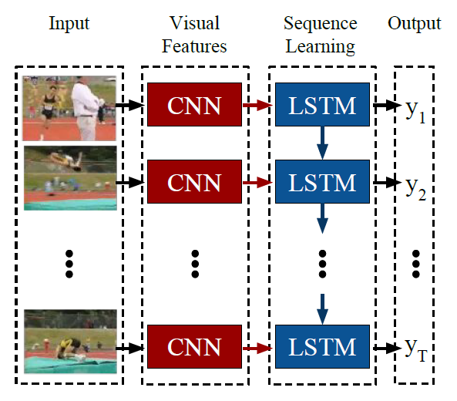
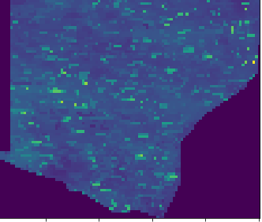
CNN-LSTM Modelling
(Sat Images)
(Yield)
https://stackoverflow.com/questions/44778439/keras-tf-time-distributed-cnnlstm-for-visual-recognition

Slide 8
Model Evaluation
Model | MAE (Bu/Acre) | % Error
CNN(2D)-LSTM | 18.22 | 13.1
CNN(Sep2D)-LSTM | 21.54 | 15.9
CNN(3D) | 94.1 | 60.6

