Slide 1

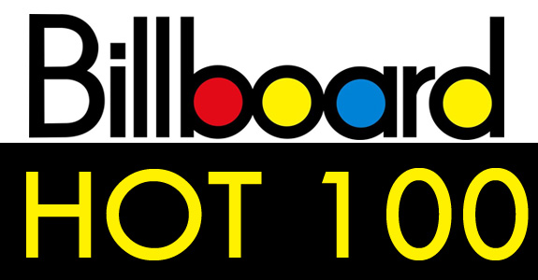
Billboard Top 100: Predicting Song Popularity
James Parks

Slide 2
The Billboard Hot 100 Chart
Introduced on November 12, 1955
Song popularity measured by:
  airplay, album sales, streaming
What determines a song's success on the chart?
Can we predict song popularity from audio and lyrical metadata?

Slide 3
The Client
Music producers:
  - Study musical trends over time for signing artists
Songwriters:
  - Want to have their songs appear on the chart
Music recommendation apps:
  - Implement audio and lyrical metadata to improve their recommendation system

Slide 4
The Data
Billboard Hot 100 data from September 8, 1958 to January 8, 2017
  Source: Decibels and Decimals
Spotify audio metadata for 78% of the tracks
  Features include: tempo, key, duration, time signature, “danceability”, “speechiness”, etc.
  Source: Spotify API
Lyrics for 83% of the tracks
  Scraped from lyric websites like metrolyrics.com, songlyrics.com, lyricsmode.com
Merged the three datasets together.

Slide 5
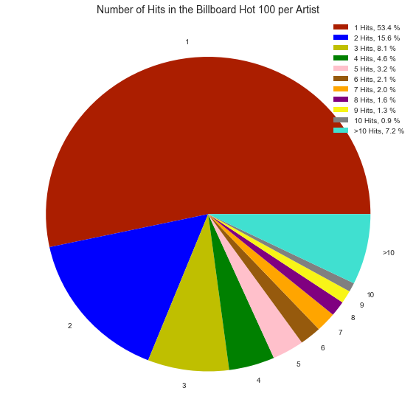
One Hit Wonders
53% of Billboard Hot 100 artists only have one hit song.

Slide 6
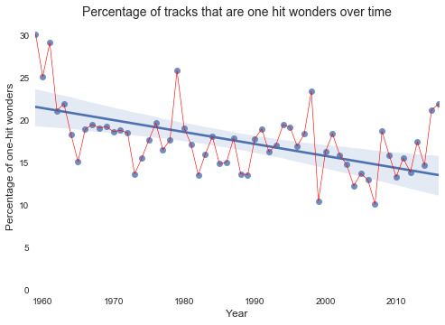
One Hit Wonders
Average number of one-hit wonders decreased over time.

Slide 7
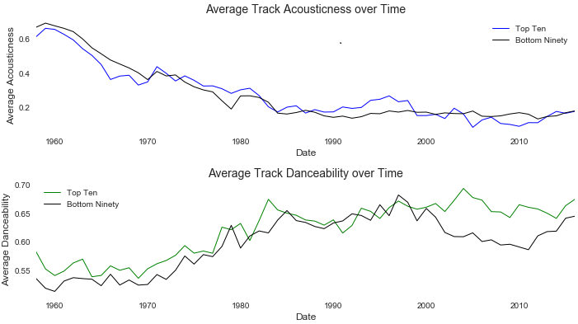
Audio Trends Over Time

Slide 8
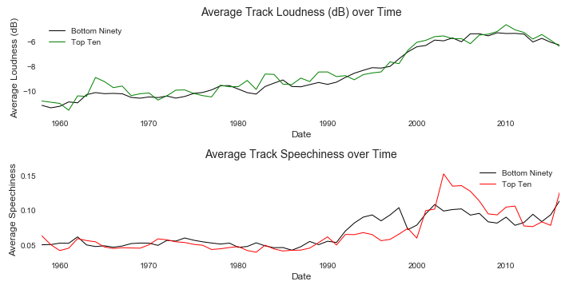
Audio Trends Over Time

Slide 9
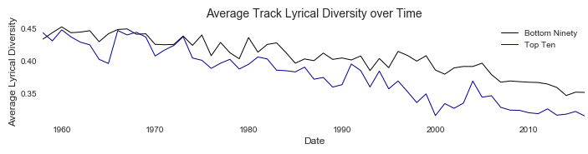
Lyrical Diversity
Lyrical Diversity = # of unique words / total # of words

Slide 10
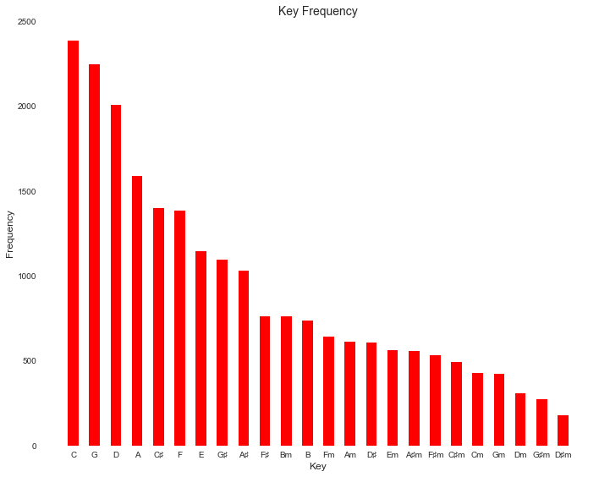
Key Frequency

Slide 11
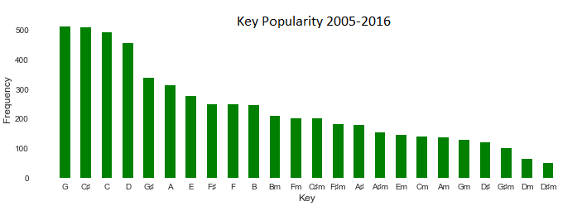
Key Frequency post-2005

Slide 12
Machine Learning Models
Random Forest Classifier: Area under the curve (AUC) of 0.62
  - Useful for binary classification problems
  - Imbalanced data (confusion matrix not a good metric)
  - Quick and easy
Gradient Boosted Classifier: AUC of 0.64
  - Similar to random forest but incorporates ensemble methods.
Most important predictors of song popularity:
  - Lyrical diversity, danceability, duration

Slide 13
Recommendations for Music Producers
Song key makes a difference
- C♯ major is gaining in popularity.
- Major keys are much more popular than minor keys.
Make it “danceable”
- Post-2000's top ten hits have been much more “danceable” on average.
- The average tempo has been always been around 120 BPM.
- 92% of songs are written in 4/4 time.

Slide 14
Recommendations for Songwriters and Music Recommendation Apps
Repetitive Lyrics
  Lyrical diversity is the most important predictor.
  The average lyrical density of recent top ten hits is 33%.
  Post-2001 “Like” is now more common than “Love”.

