Slide 1


Billboard Top 100: Predicting Song Popularity
James Parks

Slide 2
The Billboard Hot 100 Chart
Introduced on November 12, 1955
Song popularity measured by:
  Airplay
  Sales
  Streaming
What determines a song success on the chart?

Slide 3
Spotify Audio Metadata
Features include:
  “Acousticness”
  “Danceability”
  Key
  Loudness
  “Speechiness”
  Tempo
  Time Signature
  Etc.

Slide 4
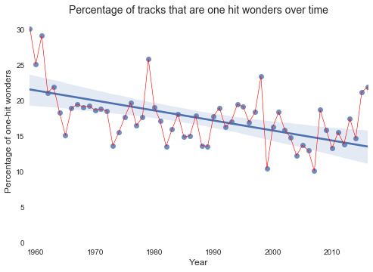
One Hit Wonders
53% of Billboard Hot 100 artists only have one hit song.

Slide 5
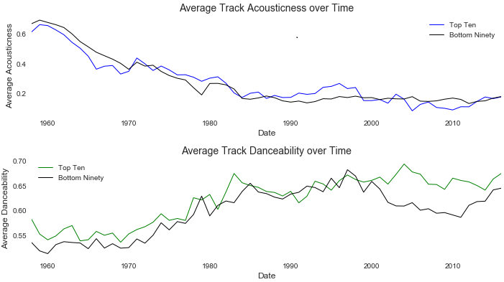
Audio Trends Over Time

Slide 6
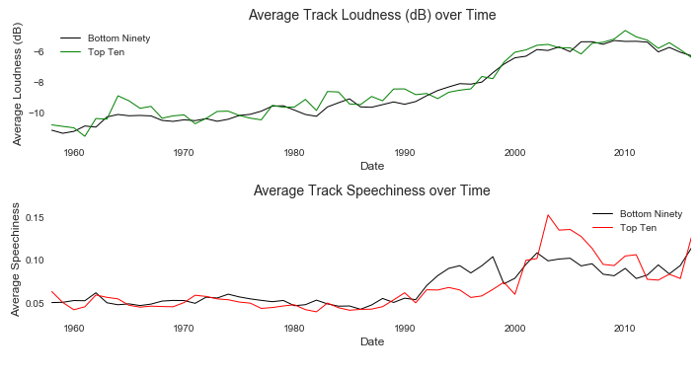
Audio Trends Over Time

Slide 7
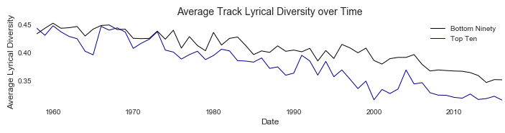
Lyrical Diversity
Lyrical Diversity = # of unique words / total # of words

Slide 8
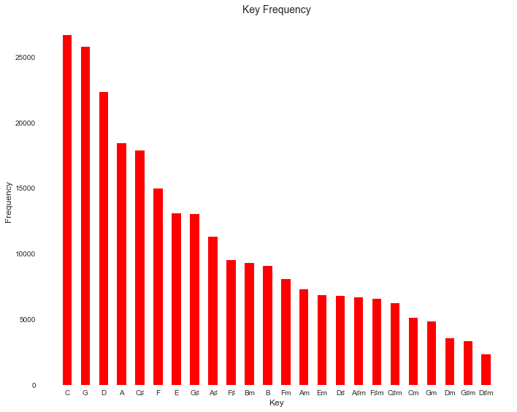

Slide 9
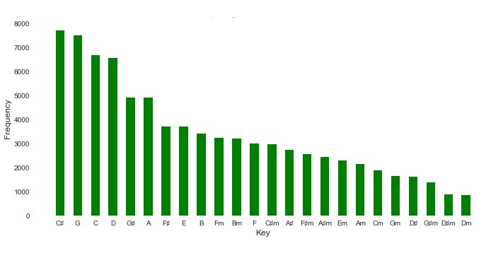
Key Frequency post-2000's

Slide 10
Recommendations
#1. Song key makes a difference
  C and G used to be the most popular.
  Easy keys for both guitar and piano.
  C♯ is now the most popular key.
  Major keys are much more popular than minor keys.

Slide 11
Recommendations
#2. Make it “Danceable”
  Post-2000's top ten hits have been much more “danceable” on average.
  The average tempo has been always been around 120 BPM.
  93% of songs are written in 4/4 time.

Slide 12
Recommendations
#3. Repetitive Lyrics
  The average lyrical density of recent top ten hits is only around 33%, meaning two thirds of the lyrics should be repetition.
  Post-2001 “Like” is now more common than “Love”.

