Slide 1


Ontario Energy Use: Predicting demand from weather and population data
James Parks

Slide 2
Ontario Energy Use
The Independent Electricity System Operator (IESO) operates and settles Ontario, Canada's electricity wholesale market.
The market went online on May 5, 2002.
Investigate hourly energy demand of Ontario, Canada from January 1994 until August 2017.
Investigate hourly weather data for Toronto, Ontario (the largest city) from the same time period from Environment Canada.

Slide 3
The Client
The IESO (or similar organizations in other regions)
    - Need to have a model to predict energy demand
The model uses weather, price and population data.
    - More features like energy source and economic activity could be beneficial.
The Goal is to create an accurate model to reduce cost and prevent blackouts.

Slide 4
The Data
Hourly Ontario energy demand and price from May 5,2002 – August 31, 2017
  Source: IESO
Climate data for Toronto, Ontario for the same period.
  Features include: temperature, wind speed, atmospheric pressure, etc.
  Source: Environment Canada
Population data for Toronto and Ontario
  Source: Wikipedia, only for the years: 1996, 2001, 2006, 2011, 2016
Merged the three datasets together.

Slide 5
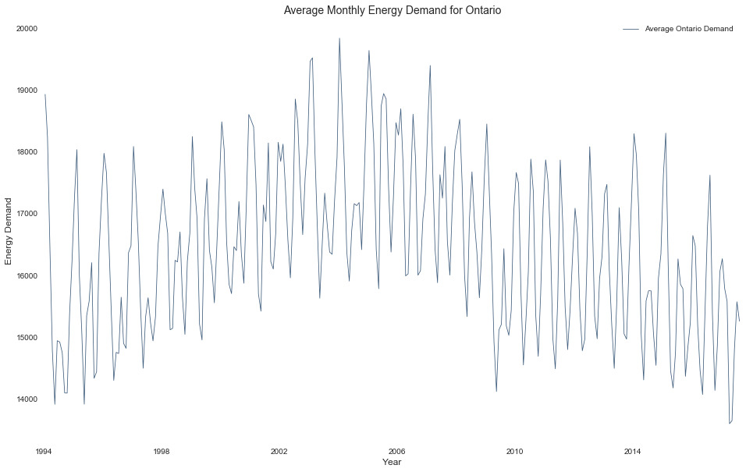
Average Monthly Energy Demand
Average Monthly energy demand peaked in 2004

Slide 6
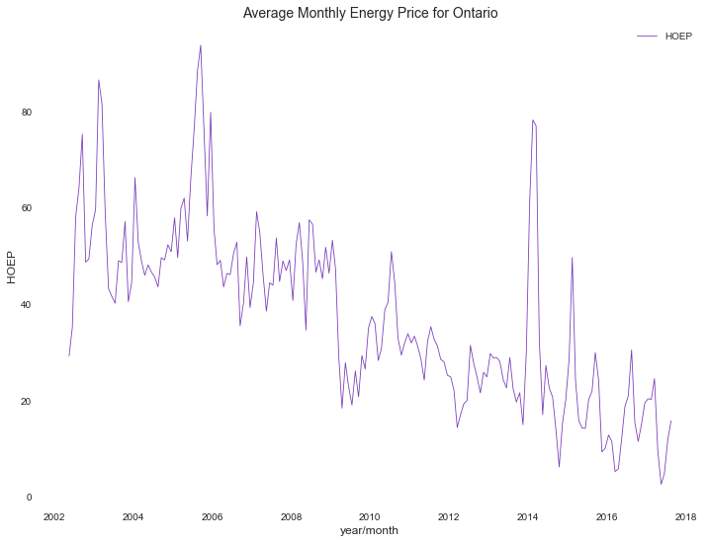
Energy Price
The average monthly energy price has been decreasing over time.

Slide 7
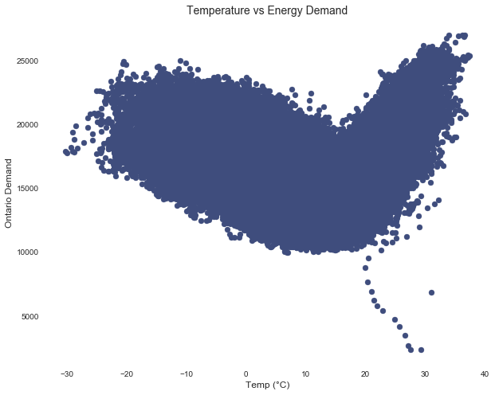
Temperature vs Ontario Energy Demand

Slide 8
Outliers
On August 14, 2003, Ontario and the north eastern United States experienced a large scale blackout.
It was the world's second most widespread blackout in history.
The outliers present on the previous plot all took place during a _x000c_fifteen hour time period on this day.
day.

Slide 9
Machine Learning Models
Model | Train Accuracy | Test Accuracy
Linear Regression | 0.412 | 0.433
Random Forest Regression | 0.626 | 0.627
Gradient Boosted Regression | 0.833 | 0.836

Slide 10
Random Forest Model
Ensemble method that fits a number of decision trees on various sub-samples of the data.
Uses averaging to improve accuracy and account for over-fitting.
Rank | Feature | Importance
1 | HOEP (Hourly Energy Price) | 0.711248
2 | Temp (º_x000e_C): | 0.171001
3 | Imports | 0.044065
4 | Humidex | 0.041706
5 | Toronto Population | 0.013703

Slide 11
Gradient Boosting Regression Model
A sequential ensemble technique.
Combines a set of weak learners to improve accuracy.
Rank | Feature | Importance
1 | Toronto Population | 0.276852
2 | Ontario Population | 0.243368
3 | HOEP | 0.125280
4 | Imports | 0.067934
5 | Exports | 0.062903

Slide 12
Bagging
Uses parallel ensemble: each model is built independently
aim to decrease variance, not bias
suitable for high variance low bias models (complex models)
Performing bagging on our three models we obtain a weighted average prediction of 80.4%

Slide 13
Client Recommendations
Temperature plays the largest role in terms of weather.
  - The relationship is not linear since heating and
  cooling has a dramatic effect on energy demand.
Average monthly energy demand and price are both trending downwards.
  - Energy exports are forecast to increase.
_x000f_
Ontario is increasing the percentage of its energy production coming from solar and wind sources.
- Wind and visibility will be more important features.

