Slide 1

Temperature and Humidity Measurement
with pyserial and matplotlib animation on a Raspbery Pi
Leonard Samuelson
and
Michael Handler
LB Foster/Salient Systems, Inc.
(based on an idea by Shane Lanham)
Notes:
This is a presentation about a little side project we did at work
This is NOT a presentation about coding best practices
Has some techniques of interest
Took maybe 3 or 4 days of part time work from both of us

Slide 2
Motivation
We needed to monitor temp and humidity at our CM’s facility while boards were baked in an oven
CM didn’t have equipment and wouldn’t buy it
Improperly prepared circuit boards have high probability of failure
Board designer had the idea to use the iButtonLink temp/humidity sensor
Notes:
Board design was more complex than the manufacturer had ever made and was more sensitive to humidity during manufacturing
Shane Lanham (our board designer) asked manufacturer to monitor temperature and humidity, but manufacturer didn’t have the equipment to do that and didn’t want to buy it
Shane Lanham had the idea to develop something using the iButtonLink temp/humidity sensor and asked Len to do it

Slide 3
Constraints
Cheap
Quick development
We had management complaining about the time we were spending on it
Notes:
Not a product, minimum investment of time/effort/equipment

Slide 4
Requirements
Inexpensive hardware
Easy connection to monitored oven
Easy connection to Internet
Local display for CM
Remote display for salient
Notes:
Internet connection for remote monitoring
Local display so that CM can monitor the process
Remote display to enforce accountability on CM

Slide 5
Implementation at CM
Raspberry Pi running Raspbian
Python
Matplotlib
iButtonLinkTH temp/humidity sensor
USB-serial connection to the iButtonLink
Notes:
The Swiss Army Knife of inexpensive computing
The batteries included rapid development scripting language
A well-supported, well-understood presentation library (and one that Mike had been using on another project, really)
Well-understood serial port access to temp/humidity
USB-serial – commonly available connection to iButtonLink

Slide 6
Remote Monitoring Implementation
FTP from CM to Salient FTP server
FTP from Salient FTP server to local storage
Bash script for data transformation
Gnuplot for display at Salient
Notes:
Gnuplot allowed Len to provide the display without learning Matplotlib

Slide 7
Division of Labor
Len:
  Serial connection to iButtonLink
  Queuing of sensor data
  FTP transfer
  Remote static display
Mike
  Local animated display

Slide 8
DEMO

Slide 9
SENSOR DATA ACQUISITION AND REMOTE DISPLAY

Slide 10
Basic System Structure
temp_humid.py
HTTP
browser
Local
display
thread
FTP
thread
FTP
server
Block
files
Remote display
Record thread
Python
http.server
FTP script
temp_humidity.png
Block
files
Image
generation
Ibuttonlink
linkTH

Slide 11
Parse, convert
Input format:
260A8AE1010000B5 19,21.21,70.12,50,00:00:30.2
EOD
260A8AE1010000B5 – Device (One-wire) ID
19 – Device type: This is a “linkTH”
21.21 – Temperature, C
70.12 – Temperature, F
50 – Relative humidity, %
00:00:30.2 – Device uptime, HH:MM:SS.t
EOD – End Of Data (cycle)
Parsed measurements format (python list):
[hour, datetime, ID, type, tempC, tempF, humidity, uptime, unix-secs]
Hour – Simplify measurement block splitting
Unix-secs – Simplify remote display gnuplot image

Slide 12
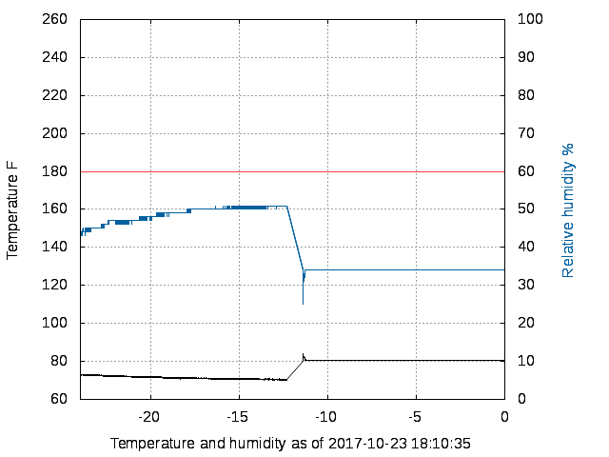
Remote image

Slide 13
System Structure: temp_humid.py, on the Pi
temp_humid.py
HTTP
browser
Local
display
thread
FTP
thread
FTP
server
Block
files
Remote display
Record thread
Python
http.server
FTP script
temp_humidity.png
Block
files
Image
generation
Ibuttonlink
linkTH

Slide 14
Record thread: Read Parse Store Notify
Outer loop: Generate measurement block files forever
  Open recording file
    Filename is related to current hour
    Append mode, in case of interruption
  Run recording cycle
    Report cycle start to FTP thread on recordqueue
    Execute record_cycle to collect and store data
      Ends on the hour or error, whichever comes first
    Report cycle end to FTP thread on recordqueue
  Close recording file

Slide 15
Record_thread outer loop code
def record_thread(recordqueue, graphqueue, datadir, portname, portretry):
""" entry point for the data recorder, collector, distribution thread
Manage report files and notification to the main thread for
triggering FTP transfers.
"""
logging.info("record_thread start dir=%s, port=%s" % (datadir, portname))
while True:
# Start recording
outfilename = time.strftime('temp_monitor_%Y-%m-%d_%H.txt')
outfilepath = os.path.join(datadir, outfilename)
logging.info('outfile ' + outfilepath)
outfile = open(outfilepath, 'a')
try:
recordqueue.put( (outfilepath, outfilename, "start") )
record_cycle(portname, outfile, graphqueue)
recordqueue.put( (outfilepath, outfilename, "end") )
except serial.serialutil.SerialException:
recordqueue.put( (outfilepath, outfilename, "error") )
logging.critical("Warning: Serial port %s unavailable" % portname)
time.sleep(int(portretry))
outfile.close()

Slide 16
Recording cycle
Open serial port
Get measurements from recorder until “done”
  Report measurements to display thread on graphqueue
  Stop on error
  Stop when crossing hour boundary
Close serial port

Slide 17
Recording cycle code
def record_cycle(portname, outfile, graphqueue):
""" Get and handle measurement data from the iButtonLink LinkTH controller.
Manage distribution of the data to the graphqueue, and manage
starts/stops and errors detected by the recorder.
"""
start_hour = time.localtime().tm_hour
try:
sport = serial.Serial(portname, baudrate=9600)
for measurement in recorder(sport):
print(' '.join(measurement[1:]), file=outfile)
outfile.flush()
graphqueue.put(measurement)
if measurement[0] != start_hour:
break
except serial.serialutil.SerialException as e:
raise e
except KeyboardInterrupt:
return outfile
finally:
try:
sport.close()
except:
pass
return

Slide 18
iButtonLink data collection, parsing and delivery
Classical read/parse/deliver
Implemented as a Pythonic generator
Repeat while moving valid data (30 second timeout)
  Collect raw serial data
  Locate iButtonLink data boundary
  Transform to target measurement format
  Yield measurement to caller
Return (raising StopIteration)
  Data read timeout
  Error from serial object

Slide 19
Data collection: Locate data boundary
def recorder(serport):
serport.timeout=1.0
newdata = b''
start_time = time.time()
now = start_time
while now - start_time < 30:
now = time.time()
newdata += serport.read(500)
eodpos = newdata.find(b'EOD')
if eodpos > 0:
lines = newdata[:eodpos].split(b'\n')
newdata = newdata[eodpos+3:]
for dl in lines:
<<< Next slide: Handle lines, including yield/break >>>
newdata = b''
logging.info("timeout")
return b'Timeout'

Slide 20
Data collection: parse, deliver
if len(dl) < 20:
continue
dl = dl.strip(b'\r').strip(b'?')
matcher = datafmt.match(dl)
if matcher:
ident = matcher.group(1).strip().decode(encoding="ascii", errors="none")
if len(ident) < 16:
ident = None
else:
ident = None
if ident is not None:
now = time.time()
timeobj = time.localtime(now)
nowstr = time.strftime('%Y-%m-%d %H:%M:%S', timeobj)
timesecs = str(int(now))
measurements = [timeobj.tm_hour, nowstr, ident]
measurements.extend( [x.strip().decode(encoding="ascii", errors="none") for x in matcher.group(2).split(b',')] )
measurements.append(timesecs)
start_time = now
yield measurements

Slide 21
Send reports to home base:
FTP thread
Use FTP to send measurement files
Repeat forever:
  Wait for timeout or item in recordqueue
  If there’s something useful to report,
    Run the ftpsend

Slide 22
Send reports, top level
ftpperiod = None
def ftp_thread():
global recordqueue, ftpperiod
fileobj = None
recordstate = None
while True:
try:
fileobj = recordqueue.get(block=True, timeout=ftpperiod)
if fileobj[2] == "end":
recordstate = "Complete"
else:
recordstate = None
except queue.Empty:
recordstate = "timeout"
pass
logging.info("main thread")
if fileobj is not None and recordstate is not None:
ftpsend(fileobj[0], fileobj[1])

Slide 23
Send reports, FTP file transfer
def ftpsend(filepath, filename):
try:
with ftplib.FTP(host="www.salientsystems.com", user="******", passwd="******") as ftp:
logging.info("ftp start")
with open(filepath, 'rb') as ftpfile:
ftp.cwd("test_temperature")
ftp.storbinary("STOR %s" % filename, ftpfile)
ftp.quit()
logging.info("ftp complete")
except socket.gaierror:
logging.critical("Bad FTP host address")
except socket.error:
logging.critical("FTP socket error")
except socket.herror:
logging.critical("FTP socket H error")
except ftplib.Error as ftpe:
logging.critical("FTP error")

Slide 24
System Structure:
Remote display, running on workstation
temp_humid.py
HTTP
browser
Local
display
thread
FTP
thread
FTP
server
Block
files
Remote display
Record thread
Python
http.server
FTP script
temp_humidity.png
Block
files
Image
generation
Ibuttonlink
linkTH

Slide 25
Remote Display
Cron-scheduled collect/image generator shell script
  Run at least once per hour
  Retrieve measurement files from FTP server
    Use “.netrc” to automate
  Generate PNG image with gnuplot
    Write image file to /tmp/temp_humidity.png
HTTP server
  Pythonic command line:
  python3 -m http.server 8001
  Anyone in office can see results:
  http://helicon:8001/temp_humidity.png

Slide 26
Remote collection script (1/3)
#!/bin/bash
if [ "$1" = "ftp" ]
then
ftp -i www.salientsystems.com
fi
WORKFILE=/tmp/plot_temp_humid.txt
cat `ls /home/lcs/work/ibuttonlink/test_temperature/*.txt | tail -n24 | xargs` >$WORKFILE
CURRENT="`tail -n1 $WORKFILE | cut -d ' ' -f 1,2`"
gnuplot <<PLOTEND
… Gnuplot script, see 3/3 ...
PLOTEND
rm $WORKFILE
echo Plotting temperature and humidity as of $CURRENT

Slide 27
FTP script, ~/.netrc (2/3)
lcs@helicon:~$ cat .netrc
machine www.salientsystems.com
login ********
password ********
macdef init
cd test_temperature
lcd /home/lcs/work/ibuttonlink/test_temperature
mget *
mdelete *
quit
lcs@helicon:~$

Slide 28
Image generation (3/3)
set terminal png size 800,600
set output "/tmp/temp_humidity.png"
set multiplot
stats "$WORKFILE" using 9 name 'T'
set xrange [-24:0]
set xlabel "Temperature and humidity as of " . "$CURRENT"
set yrange [60:260]
set y2range [0:100]
set ylabel "Temperature F"
set y2label "Relative humidity %" textcolor rgb "#0060a0"
set ytics 20
set y2tics 10
set grid
plot "$WORKFILE" using ((\$9 - T_max)/3600):7 axes x1y2 with lines lc rgb "#0060a0" notitle
set nogrid
replot 60 axes x1y2 with lines lc rgb "#ff4040" notitle
replot "$WORKFILE" using ((\$9 - T_max)/3600):6 axes x1y1 with lines lc rgb "#000000" notitle

Slide 29
Animated Display Graph

Slide 30
Requirements
Initial
  Animated chart with one 12 hour graph showing temp and humidity
  Dual y-axes
Later
  Two charts:
    12 hours
    10 minutes
    Line showing humidity threshold
    Threshold exceeded notification

Slide 31
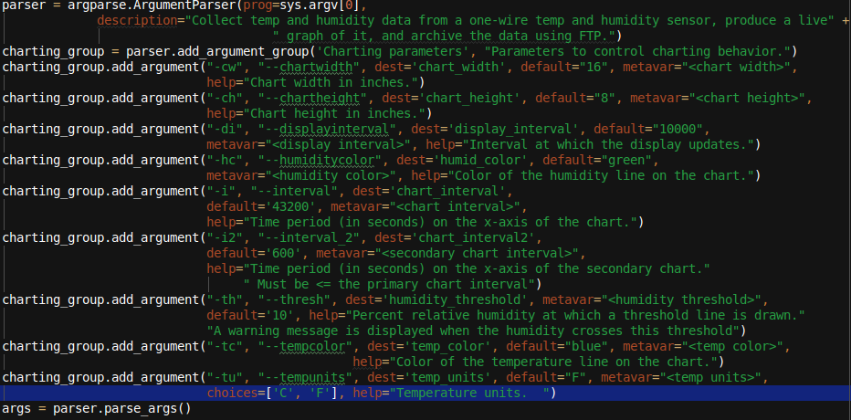
Script Arguments (1 of 2)
Notes:
Used argparse – I’d used getopt in C, and for a previous project, I looked at click, optparse, and docopt. argparse was the best compromise between quick understanding and functionality then. I’d already used it, so I used it here.
Aliases
-dest is destination argument name if it’s different than command-line param name
Metavar get’s displayed for value in help
The embarrassment of adding the second chart by brute force

Slide 32
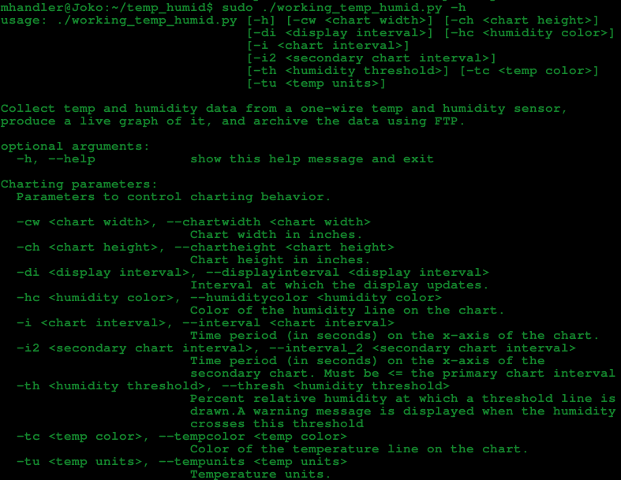
Script Arguments (2 of 2)
Notes:
All the parameters are charting options
Run through them briefly

Slide 33
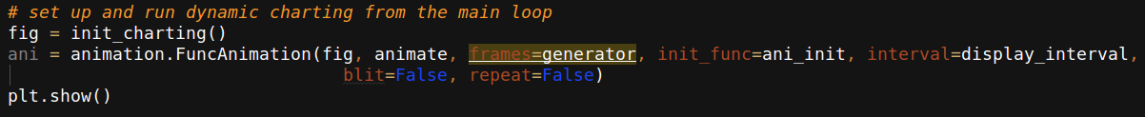
Animation
Matplotlib.animation module
Matplotlib.animation.FuncAnimation function
https://matplotlib.org/api/_as_gen/matplotlib.animation.FuncAnimation.html#matplotlib.animation.FuncAnimation
All the examples on the web were canned animations, e. g., …
https://brushingupscience.wordpress.com/2016/06/21/matplotlib-animations-the-easy-way/
Notes:
init_charting is my matplotlib init routine – next slide
Fig – matplotlib figure
Func – the function that’s called with data for each frame of the animation
Frames – iterable, int, or generator function – value passed func() – generator is a function that pulls sensor readings from the queue and implements the generator interface
int_func – initialization function
Fargs – additional args to pass to func() which I did not use
save_count – # of frames values to cache which I did not use
Interval -- delay between frames in ms – taken from the command line argument
Repeat – should animation repeat when frames is depleted?
Blit: controls whether blitting is used to optimize drawing. I made a half-assed attempt to make it work and failed. If I could have gotten it to work it would have improved the performance of the script on the RP

Slide 34
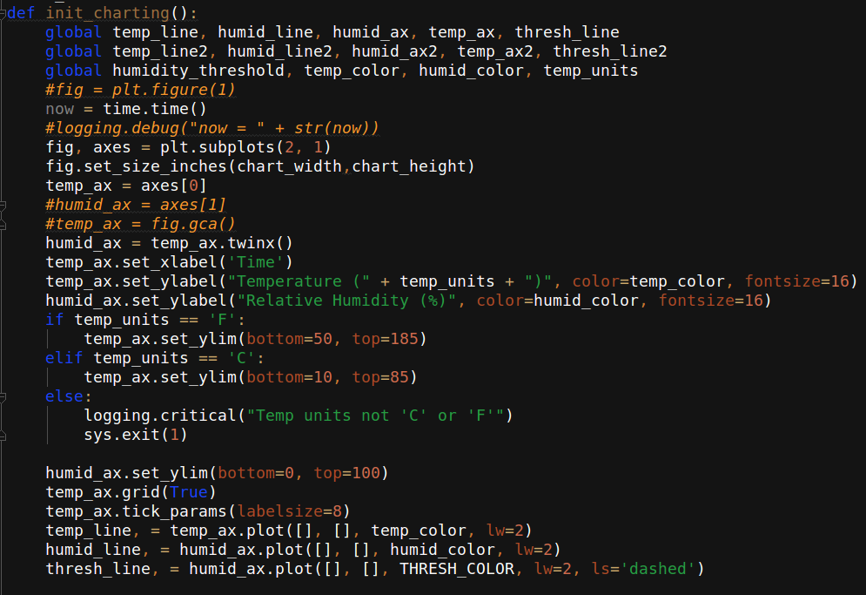
Matplotlib Initialization (1 of 2)
Notes:
Subplots call – 2 rows, 1 column, don’t share x or y axes
Calls matplotlib.axes.Axes.plot() returns lines that are created as Line2D objects (arguments are Line2D properties)
Twinx call: “Create a new Axes instance with an invisible x-axis and an independent y-axis positioned opposite to the original one (i.e. at right).”
tick_params(labelsize=8) – font size 8 for labels

Slide 35
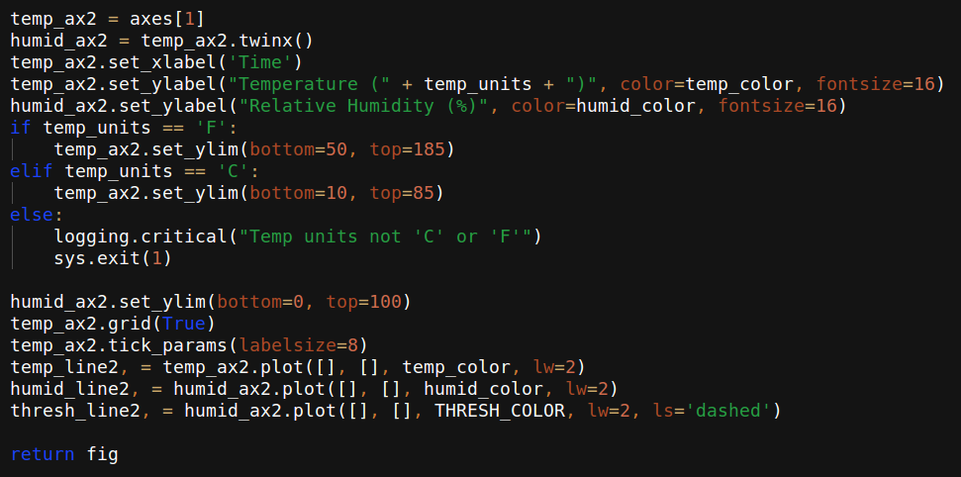
Matplotlib Initialization (2 of 2)
Notes:
The embarrassment of doubling everything to meet the late requirement

Slide 36
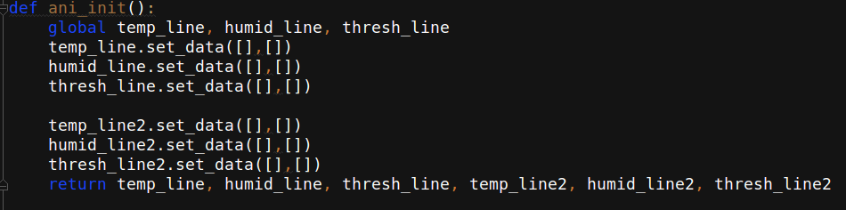
Animation Initialization
Notes:
Initialize empty lists that represent lines
These are Line2D objects created in init_charting() by calls to matplotlib.axes.Axes.plot()

Slide 37
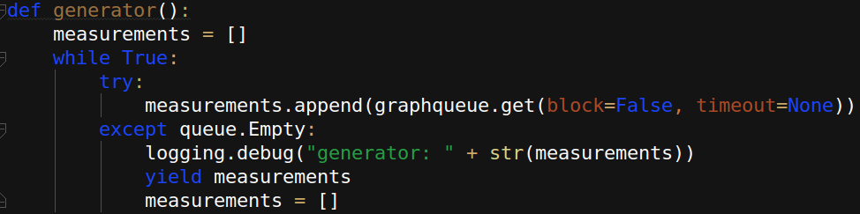
Generator Function
Notes:
Generator function is a function that acts as an iterator.
Yield statement returns a value, but saves context (a coroutine yield – maybe hops to another stack?)
runs once per display interval
reads measurements out of the queue until there are no more
Returns list of new received measurements

Slide 38
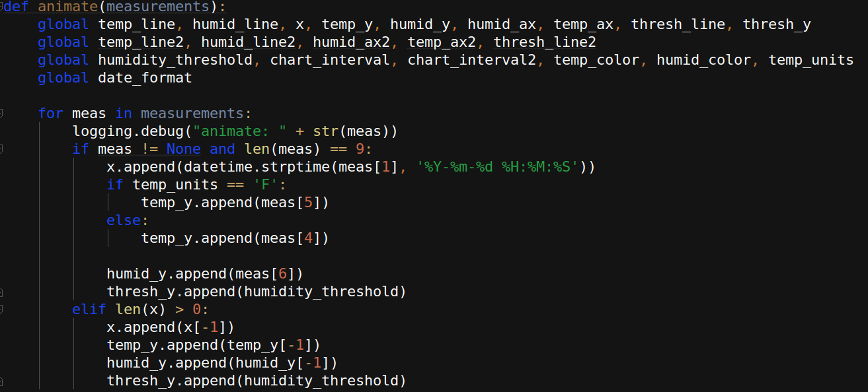
Animate Function (1 of 3)
[18, '2017-10-23 18:16:35', '26B55411020000FF', '19', '20.62', '69.06', '94', '00:00:32.2', '1508796995']
Notes:
Each time it receives a set of measurements from generator function
Generate formatted time
Set temp_y to proper value for units
Set humid_y
Set the threshold to its constant value
If the measurement is truncated, insert previous values

Slide 39
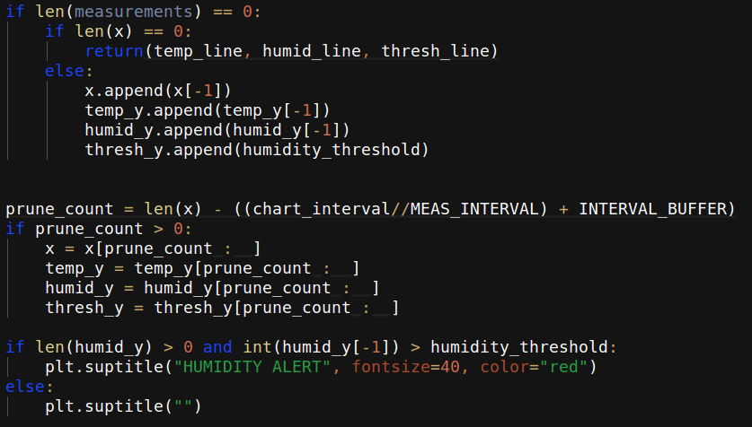
Animate Function (2 of 3)
Notes:
Done pulling measurements out of queue: If measurements is zero length, we’re done
If length of the chart data is 0 return the null lines because we haven’t started yet
If the number of measurements is nonzero, it means that we had an interval with no data, so we append an extra copy of the last measurement to occupy that interval
Prune measurements – prune the lists of x and y values to slightly exceed the size of the longer chart.
Pruning:
Len of x-values (time) minus (43200//2) plus 20
Generate alarm, if appropriate

Slide 40
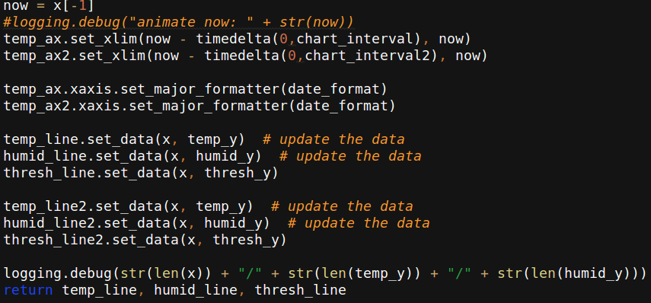
Animate Function (3 of 3)
Notes:
set_xlim calls
Set data limits for the x-axis(left, right)
timedelta([days,[seconds,[,...)
Set formatter for the date (probably don’t have to do this every time, but there it is)
Update the data in the 2D line objects
The embarrassment of doubling
Return the line data

Slide 41
Q&A
Any Questions?...Any Answers?

