Slide 1

Taxpayers’ system
Mra taxpayers management system

Slide 2

Table of Content
Introduction
Login
Dashboard
Taxpayers
Add taxpayer
Edit taxpayer
Delete taxpayer

Slide 3
Introduction
MRA Taxpayers system is a system designed to allow the management of taxpayers. Users need to log in in order to use the system
The system was designed and developed using C# ASPNetCore 5 and Datatables, Jquery and Bootstrap were used to enhance the presentation

Slide 4
Login Page
In order to access the system, users must login by entering their email and password. Only correct credentials will be logged in.
See next page

Slide 5
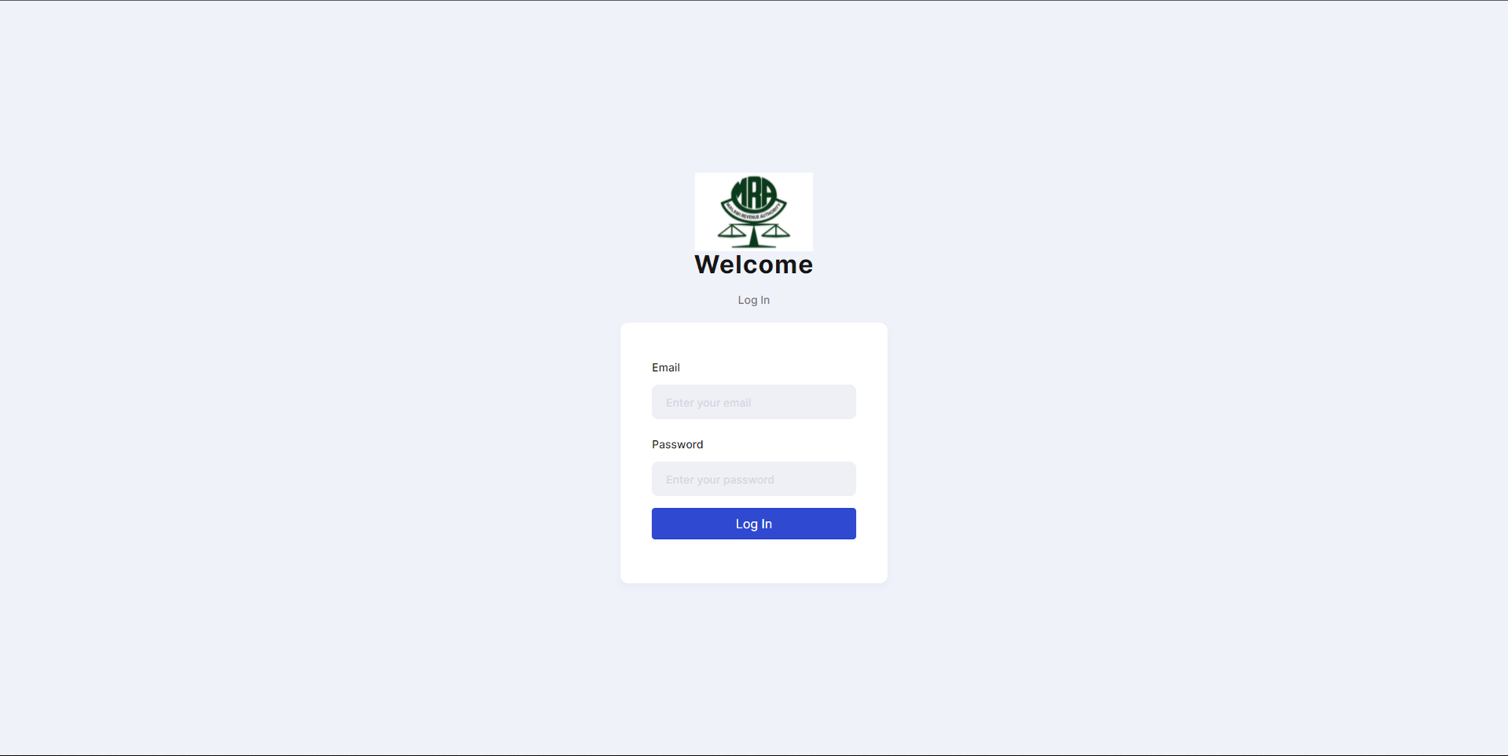
Login Page

Slide 6
home Page
After successfully login in, users are presented with a dashboards which shows the totals number of taxpayers in the system as of that time.
Next page shows the image

Slide 7
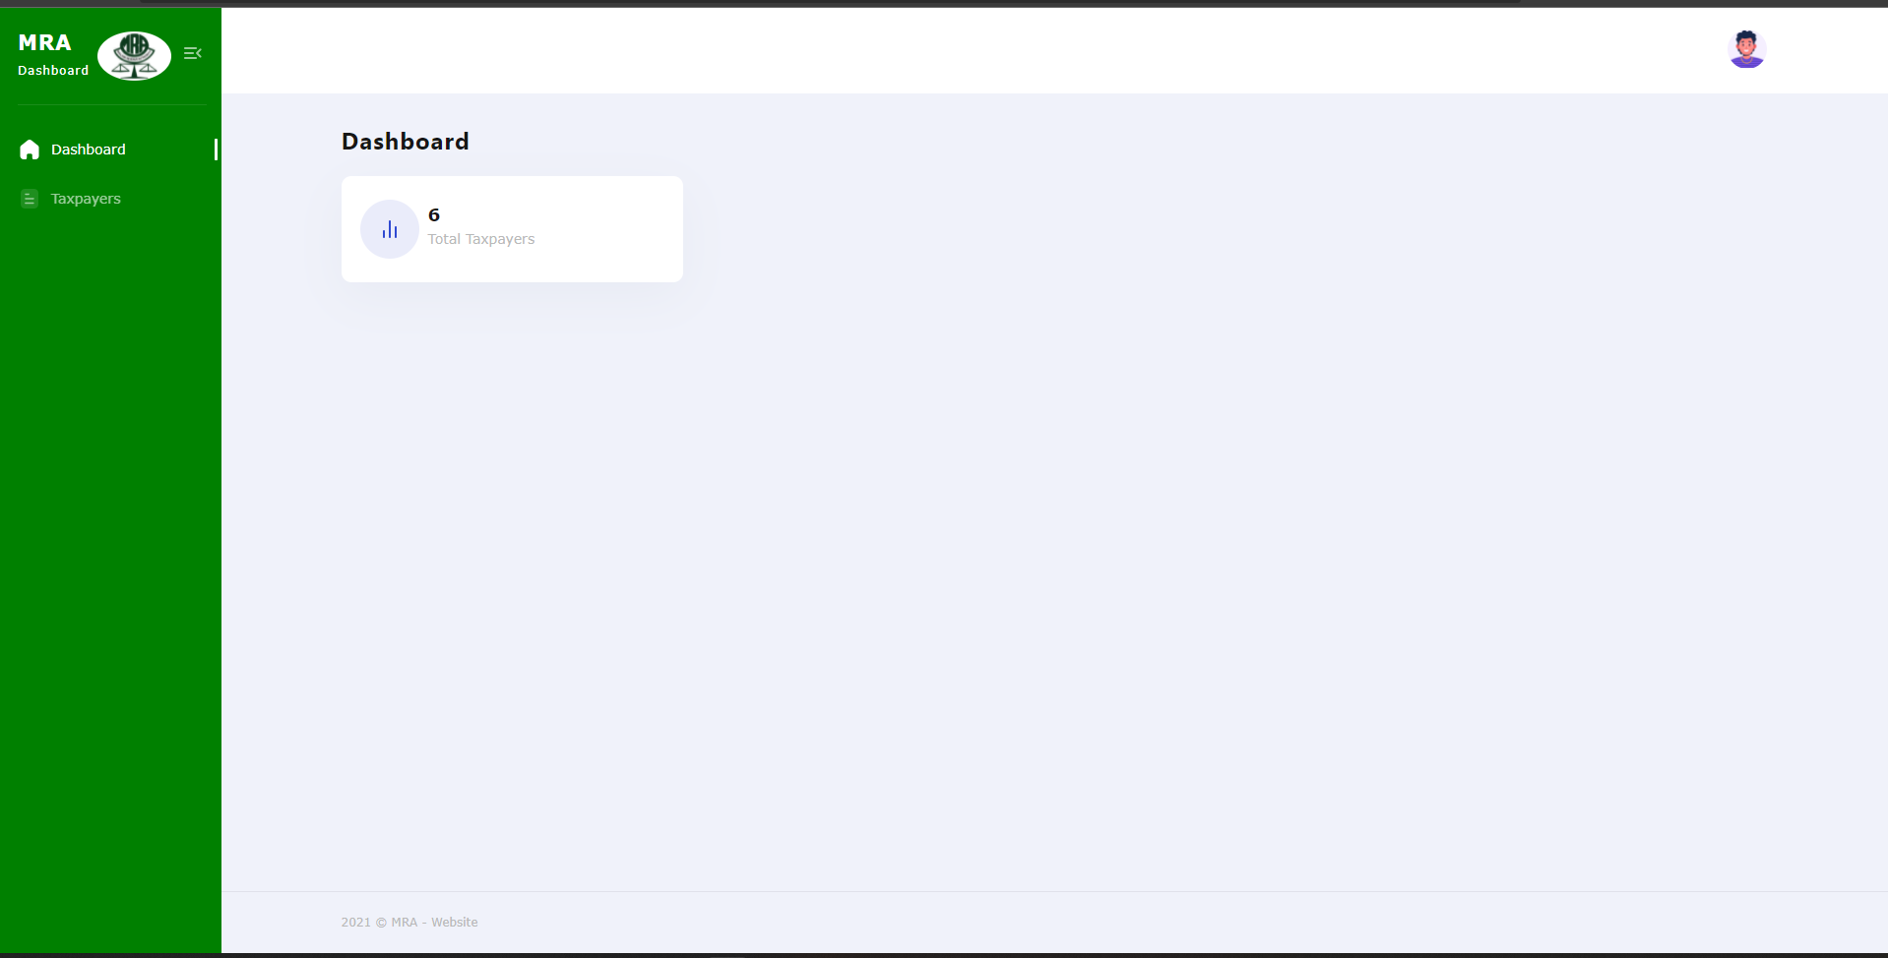
home Page

Slide 8
Taxpayer’s Page
The taxpayers page displays all the information about taxpayers. It allows users to add, edit, and delete a particular taxpayer
Each action has a specific button
Next page shows the image

Slide 9
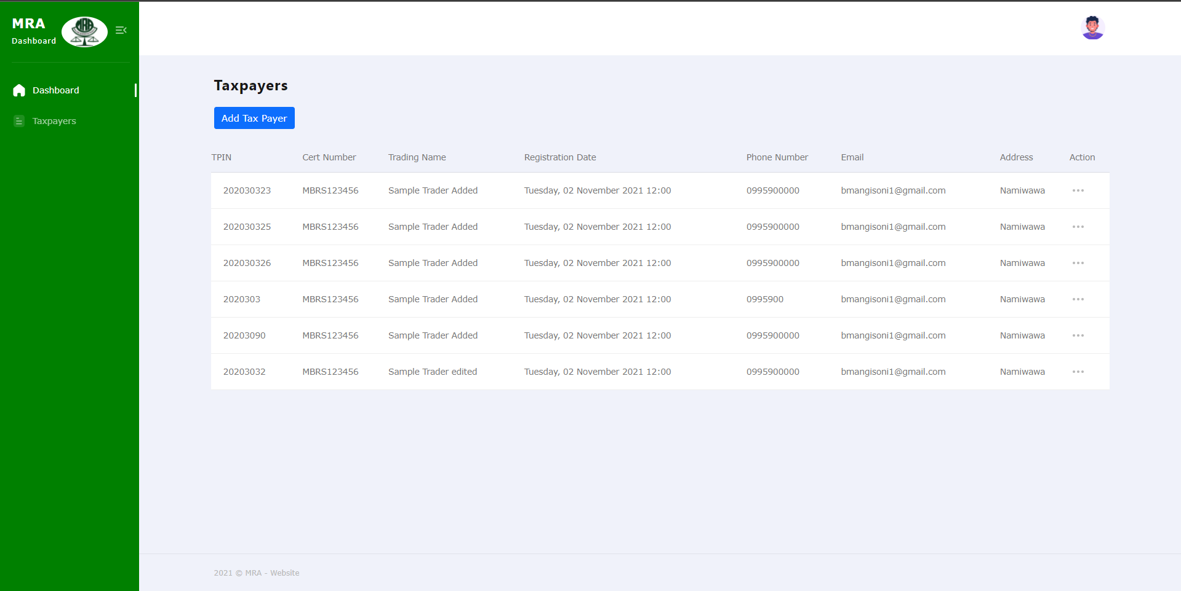
Taxpayers Page

Slide 10
Add taxpayer
To add a taxpayer, click on the blue button at the top of the table, a modal is shown with a form
Enter the correct details accordingly. Otherwise errors are displayed if requirements are not met
After filling the form, click save to add the record and a notification is shown based on the status of the request
Next page shows the image

Slide 11
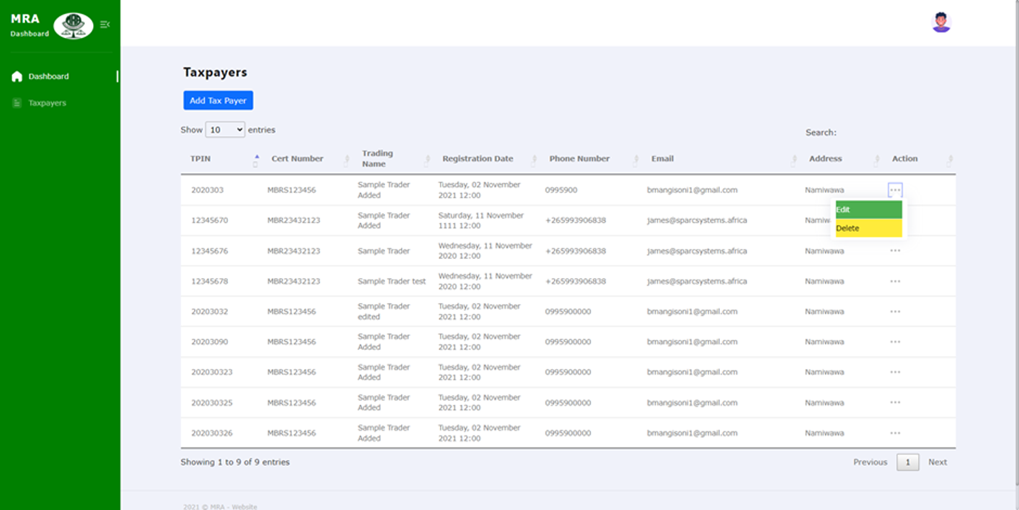
Add taxpayer

Slide 12
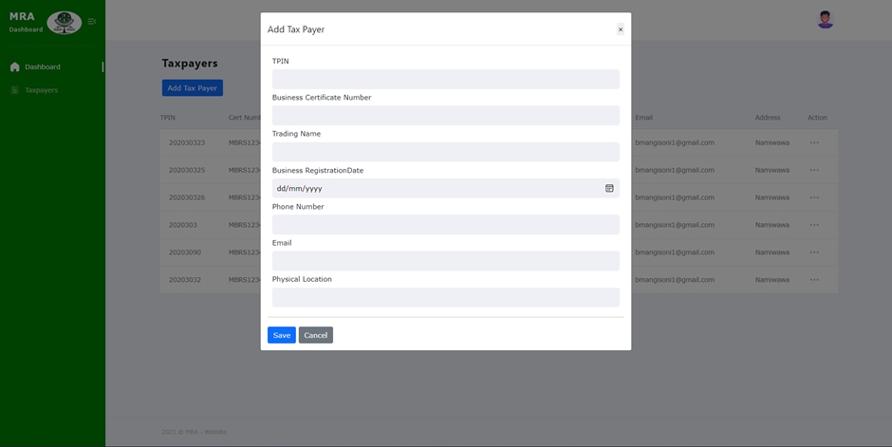
Add taxpayer modal

Slide 13
update taxpayer
To edit a taxpayer, click on the 3 dots and the green button on a specific record, a modal is shown with a form with details for the specific record chosen
Change the correct details accordingly. Otherwise errors are displayed if requirements are not met
After filling the form, click update to add the record and a notification is shown based on the status of the request
Next page shows the image

Slide 14
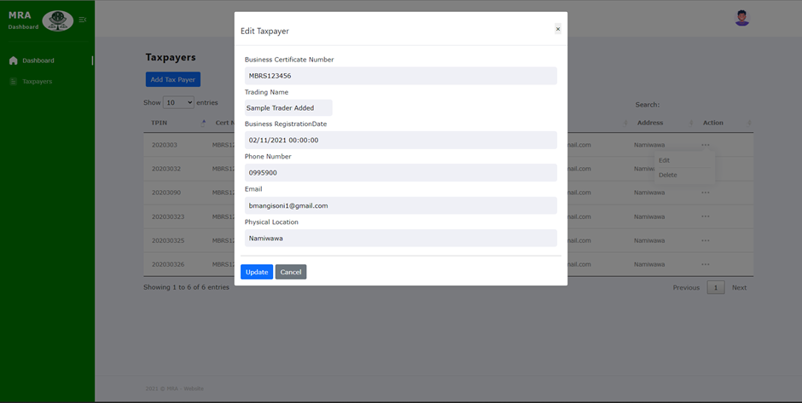
update Page

Slide 15
delete taxpayer
To remove a taxpayer, click on the 3 dots and the yellow button on a specific record, a modal is shown asking for conformation to proceed
Click okay if you are certain or Cancel if not
A notification is shown based on the status of the request
Next page shows the image

Slide 16
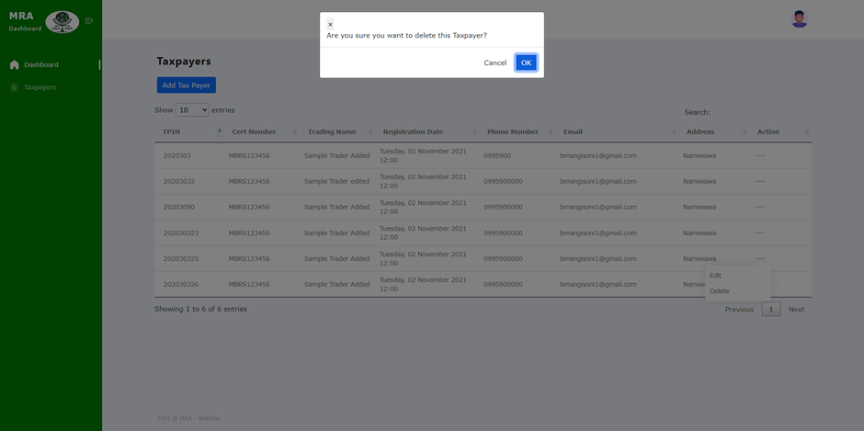
Delete Page

Slide 17
Logout
To logout, click on the avatar at the top right corner, a logout button is shown
Click it and the user is directed to the login page
See next page for image

Slide 18
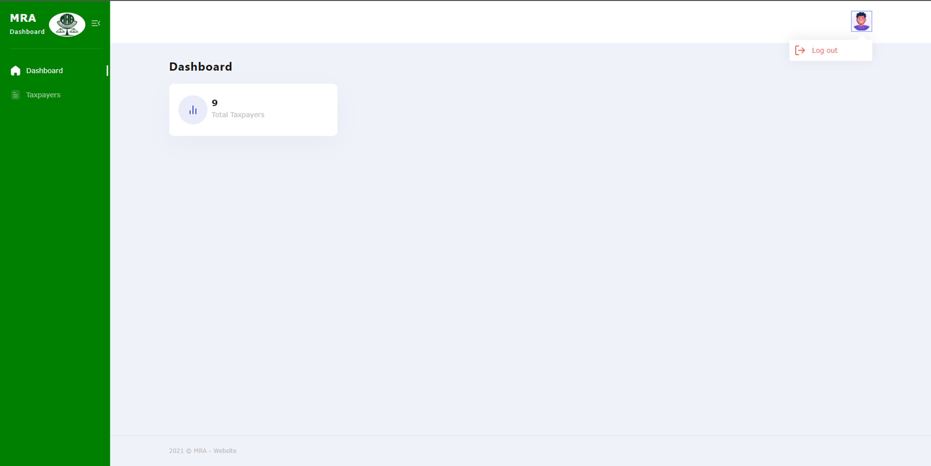
logout Page

Slide 19

Thank You
James simbi
Mjuweni@outlook.com
0882429263

