Slide 1
Blood & Money Detecting and Visualizing Blood Analyzer Anomalies
W205 Section 4 Final Project
James, Weixing, Annalaissa, Yang

Slide 2
Business Problem
Our client is a blood analyzer device manufacturer
They have thousands of customers throughout the nation
By federal law, every blood analyzer device must be regularly tested to ensure a baseline in measurements
Incorrect measurements can lead to false diagnosis
How can we improve predicting performance problems with the machines?

Slide 3
Our approach
We built a scalable data transformed pipeline using three aggregated client data sources:
Quality Control
Machine Raw
Sample Means
Used Recurrent Neural Net with Tensorflow to build a predictive model
And presented the analysis in two ways:
Tableau book to highlight statistical properties
Dynamic dashboard for visualizing outliers

Slide 4
Dataflow High-level
Load
Transform
Present
Load raw csv
Cleanse data
Push to database
Visualize data
Show outliers
Model
Build predictive model

Slide 5
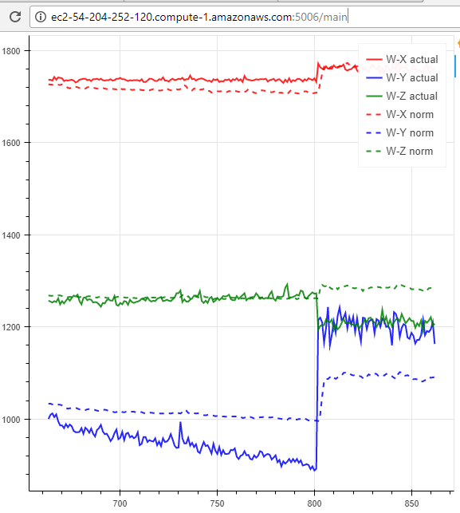
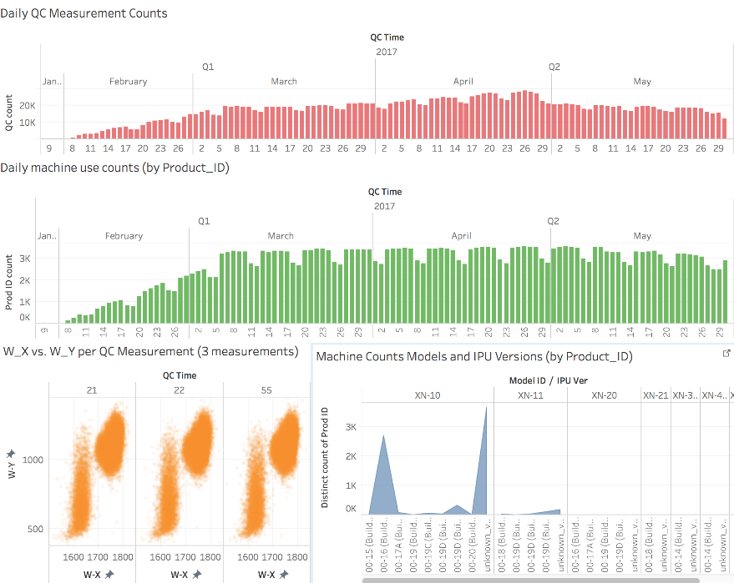
Results
Bokeh Dashboard | Tableau workbook

Slide 6
Future Expansions
Decreasing the overhead costs for diagnosing failing devices
Scalable real time data ingestion, to complement the streaming visualization
Leveraging a distributed architecture
More efficient data transformations and modeling
More robust architecture

Slide 7
Appendix: Dataflow Detailed

