Slide 1
Blood & Money Detecting and Visualizing Blood Analyzer Anomalies
W205 Section 4 Final Project
James, Weixing, Annalaissa, Yang
Notes:
YYQ

Slide 2
Business Problem
Our client is a blood analyzer device manufacturer
They have thousands of customers throughout the nation
By federal law, every blood analyzer device must be regularly tested to ensure a baseline in measurements
Incorrect measurements can lead to false diagnosis
How can we improve predicting performance problems with the machines?
Notes:
YYQ

Slide 3
Our approach
We built a scalable data transformation pipeline using three aggregated client data sources:
Quality Control
Machine Raw
Sample Means
Used Recurrent Neural Net with Tensorflow to build a predictive model
And presented the analysis in two ways:
Tableau book to highlight statistical properties
Dynamic dashboard for visualizing outliers
Notes:
YYQ

Slide 4
Dataflow High-level
Load
Transform
Present
Load raw csv
Cleanse data
Push to database
Visualize data
Show outliers
Model
Build predictive model
Notes:
YYQ

Slide 5
Components of the Project
Notes:
James

Slide 6
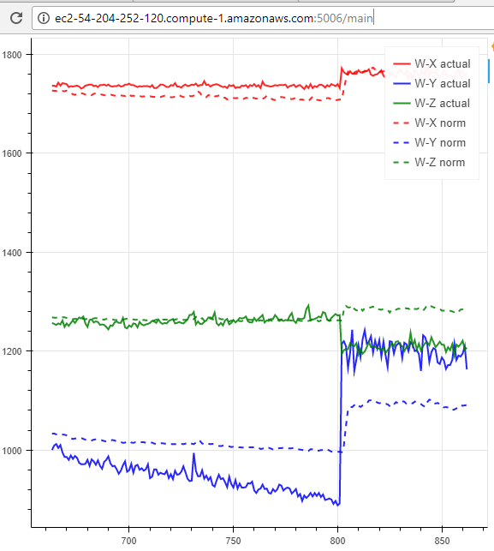
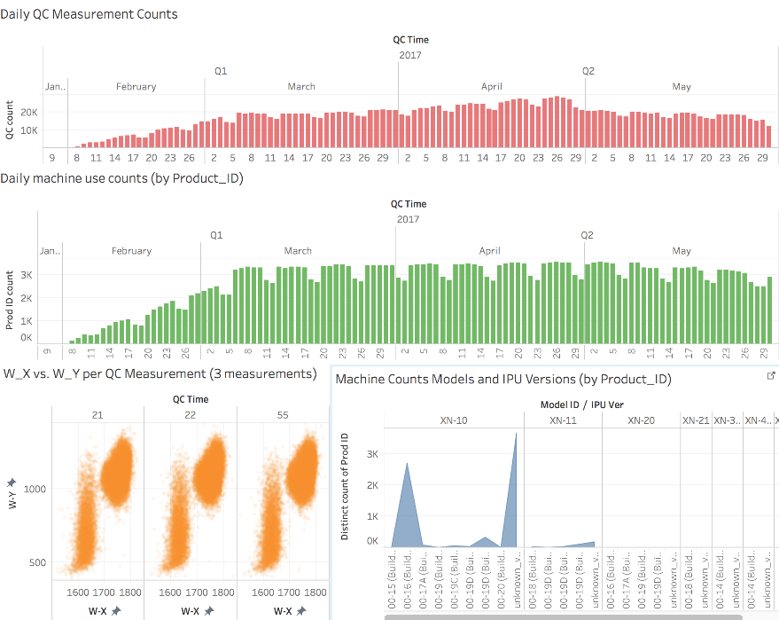
Results
Bokeh dashboard 1 “main.py” | Tableau workbook “qc_data_dashboard.twb”
Notes:
Bokeh streaming dashboard – YYQ
Tableau – Annalaissa

Slide 7
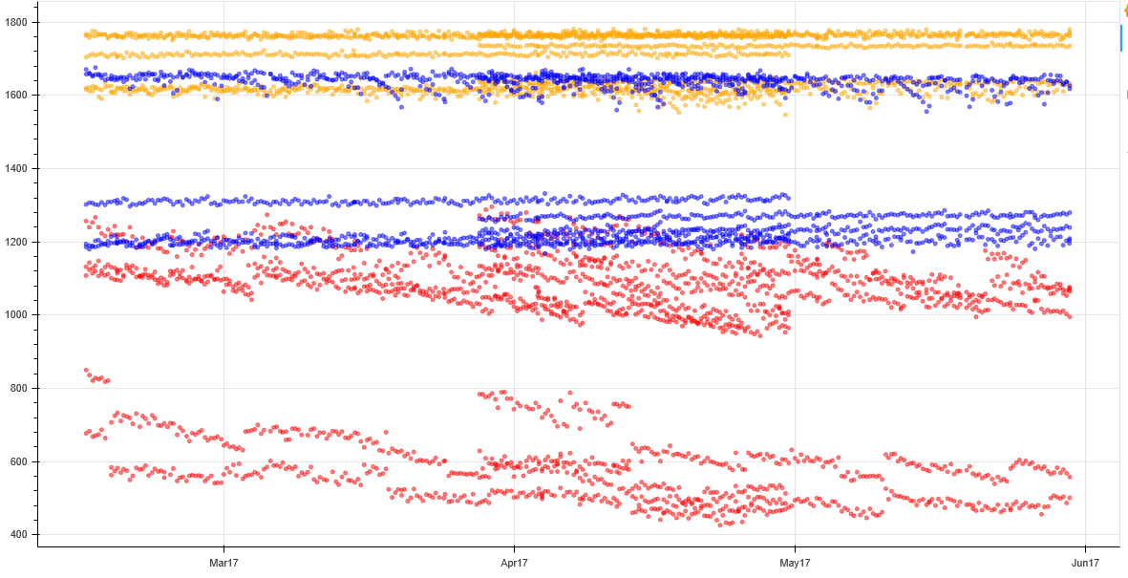
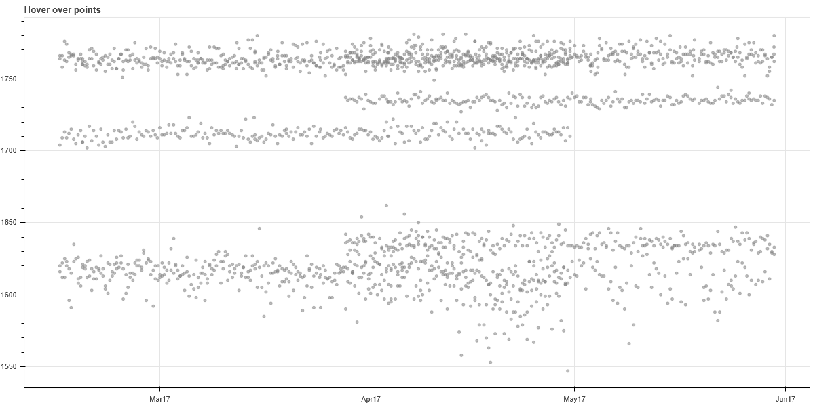
Results Continued
Bokeh dashboard 2 “qc_over_time.html” | Bokeh dashboard 3 “wx_select.html”
Notes:
Bokeh static dashboard - Weixing

Slide 8
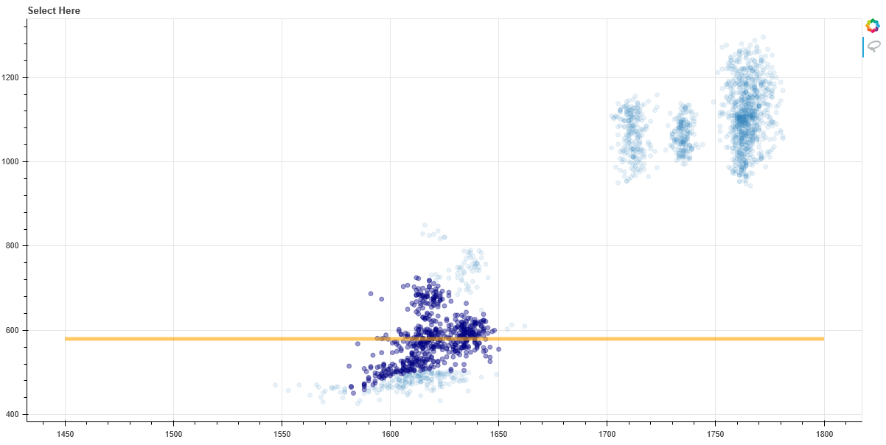
Results Continued
Bokeh dashboard 4 “wx_wy.html”
Notes:
Bokeh static dashboard - Weixing

Slide 9
Future Expansions
Decreasing the overhead costs for diagnosing failing devices
Scalable real time data ingestion, to complement the streaming visualization
Leveraging a distributed architecture
More efficient data transformations and modeling
More robust architecture
Notes:
Annalaissa

Slide 10
Appendix: Dataflow Detailed

