Slide 1

Amazon Book Review Analysis Author: James Warsing

Slide 2

Books: Adored and Abhorred
Books hold a significant place in our lives, evoking a wide range of emotions from love to disdain.
This analysis is crucial for enhancing customer satisfaction, as it allows Amazon to tailor recommendations that meet diverse preferences and needs.

Slide 3

Business Understanding
Amazon aims to enhance customer satisfaction and improve book recommendations.
Gain insights into customer sentiment through user reviews.
Predict review scores to tailor recommendations and identify areas for product improvement.

Slide 4
Data Understanding
The Amazon Book Review dataset consists of two large datasets of containing roughly 3 million rows of data. This robust data allows for many different types of models to used to make predictions.

Slide 5
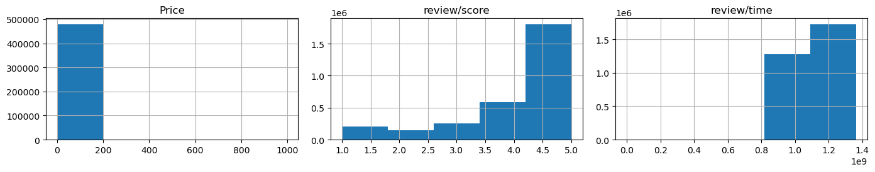
As we can see the distribution of numerical data is heavily imbalanced. This can cause issues down the line

Slide 6
Data Preparation
Combined the two large datasets then sampled it into a smaller set with balanced classes focusing on the scores of reviews.
Feature Extraction: Use TF-IDF to convert text data into numerical features suitable for machine learning models.

Slide 7
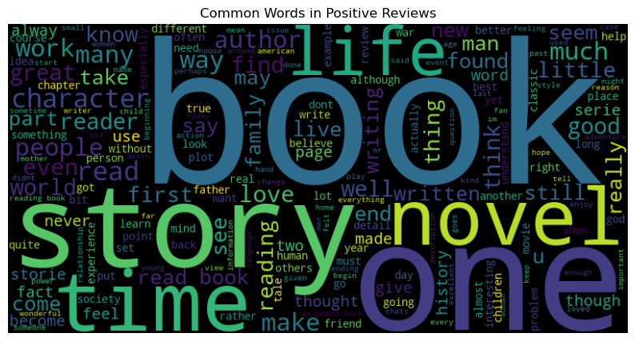
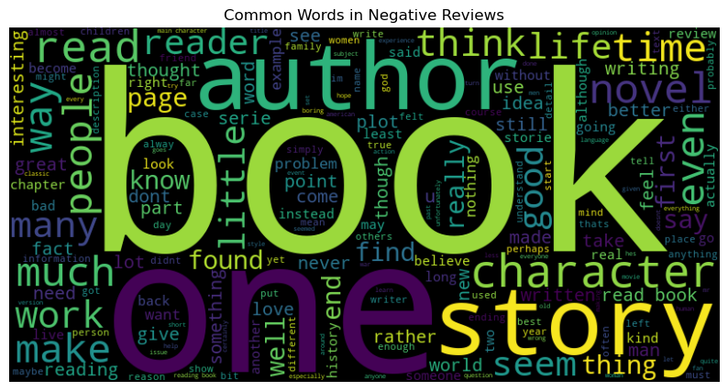
Word Cloud

Slide 8
Modeling
Logistic Regression: Simple and interpretable, helps predict positive ratings for better recommendations.
Random Forest: Robust, identifies important features influencing customer satisfaction.
XGBoost: High performance, handles imbalanced datasets, identifies highly satisfied customers.

Slide 9
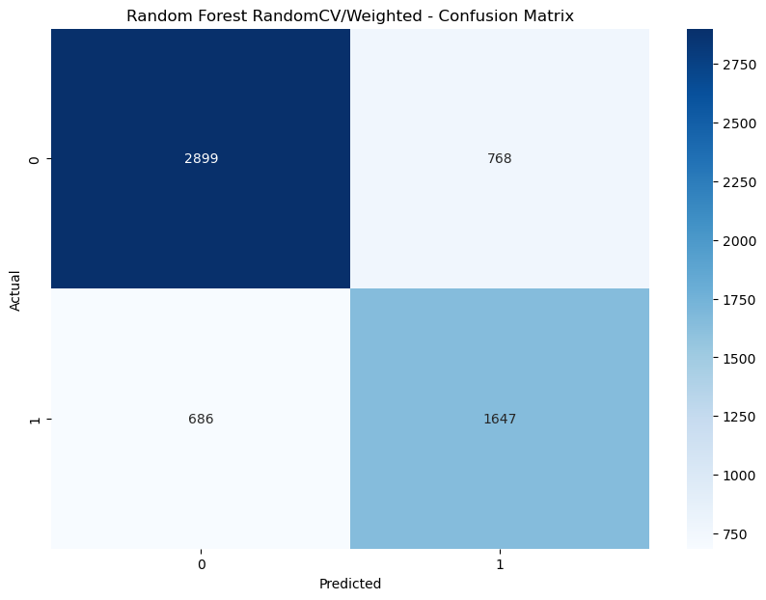
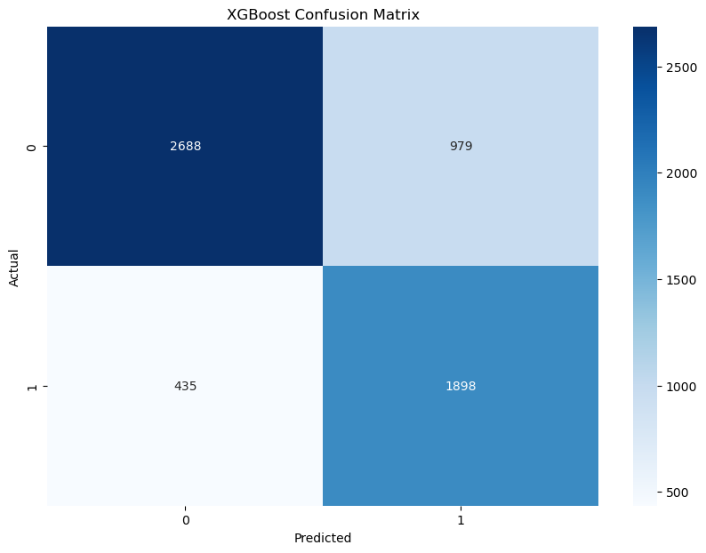
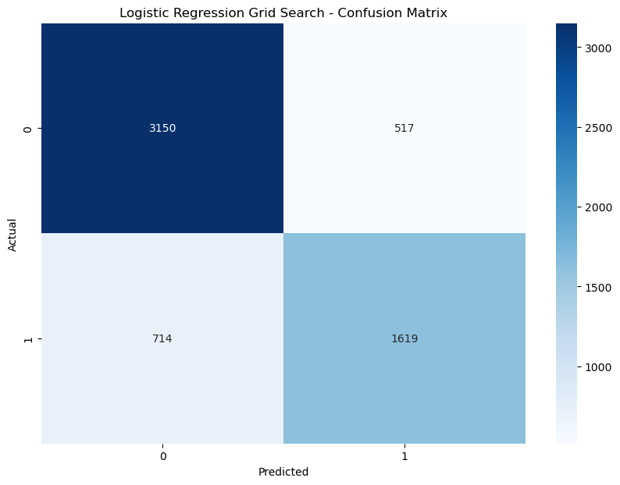

Slide 10
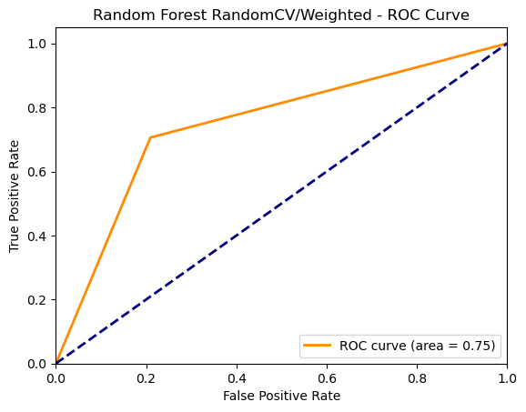
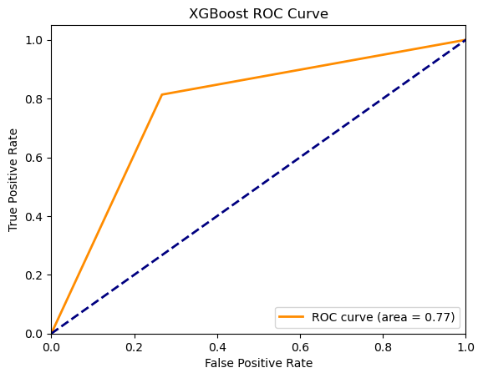
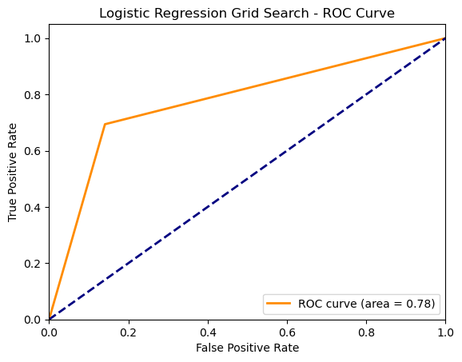

Slide 11
Evaluation
Confusion Matrices: Visualize model performance, showing true positives, false positives, true negatives, and false negatives, which are crucial for understanding model errors and areas for improvement.
ROC Curves: Illustrate the trade-off between sensitivity and specificity, helping in selecting the optimal model threshold.

Slide 12
Scores
Accuracy:
Indicates the overall correctness of the model.
Important for understanding the model's general reliability but should be considered alongside other metrics to get a full picture of performance.
Precision:
The proportion of true positive predictions out of all positive predictions made by the model.
Crucial for making accurate recommendations, as it minimizes the number of incorrect positive predictions.
Recall:
The proportion of actual positive cases correctly identified by the model.
Essential for identifying promoters, as it minimizes the number of missed positive reviews.
F1-Score:
The harmonic mean of precision and recall.
Helps in minimizing both false positives and false negatives, ensuring a balanced performance.
Logistic Regression: Accuracy: 0.79, Precision: 0.76, Recall: 0.69, F1-Score: 0.72
Random Forest: Accuracy: 0.76, Precision: 0.68, Recall: 0.71, F1-Score: 0.69
XGBoost: Accuracy: 0.76, Precision: 0.66, Recall: 0.81, F1-Score: 0.73

Slide 13
Best Model
With accuracy being our main metric, the Logistic Regression model would be the best bet to use.
Accurate recommendations maintain customer trust by consistently providing relevant book suggestions.

Slide 14
Sentiment Analysis
TextBlob: High recall indicates better identification of positive sentiments, crucial for highlighting satisfied customers.
VADER: Handles informal language well, suitable for social media text, and captures nuanced sentiments, helping in understanding customer emotions more accurately.
TextBlob: Accuracy: 0.43, Precision: 0.39, Recall: 0.81, F1-Score: 0.52
VADER: Accuracy: 0.45, Precision: 0.39, Recall: 0.71, F1-Score: 0.50

Slide 15

Business Recommendations
Improve Product Recommendations: Use Logistic Regression to predict positive ratings. Target Satisfied Customers: Use XGBoost to identify highly satisfied customers for testimonials and promotions. Identify Customer Issues: Use TextBlob and VADER to analyze reviews for common issues or complaints.

Slide 16

Next Steps
Invest in Advanced Text Analysis Tools: Explore models like BERT for better sentiment analysis. Continuous Model Improvement: Regularly update and fine-tune predictive models with new data.
Potential use of the cloud due to the sheer size of the data

Slide 17

Questions?
Thank you for your time, I will now take any questions!
Photo by Pexels

