Slide 1

HELLO!
CHESS
By James Zhuang and Wallace Gray

Slide 2
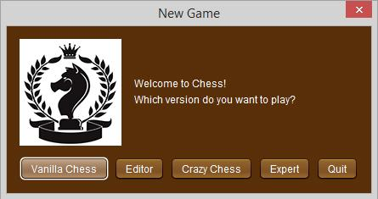
INTRO
AND
GAME MODES

Slide 3
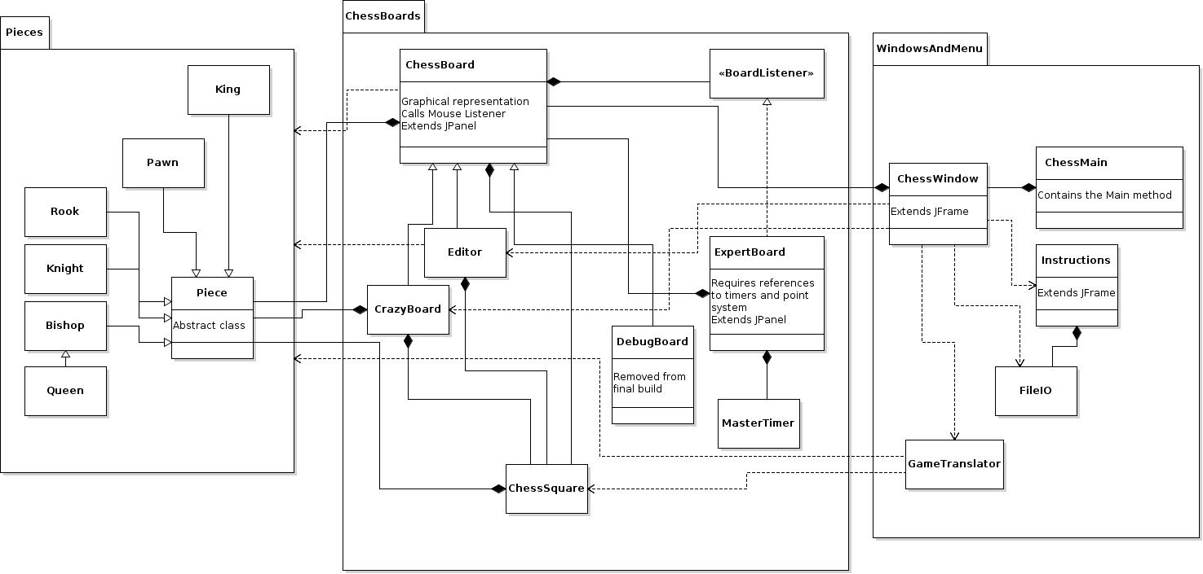
UML

Slide 4
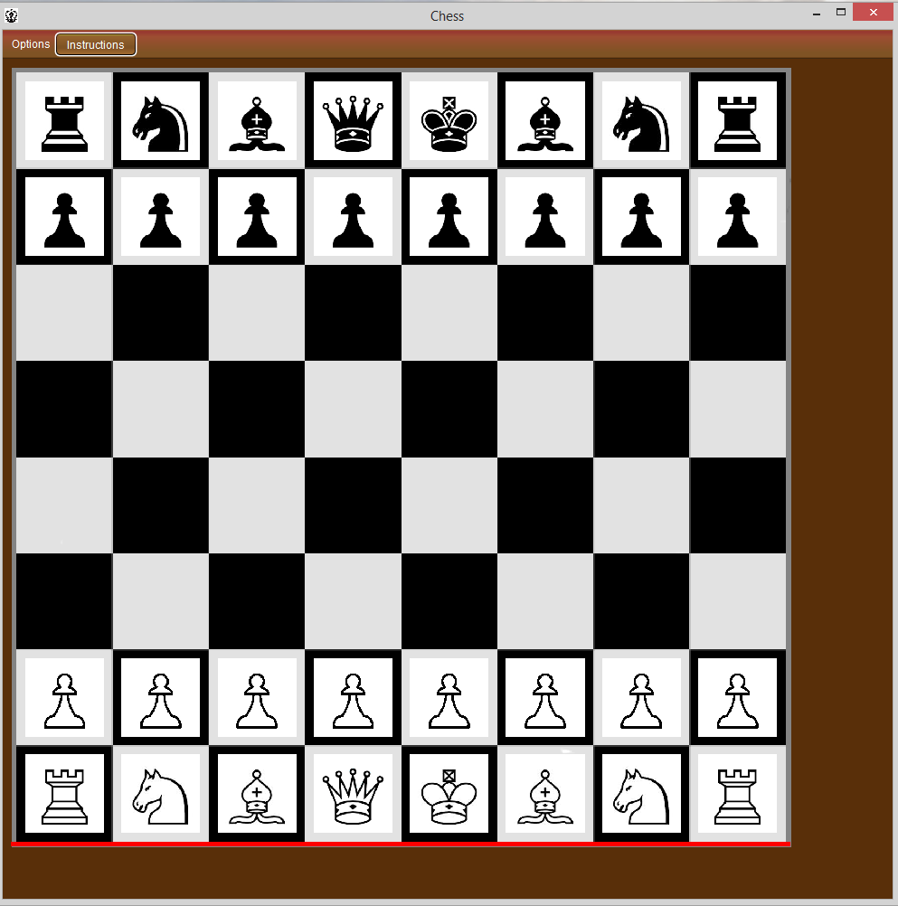
VANILLA CHESS

Slide 5
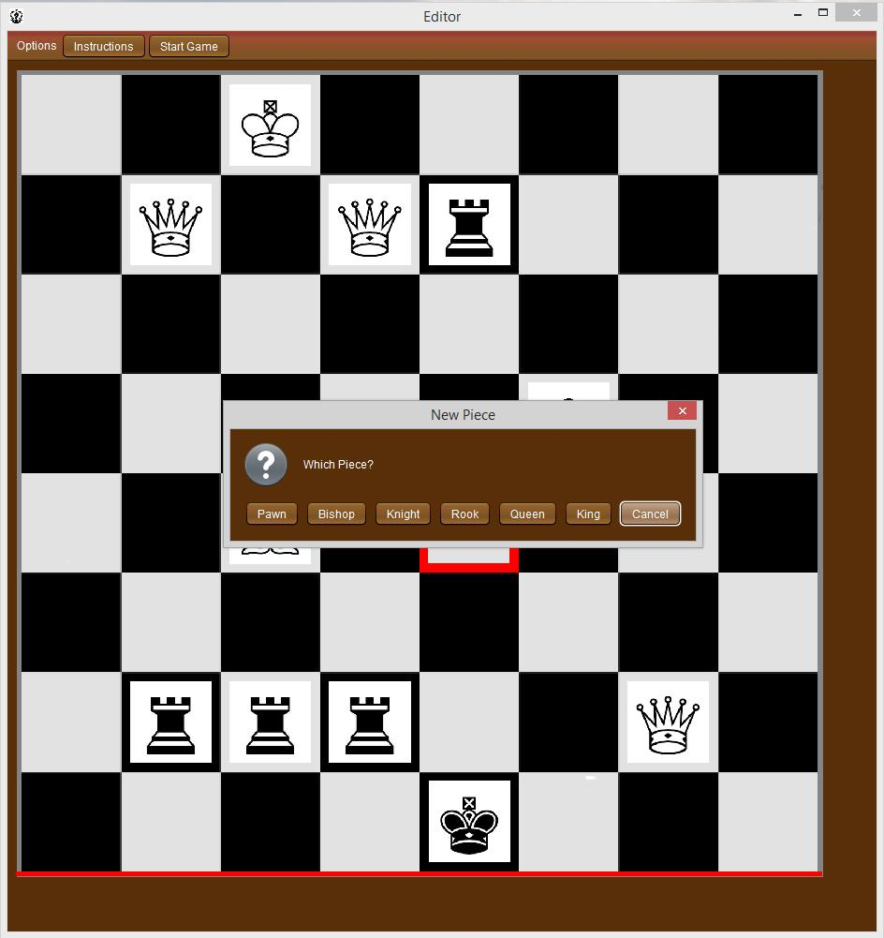
EDITOR

Slide 6
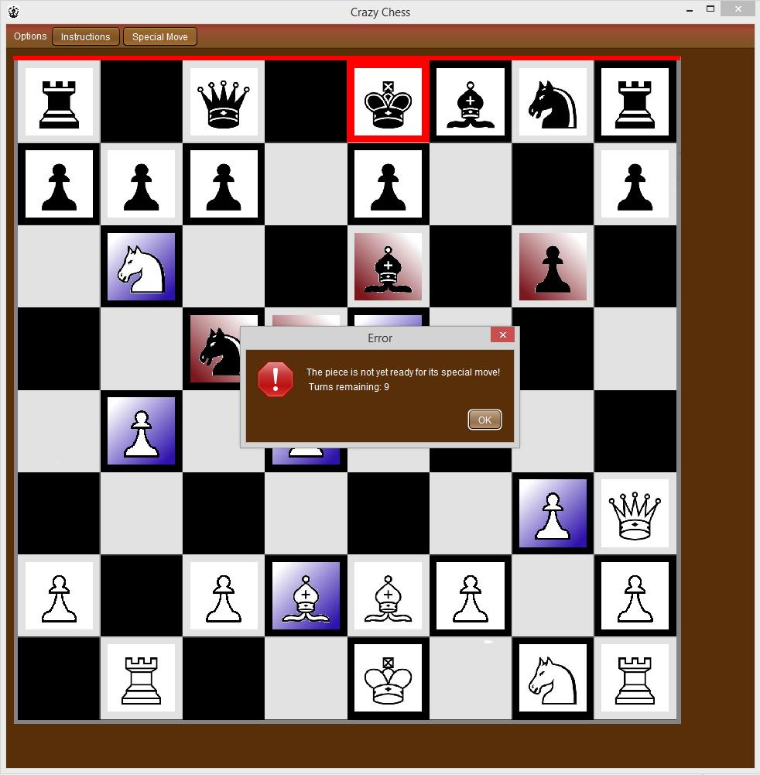
CRAZY CHESS

Slide 7
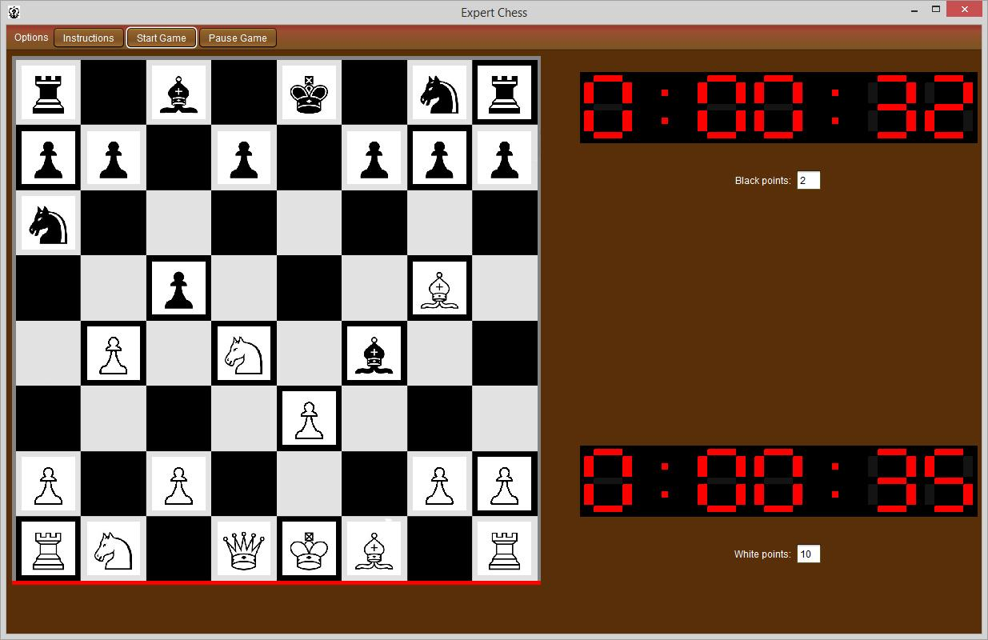
EXPERT

Slide 8

CODE OVERVIEW
Design Decisions
-Abstract Piece class
-Queen extends Bishop
-Inheritance of boards
-BoardListener interface
Hardest Problems
-Check/Checkmate algorithms
-Opening to Main Menu
-Layout for Expert Mode

Slide 9
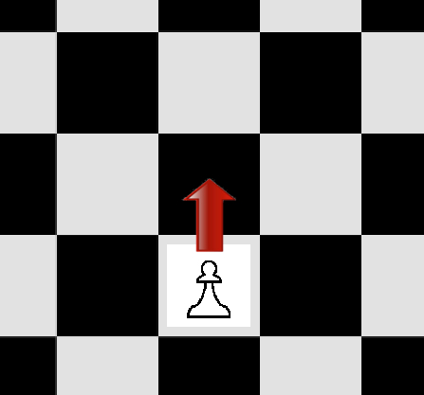

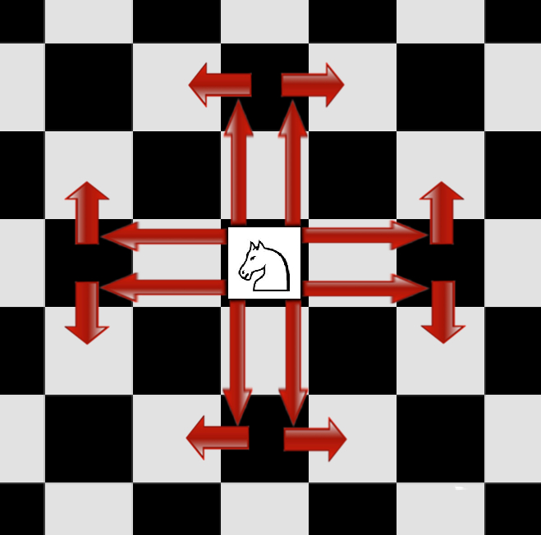
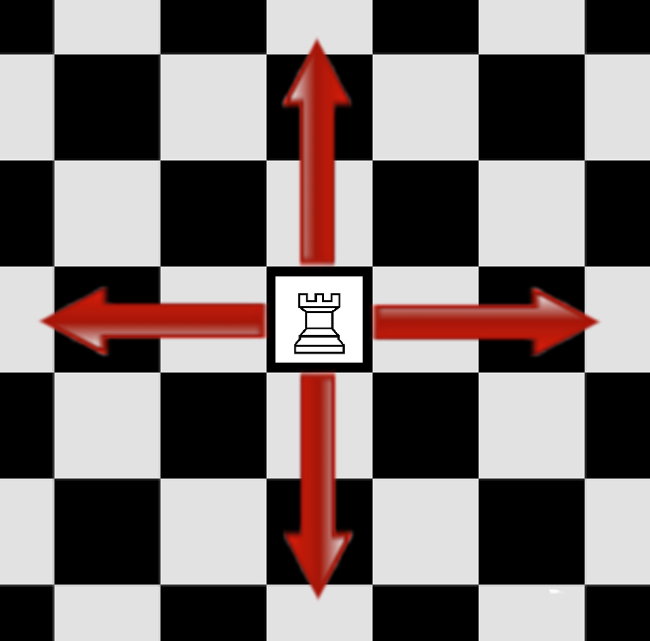


Ready to play? Controls:
If it’s your turn, click on a piece. Then select the square you want to move it to. For more information, see “Instructions.”

Slide 10

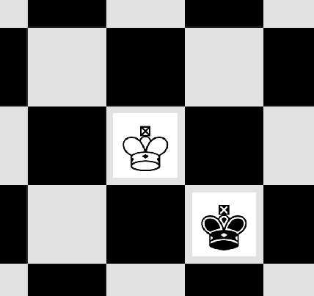
KNOWN BUGS
Bug 1:
Flaw in King’s check algorithm
Bug 2:
Expert Chess timers sometimes tiny
FIX:
Resize the screen - timers will resize properly
Bug 3:
Play again on editor mode does not work

Slide 11
NEXT STEPS
Smooth animations
Networking to play against opponents
Working AI to play against

