Slide 1

elasticsearch
What is it?
Why use it?
Architecture Overview
Scalability
Indexing
Searching
Locker elasticsearch
Demo

Slide 2
What is elasticsearch?
Scalable search technology
Apache Lucene core
Peer to peer
JSON in JSON out
REST API

Slide 3
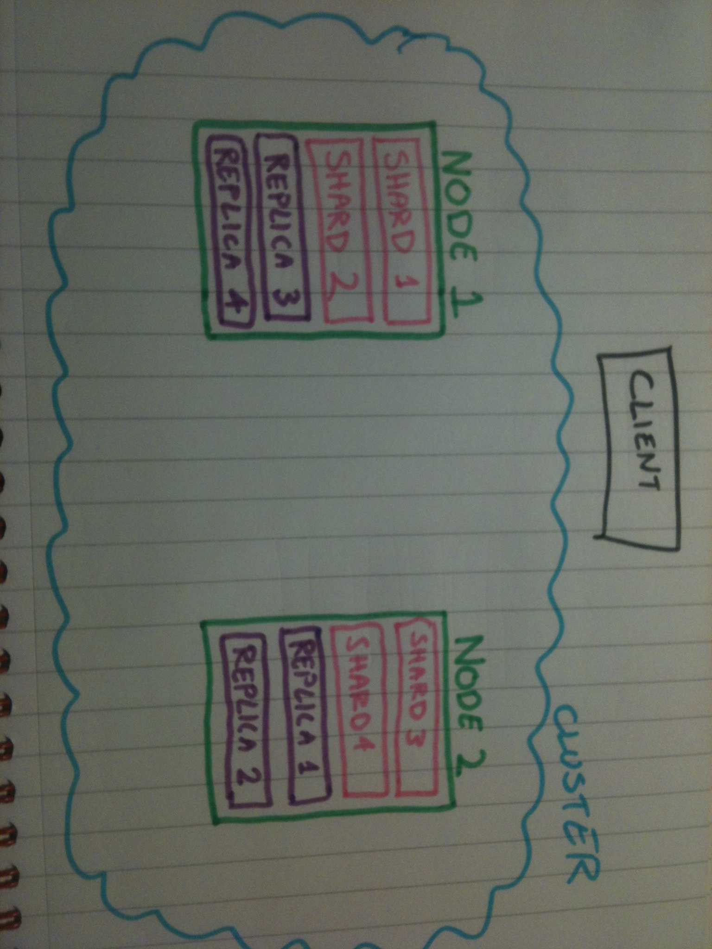
Architecture

Slide 4
Cluster
Conceptual “brain”
Represents a configuration of nodes
Contains at least 1 master node
Decides how to distribute shards
Decides how to distribute replicas

Slide 5
Nodes
An instance of Elasticsearch (e.g. a server)
Usually contains all or some shards of an index
Usually contains all or some replica shards of an index
Special types of node (e.g. clever load balancers)
This is what you send requests to (query / index)

Slide 6
Shard
Every index has at least 1
Read / write
Full Lucene index
Sharding of data is automatic out of the box
  Uses a hash of the document ID
  Can be overridden by “routing”

Slide 7
Replica
Read only copy of a shard
Promoted automatically when required
Never on same node as master shard
Therefore must have > 1 node for replicas

Slide 8
Lucene Index
Consists of index segments
Responsible for search
Responsible for indexing
Stores lucene documents
Stores fields
Stores terms
Does all the tokenizing / analysing

Slide 9
Index
“Schemaless...” (not really)
Consists of 1 or more types
Types have 1 mapping
Think:
  Index = database
  Type = table
  Mapping = schema
  Document = row
  Field = column

Slide 10
Recap
Architecture of a cluster:
  Cluster
  Nodes
  Indices
  Shards
  Replicas
  Lucene indices

Slide 11
Scalability
Number of shards is fixed at index creation
You can scale to the number of shards
So unit of scalability is predetermined
As easy as starting a new instance of elasticsearch
Shard / replica distribution is automatic

Slide 12
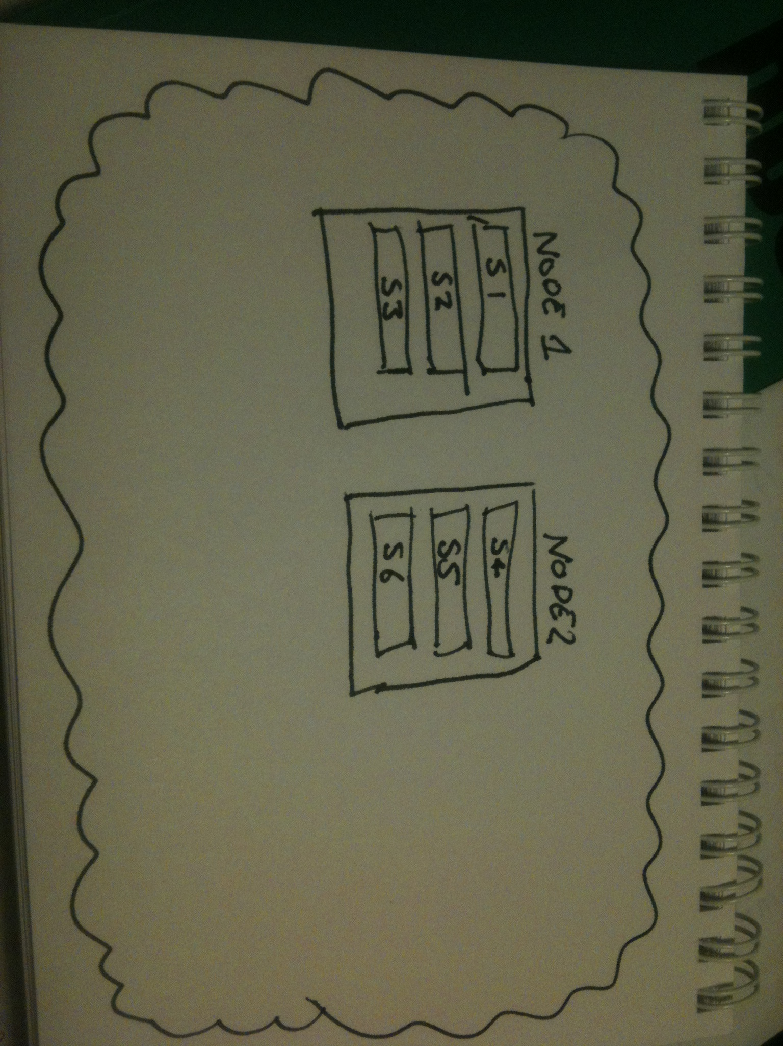
Scalability

Slide 13
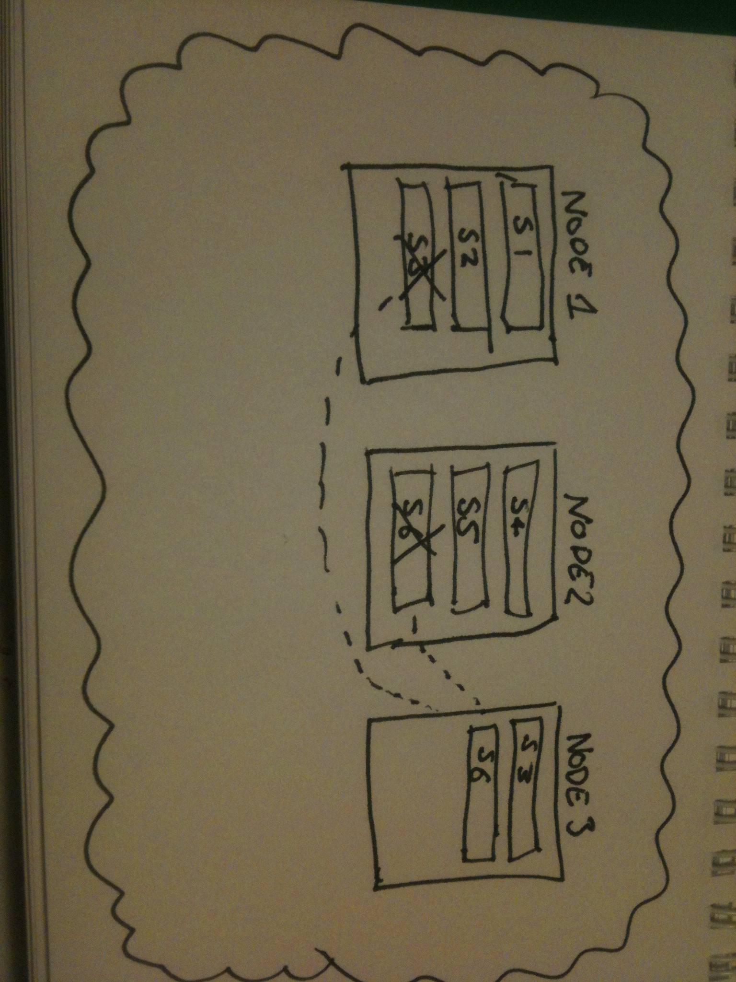
Scalability

Slide 14
Indexing
Json in (to elasticsearch/index/type/)
Hash document & delegate
Flatten json document into unique fields
Analyze the values of the fields to produce terms
Index fields and terms using lucene

Slide 15
Indexing
Sending data to elasticsearch with curl:
curl -XPOST http://localhost:9200/MyIndex/MyType/ -d
{
“name” : “james lewis”,
“age” : 29,
“address” : {
“street” : “blah”,
“postcode” : “N44EU”
}
}

Slide 16
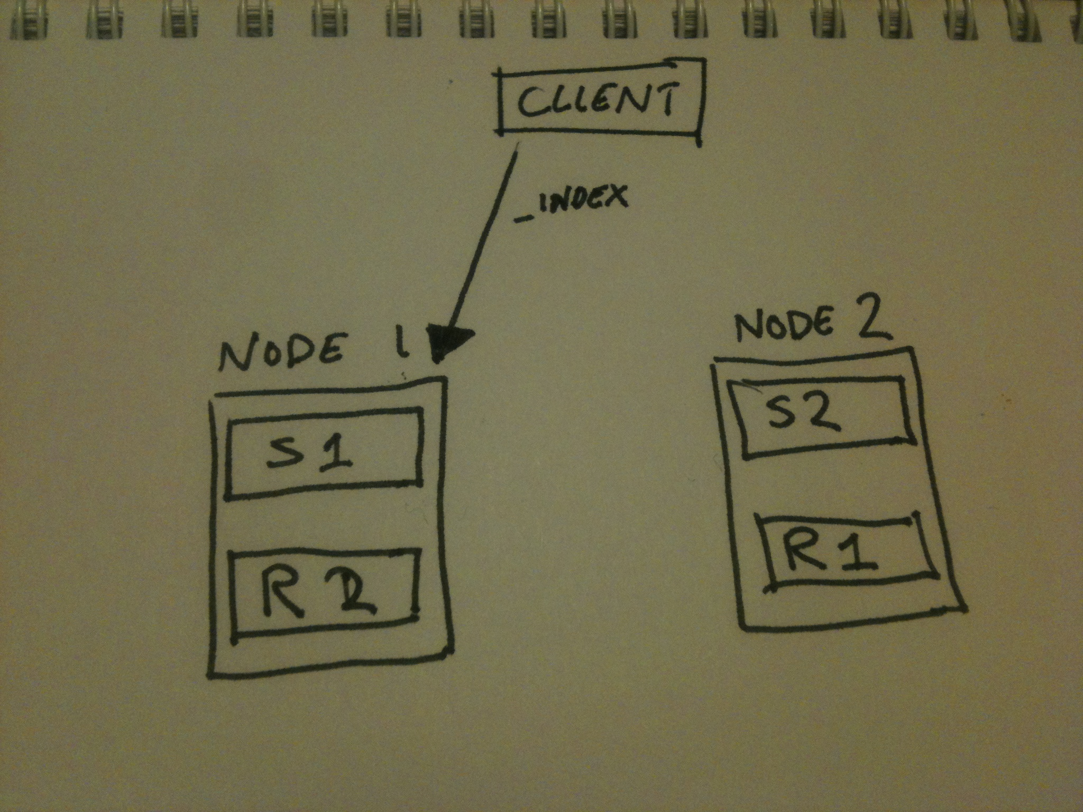
Indexing

Slide 17
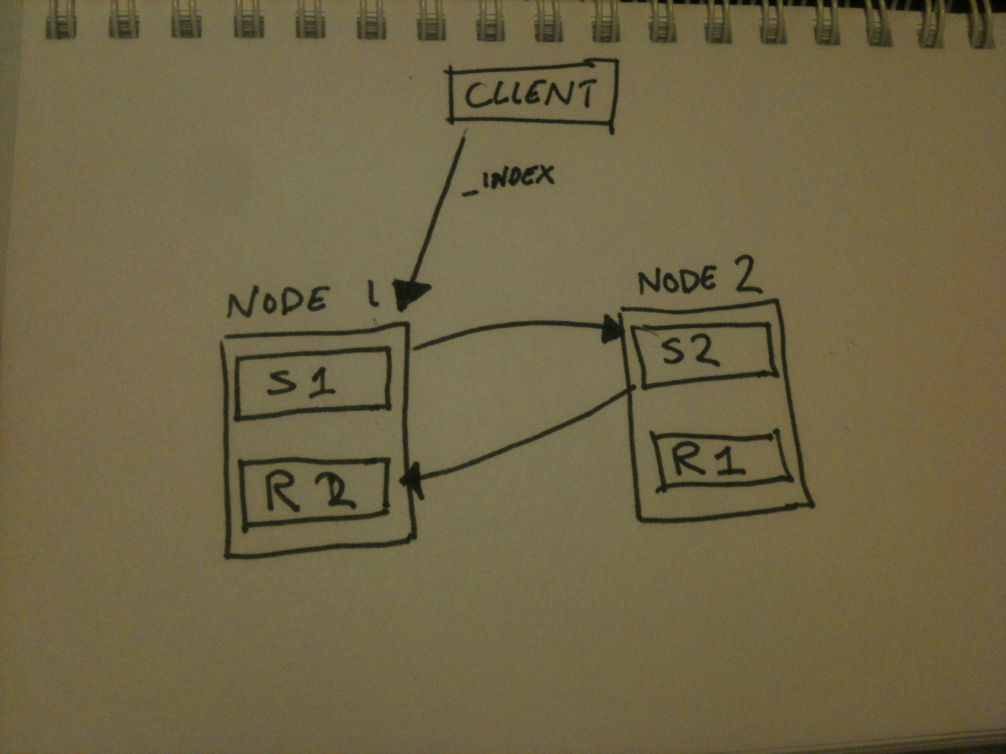
Indexing

Slide 18
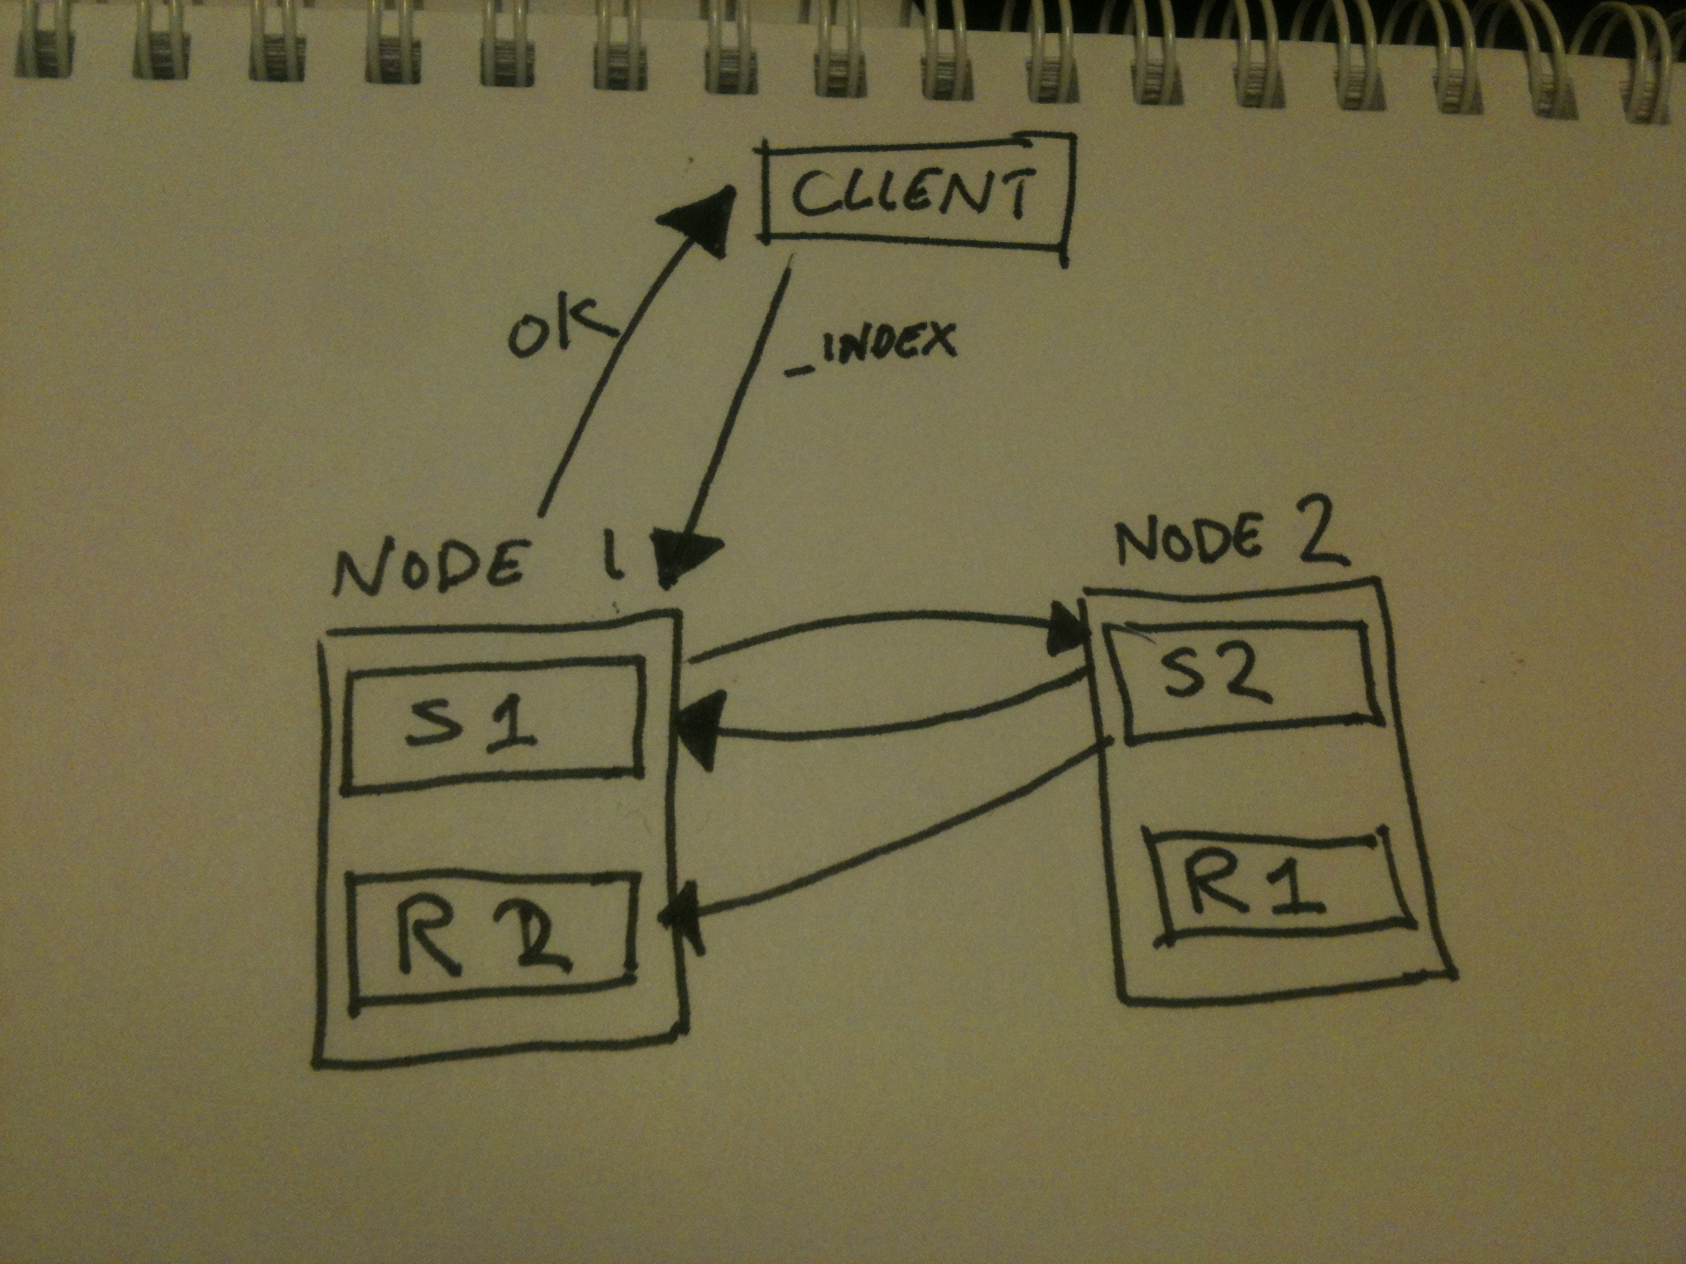
Indexing

Slide 19
Basic Searching
Json in (to elasticsearch/index/_search or /type/_search)
Searches every lucene index (shard)
Aggregates results from each shard
Returns result set as json
A node can delegate a search to a shard or a replica (think; load balance)

Slide 20
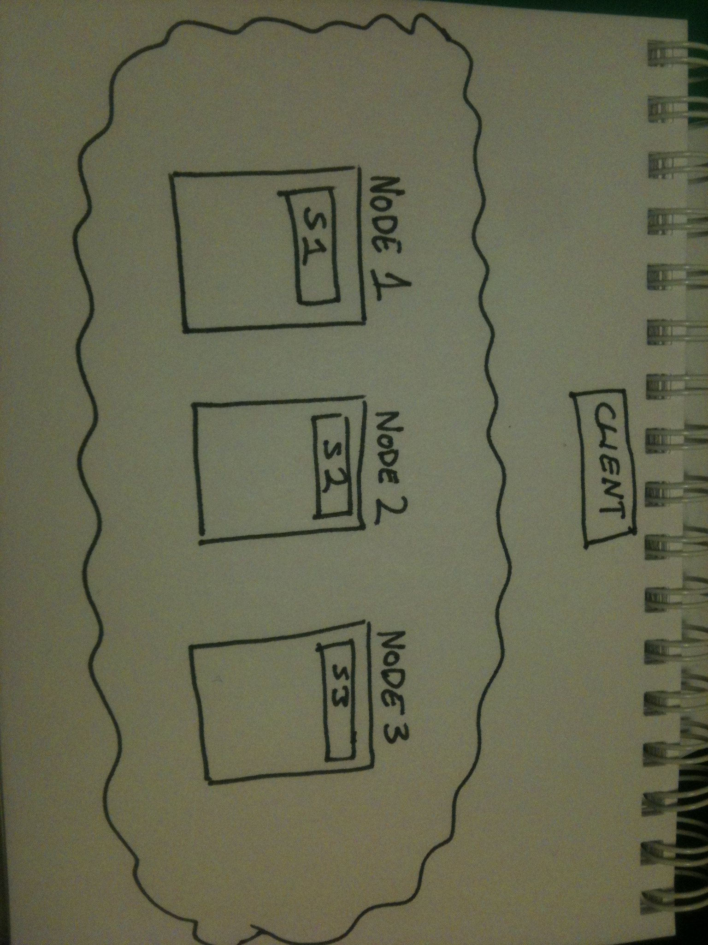
Basic Searching

Slide 21
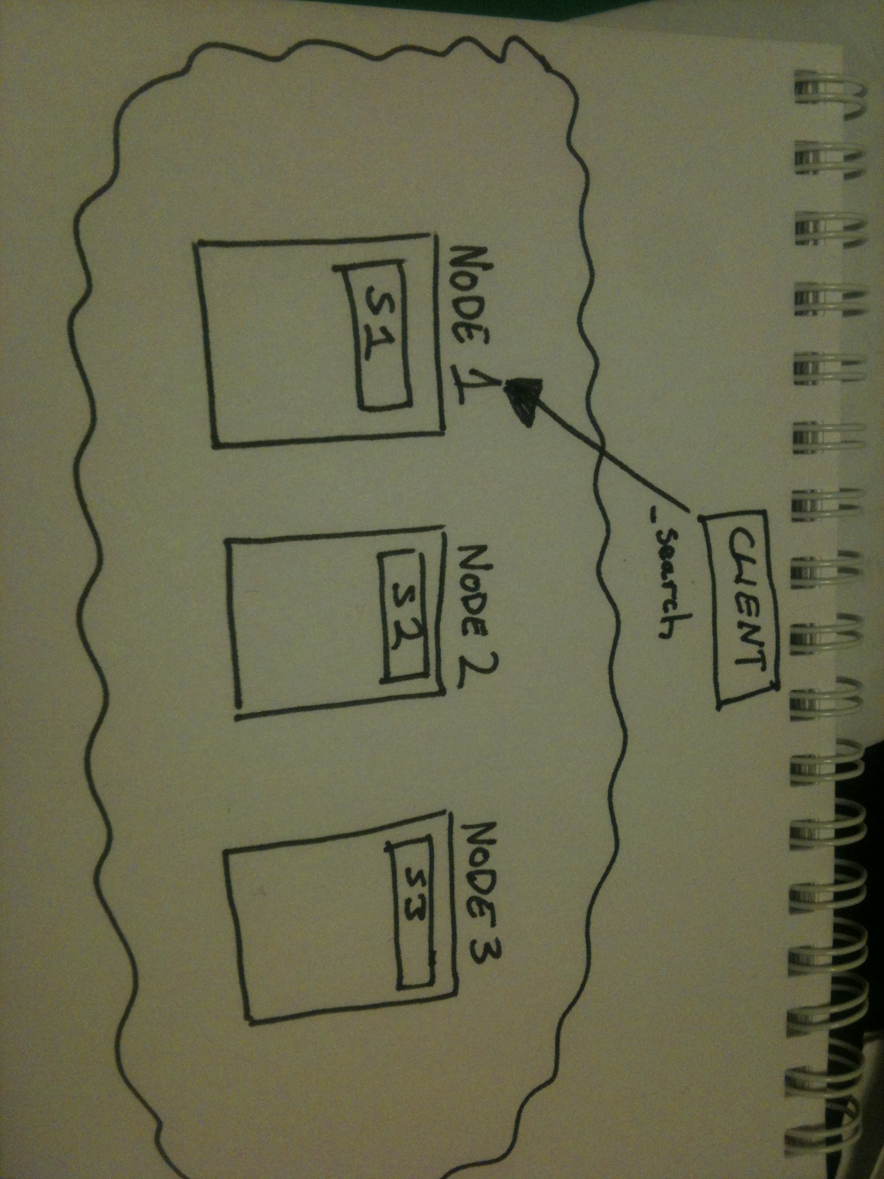
Basic Searching

Slide 22
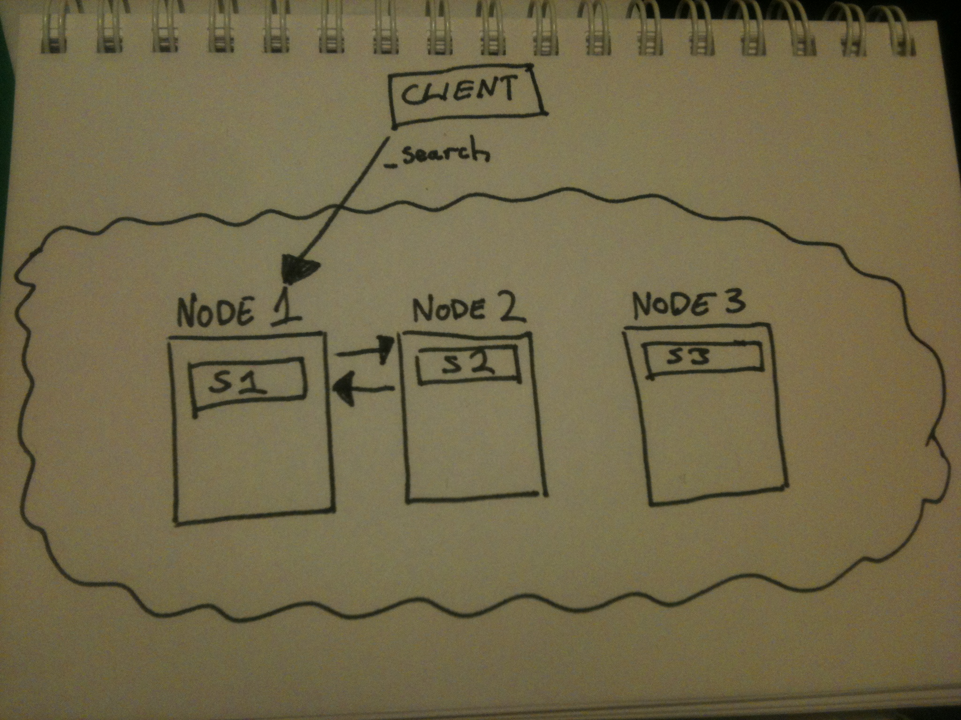
Basic Searching

Slide 23
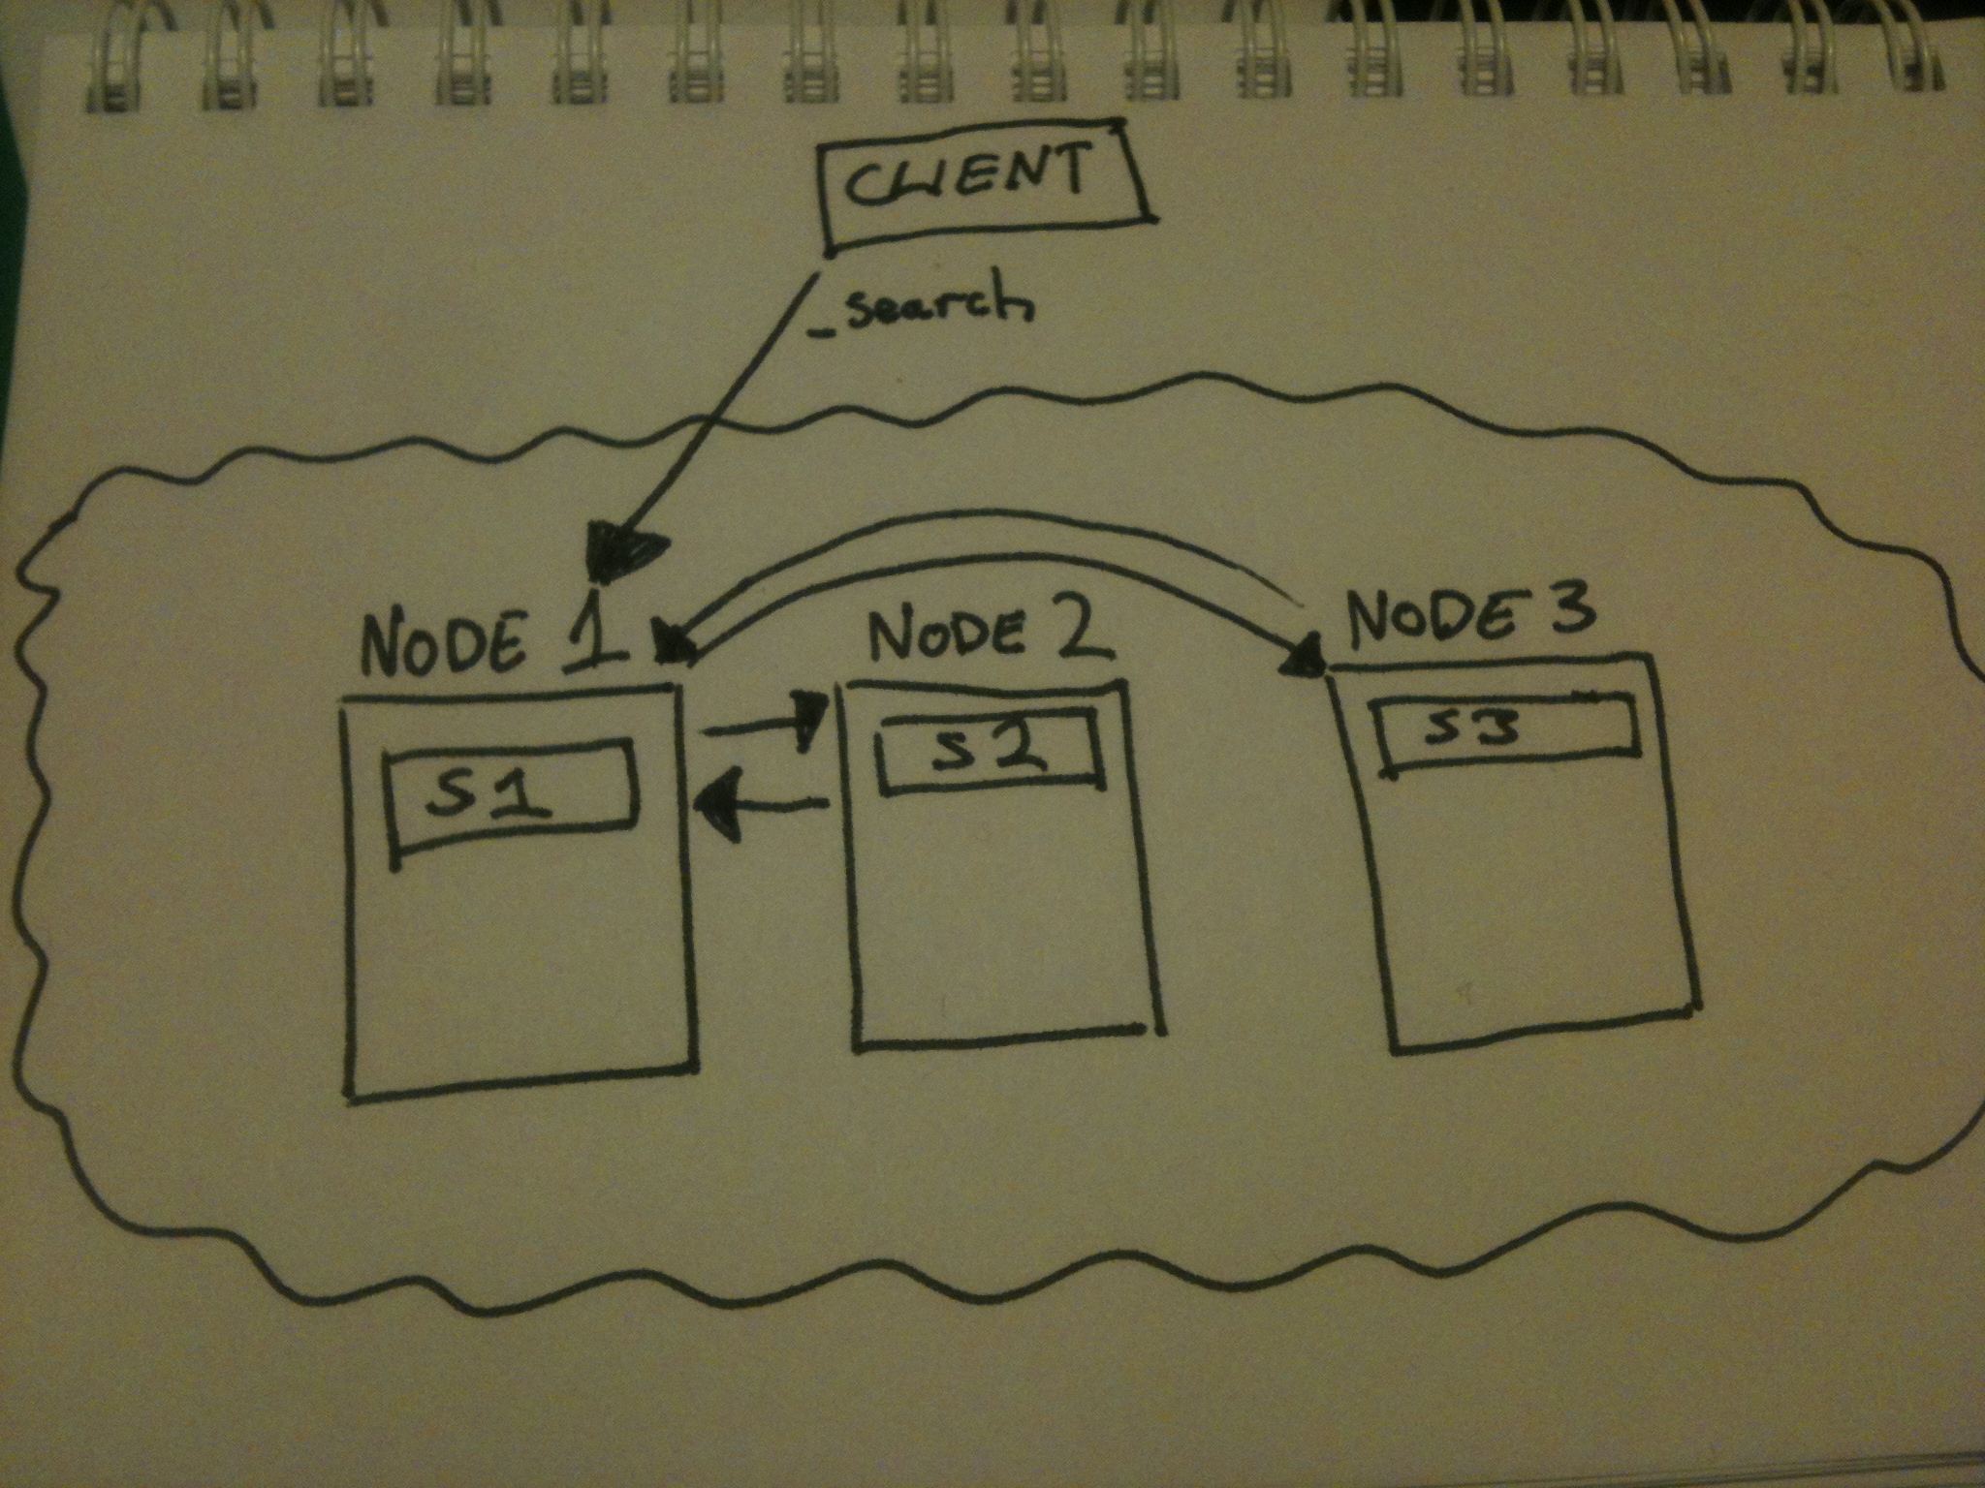
Basic Searching

Slide 24
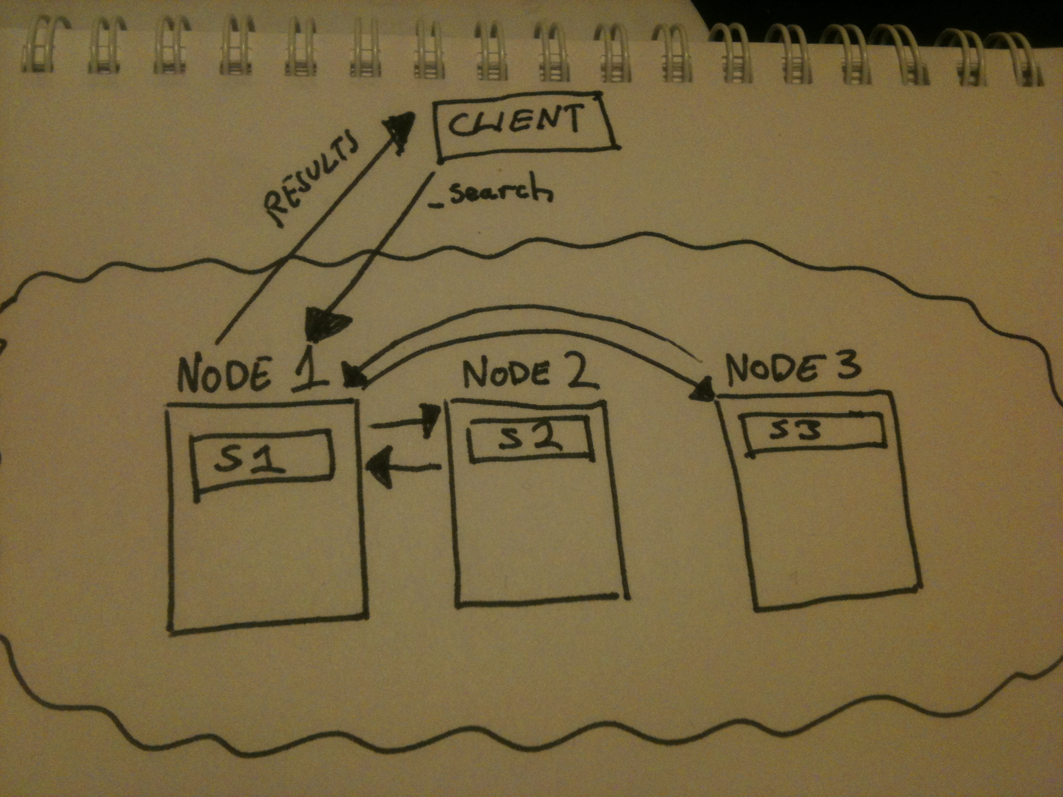
Basic Searching

Slide 25
Advanced Searching
Filters
  Subset of data
Routing
  For shards
Aliases
  Multi index, routing, filter
Faceted
  Grouped

Slide 26
Locker elasticsearch
1 index (called “inbox”)
1 replica index
Over allocated shards (so 100 shards, 100 replicas)
2 non-data nodes for load balancing
6 data nodes (~17 shards each + replicas)
Use aliases for all indexing & search operations
  Filter on user id
  Route on user id

Slide 27
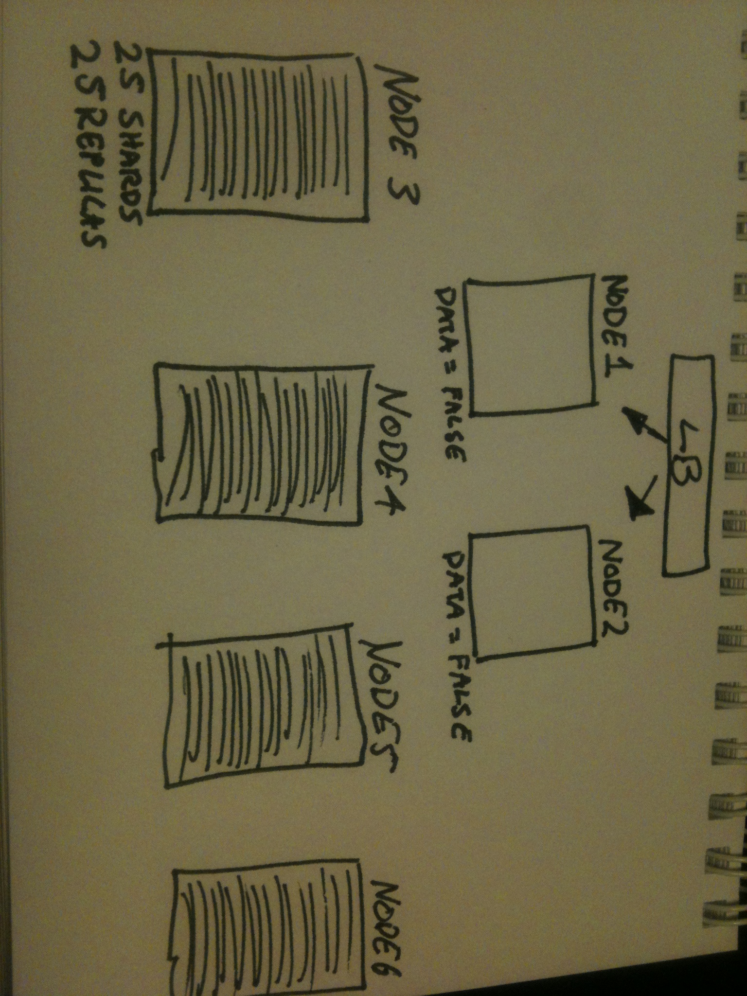
Locker elasticsearch

Slide 28
Demo
Have a look at paramedic...

