Slide 1
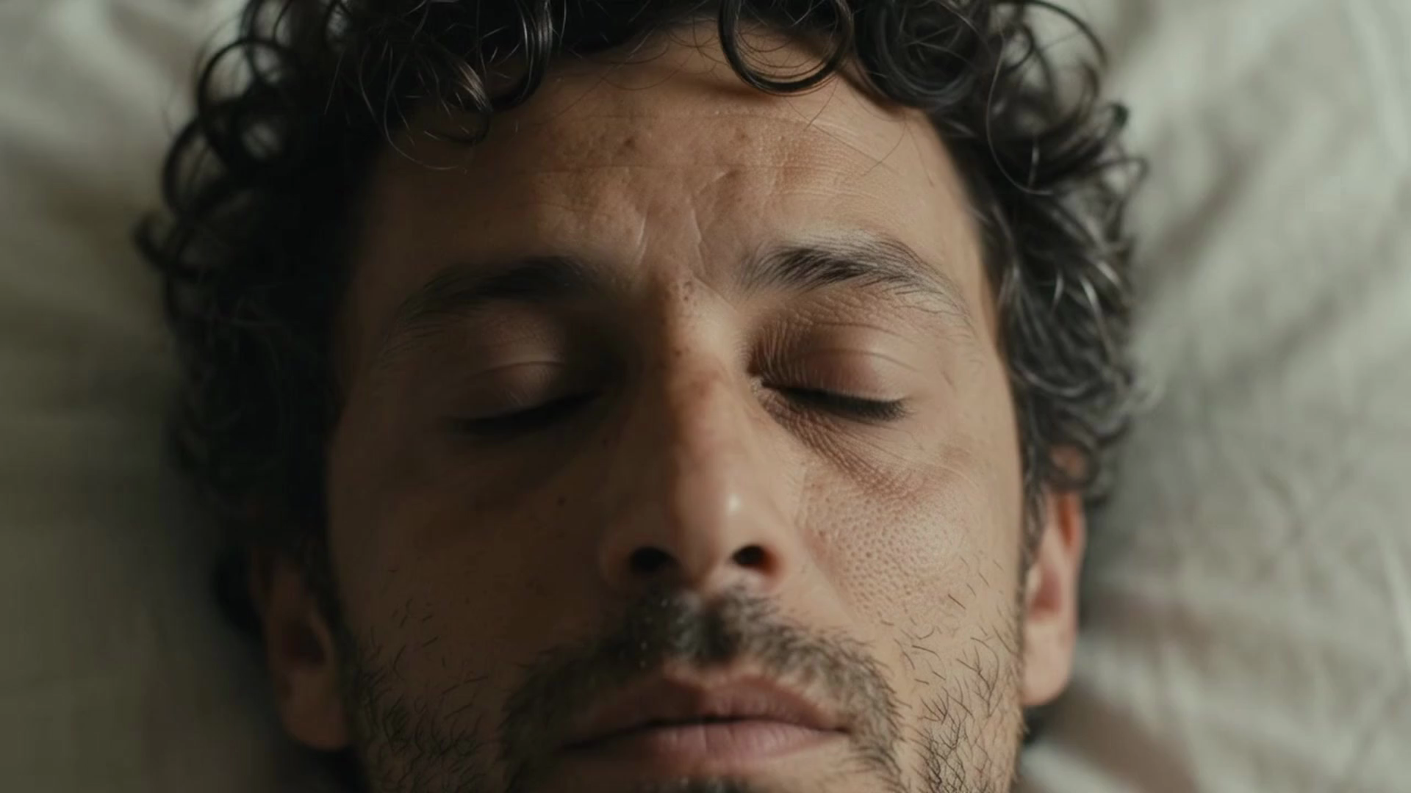
Notes:
0:00–1:00. Opening film. Let the soundtrack lead. Do not speak over it. The camera-preview and coaching sequence is a scripted product demonstration, not a validation study of the generated actor. The Finn reminder is a proposed notification experience, composited for this film. Continuous source video replaces simulator playback. Vision landmark positions are interpolated for visual smoothness in this scripted product demonstration.

Slide 2
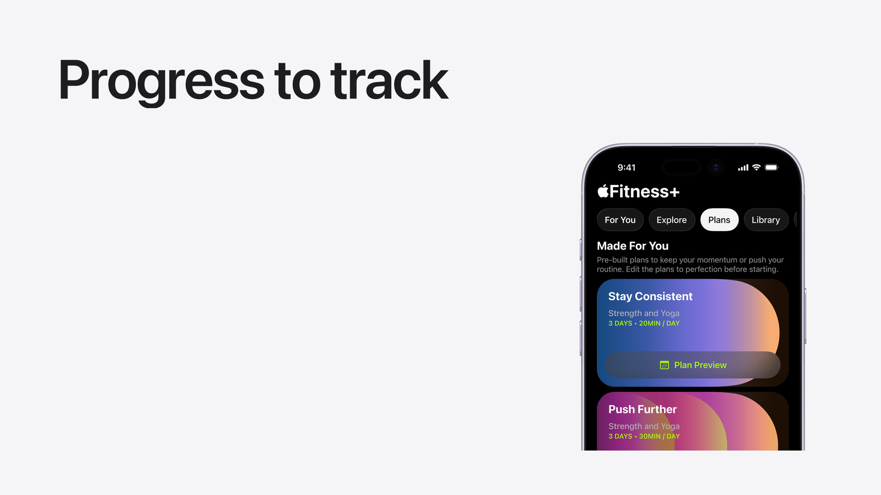
Notes:
1:00–1:30. Fitness apps have made getting started easier. Apple Fitness+ offers guided workouts. Workout and logging apps help us keep track of what we do. But following a class and recording a set do not, by themselves, tell us how our own movement changed. Camera form coaches already exist, including Tempo. Our focus is bringing a clear movement-feedback loop to an iPhone and Apple Watch.
Sources: https://www.apple.com/apple-fitness-plus/ ; https://www.hevyapp.com/ ; https://support.tempo.fit/support/solutions/articles/151000154714-3d-tempo-vision-form-feedback

Slide 3
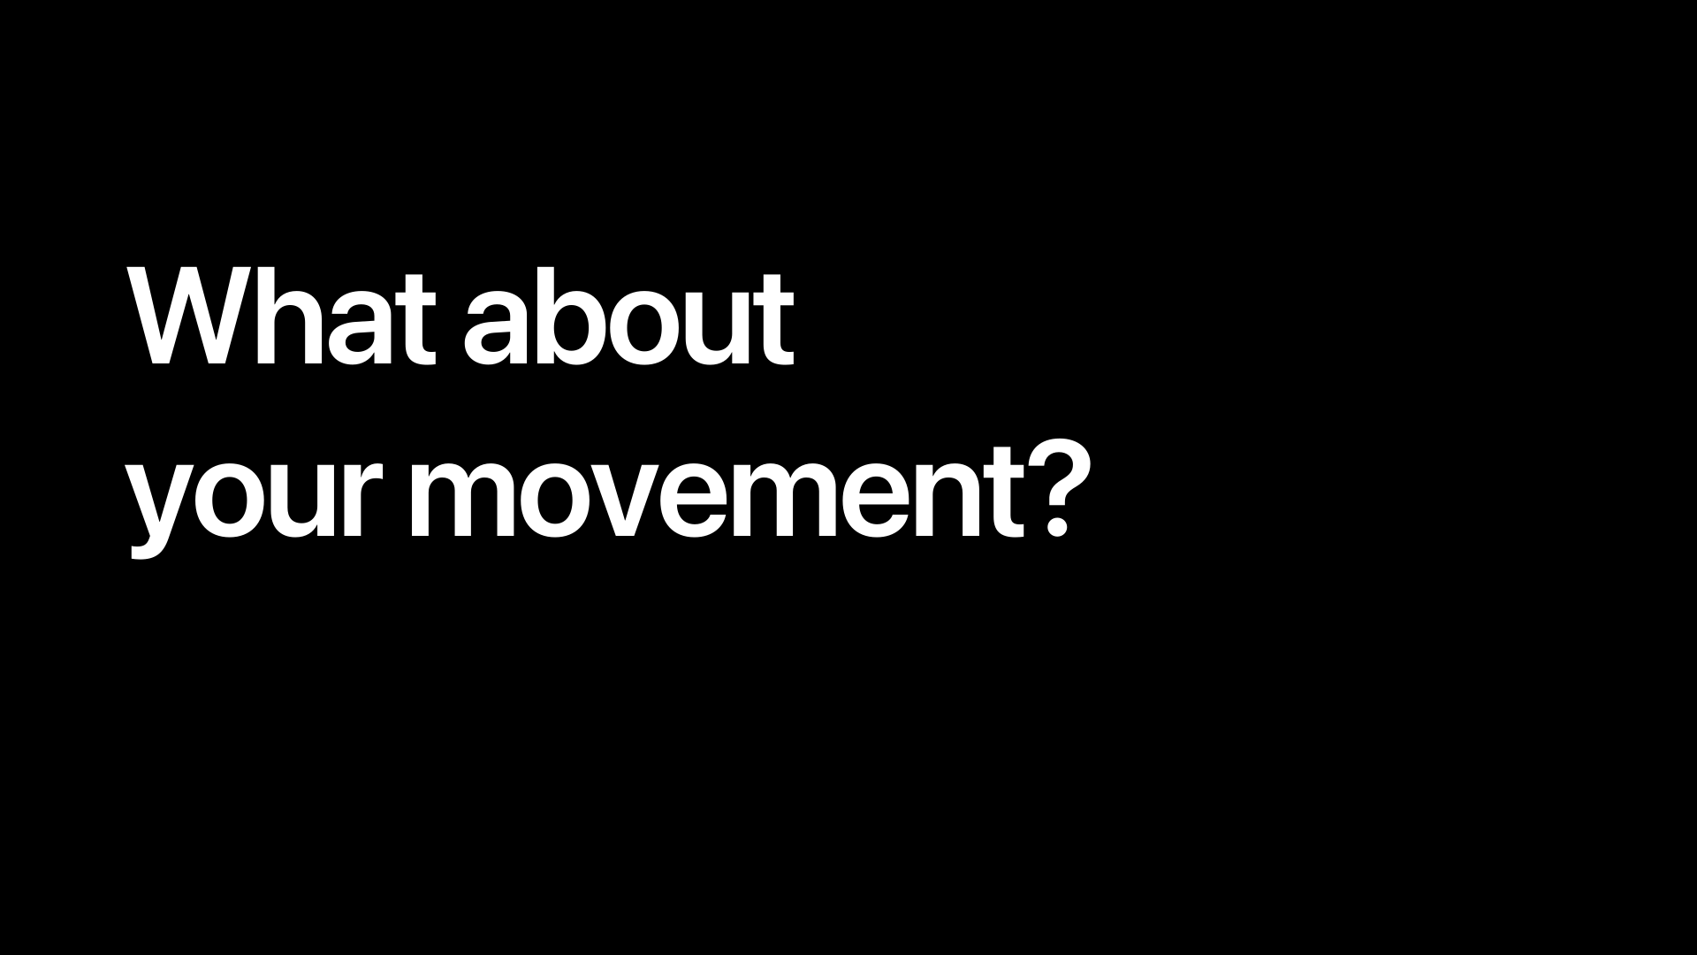
Notes:
1:30–1:45. When you train alone, who sees the rep you cannot see? That is the problem Finn takes on. A view of your own movement, and one useful adjustment for the next set.

Slide 4
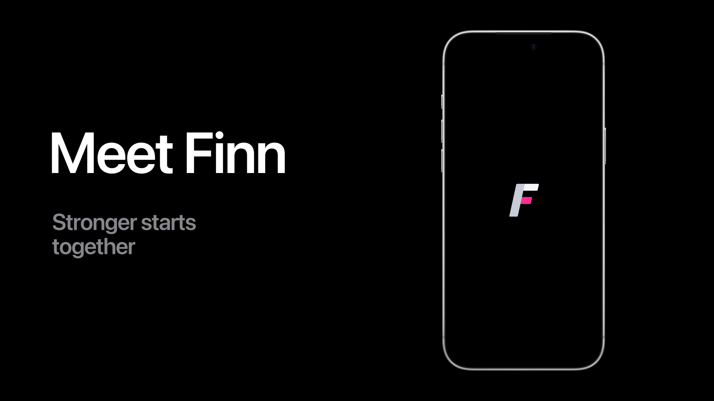
Notes:
1:45–2:05. Meet Finn. A second perspective on the way you move. Set down your iPhone, choose an exercise, and start a set. Finn is still in implementation. This walkthrough shows the current experience with scripted example coaching.

Slide 5
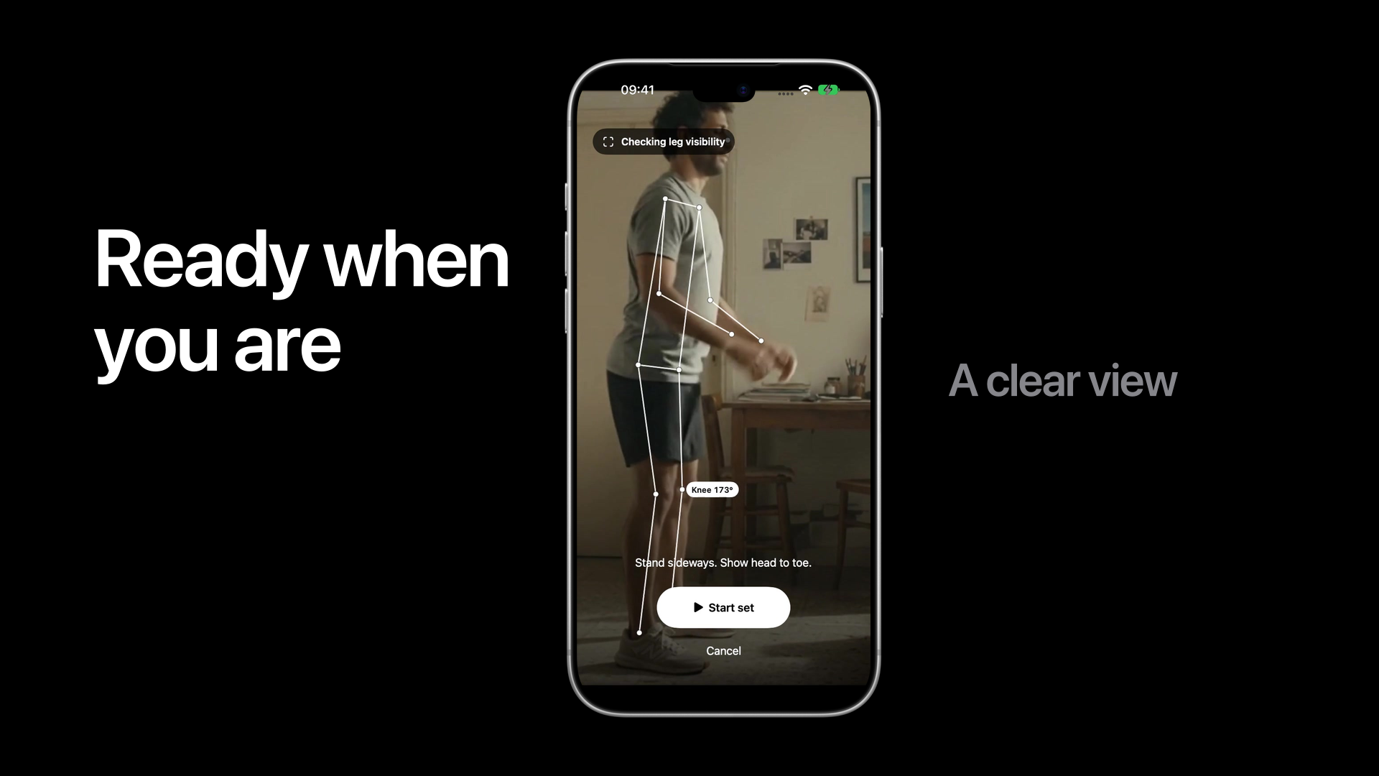
Notes:
2:05–2:30. Start with the exercise you want to work on. Finn helps you find the right camera view. For this squat, that means standing sideways with your whole body visible. Once the camera can see the joints it needs, start the set and focus on the movement. [Advance to begin the set.]

Slide 6
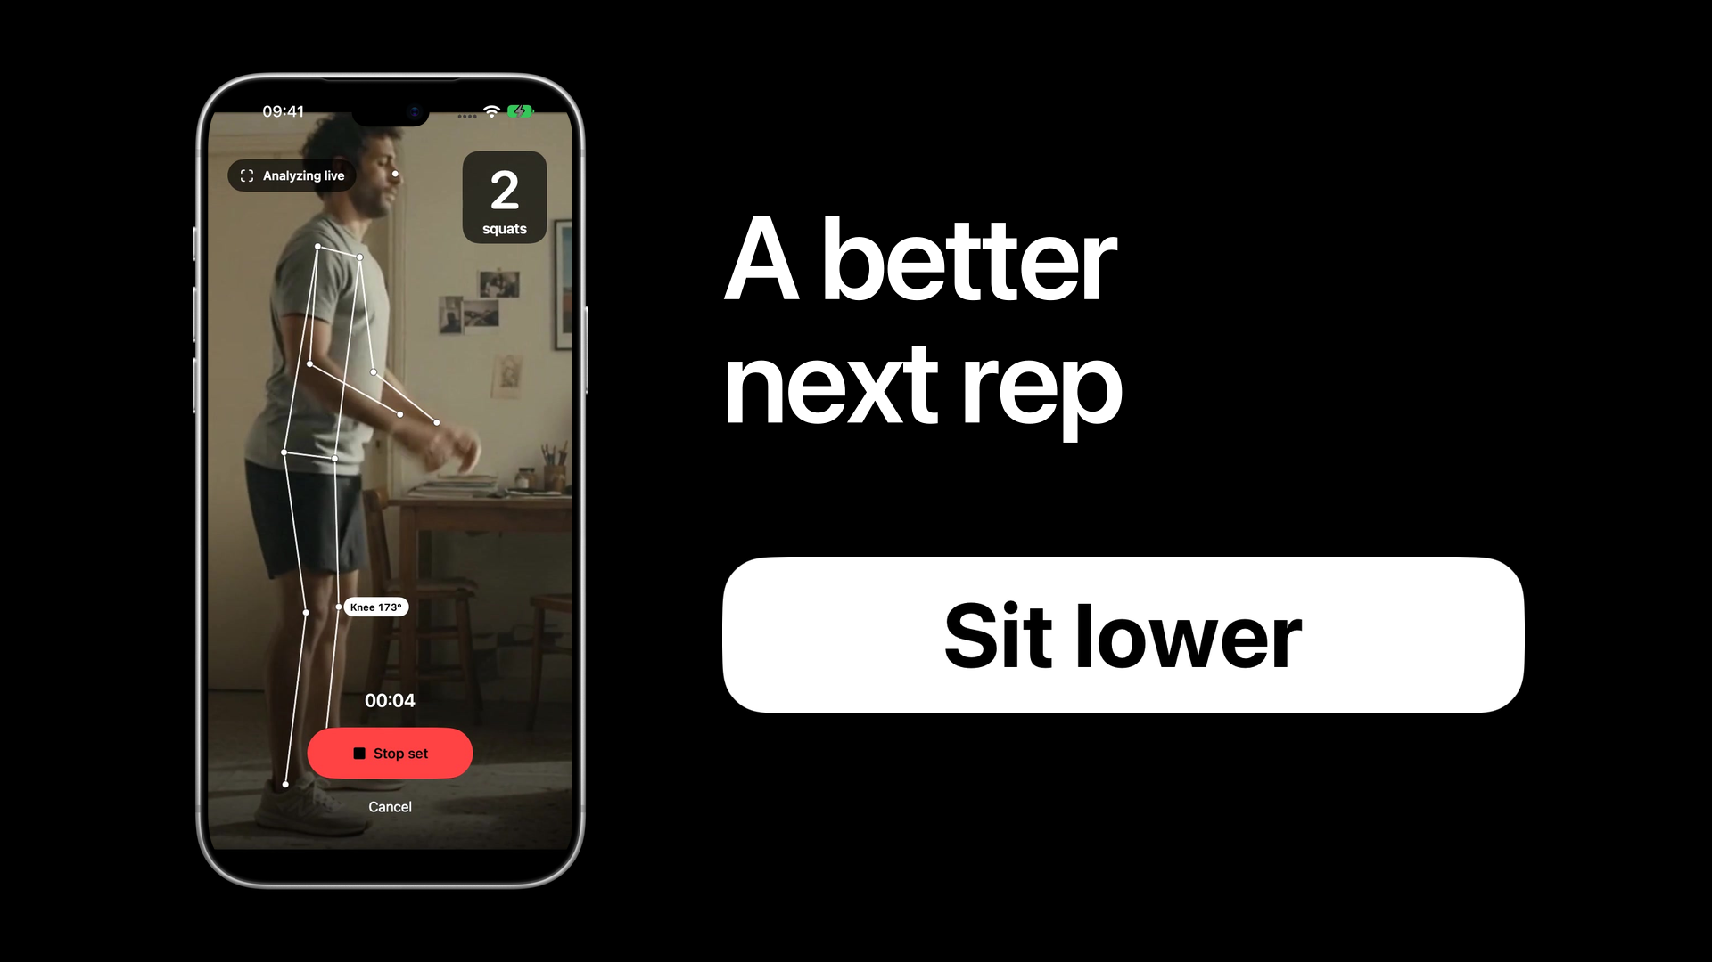
Notes:
2:30–3:05. Your iPhone follows the body landmarks and counts your reps. But the useful moment is the adjustment. [Let the cue enlarge at 6 seconds.] Sit lower. A short cue, connected to the movement in front of the camera. The next rep becomes a chance to use that guidance. Afterward, a compact review keeps the observation with your set. This cue is a scripted product demonstration, not a measured finding about the actor.

Slide 7
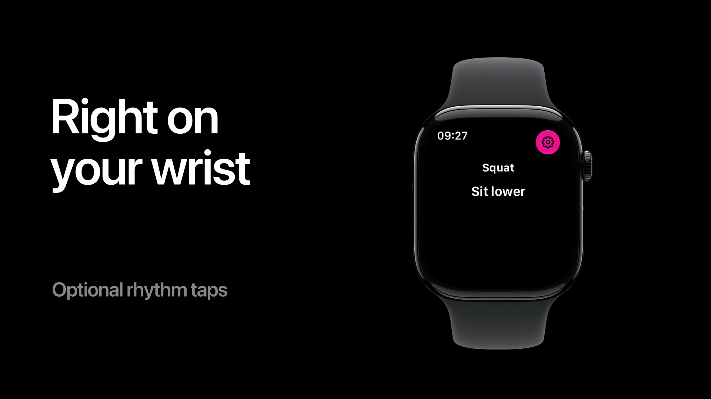
Notes:
3:05–3:35. The same cue comes to your Apple Watch, while your iPhone performs the camera analysis. WatchConnectivity keeps the set and short guidance in sync. [At 20 seconds, Progress.] Your saved sets build a history. Here the latest best set is eleven reps. Project looks ahead from that history. It is an estimate, not a promise. These are illustrative workouts in the current native app, not a participant study.

Slide 8
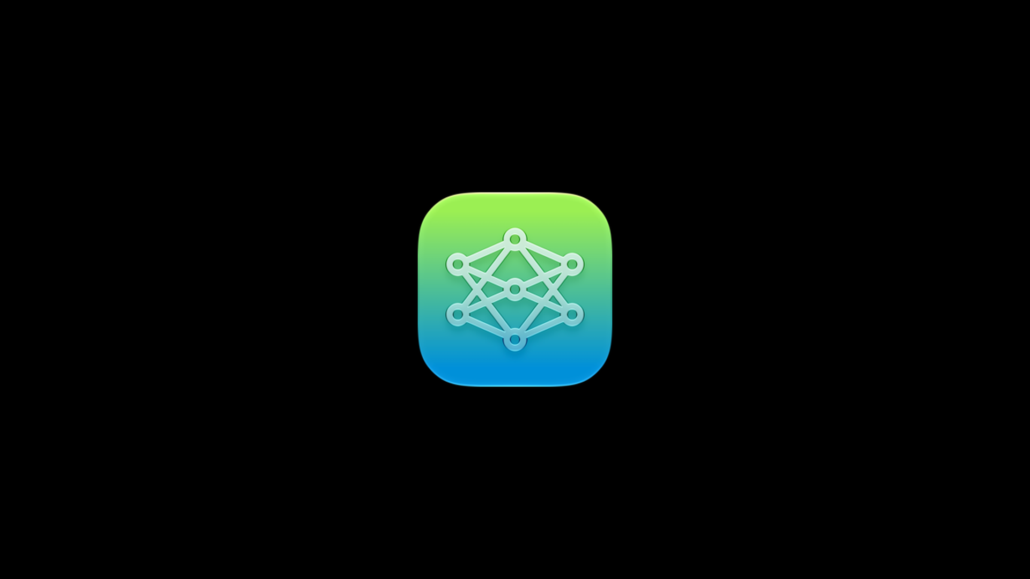
Notes:
3:35–4:00. The coach uses Foundation Models, Apple’s Swift framework for Apple Intelligence. It receives saved set facts and returns structured set references, which Finn validates. The standard build uses the on-device model. If Apple Intelligence is unavailable, saved observations still work. This model supports the conversation; it does not invent the movement measurements.
Source: https://developer.apple.com/foundation-models-framework/

Slide 9
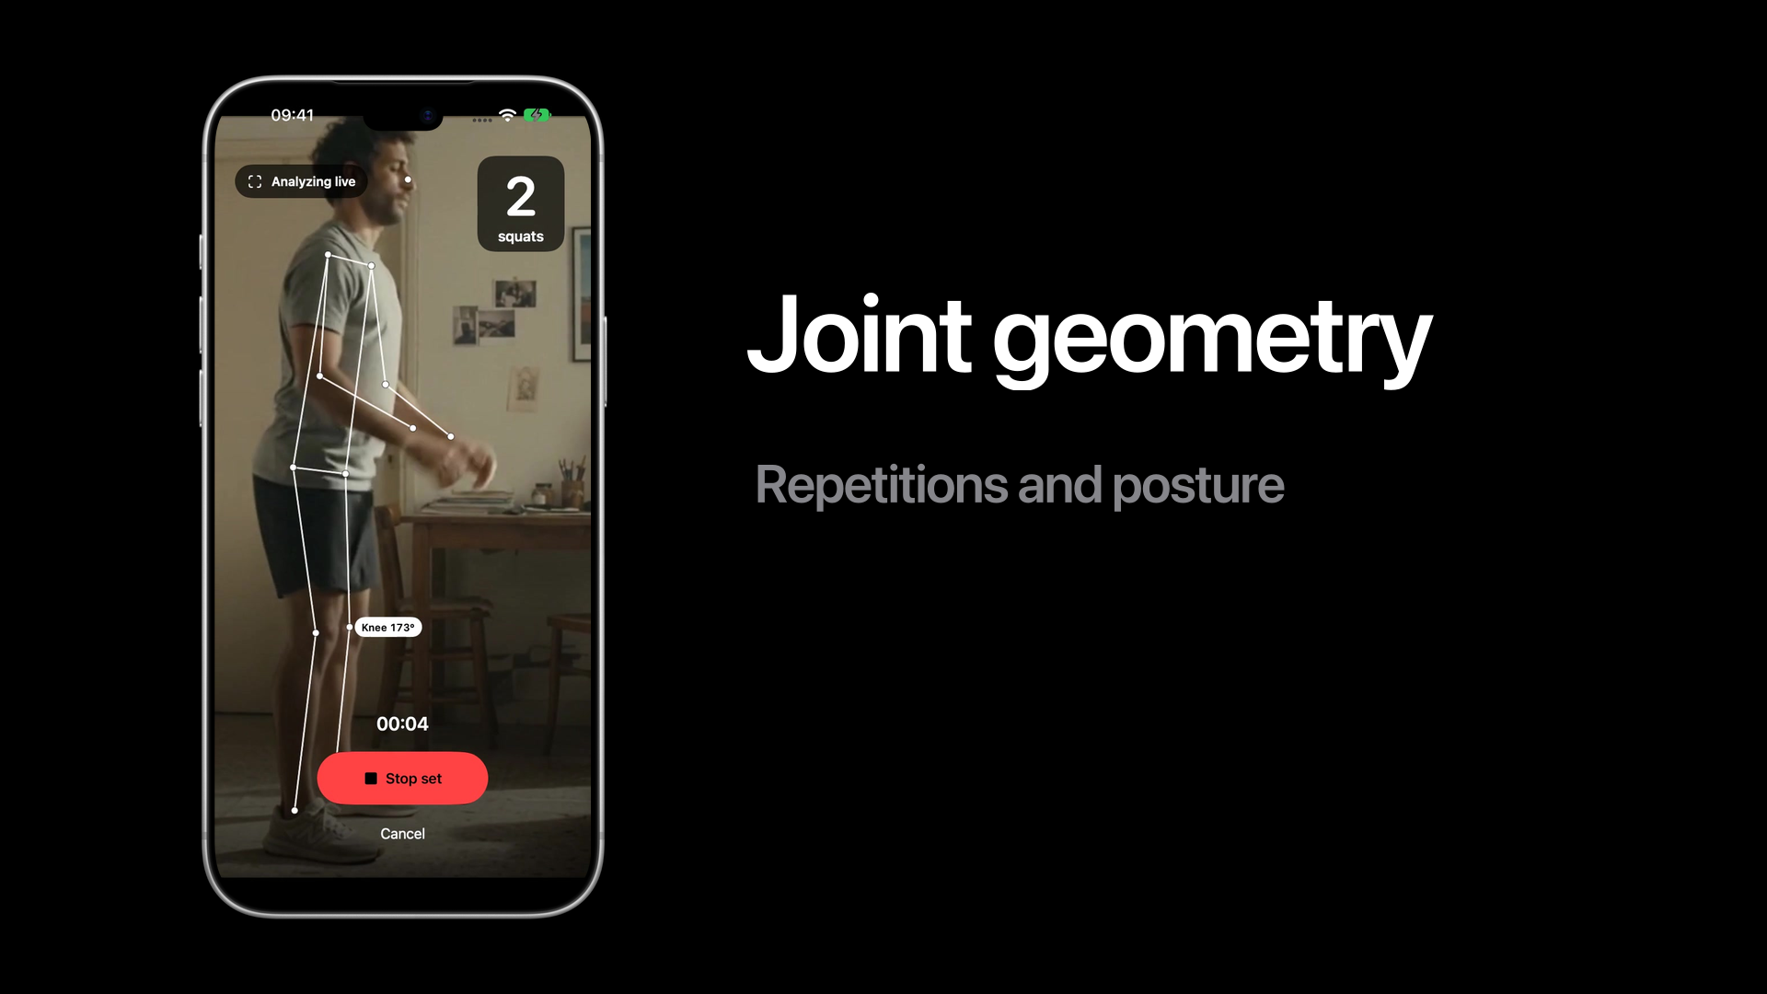
Notes:
4:00–4:40. [0–12 seconds: Vision.] AVFoundation supplies camera frames. Apple’s pretrained Vision model finds the body landmarks on your device. We do not train that model ourselves. [12–25 seconds: Joint geometry.] Finn tracks the selected athlete and uses joint angles over time to count repetitions and apply exercise-specific posture rules. No custom trained classifier ships in this build. [26–40 seconds: Confidence.] A measurement has to pass visibility and confidence checks before it can support advice. If the camera cannot see enough, Finn should ask for a better view instead of guessing.
Sources: Finn/Capture/PoseFrameAnalyzer.swift; Finn/Workout/FormChecks.swift; tools/exercise-classifier/README.md; https://developer.apple.com/documentation/vision/vndetecthumanbodyposerequest

Slide 10
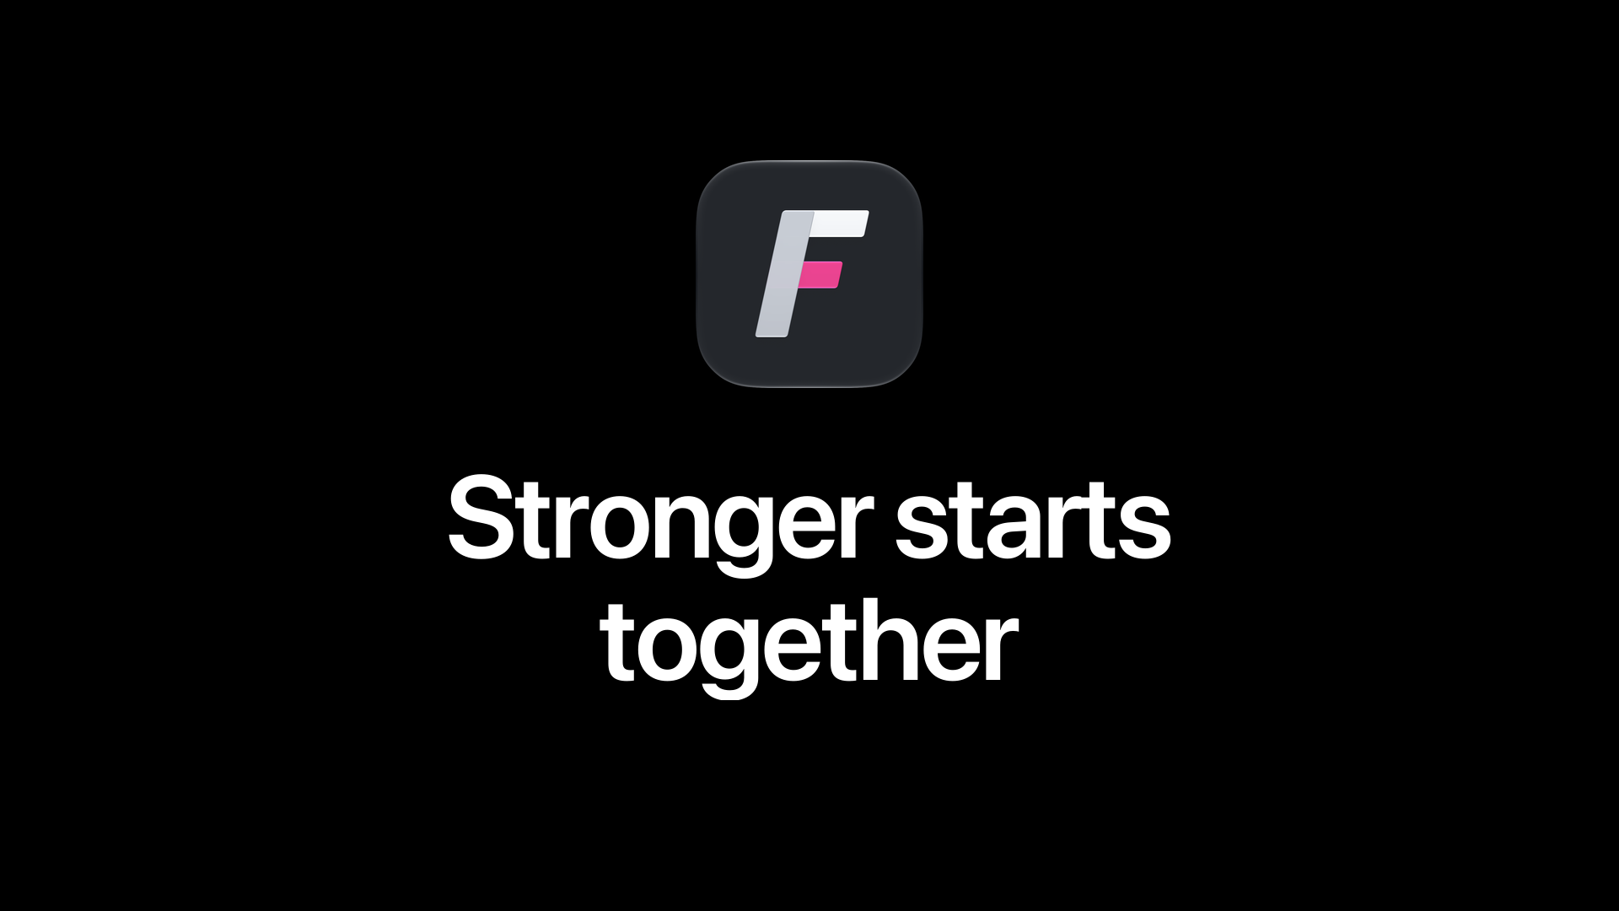
Notes:
4:40–5:00. A second perspective. A useful adjustment. Guidance on your wrist. That is Finn. Our next step is validating the experience with real people, real movement and real devices. We want every set to leave you with something useful for the next one. Stronger starts together.

