Slide 1
Crowd-Sourced Pixel Art Mosaic Generator
CLOUD COMPUTING PROJECT · BRD
A photo mosaic platform built as microservices on Google Cloud
Roll No. 24 & 25 · [Name 1] & [Name 2] · [College / course]
Notes:
Introduce the project: a platform that turns thousands of photos into one large photo mosaic. It is built as separate microservices and deployed on Google Cloud. Fill in your names and course on this slide.

Slide 2



1 · PRODUCT OBJECTIVE
Turn thousands of photos into one giant, high-resolution photo mosaic, rendered by a cluster of cloud machines.
Two sources of tiles (dual-asset sourcing):
Community library
Personal vault
Live event submissions
A shared pool everyone can donate to, filterable by category tags
Your own photos: saved to your account, or temporary for guests
Moved to future scope
Notes:
The objective: give artists and communities a way to build one large artwork from many photos. Tiles come from the shared community library and from each user's private vault. Live event submissions were part of the original plan and are now future scope.

Slide 3
How the app benefits from Google Cloud
2 · WHY CLOUD COMPUTING
Benefit | What it means for PixelMosaic | Google Cloud feature behind it
Scales with demand | A big render gets more workers; quiet hours shrink back to one VM per service | Managed Instance Groups + autoscaler (1–7 VMs)
Pay only for what runs | The heavy image maths runs on discounted Spot VMs; everything else on small e2 machines | Spot VMs, e2 machine types
Survives failures | A crashed or preempted VM is replaced, and another worker finishes its piece of the render | Health checks, auto-healing, lock leases in Cloud Storage
One secure way in | Users only ever reach the website; services and storage stay private | Cloud Load Balancing, VPC firewall, Cloud NAT
Durable data, no database | Photos, accounts, jobs and results outlive any VM, with no database to run | Cloud Storage (4 private buckets)
Repeatable, zero-downtime releases | One script rebuilds every service and rolls it out VM by VM | Cloud Build, Artifact Registry, Terraform
Notes:
Why this project belongs on the cloud. Rendering is bursty: a large mosaic needs many CPUs for a short time, so autoscaling groups grow for the render and shrink back afterwards, and Spot VMs make that heavy maths cheap. Failures are routine and handled automatically. Users only reach the website through the load balancer. All state lives in Cloud Storage, so any VM can be replaced at any time without losing photos, accounts or results. Releases are one command and roll out without downtime.

Slide 4











Four microservices, each on its own VMs
3 · MICROSERVICE ARCHITECTURE
/api/*
Users
External HTTP(S) LB
Frontend
Internal TCP LB
API Gateway
Browsers
the only public entry
nginx + React · e2-micro
private IP :8000
FastAPI · e2-medium
Build & deploy
accounts, uploads,
job tasks
Assembler
Workers ×N
Terraform
creates every resource
stitches the final image · e2-medium
4 render engines · Spot e2-small
Cloud Build
builds the 4 images
Cloud Storage · 4 private buckets
Artifact Registry
VMs pull images at boot
photo-library · target-posters · task-coordination · mosaic-outputs
Private VPC · no public IPs · firewall-restricted
Notes:
Walk the request path left to right. Users reach only the external load balancer, which forwards to the frontend VMs. The frontend sends /api requests through a private internal load balancer to the API Gateway. The gateway, the workers and the assembler share nothing except the private buckets: the gateway handles accounts and uploads and writes job tasks, workers pull tasks and write results, the assembler stitches the final image. Workers and the assembler accept no inbound traffic. On the left: Terraform creates everything, Cloud Build builds the images, and VMs pull them from Artifact Registry.

Slide 5
Technologies and where they run
TECHNOLOGY STACK
Where | Technologies
Frontend VMs | React 18, Vite 5, nginx 1.27
API Gateway VMs | Python 3.11, FastAPI, Uvicorn, Pillow, bcrypt
Worker VMs (Spot) | Python 3.11, NumPy, OpenCV, SciPy
Assembler VMs | Python 3.11, OpenCV, NumPy
Every VM | Docker on Container-Optimized OS
Storage | Google Cloud Storage (MinIO locally)
Network | Cloud Load Balancing, VPC, Cloud NAT
Build & deploy | Cloud Build, Artifact Registry, Terraform
Local & testing | Docker Compose, fake-gcs-server, unittest, Playwright
Notes:
The technology used in each part of the system.

Slide 6





One way in, nothing else exposed
3 · SECURITY BOUNDARIES
Single entry point
One API Gateway
Private buckets
The external load balancer forwards only to the frontend. No VM has a public IP address.
Firewall rules let only frontend VMs reach the gateway; every data request passes through it.
Public access prevention is enforced; browsers never contact storage directly.
Checked uploads
Least-privilege identities
Accounts & private vaults
Each upload gets a single-use, expiring ticket; size and file type are verified before storage.
One service account per microservice, holding only the bucket roles it needs.
bcrypt passwords and signed HttpOnly cookies; account and guest vaults are readable only by their owner.
Notes:
These are the guarantees the deployment enforces. Users can only ever reach the frontend. Storage is private, uploads are relayed through the gateway with single-use tickets, each service has its own minimal identity, and personal vaults are tied to signed-in accounts.

Slide 7







Compute and autoscaling
GOOGLE CLOUD SERVICES · 1 OF 2
Compute Engine
Instance templates
Managed Instance Groups
Autoscaler
Every microservice runs on its own VMs, on Container-Optimized OS
One per service: machine type, image, start-up script, identity
Regional groups spread VMs across zones in asia-south1
Every group scales between 1 and 7 VMs on CPU utilisation
Spot VMs
Health checks & auto-healing
Rolling updates
Shielded VMs
Workers run on discounted Spot capacity; lock leases recover preempted work
A VM whose service stops answering is recreated automatically
New images replace VMs gradually; connection draining lets old VMs finish requests
Secure boot, vTPM and integrity monitoring on every VM
Notes:
The compute side. Each microservice has an instance template and a regional managed instance group with its own autoscaler, from 1 to 7 VMs. Health checks drive auto-healing, and workers use Spot VMs to keep the heavy maths cheap.

Slide 8




Network, storage and delivery
GOOGLE CLOUD SERVICES · 2 OF 2
Cloud Load Balancing
VPC & firewall rules
Cloud NAT & Private Google Access
Cloud Storage
External Application LB for users; internal TCP LB in front of the gateway
Custom private network; only the listed paths are allowed in
Outbound access and Google APIs without public IP addresses
4 private buckets with lifecycle rules: the only data store, accounts included
Cloud Build
Artifact Registry
IAM service accounts
Cloud Logging & Monitoring
Builds the four container images from source in the cloud
Private Docker repository that every VM pulls from
Five identities: one per microservice, plus one for builds
Container logs and metrics from every VM
Notes:
The supporting services: two load balancers, a private VPC with firewall rules and Cloud NAT, private Cloud Storage buckets as the only data store, and Cloud Build plus Artifact Registry for images. IAM gives each service its own identity, and Logging collects every container's output.

Slide 9

Smallest machines that do the job
DEPLOYMENT · asia-south1 (MUMBAI)
Microservice | Machine | VMs | Scales on | Health check | Reachable from
Frontend | e2-micro · 1 GB | 1 – 7 | CPU 60% | /healthz :80 | Internet, via external LB
API Gateway | e2-medium · 4 GB | 1 – 7 | CPU 60% | /health :8000 | Frontend VMs only
Workers | e2-small · 2 GB · Spot | 1 – 7 | CPU 75% | /health :8080 | Nothing (health checks only)
Assembler | e2-medium · 4 GB | 1 – 7 | CPU 70% | /health :8080 | Nothing (health checks only)
Why these sizes
One microservice per VM
The gateway and assembler hold up to 12,000-pixel images in memory (about 1–1.5 GB); the frontend only serves files.
Every VM runs exactly one service container; no two microservices ever share a machine.
Notes:
Each group runs between 1 and 7 VMs. Machines are the smallest that work: the frontend is an e2-micro, the gateway and assembler need about 4 GB for large images, and workers are small Spot VMs. The project's quota is 12 vCPUs, so small machines give the autoscaler the most headroom.

Slide 10
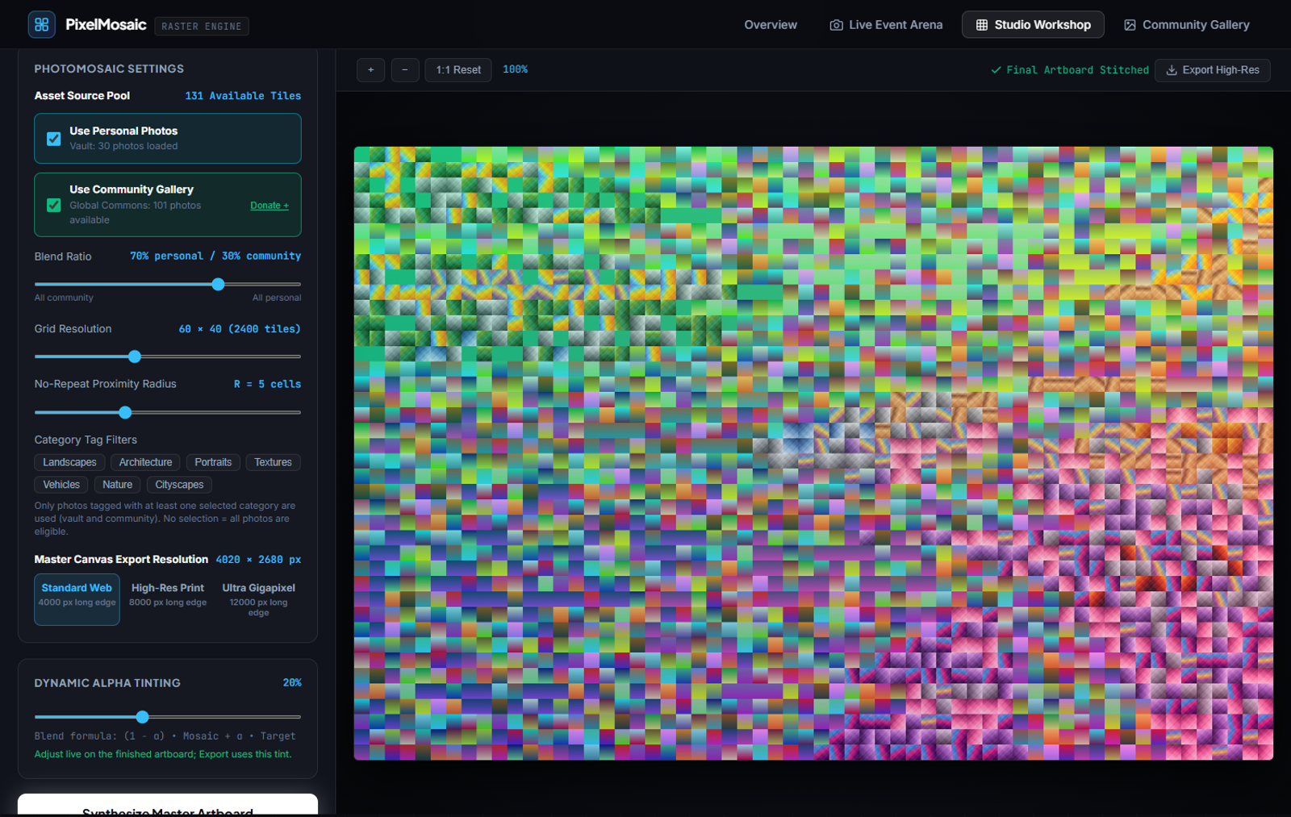
A full creative studio
8.1 · PHOTO MOSAIC STUDIO
Controls from the BRD
Engines: photomosaic, true-colour ASCII, Kuwahara oil, flow field
Blend slider, tag filters, grid density, no-repeat radius
Alpha-tint slider 0–50%, adjustable live
Tiles fly into place once processing finishes
Click any tile: original photo, contributor, ΔE₀₀
Sharp 256 px tiles when zoomed past 200%
Export PNG or JPEG up to 12,000 px
Personal vault saved to your account
Notes:
The Studio is the main product. Every control in the BRD works: the engine picker, the personal-versus-community blend slider, strict tag filters, grid density, the no-repeat radius, and an alpha-tint slider you can still adjust after rendering. While the workers process, the canvas shows a ghosted version of the target; once every chunk is done, all the tiles fly in from the edges and dock into place. Click any tile to see the original photo, who contributed it and its colour-match score. Zooming past 200% swaps in sharp 256-pixel tiles, and large exports are stitched from the original photos. Exports go up to 12,000 pixels as PNG or JPEG.

Slide 11




Your photos follow your account
8.1 · ACCOUNTS & PERSONAL VAULT
1 · Optional sign-up
Stored in buckets, no database
Guests can make mosaics from their own photos, but those are deleted when they leave. Signing up keeps them.
users/{username}.json
2 · Upload to your vault
profile + bcrypt hash
Photos are analysed by the workers and saved under your account in Cloud Storage.
user-emails/{sha256}.json
one account per email
3 · Sign in anywhere
auth/signing-key.json
session key shared by every gateway VM
Another browser or device shows the same vault, with nothing to re-upload.
personal/{user_id or gst_…}/…
the vault's photos (guest vaults expire after a day)
4 · Manage it yourself
Signed HttpOnly session cookie · lockout after 10 failed logins · forgot-password link (email delivery is future scope)
The Account page shows storage used (500 MB quota), deletes chosen photos, or erases the account.
Notes:
Signing in is optional. Guests can upload their own photos and make mosaics straight away, but their vault only lasts for that browser session: the Studio shows a clear warning, the browser asks before they leave, and a storage lifecycle rule deletes guest photos after a day. If a guest signs up or signs in, everything they uploaded moves into their account. Accounts make the personal vault persistent. A user signs up once; photos they upload are saved under their account id in Cloud Storage, so signing in on any other device shows the same vault. There is still no database: each account is a small JSON file in a private bucket, and usernames and emails are claimed with create-if-absent writes so they can't be taken twice. Sessions are signed cookies that any gateway VM can verify. Forgot password works as a stub: the reset link is written to the server log until an email service is added. The Account page gives each user full control: their profile, storage used against a 500 MB quota, a grid to delete individual photos, and a danger zone that deletes the account and every personal photo after they type their username or password.

Slide 12




Four render engines, all on CPUs
4 · MULTI-ENGINE COMPUTE CORE
MODE 1
MODE 2
MODE 3
MODE 4
Photomosaic
Sobel ASCII
Kuwahara oil
Vector flow field
Two-stage search: a matrix product shortlists 256 photos per cell, CIEDE2000 picks the best. No-repeat radius, personal / community blend.
CLAHE-equalised brightness picks from a 70-glyph ramp; strong edges become ─ │ ╱ ╲. True Color paints each glyph in the photo's own colour.
Each pixel takes the mean colour of the calmest of its four quadrant windows. Fully vectorised box filters: a 4K frame in about 0.3 s.
Brush strokes follow the edge direction, θ = atan2(Gy, Gx) + π/2, traced in RK2 steps and painted in the photo's colours.
Notes:
Four engines, all on ordinary CPUs. Photomosaic is the core: it compares colours perceptually in CIELAB space and matches each tile's internal layout. It searches in two stages: a single matrix product finds the 256 closest photos for every cell, then the exact CIEDE2000 formula picks among them, which matches 1,700 cells against 11,800 photos in about a second with the same result as a full search. ASCII equalises brightness with CLAHE so midtones such as skin use the whole glyph ramp, turns the strongest edges into line glyphs, and can paint every glyph in the photo's own colour. Kuwahara gives an oil-paint look by averaging each pixel's calmest neighbourhood quadrant; it is computed entirely with box filters, so a 4K frame takes about 0.3 seconds. The flow field paints brush strokes along the edges of the picture.

Slide 13
One render, shared between many workers
WHY IT'S DISTRIBUTED
2,700
9
3
~7 s
→
→
→
tiles in a 60 × 45 grid
row-band chunks
workers at the same time
for an 8,000 px image
Each worker claims a chunk by writing a lock file in the bucket and keeps renewing it while it works, so no two workers do the same piece. If a Spot VM is preempted, its lock expires after 120 seconds and another worker finishes the chunk. Neighbouring bands run in two waves, so the no-repeat rule holds across chunk boundaries.
Notes:
These are measured numbers from the local cluster: a 60-column grid on a 4:3 target gives 2,700 tiles, split into 9 row bands and processed by 3 workers, producing a 7,980 × 5,985 image in about 7 seconds. Coordination is entirely through lock files in the bucket.

Slide 14

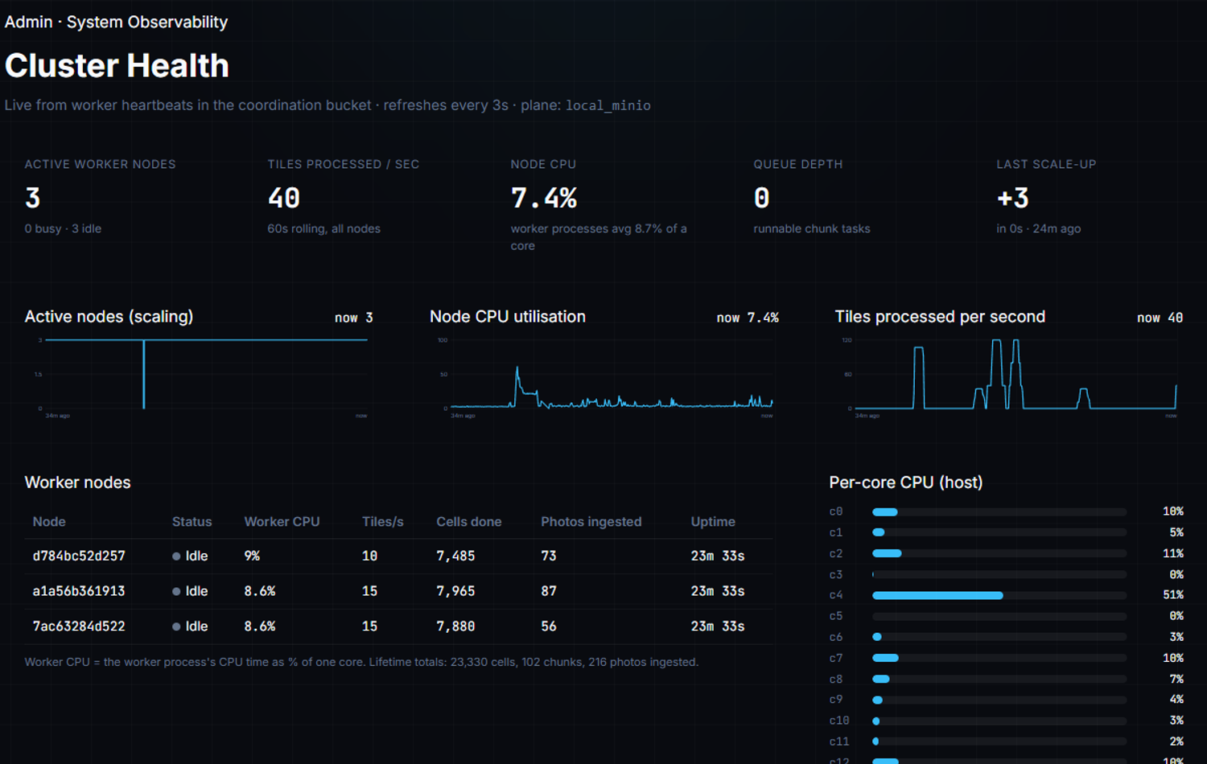


System numbers stay behind the scenes
6 & 8.2 · OBSERVABILITY AND ADMIN
What admins see
Live nodes, CPU per worker and per core, tiles per second, queue depth; live pulse, every 5 s
Scaling history
Node count over time, plus every VM joining or leaving the cluster
Community moderation
Browse every community photo and delete any of them
Who sees it
Unlisted URL, never linked or indexed; deleting needs an admin account
Notes:
Workers publish a heartbeat to the coordination bucket every three seconds, with real CPU readings and throughput counters. The admin dashboard aggregates them. The dashboard refreshes every five seconds. The same page has a moderation grid of every community photo; deleting one removes its original, tiles and index entry, and requires a signed-in admin account. The page is only reachable on an unlisted URL; audience pages never show cluster data.

Slide 15
Same code on a laptop and on Google Cloud
9 · DUAL ENVIRONMENT: WRITE ONCE, RUN ANYWHERE
Setting | LOCAL (Docker Compose) | PROD (Google Cloud)
USE_GCP | false | true
Storage | MinIO, private network only | Cloud Storage, 4 private buckets
Entry point | Frontend on port 3000, the only open port | External Application Load Balancer
Workers | Compose replicas | Spot VM group, autoscaled 1–7
Health | Container health checks | LB health checks + MIG auto-healing
Images | docker compose build | Cloud Build → Artifact Registry
Setup | docker-compose.yml | Terraform + one deploy script
The production code path was also tested locally against a Cloud Storage emulator before deploying.
Notes:
The same images run in both environments; only environment variables change. Locally the network layout mirrors the cloud firewall: the frontend is the only open port. Before deploying, the full test suite also ran against a local Cloud Storage emulator in production mode.

Slide 16


Core platform delivered and deployed
PROGRESS AGAINST THE BRD
Delivered
Bucket-only storage, MinIO ⇄ Cloud Storage (§3, §9)
Photomosaic, ASCII, Kuwahara and flow-field engines (§4)
Blend slider, strict tag filters, no-repeat, live alpha-tint (§8.1)
Optional accounts: guest vaults, saved vaults, self-service /account
Fly-in assembly, tile inspector, community moderation
Drag-and-drop uploads through the API Gateway (§4.1)
Live cluster telemetry on an unlisted admin URL (§6, §8.2)
Terraform deployment: 4 autoscaled VM groups, load balancers (§2)
Search-friendly landing page; 43 automated tests
Live on Google Cloud
http://8.233.196.233
44 s
end to end on the cloud: 30 photos uploaded, a 2,400-tile mosaic rendered, exported and the vault cleared
Notes:
Everything in the core scope is built, tested end to end, and deployed to Google Cloud, including user accounts with a personal vault that persists across devices. There are 43 automated tests: engine unit tests plus end-to-end tests that also ran against the live deployment. The automated browser test ran against the live deployment: upload 30 photos, render a 60 by 40 mosaic, export it and clear the vault, in 44 seconds.

Slide 17






What comes next
FUTURE SCOPE
Event-driven ingestion
Live Event Arena
Start workers from Cloud Storage events via Pub/Sub, not polling
Moved from core scope
Password-reset email
Email the reset link; today it is written to the server log
Organizer uploads the main picture and gets a QR code
Attendees scan it and add a selfie from their phone
The big screen reveals each new tile with a spotlight
"Find My Photo" zooms back to a guest's code, e.g. #T-2506
Groundwork in place: event state and tokens already live in buckets
Admin-only dashboards
Put the read-only telemetry behind the admin role too
HTTPS on a custom domain
Google-managed certificate on the existing load balancer
Monitoring dashboards & alerts
Cloud Monitoring dashboards and alerting for the cluster
Deep-zoom viewer & time-lapse
Pan-and-zoom tile pyramids and a replay of the assembly
Notes:
The Live Event Arena is the main item moved to future scope: QR-code joining, phone selfies, a spotlight on the big screen, and Find My Photo. Much of its groundwork already exists in the gateway, since its state is already stored in buckets. Everything else not yet built is listed on the right: event-driven ingestion with Pub/Sub, emailing password-reset links (today a stub that logs the link), putting the read-only dashboards behind the admin role that already guards moderation, HTTPS on a custom domain, Cloud Monitoring dashboards and alerts, and the deep-zoom viewer with an assembly time-lapse.

Slide 18
Thank you
PIXEL MOSAIC PLATFORM
Questions? Try it live at http://8.233.196.233
[Name 1] & [Name 2]
Notes:
Close and invite questions. The deployed application is live on Google Cloud at the address on the slide.

