Slide 1




Technology in Psychology
By: Asia James

Slide 2
Neuroimaging Techniques
Starting from the beginning, neuroimaging techniques allow the observation of the human’s brain movement. Electroencephalogram machines, known as the EEG, are the mostly known in psychology.
It’s used to help analyze, keeping track of conditions within the brain. Helps diagnose epilepsy, dementia, head injuries, brain tumors, inflammations, or sleep disorders (NHS).
Uses sensors on the scalp to record the information.

Slide 3
Neuroimaging Techniques (cont.)
The magnetic resonance imaging, or MRI, creates images of the whole human body.
Tube-like machine that takes images from “brain and spinal cord, bones and joints, breast, heart and blood vessels, and internal organs” using “magnetic fields and radio waves” (NHS).
Diagnoses conditions within the body using the technology and help patients find a treatable way to conquer the condition.

Slide 4
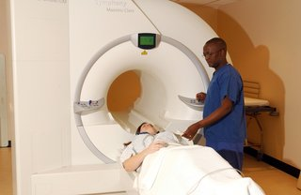
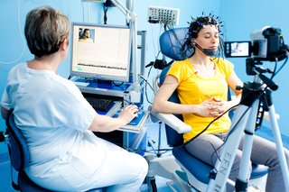
Both these machines helped mapped where in the body and the brain is associated with the behaviors and mental states of patients.
“MRI Scan.” NHS Choices, NHS,
“Electroencephalogram (EEG).” NHS Choices

Slide 5




Teletherapy
Online counseling platform
Allows patients to have direct access to therapy remotely. (Video conference, message, or call)
Helps patients receive immediate counseling in case of an emergency.

Slide 6
Mobile Apps
Mental health apps provide a wide array of resources for patients.
Contains psychology podcast or websites that have useful information on it.
Helps patients learn different ways to mange their stress, learn to meditate and use cognitive behavioral techniques.
Patients can journal their emotions.
Establishes self-awareness

Slide 7
Mobile Apps (cont.)
Psychologist are using social media to expand to larger audiences.
They use social media platforms to create videos to inform people about certain disorders and how to spot them.
This is also a great way for psychologist to interact with any generation, that is using social media, in learning how they can overcome any challenges they are facing.

Slide 8
Technology finding Participants
One: Through online surveys and self questionaries, on social media apps or the internet, psychologist can use the information for their studies.
For example, the Incoming Student Skills Attitudes Questionnaires (ISSAQ).
Assessments that are digital, like ISSAQ, help psychologist gain participants from a larger population.
Two: Devices that patients can wear help monitor biometric attributes.
Help patients keep track of their physical and mental well being. Also, helps researchers with their studies without being a laboratory setting.

Slide 9
As technology advances, instruments are created which allow scientist to obtain larger samples and be more precise in their measurements. One of the great problems in psychological research is the replication of results. Pen and pencil self-report has been inherently unreliable. New instruments that exhibit improved accuracy and accessibility are easier to replicate.
Psychologist MS Broudy
These methods, mentioned previously, help produce natural and ethical results. Which is extremely important in psychological research studies.

Slide 10
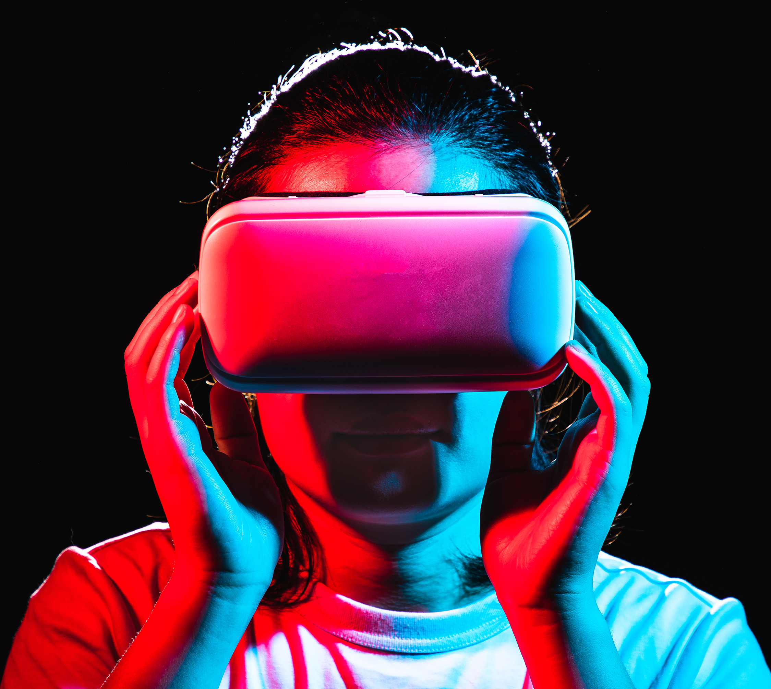
Virtual Reality
Uses a computer-based environments to help patients in exposure therapy.
Therapist use VR to help with anxiety disorders.
This results in patients being confident in overcoming their disorders in the real world.
Stock Images

Slide 11

Gaming
Gaming uses controlled environments to help with mental health.
Creates treatment for anxiety and depression disorder.
Deborah Bach, writer for Microsoft, stated “85% of respondents agreed gaming has positively impacted their mental health.”

Slide 12
References
Bach, Deborah. “Mind games: How gaming can play a positive role in mental health.” Microsoft Source, 2023, https://news.microsoft.com/source/features/work-life/mind-games-how-gaming-can-play-a-positive-role-in-mental-health/.
Brooks, Ruth. “Emerging Technologies in Psychology.” North Wales Management School – Wrexham University, 2023, https://online.wrexham.ac.uk/emerging-technologies-in-psychology/.
Broudy, MS. “How Is Technology Changing the Study of Psychology?” Online Psychology Degrees, 2023, https://www.online-psychology-degrees.org/study/technology-changing-psychology/.
Santoro, Helen. “Researchers are using technology to communicate psychological science to a wider audience.” Monitor on Psychology, vol. 54, no.1, 2023. https://www.apa.org/monitor/2023/01/trends-communicating-psychological-science/.
“MRI Scan.” NHS Choices, NHS,
https://www.nhs.uk/conditions/mri-scan/.
“Electroencephalogram (EEG).” NHS Choices, NHS, https://www.nhs.uk/conditions/electroencephalogram/.

