Slide 1

SF Python - Feb 8, 2023
Agenda
Welcome back to SF Python in person and online (James)
Sentry (David Cramer)
Bay Area Python Association (Phebe Polk)
A Story from Back to Front: Python in the Browser (Mahmoud Hashemi)
Announcements (James)
Python, Rust and Regexes: A Retrospective (Nisanthan Nanthakumar)
Wrap up (Phebe Polk)

Slide 2
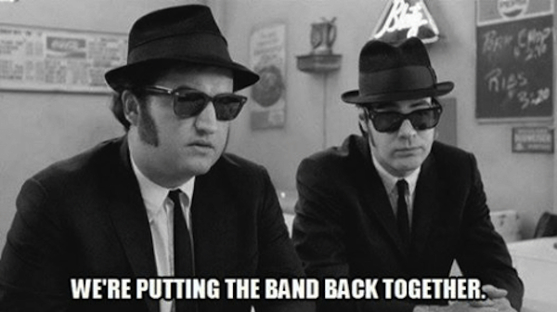
Welcome and thanks! SF Python - Feb 8, 2023
SF Python is community led
Thank you to Grace Law for many years of service to the Python community
Thanks to Phebe Polk and Tanya Bold for making SF Python meetup happen
Thanks to all the volunteers
Code of Conduct updates
https://www.sfpythonmeetup.com/coc
Thanks to you for attending!

