Slide 1

Balsa Lightweight Python Logging
https://www.turbosquid.com/3d-models/blend-balsa-wood-toy-airplane/608014
James Abel
PyBay - Sept 10, 2022
j@abel.co

Slide 2
The logging module
The logging module is awesome!
Handlers – stream (console), files, sockets, HTTP, custom, … many more!
Filters
Formatters
Hierarchal
Log Levels – debug, info, warning, error, critical
logging.getLogger(name)provides the logger associated with name
Can directly access a logger from anywhere in your program with just the name string
https://docs.python.org/library/logging.html

Slide 3
However, logging options and configurations can get rather involved for relatively simple apps
Log message format
Handers
UI, File, Services
Where to write log files?
Log levels
Often different for each handler
GUI
Multiprocessing
Tracebacks
Interface into cloud services
Setting up logging Can Be Significant Effort

Slide 4
Balsa – Lightweight Logging
Provide useful logging with a few lines of code
Consistent formatting and interface
appdirs for log file directory
CLI and GUI
GUI: tkinter or PyQt5 dialog box (avoid writing to stdout/stderr)
Structured Logging (via yasf)
Supports Multiprocessing
Balsa → config as a dict → Balsa clone in separate process
Object Oriented
Inherit from Balsa to select options, set alternative log levels, provide service credentials, etc.
Optional Services
AWS CloudWatch (via boto3) – query-able structured logging
Sentry exception service - e.g., for >= ERROR log level (sentry-sdk)
Verbosity expressed by intent rather than level (e.g., verbose for development)
Cross-platform
Available on PyPI
pip install balsa

Slide 5
Simple Example
from balsa import get_logger, Balsa
application_name = 'example'
log = get_logger(application_name)
def main():
balsa = Balsa(name=application_name, author='james abel')
balsa.init_logger()
log.error('my error example')
Output:
app name
function name
message
2018-08-18 20:43:33,756 - example - balsa_simple_example.py - 12 - main - ERROR - my error example
timestamp
source file name
line number
level
Also writes out a file (e.g., Windows):
C:\Users\<user>\AppData\Local\james abel\example\Logs\example.log

Slide 6
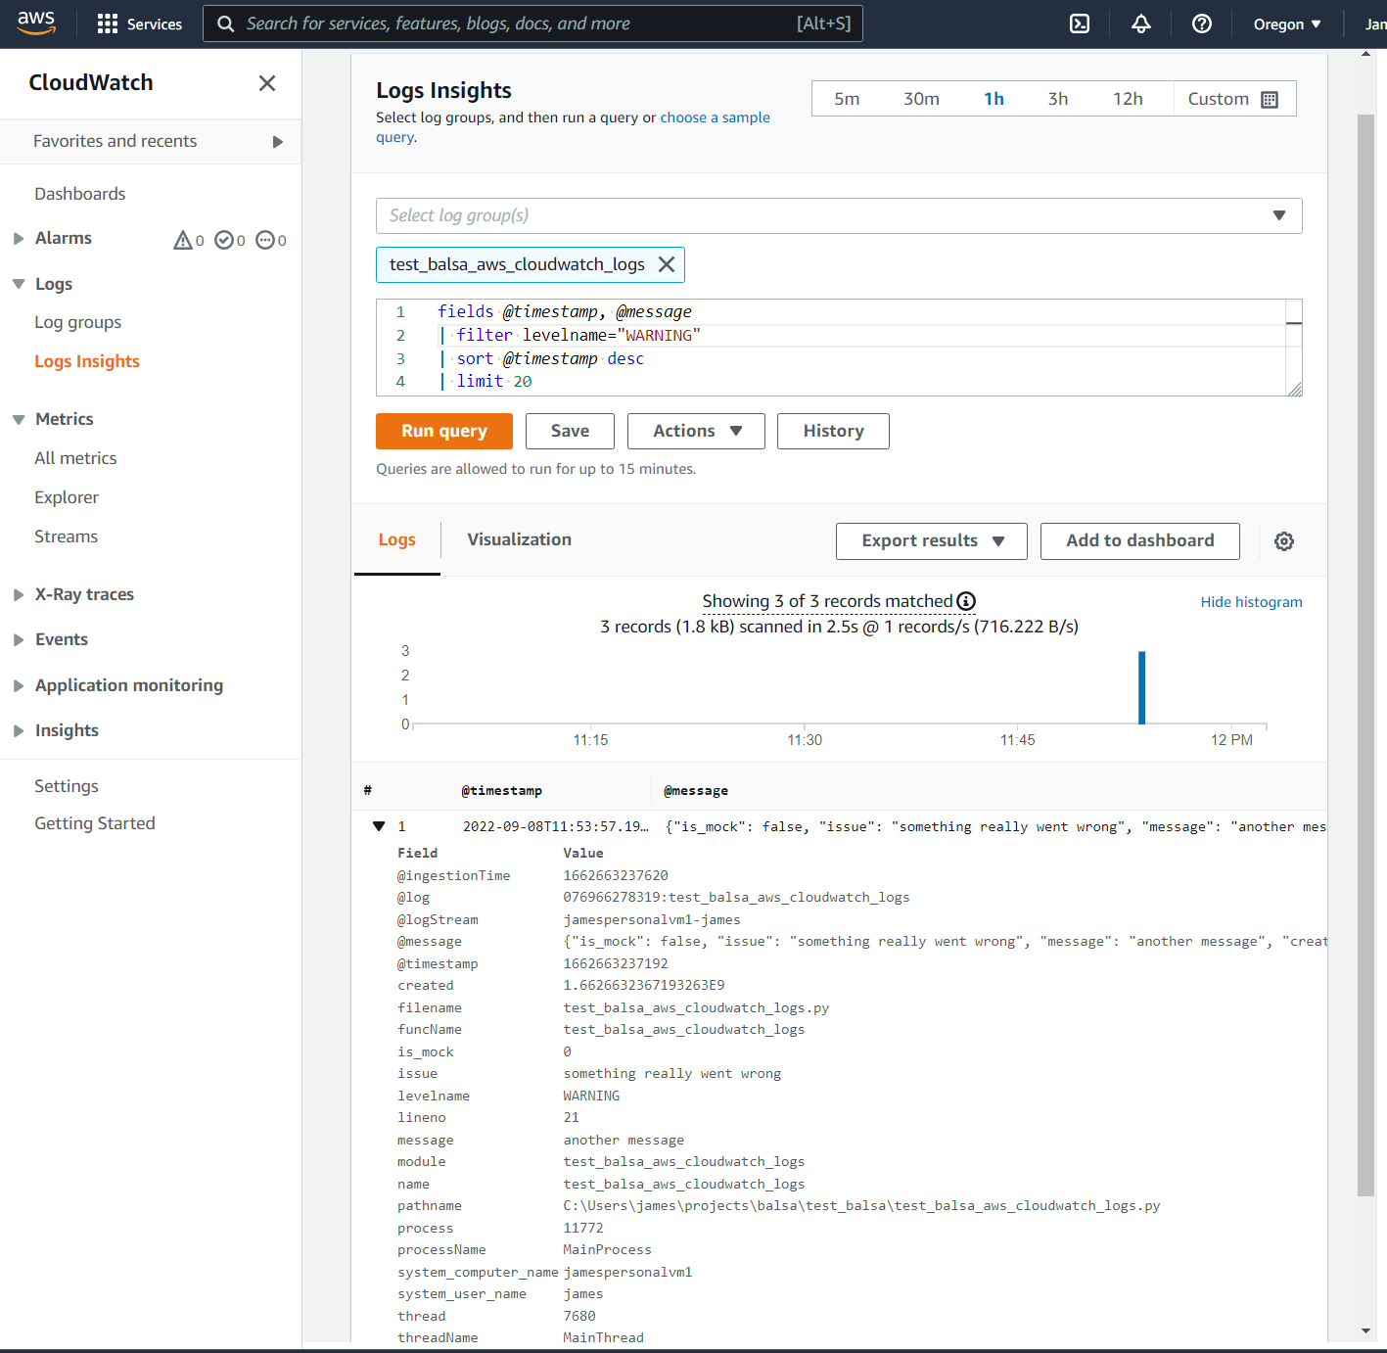
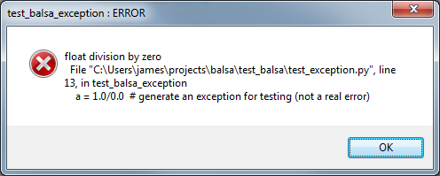
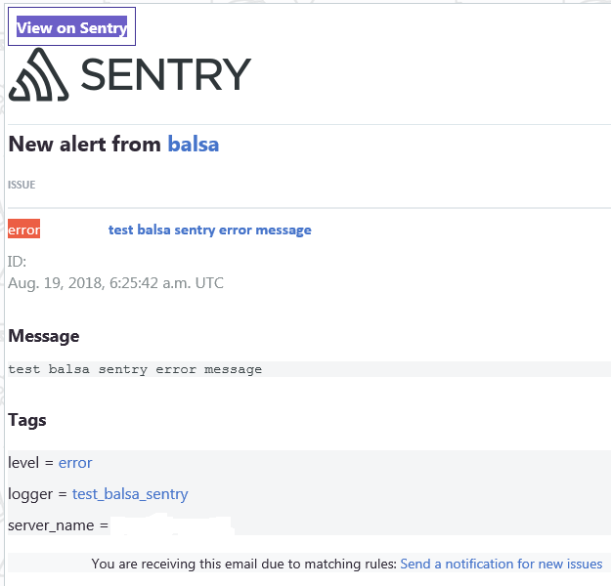
GUI messages (rate limited)
AWS CloudWatch
Sentry (exception service)

Slide 7
Summary and Thank You
Try balsa!
pip install balsa
https://github.com/jamesabel/balsa
http://balsa.readthedocs.io/
Please provide feedback, issues, PRs, …

