Slide 1
How Python and AI helped keep me from getting thrown out of a saloon
James Abel
8/27/26

Slide 2
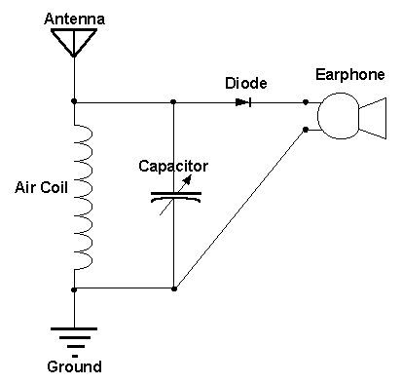
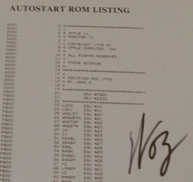
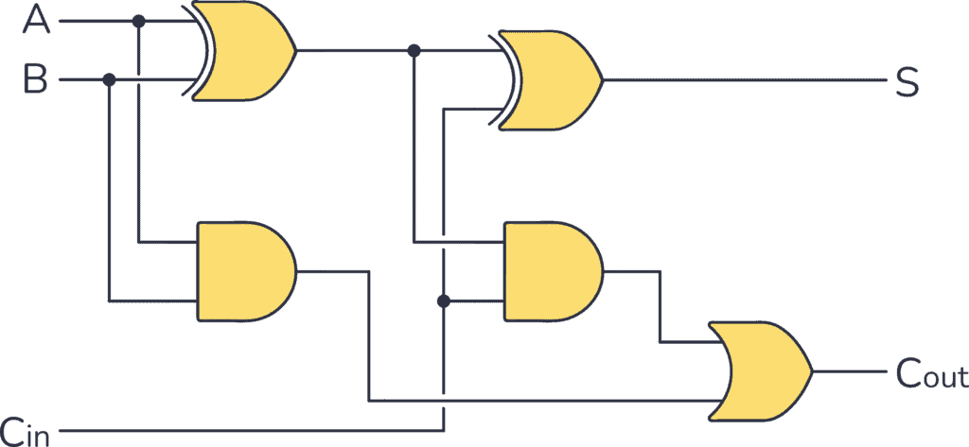
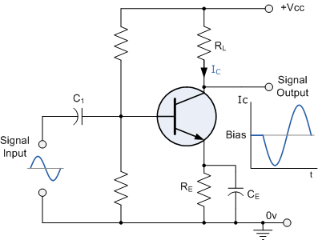
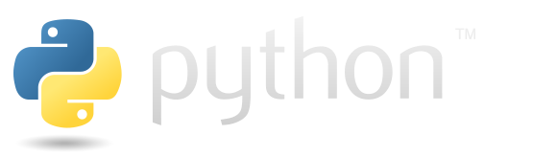
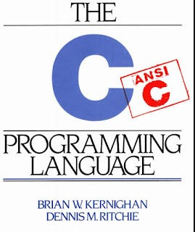
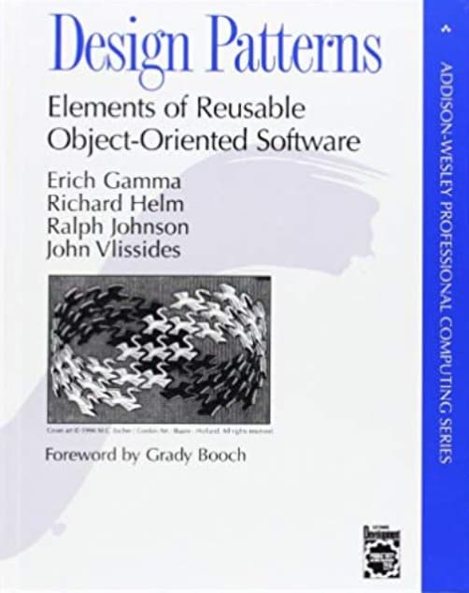
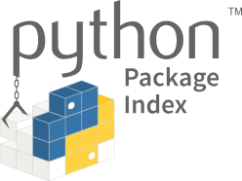
My Journey …

Slide 3
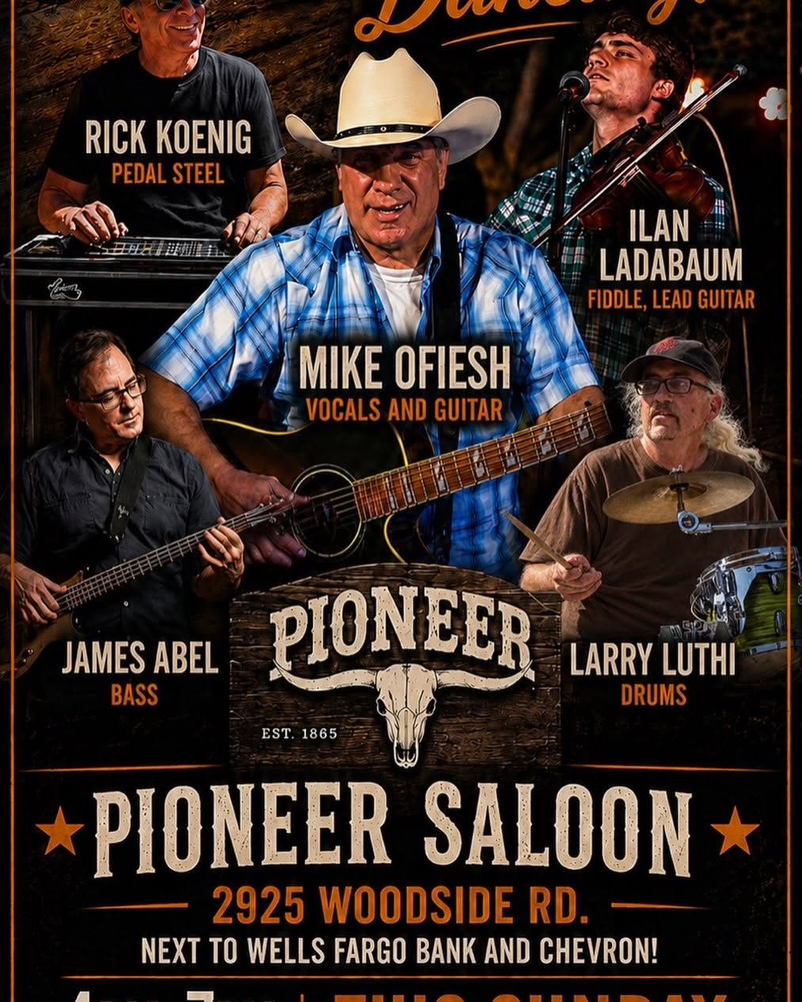
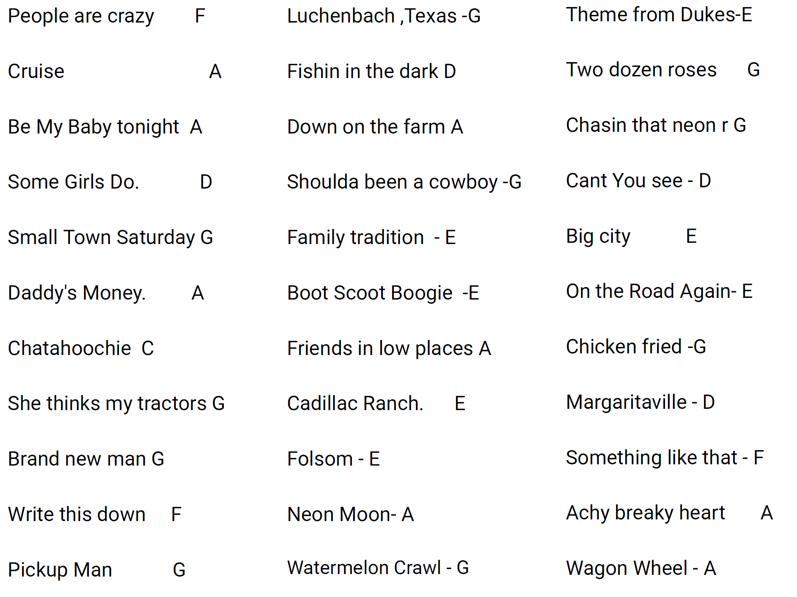
Set List (song, key)
Transposition
Stem Extraction
Stem Solo and Mute

Slide 4
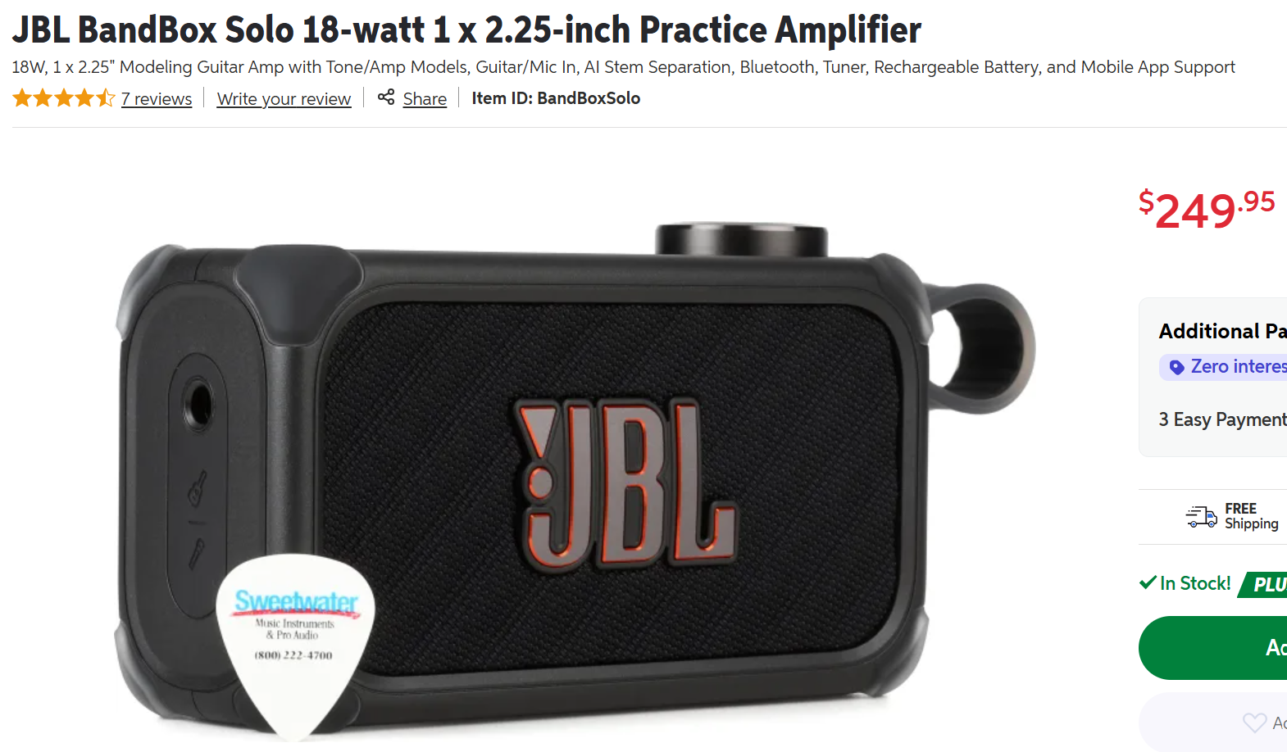
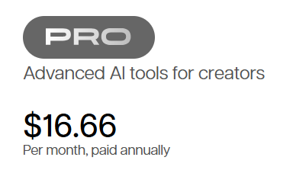
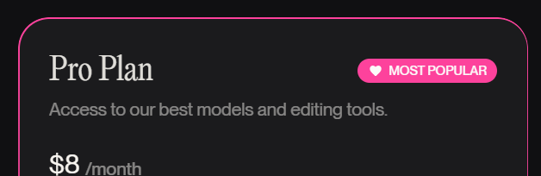

Slide 5

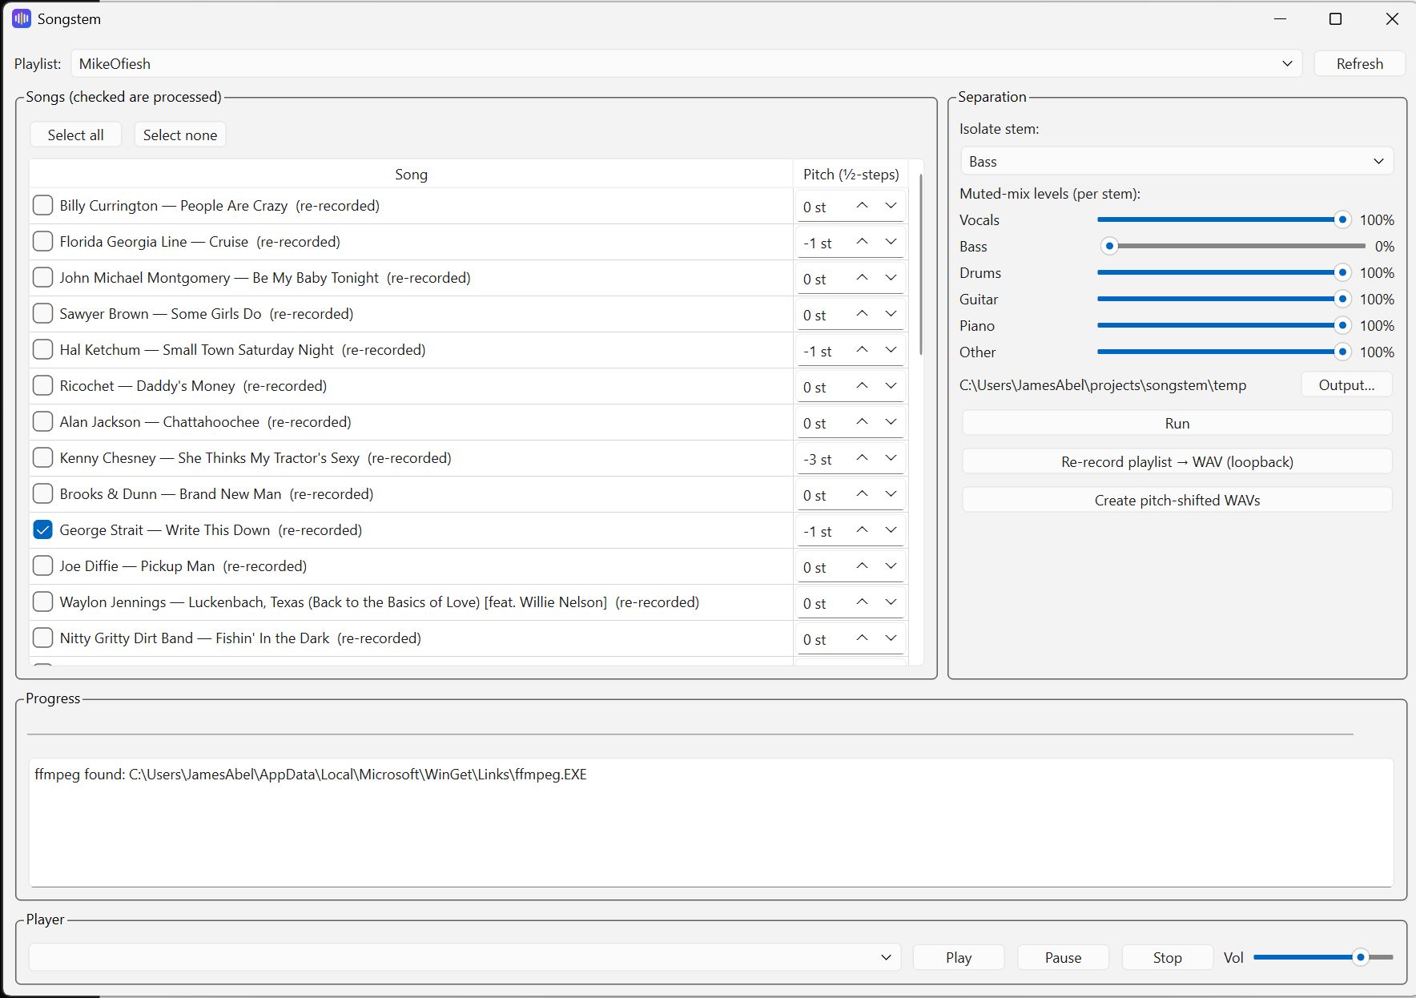
Songstem Demo

Slide 6
Songstem
Instrument removal for Apple Music on Windows — batch stem separation for music practice
Solo
the chosen stem, isolated — e.g. bass only
Full mix
any song in an iTunes playlist
Play along with the band —
or study your part in isolation.
Muted
the mix with that stem removed
Windows · Python · optimized for practice and cover-song rehearsal — quality over latency (batch, not live)

Slide 7
Architecture
Layered pipeline — every heavy dependency sits behind a swappable seam
GUI — PySide6 (Qt 6): playlist picker · stem & level controls · progress/Stop · built-in player (Qt Multimedia) · UI state in SQLite (pref)
Playlist source
iTunes COM (pywin32)
or a folder of WAVs
Batch pipeline
child process — GUI
never stalls; per-song
errors don't abort
Separation backend
Demucs (PyTorch, CPU)
pluggable via registry —
e.g. Open-Unmix
Mixer
pure NumPy —
solo & muted sums,
per-stem gains
Audio I/O
soundfile + ffmpeg
atomic writes
→ WAVs on disk
Design rule
Heavy/platform imports (Demucs, Qt, COM, soundfile) stay local behind ABCs with in-memory fakes — the core is importable and tested headless.
Analysis (best-effort, never fails a job)
librosa: key (Krumhansl–Schmuckler) · tempo · note patterns
synced lyrics (network) → Markdown cheat sheet

Slide 8
Underlying technologies
All Python — Windows x86 desktop, Python 3.14
Separation / ML
• Demucs v4 — hybrid transformer source separation
• PyTorch, CPU inference (GPU-ready via config)
• Backend registry → swappable engines
Desktop UI
• PySide6 (Qt 6) widgets
• Qt Multimedia output player
• QThread workers + child process for heavy work
Audio processing
• NumPy mixing · soundfile (libsndfile) I/O
• ffmpeg for AAC/ALAC decode (auto-installed via winget)
• librosa — key/tempo/note analysis, pitch shifting
Windows integration
• pywin32 — iTunes/Apple Music COM automation
• sounddevice + VB-Audio Virtual Cable loopback capture
• Runs on regular CPython (not free-threaded 3.14t)
Persistence & state
• pref — SQLite-backed UI state
• Remembers playlist, checked songs, pitch, window
• Atomic file writes for crash-safe outputs
Quality & tooling
• pytest suite over the dependency-light core
• Fakes for iTunes, separation, recording, analysis
• ruff linting · hatchling packaging
Every dependency is plain PyPI — no services, no accounts; everything runs and stays on the local machine.

Slide 9
Development
All done in ~1 day with Claude Code
Simple interactive prompts
Iterative
I’m responsible for functionality – via use
I wrote no Python
Claude Code added regression tests
Notes:
Many people took years to learn to program in assembly, how to program well in C, what OOO is, how to use Python and the ecosystem. But are picking up generative coding tools essentially immediately.

Slide 10
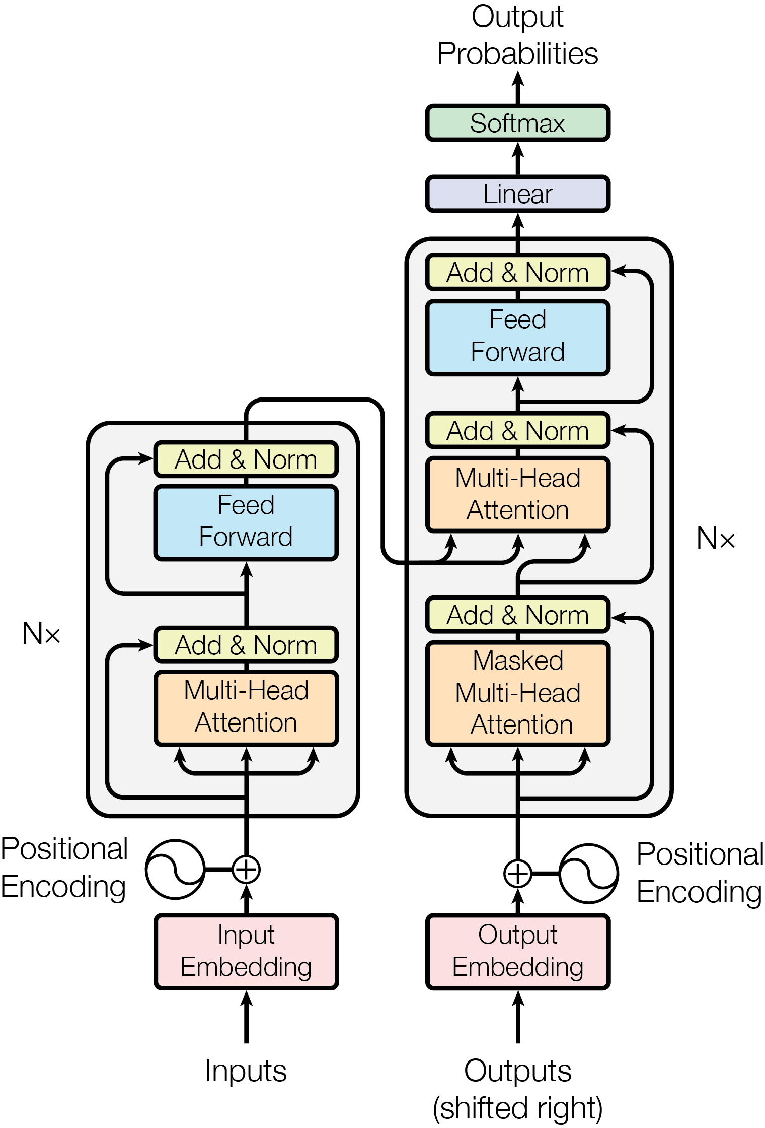
My Journey …
Transformer model architecture
Notes:
From “Attention Is All You Need” - paper

Slide 11

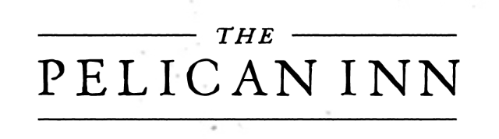
Summary
With AI, less of the work is now coding per-se.
The Responsibility of the delivered product hasn’t changed.
Specifications (Prompts) is a skill.
What technologies should be applied to the end product?
Tool selection is important (what model, security, cloud vs. local, cost, etc.).
What AI techniques exist and should be applied?
What are Transformers, Generative Pretrained Transformer (GPT), RAG, MCP, Agents, etc.
Tests are as important as ever (if not more so).
The responsible party must still be able to ensure things are fixed when they go wrong.
https://github.com/jamesabel/songstem
10 pacific way, Muir beach, California 94965
Mon Sept 7, 2026
Notes:
Many people took years to learn to program in assembly, how to program well in C, what OOO is, how to use Python and the ecosystem. But are picking up generative coding tools essentially immediately.

Slide 12
BACKUP

Slide 13
Usage model
One button after setup — the batch runs in the background
1 · Pick a playlist
read live from iTunes /
Apple Music (COM)
2 · Check songs
unusable (DRM, cloud-only)
tracks are greyed out
3 · Choose the stem
bass, guitar, vocals… plus
per-stem muted-mix levels
4 · Run
separation runs in a child
process; progress + Stop
Per song, in the output folder
Optional per-song pitch shift
±12 half-steps → transposed WAV copies,
for comfortable keys / alternate tunings
5 · Practice
audition solo / muted in the
built-in player; selections are
remembered between launches
Artist – Title [bass solo].wav
Artist – Title [bass muted].wav
Artist – Title [bass cheatsheet].md
cheat sheet: key, tempo, note patterns, synced lyrics

Slide 14
Audio sources and the DRM boundary
Separation needs decodable audio — Apple's FairPlay DRM cannot be decrypted
iTunes / Apple Music track
DRM-free file
CD rips, .mp3, DRM-free .m4a purchases
DRM-protected .m4p
subscription downloads — undecodable, greyed out
Stem separation
the resolved source — original file or
re-recorded WAV — feeds the pipeline
Loopback re-record → DRM-free WAV
iTunes plays → VB-Audio virtual cable → capture (sounddevice)
resumable · atomic writes · silent captures stop the run · personal use only
Re-recording captures playback in real time (a playlist takes about its runtime); it records audio output — it does not remove DRM.

Slide 15
Testing
Owner-Generated or AI?
Avoid “tests are boring – I’ll let AI do it”
Owner
For critical code and/or delivering to others, owner’s tests should specify functionality (TDD, Spec Driven Tests, etc.).
For non-critical and/or hyper-personalized code (code is tested during use), user-written tests may not be necessary.
AI
AI can created Regression Tests once functionality is defined. Enables refactoring, performance improvements, framework migration.
Use Code Coverage (including branch coverage) to guide test efforts.
80% Code Coverage → 20% “not covered”.
The expertise is in deciding what tests to create and by whom.

Slide 16
Finish up with my tech over time, with AI added.

