Slide 1
The PLDI Story (in one picture)
The Web
(browser)
Plentiful RAM
World of great frameworks
for beginning programming
(Blockly)
Web App
JavaScript
Single-threaded
Static TypeScript
our contribution
bringing the worlds of
Web and MCU together
WA = integration/entry point
Languages
Compiler
Runtime
CODAL
Reactive/
concurrent
C/C++
Full bare-metal binary
The microcontroller
(MCU)
Little RAM
World of the pro IDE
(Eclipse, VS, VS Code)

Slide 2
Editors
Simulator
MakeCode
Web App
Blockly
JavaScript
TypeScript
Metadata generation
Browser compilation
Monaco
Static TypeScript
IR
Assembly
user
binary
TypeScript
Device
runtime
Linker
Static
TypeScript
runtime
binary
cached copy
Shim generation
final binary
(UF2 file)
CODAL
(C++)
runtime
binary
compile
Cloud compilation
decompile
link

Slide 3
codal-core
Blockly,
Typescript, Monaco
pxt
uses
references
extends,
implements
codal-atmega328p
pxt-common-packages
references
uses
codal-arduino-uno
uses
codal
(build shell)
uses
pxt-target
extends,
implements
codal-samd21
selects from
uses
codal-circuit-playground
MakeCode web app
Notes:
https://github.com/lancaster-university/codal-adafruit-cplay

Slide 4
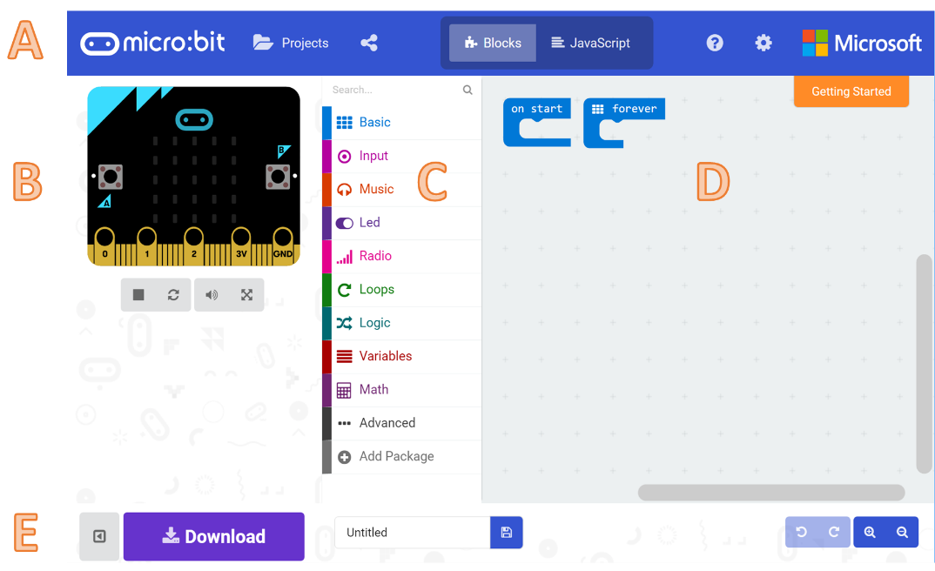

Slide 5
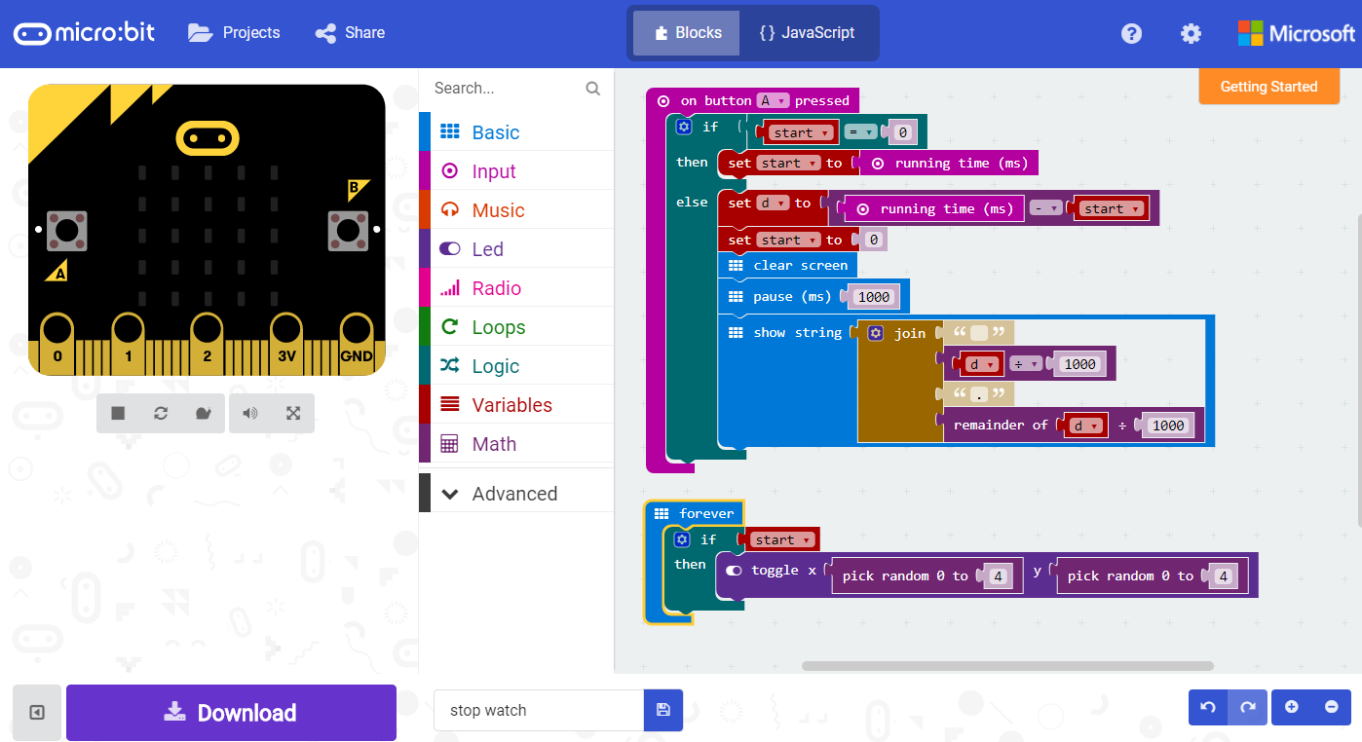
A
B
D
C
E

Slide 6
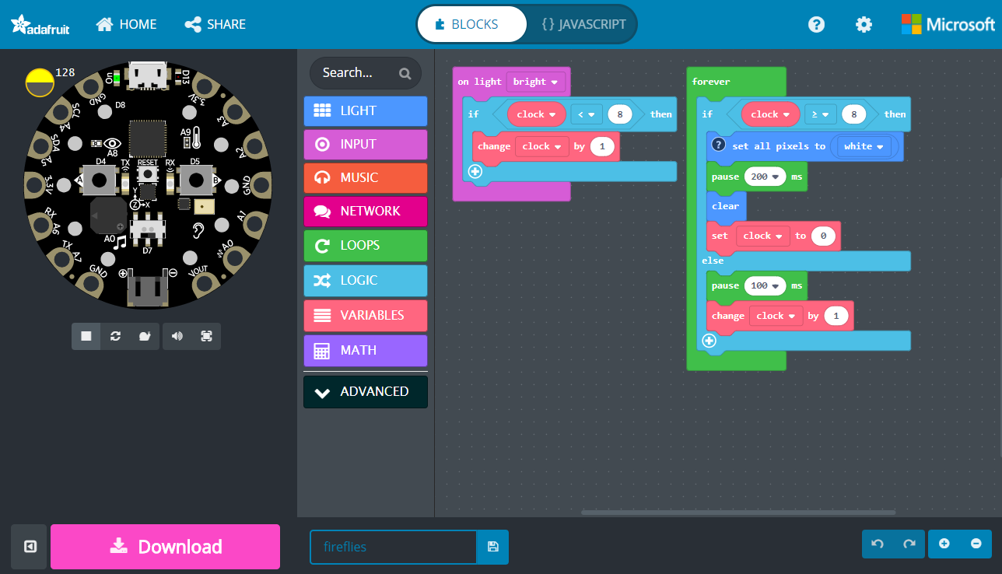
A
B
D
C
E

Slide 7
codal
(build shell)
codal-arduino-uno
codal-circuit-playground
codal-atmega328p
codal-samd21
codal-mbed
codal-core
mbed-classic

Slide 8
RT
(build shell)
RT-arduino-uno
RT-circuit-playground
RT-atmega328p
RT-samd21
RT-mbed
RT-core
mbed-classic

