Slide 1


PREDICTION OF OIL, GAS & WATER PRODUCTION IN THE DSEATS FIELD USING MACHINE LEARNING
CONTESTANT NAME: JAMES ALLEH
SPE NUMBER: 5055998
SECTION: SPE BENIN SECTION
CATEGORY: STUDENT MEMBER
COURSE OF STUDY: PETROLEUM ENGINEERING
University of Benin, Benin City, Nigeria.
13 JULY, 2024

Slide 2
PRESENTATION OUTLINE
1
Objectives
2
Methodology
3
Results and Discussion
4
Conclusion and Recommendations
5
References

Slide 3
OBJECTIVES & ABOUT DSEATS FIELD
OBJECTIVES
DATA PROVIDED
To develop a machine learning model to predict oil, gas and water production based on historical records.
The data available for DSEATS Field is an oil and gas production data. The data include
Training data set
Validation data set
Training Data set
ML Model
Validation Data Set
ML --- Machine Learning

Slide 4
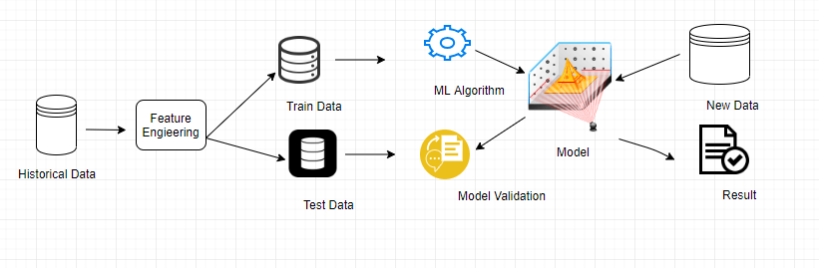
METHODOLOGY: THE WORKFLOW
Data Preparation
Data Description
Data Preprocessing
Exploratory Data Analysis (EDA)
Model Selection
Model Training
ML Model Creation
Validation Results
Model Deployment
Model Evaluation & Fine Tuning
Figure 1: Conceptual Framework of the step by step approach to achieving the objectives of the study
Figure 2: Pictorial representation of the step by step approach to achieving the objectives of the study

Slide 5
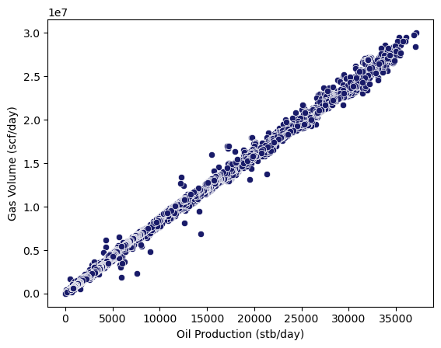
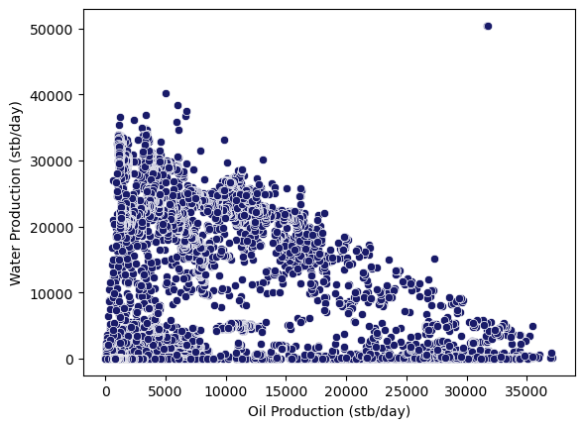
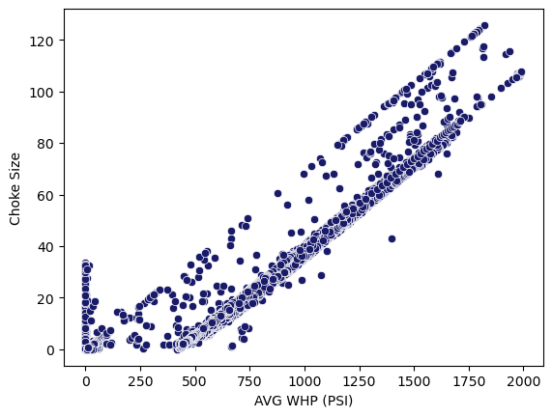
DATA PREPARATION: STATISTICAL DATA INSIGHTS & TREND
Table 1: Summary of statistical information of training Data set
 | N_WELL_BORE_CODE | Downhole Pressure (PSI) | Downhole Temperature (Kelvin) | Average Tubing Pressure (PSI) | Annulus Pressure (PSI) | AVG WHP (PSI) | Choke Size | Oil Production (stb/day) | Gas Volume (scf/day) | Water Production (stb/day)
count | 6915.00 | 6915.00 | 6915.00 | 6915.00 | 6915.00 | 6915.00 | 6915.00 | 6915.00 | 6915.00 | 6915.00
mean | 107.30 | 2589.58 | 349.74 | 2163.87 | 180.55 | 717.00 | 21.85 | 8497.31 | 6981247.00 | 11497.65
std | 0.98 | 1587.29 | 46.21 | 1052.51 | 139.75 | 347.27 | 22.30 | 8928.07 | 7100618.00 | 11483.94
min | 105.00 | 0.00 | 273.15 | 0.00 | 0.00 | 0.00 | 0.00 | 0.00 | 0.00 | 0.00
0.25 | 107.00 | 0.00 | 273.15 | 920.63 | 0.00 | 476.67 | 4.63 | 1687.64 | 1436886.00 | 85.14
0.50 | 107.00 | 3378.87 | 376.92 | 2472.96 | 213.25 | 619.67 | 14.29 | 5479.47 | 4773450.00 | 5607.98
0.75 | 108.00 | 3664.90 | 379.50 | 2907.64 | 300.38 | 903.94 | 31.53 | 11731.57 | 9896699.00 | 22271.47
max | 109.00 | 4606.67 | 381.65 | 4592.61 | 435.29 | 1991.01 | 125.72 | 37122.57 | 30044940.00 | 50444.16
Figure 3: Scatter Plots of relationship between features

Slide 6
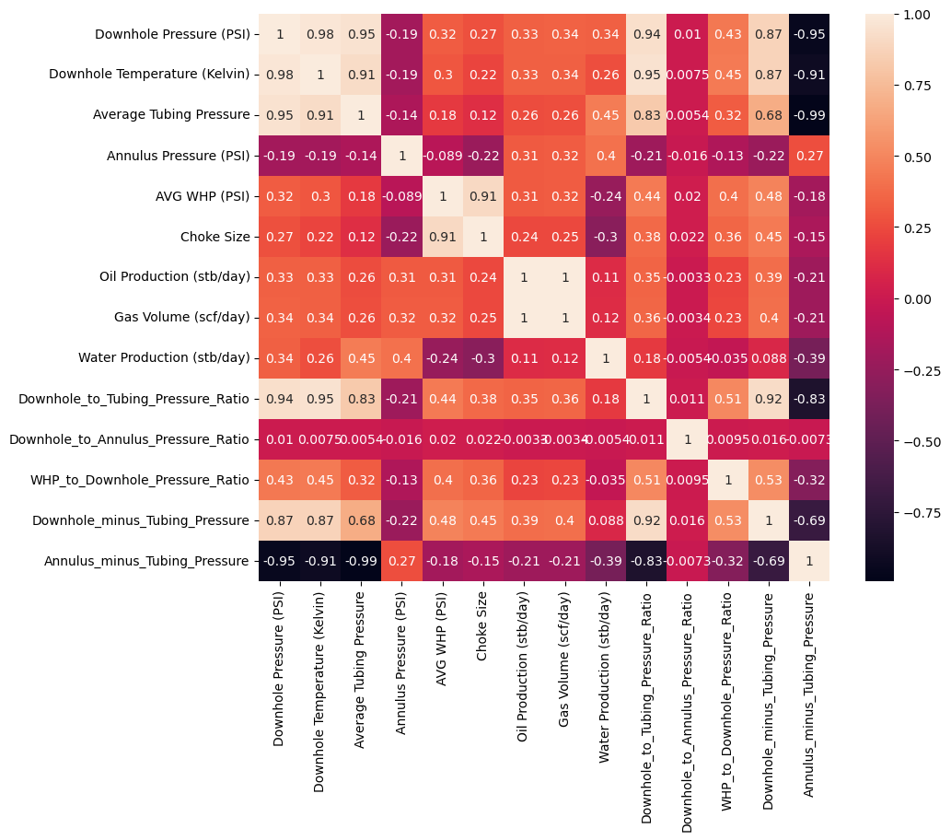
DATA PREPARATION: STATISTICAL DATA INSIGHTS & TREND
Table 2: Input Features
Table 3: Target features
S/N | Input Features
1 | Downhole pressure (PSI)
2 | Downhole Temperature
3 | Average Tubing Pressure (PSI)
4 | Annulus Pressure (PSI)
5 | AVG WHP (PSI)
6 | Choke Size
7 | Downhole to tubing ratio
8 | Downhole to annulus Pressure Ratio
9 | WHP to Downhole Pressure Ratio
10 | Downhole minus Tubing Pressure
11 | Annulus minus Tubing Pressure
S/N | Target features
1 | Oil Production (stb/day)
2 | Gas Volume (scf/day)
3 | Water Production (stb/day)
Keys
Features from data set
Created Features as a result of feature engineering
DATA SET
Train set (80%)
Test set (20%)
Figure 4: Heat map showing correlation between Input features and target variable

Slide 7

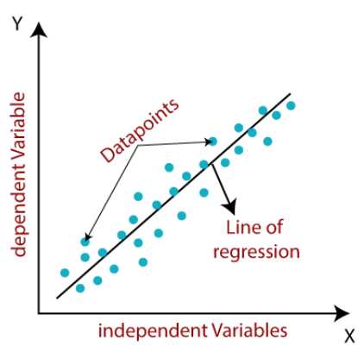
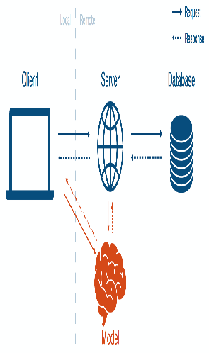

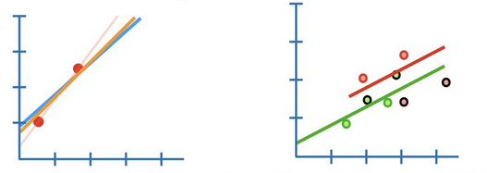
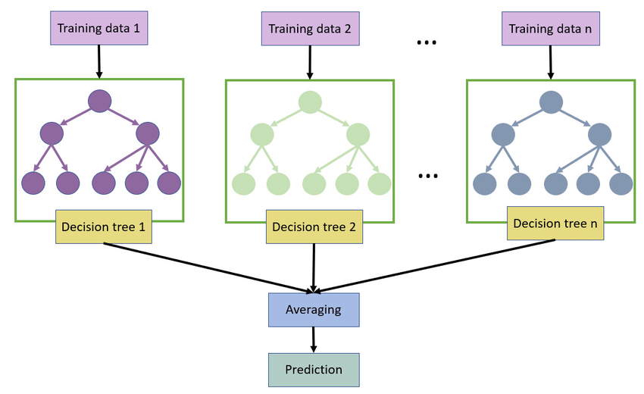
APPLIED METHODOLOGY: MACHINE LEARNING MODELING
Five (5) Supervised Regression algorithms were deployed namely:
Linear Regression (LR)
LASSO
Decision Tree Regression (DTR)
Extreme Gradient Boosting (XGB) model
Random Forest (RF) model
Input features
Features Engineering
ML Modelling
Model Optimization and Evaluation
Model Deployment
Validation Results
0
Linear Regression
2
1
Data Normalisation
Optimisation of Hyperparameters
4
5
7
LASSO
Cross validation analysis
(3-fold)
6
8
9
Ensemble models: Decision Trees, RF & XGB
10
Train set
Test set
Evaluating on the testing set
Data Preparation
{ 80:20 spilt}
Figure 5: Flowchart illustrating the process of ML model development

Slide 8
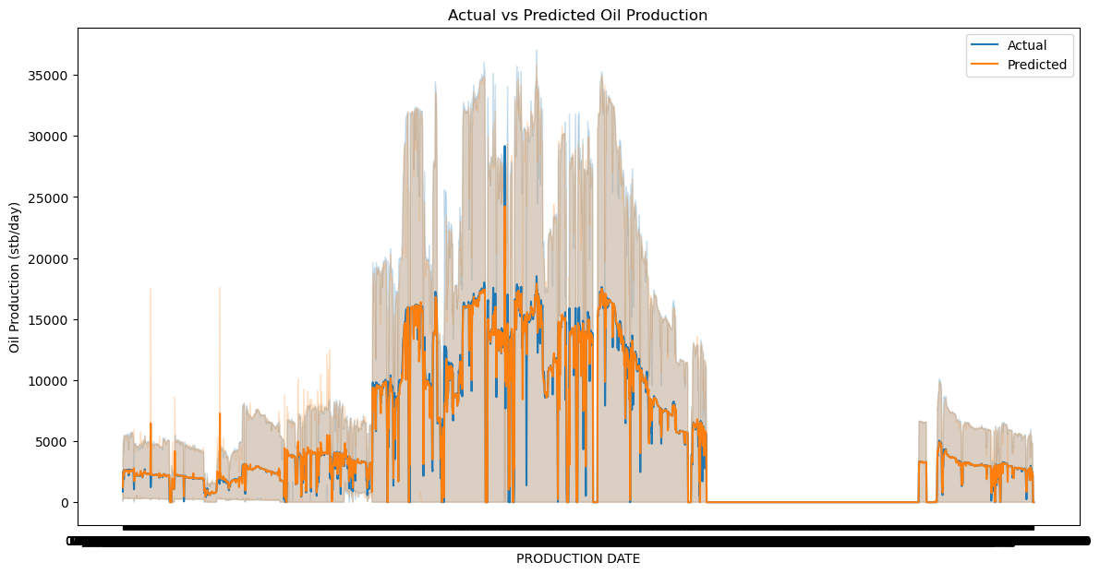
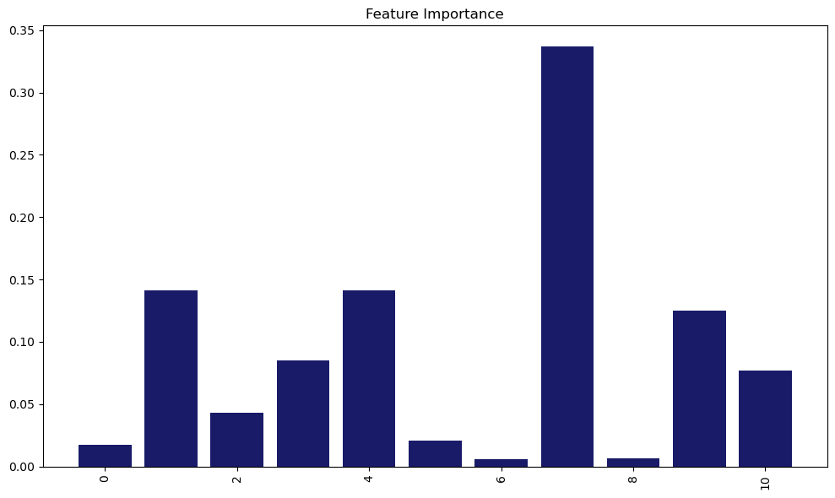
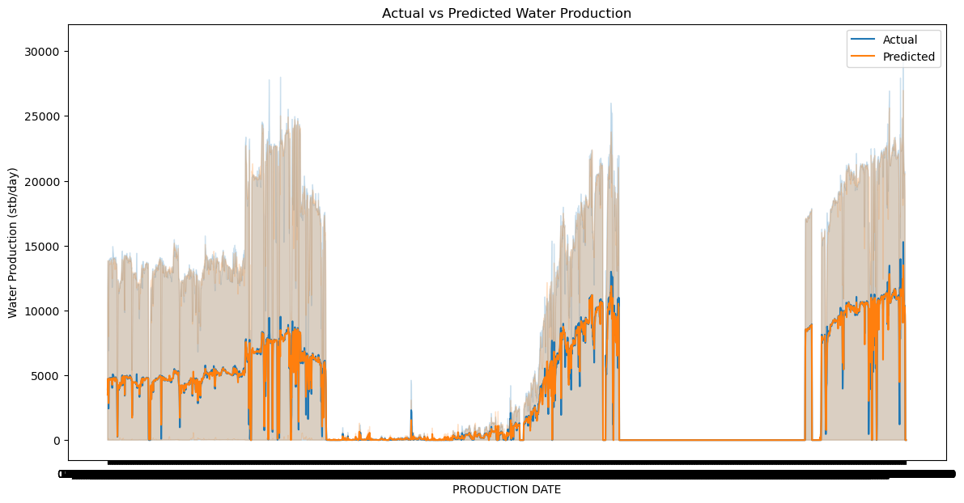
RESULTS AND DISCUSSION: MODEL ASSESSMENT AND VISUAL ANALYSIS
Figure 7: Feature importance from the final model
KEYS | LABELS
0 | Downhole pressure (PSI)
1 | Downhole Temperature
2 | Average Tubing Pressure (PSI)
3 | Annulus Pressure (PSI)
4 | AVG WHP (PSI)
5 | Choke Size
6 | Downhole to tubing ratio
7 | Downhole to annulus Pressure Ratio
8 | WHP to Downhole Pressure Ratio
9 | Downhole minus Tubing Pressure
10 | Annulus minus Tubing Pressure
Figure 6: Parity plot showing performance of the predicted and actual model

Slide 9
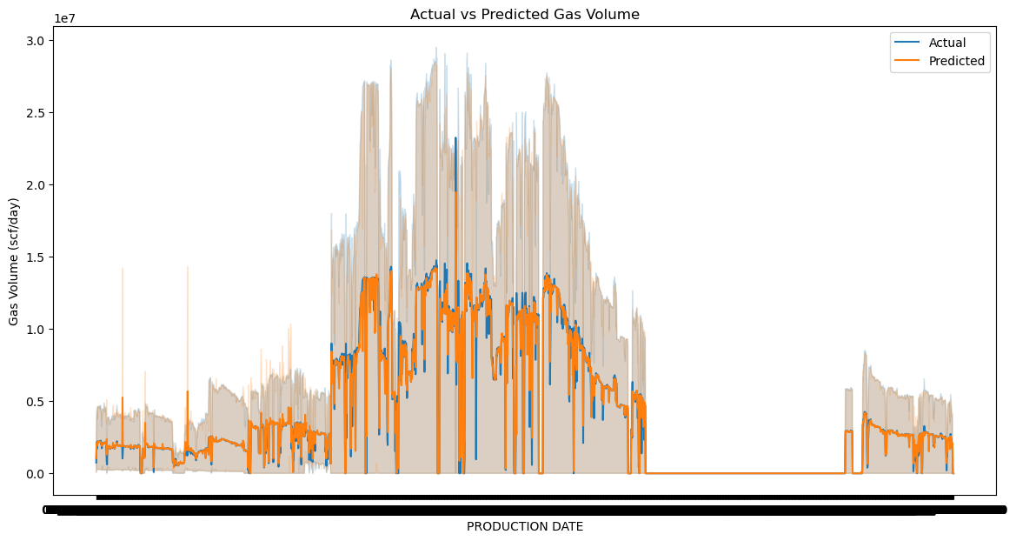
RESULTS AND DISCUSSION: MODEL ASSESSMENT & COMPARATIVE ANALYSIS
Table 4 Performance Assessment of ML model predictions
Best Model
Metrics | LR |  |  | LASSO |  |  | DT |  |  | RF |  |  | XGB
 | Oil Prod. | Gas Prod. | Water Prod. | Oil Prod. | Gas Prod. | Water Prod. | Oil Prod. | Gas Prod. | Water Prod. | Oil Prod. | Gas Prod. | Water Prod. | Oil Prod. | Gas Prod. | Water Prod.
R2 | 0.3686 | 0.3794 | 0.5836 | 0.3684 | 0.3793 | 0.5834 | 0.9039 | 0.9002 | 0.9438 | 0.9407 | 0.9499 | 0.9825 | 0.9380 | 0.9394 | 0.9742
RMSE | 6866.7 | 5444163 | 4768.9 | 6868.1 | 5444725 | 4770.0 | 2678.3 | 2183369 | 1752.7 | 1937.6 | 1546922 | 978.18 | 2152.3 | 1700868 | 1186.38
NSE | 0.3686 | 0.3794 | 0.5836 | 0.3684 | 0.3793 | 0.5834 | 0.9039 | 0.9002 | 0.9438 | 0.9407 | 0.9499 | 0.9825 | 0.9380 | 0.9394 | 0.9742
WI | 0.6929 | 0.7036 | 0.8579 | 0.6921 | 0.7030 | 0.8588 | 0.9753 | 0.9744 | 0.9859 | 0.9867 | 0.9868 | 0.9955 | 0.9838 | 0.9843 | 0.9935
MAE | 4425.87 | 3524340.2 | 3667.976 | 4421.82 | 3521177.0 | 3657.832 | 586.21 | 508821.6 | 395.6274 | 519.86 | 424679.3 | 282.4726 | 641.23 | 491590.4 | 383.5059
KEYS
NSE=Nash-Sutcliffe Efficiency
WI =Willmott index
RMSE = Root mean squared error
MAE = Mean Absolute Error
Training Data set |  |  | Validation Data set
Oil Prod. (stb/day) | Gas Prod. (scf/day) | Water Prod. (stb/day) | Oil Prod. (stb/day) | Gas Prod. (scf/day) | Water Prod. (stb/day)
51822238 | 42284784149 | 43704116 | 6604064 | 5474704814 | 6930842
Figure 8: Parity plot showing performance of the predicted and actual model

Slide 10
CONCLUSIONS AND RECOMMENDATIONS
CONCLUSIONS
Generally, the predicted trend mimicked the actual trend of the training data set provided with a reasonably accuracy (R²) of 98%.
The Random Forest model consistently outperformed the other models across all targets, showing the highest R² scores and the lowest MAE and RMSE values.
The LR model performed poorly, with negative R² scores indicating that it did not fit the data well.
From the feature performance plot, among the field parameters included in the training data set, Average Well head pressure and down hole temperature has more effect on the prediction.
RECOMMENDATIONS
More modelling tools should be attempted to better optimize the ROP model prediction.
Developing on this work can be made by incorporating the use of hybrid models, or stacked models so as to generate more efficient predictions

