Slide 1

Infrastructure as Code

Slide 2
James Allen
Introduction
What is Infrastructure as Code
Azure Resource Manager (ARM) Templates
Desired State Configuration (DSC)
Terraform
Summary

Slide 3
Infrastructure as Code
Provisioning and Configuration
Simplify Deployments
Infrastructure becomes Consistent, Predictable, Repeatable, and easy for team members to understand
Improves security
Documents your application’s infrastructure
Ensures issues are found, fixed, and deployed
Control Configuration and drift
Versioned and tracked with source control

Slide 4
ARM Templates and What can they do?
JSON formatted files defining the deployment and configuration of your environment.
Declarative in nature.
Allows repeated deployments of your application throughout the app lifecycle ensuring resources are deployed in a consistent state.
You define the infrastructure for your app, how to configure that infrastructure, and how to publish your app code to that infrastructure.
No need to worry about the order of deployment. Azure takes care of that for you.
Allows you to perform updates to your environment without affecting existing resources
Launch templates from PowerShell or directly from github

Slide 5
Requirements
Windows PowerShell
Azure PowerShell
Visual Studio or your favorite Text Editor

Slide 6
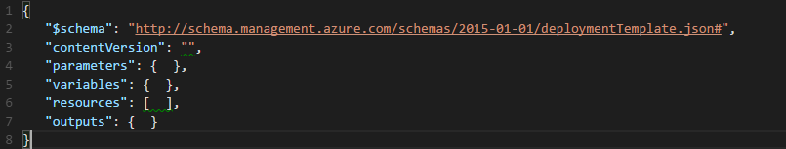
Template Format
ELEMENT NAME | REQUIRED | DESCRIPTION
$schema | Yes | Location of the JSON schema file that describes the version of the template language.
contentVersion | Yes | Version of the template (such as 1.0.0.0). When deploying resources using the template, this value can be used to make sure that the right template is being used.
parameters | No | Values that are provided when deployment is executed to customize resource deployment.
variables | No | Values that are used as JSON fragments in the template to simplify template language expressions.
resources | Yes | Types of services that are deployed or updated in a resource group.
outputs | No | Values that are returned after deployment.

Slide 7
Microsoft Quickstarts
Microsoft has provided multiple examples and quickstart configurations on github
https://github.com/Azure/azure-quickstart-templates
Can be used as building blocks
Examples include Redis, SQL Server High Availability, MongoDB, Load Balanced applications

Slide 8
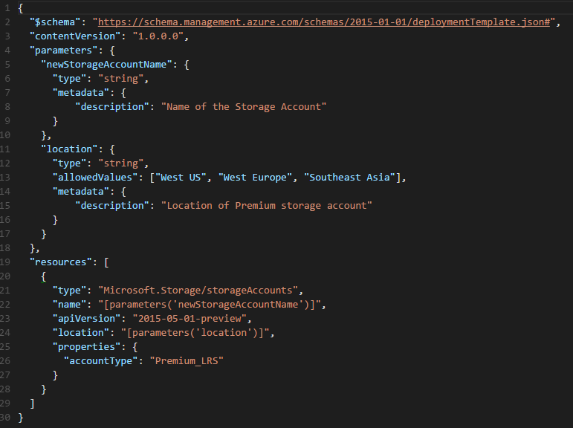
Storage Account Creation Example

Slide 9
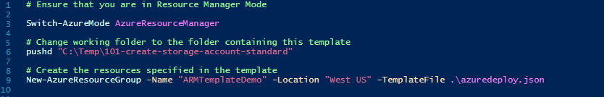

Storage Account Creation Example
Launching the template
Removing the resources

Slide 10
Desired State Configuration
PowerShell extension that ships with Windows Server 2012 R2 and Windows 8.1
Declarative in nature
Designed to support “continuous deployments” (Idempotent)
Fix a configuration that has drifted away from the desired state without breaking anything
Configuration as Code
Now changes to the configuration can be versioned and tracked with source control

Slide 11
What can it do?
Install or remove server roles and features
Manage registry settings
Manage files and directories
Start, stop, and manage processes and services
Manage local groups and user accounts
Install and manage packages such as .msi and .exe
Manage environment variables
Run Windows PowerShell scripts
Discover the actual configuration state on a given node
Works with Linux

Slide 12
vs.
Pull
Push
pull clients schedule a task that performs a periodic compliance check on the node.
Local Configuration Manager (LCM) validates the configuration.
Check interval is configurable
User initiates configuration processing
Can be combined with an automated deployment to ensure an environment’s configuration version matches the software.

Slide 13
Requirements
Windows 8.1, Windows Server 2012 R2 Standard , Windows Server 2012 Standard
Windows Server 2012 R2
Windows 8.1 Pro
Windows 8.1 Enterprise
Windows Server 2012

Slide 14
Pull Server Configuration
Enable PSRemoting
Install WMF 5.0 February Preview
Install nuget-anycpu.exe
Download and install the latest DSC resources from PowerShell Gallery
Zip up the DSC Resources and transfer those files to the pull configuration directory.
Create checksums for each file.

Slide 15
Installation the easy way
Use Boxstarter
http://boxstarter.org/WebLauncher
Installation Links
http://bit.ly/1IO5UtS
HTTP Pull Server Bootstrap
http://bit.ly/1Cy5yIl
DSC Node Bootstrap/Workstation/Push Server
http://bit.ly/1Gf2D2b

Slide 16
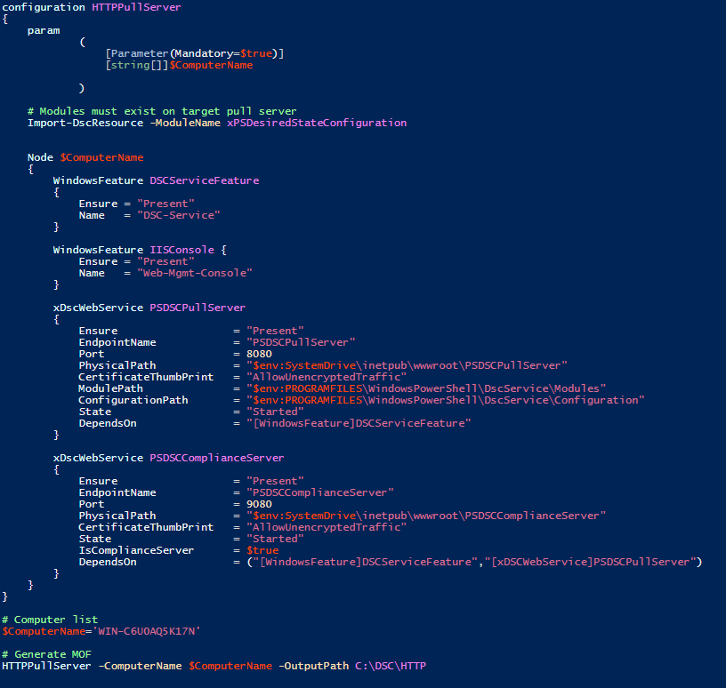
Build The Pull Server Configuration (MOF)

Slide 17
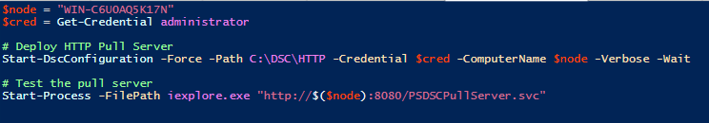
Apply the Pull Server Configuration

Slide 18
Terraform
Made by the same group that produced Vagrant and Packer
Tool for building, changing, and versioning infrastructure safely and efficiently
Terraform can manage existing and popular service providers as well as custom in-house solutions
Azure
AWS
Others
Generates an execution plan describing what it will do to reach the desired state, and then executes it
Able to determine what changed and create incremental execution plans which can be applied
You know exactly what Terraform will change and in what order, avoiding many possible human errors
Can manage low-level components such as compute instances, storage, and networking, as well as high-level components such as DNS entries, SaaS features
Terraform enables any configuration management tool to be used to setup a resource once it has been created
Declarative in nature

Slide 19
Installers
FreeBSD
Linux
Mac
Windows
Available on chocolatey

Slide 20
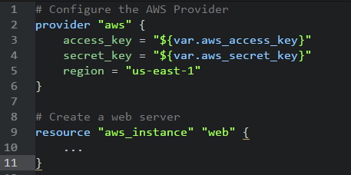
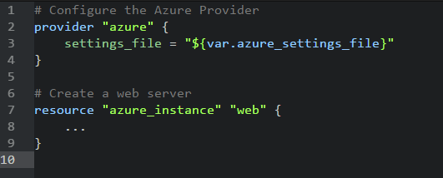
Configuration
Terraform needs an access key for your cloud provider
Amazon: Call from the project working directory
Azure: Call from the project working directory

Slide 21
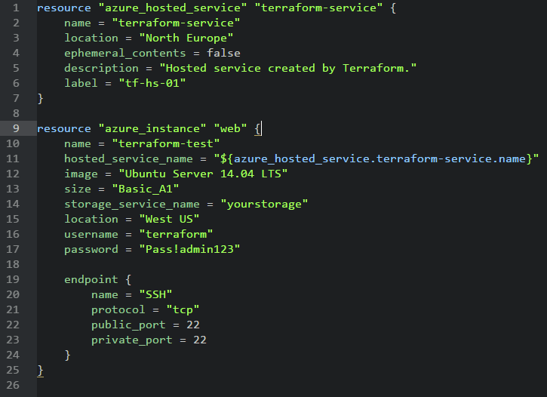
Azure Configuration

Slide 22
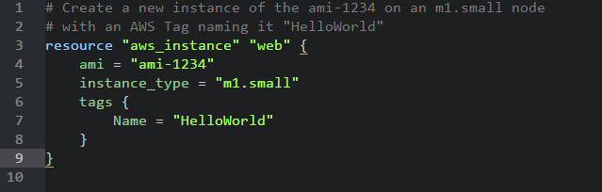
Amazon Configuration

Slide 23
Difficulties
Working in teams with terraform can be problematic because of state tracking
Currently terraform only produces a state file when it runs
It cannot build the state file from scratch from an environment (future version)
Environment state is stored in the terraform.tfstate file on the local file system
Problems result from merge conflicts if this file is checked in
Use Remote State instead
Instead of storing in a local file system you can store in AWS S3 or similar storage mechanism
Commands are provided to migrate an existing local state file and vice versa

Slide 24
Summary
Makes deployment of new environments simple
Documents your application’s infrastructure
Ensures issues are found, fixed, and deployed
CPR – Consistent, Predictable, Repeatable
Leverages existing Skills
Manage configuration as code (Track changes with version control)
Manage Drift
Manage destructive changes to your environments

Slide 25
Questions?

Slide 26
Additional Resources
Azure Resource Manager
https://azure.microsoft.com/en-us/documentation/articles/resource-group-overview/
Azure Quickstart Templates
https://github.com/Azure/azure-quickstart-templates
DSC Resources
http://www.powershellgallery.com/packages
https://github.com/PowerShell/DscResources
Microsoft Virtual Academy
http://www.microsoftvirtualacademy.com/training-courses/getting-started-with-powershell-desired-state-configuration-dsc-
http://www.microsoftvirtualacademy.com/training-courses/advanced-powershell-desired-state-configuration-dsc-and-custom-resources
The DSC Book
http://powershell.org/wp/ebooks/

Slide 27
Additional Resources
Boxstarter Gist to bootstrap a DSC Pull Server
https://gist.github.com/jamesallen-cm/f9d009444132ddfa9d54
Boxstarter Gist to bootstrap a DSC Node
https://gist.github.com/jamesallen-cm/f84797c8a2294203b205
Terraform
https://www.terraform.io/
Terraform Documents
https://www.terraform.io/docs
Terraform examples
https://www.terraform.io/intro/examples/index.html

