Slide 1
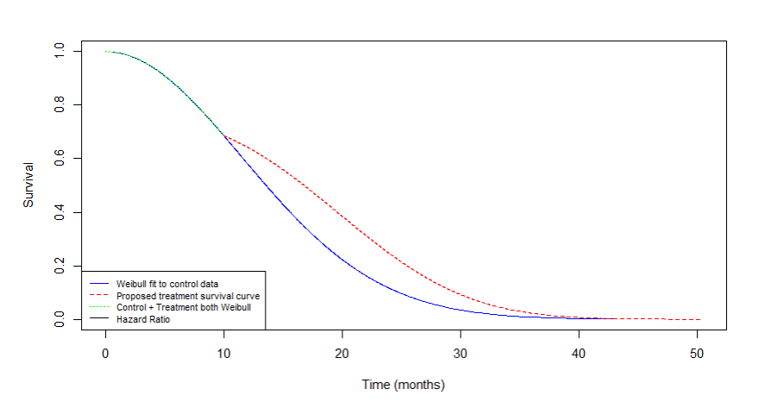
Assurance methods for Delayed Treatment Effects

Slide 2
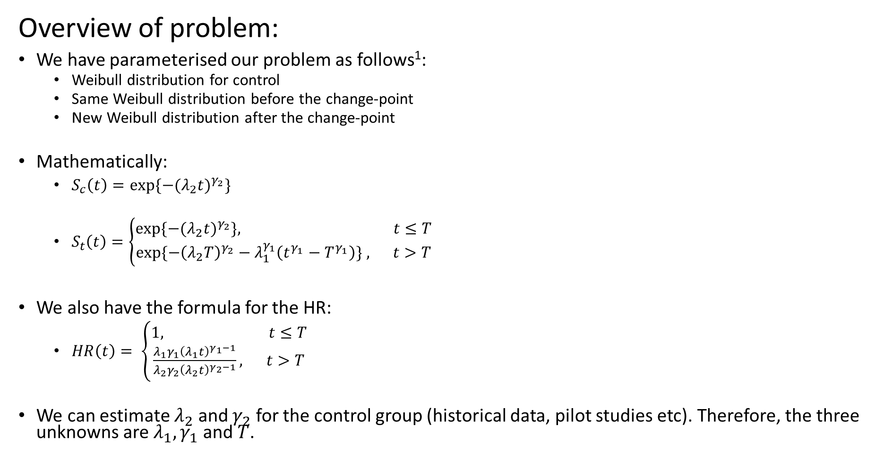
Overview of problem:
We have parameterised our problem as follows¹:
Weibull distribution for control
Same Weibull distribution before the change-point
New Weibull distribution after the change-point
Mathematically:
$S_{c}\left(t\right)={\exp{\{−(λ_{2}t)}}^{γ_{2}}\}$
$S_{t}\left(t\right)=\left\{\begin{aligned}{\exp{\{−(λ_{2}t)}}^{γ_{2}}\}, t≤T \\ &exp⁡\{−{\left(λ_{2}T\right)}^{γ_{2}}−λ_{1}^{γ_{1}}\left(t^{γ_{1}}−T^{γ_{1}}\right)\} , t>T\end{aligned}\right.$
We also have the formula for the HR:
$HR\left(t\right)= \left\{\begin{aligned}1, t≤T \\ &\frac{λ_{1}γ_{1}{\left(λ_{1}t\right)}^{γ_{1}−1}}{λ_{2}γ_{2}{\left(λ_{2}t\right)}^{γ_{2}−1}}, t>T\end{aligned}\right.$
We can estimate $λ_{2}$ and $γ_{2}$ for the control group (historical data, pilot studies etc). Therefore, the three unknowns are $λ_{1}, γ_{1}$ and $T$.
[1] https://www.psiweb.org/docs/default-source/default-document-library/alessandro-previtali-slides.pdf?sfvrsn=224dedb_0

Slide 3
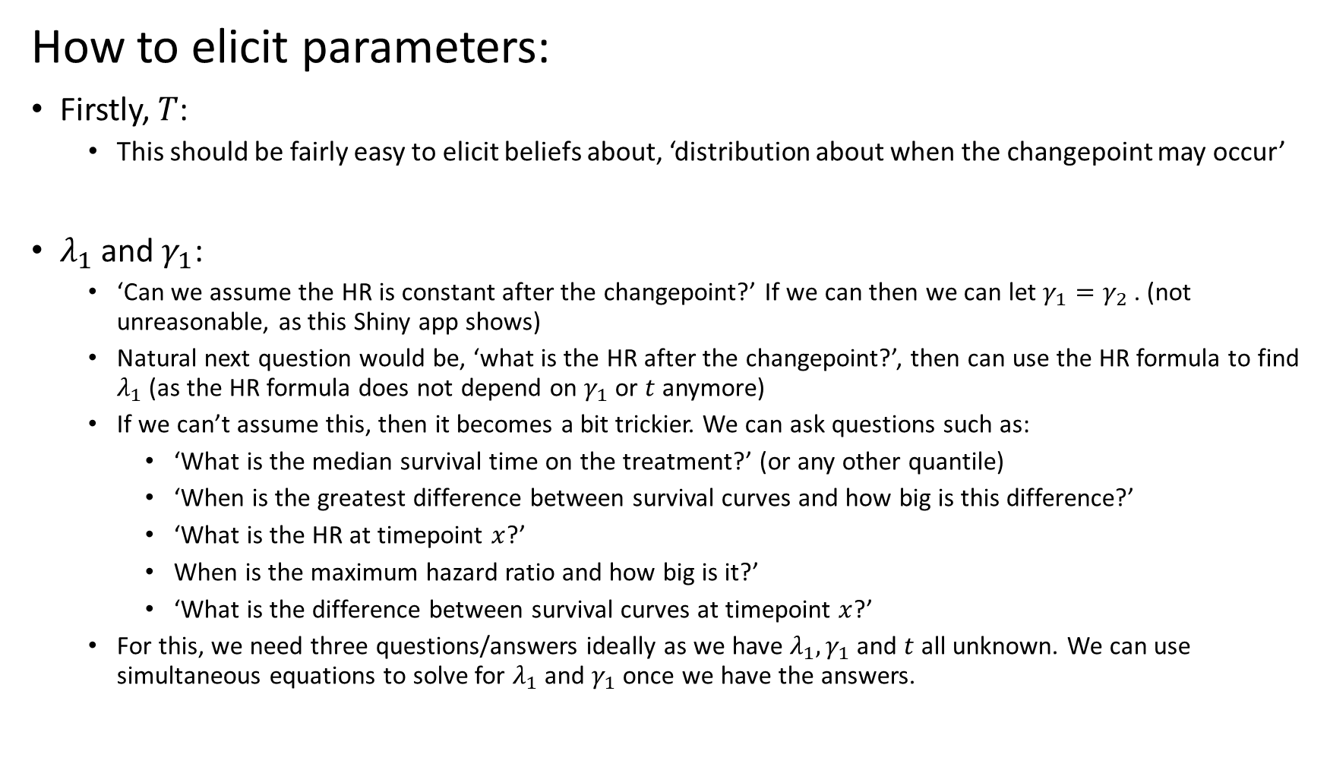
How to elicit parameters:
Firstly, $T$:
This should be fairly easy to elicit beliefs about, ‘distribution about when the changepoint may occur’
$λ_{1}$and $γ_{1}$:
‘Can we assume the HR is constant after the changepoint?’ If we can then we can let $γ_{1}=γ_{2}$. (not unreasonable, as this Shiny app shows)
Natural next question would be, ‘what is the HR after the changepoint?’, then can use the HR formula to find $λ_{1}$ (as the HR formula does not depend on $γ_{1}$ or $t$ anymore)
If we can’t assume this, then it becomes a bit trickier. We can ask questions such as:
‘What is the median survival time on the treatment?’ (or any other quantile)
‘When is the greatest difference between survival curves and how big is this difference?’
‘What is the HR at timepoint $x$?’
When is the maximum hazard ratio and how big is it?’
‘What is the difference between survival curves at timepoint $x$?’
For this, we need three questions/answers ideally as we have $λ_{1}, γ_{1}$ and $t$ all unknown. We can use simultaneous equations to solve for $λ_{1}$and $γ_{1}$ once we have the answers.

Slide 4
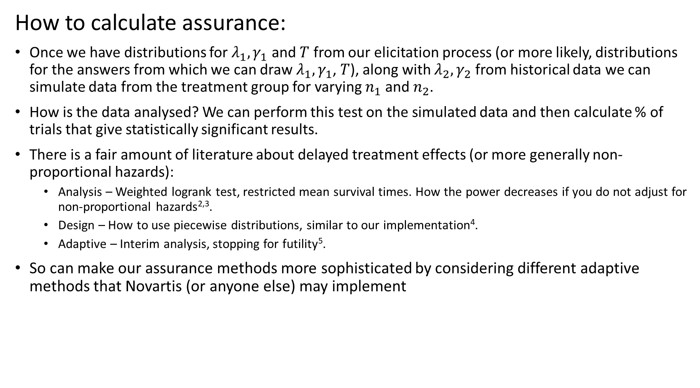
How to calculate assurance:
Once we have distributions for $λ_{1},γ_{1}$ and $T$ from our elicitation process (or more likely, distributions for the answers from which we can draw $λ_{1},γ_{1}$, $T$), along with $λ_{2},γ_{2}$ from historical data we can simulate data from the treatment group for varying $n_{1}$ and $n_{2}$.
How is the data analysed? We can perform this test on the simulated data and then calculate % of trials that give statistically significant results.
There is a fair amount of literature about delayed treatment effects (or more generally non-proportional hazards):
Analysis – Weighted logrank test, restricted mean survival times. How the power decreases if you do not adjust for non-proportional hazards^{2,3}.
Design – How to use piecewise distributions, similar to our implementation⁴.
Adaptive – Interim analysis, stopping for futility⁵.
So can make our assurance methods more sophisticated by considering different adaptive methods that Novartis (or anyone else) may implement
[2] https://onlinelibrary.wiley.com/doi/epdf/10.1002/pst.2062
[3] https://link.springer.com/content/pdf/10.1177/009286150704100412.pdf
[4] https://www.tandfonline.com/doi/pdf/10.1080/10543406.2020.1815035
[5] https://www.ncbi.nlm.nih.gov/pmc/articles/PMC6366306/pdf/JCO.2018.77.7144.pdf

