Slide 1
DTE Interim

Slide 2
Set-up
We are planning a survival trial in which we are anticipating there to be delayed treatment effects (DTE). We have elicited two prior distributions:
For $T$, the length of delay
For HR, the post-delay hazard ratio
How can we use these elicited prior distributions to help us decide when/if to perform any interim analysis?
Given some data, and these elicited prior distributions, we are able to calculate the posterior distributions for both $T$ and HR.

Slide 3
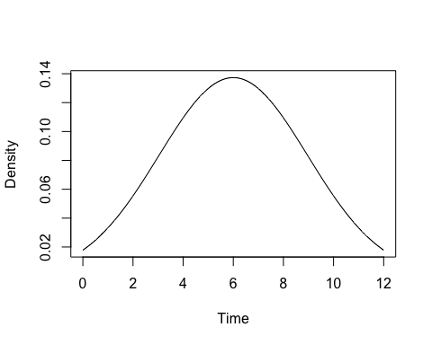
Calculating posteriors
$T∼N\left(6,{2.97}^{2}\right)$ HR $∼$ Be(10.8, 6.87)

Slide 4
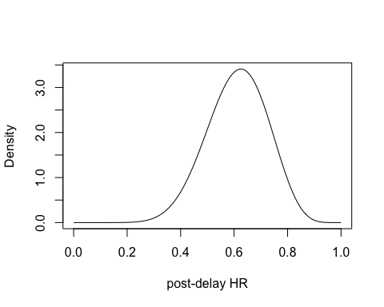

Slide 5
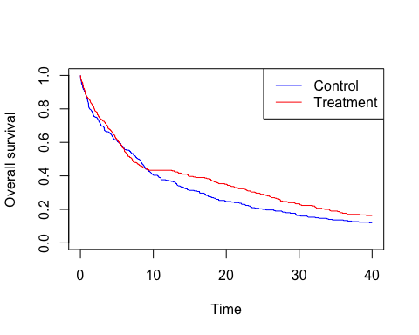

Slide 6
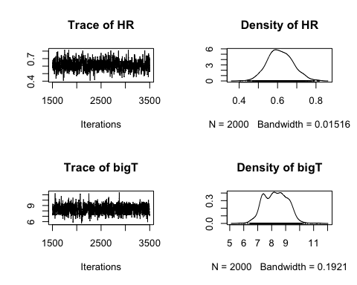

Slide 7
Set-up
Now we have this mechanism, how can we use it to investigate the problem of choosing the ‘optimum’ time to perform an interim analysis? What do these posteriors tell us?
We can change the interim analysis time and see what effect this has on the posteriors. We hypothesize that as we increase the IA time, the posterior for the HR will be more concentrated around the “true” value.
To investigate this, we choose some target effect and calculate the proportion of the posterior which is less than this target value.

Slide 8
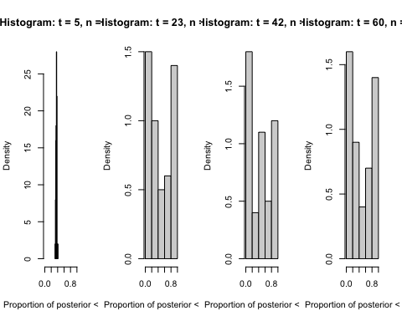
Set-up

Slide 9
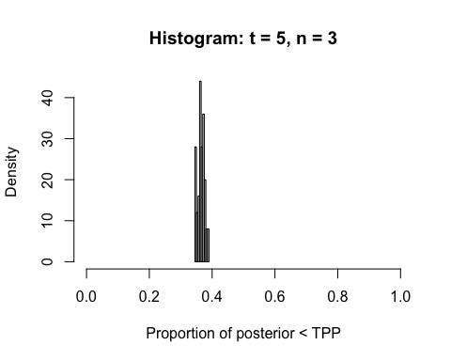
Set-up

Slide 10
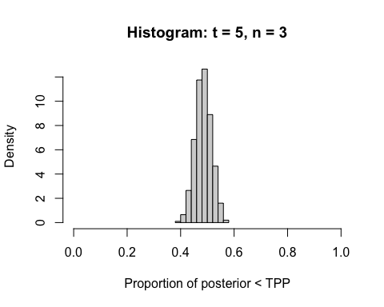
Approximation
We can approximate this by using the formula:
$$1.96±\sqrt{\frac{1}{E_{1}}+\frac{1}{E_{2}}},$$
where $E_{i}$ is the expected number of events in group i.
This approximation produces the following histograms:

