Slide 1
DTE Interim

Slide 2
Set-up
We are planning a survival trial in which we are anticipating there to be delayed treatment effects (DTE). We have elicited two prior distributions:
For $T$, the length of delay
For HR, the post-delay hazard ratio
How can we use these elicited prior distributions to help us decide when/if to perform any interim analysis?
Given some data, and these elicited prior distributions, we are able to calculate the posterior distributions for both $T$ and HR.

Slide 3
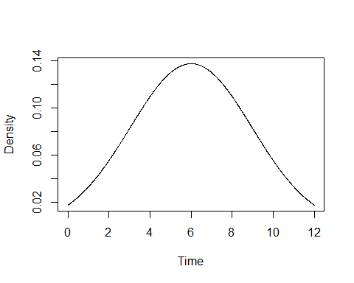
Calculating posteriors
$T∼N\left(6,{2.97}^{2}\right)$ HR $∼Be\left(10.8,6.87\right)$

Slide 4
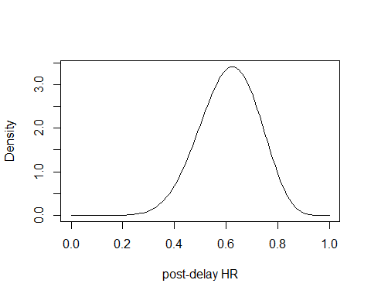

Slide 5
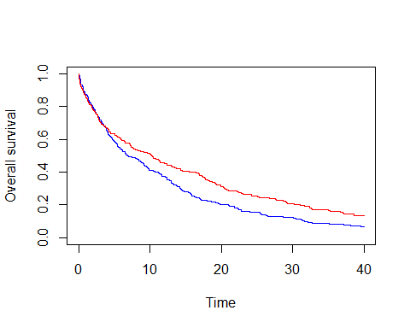

Slide 6
Slide with Plot

