Slide 1
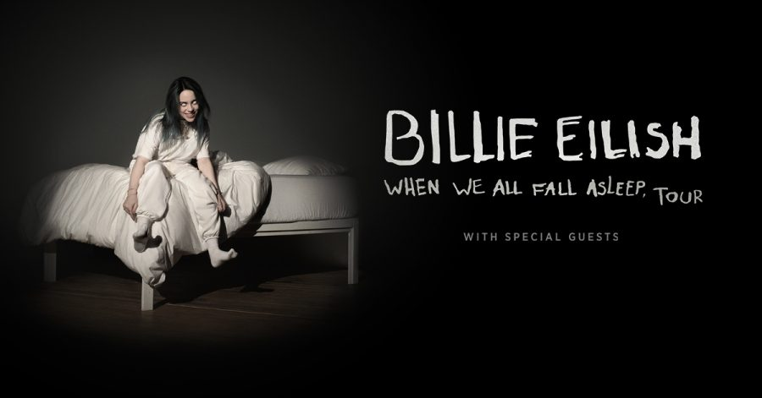
Billie Eilish Resale Concert Ticket Predictor
Prepared By: James Aniciete
(i.e. Jessie Reyez)

Slide 2

Who is Billie Eilish?
Billie Eilish Pirate Baird O'Connell is an American singer and songwriter. She first gained media attention in 2016 when she uploaded the song "Ocean Eyes" to SoundCloud, and it was subsequently released by Interscope Records subsidiary Darkroom. (via Wikipedia)
2020 Grammy Awards (5):
Best New Artist
Album of the Year (for When We All Fall Asleep)
Record of the Year (for “Bad Guy”)
Song of the Year (for “Bad Guy”)
Best Pop Vocal Album (for When We All Fall Asleep, Where Do We Go?)
Also nominated for Best Pop Solo Performance (for “Bad Guy”)
(via https://www.grammy.com/grammys/artists/billie-eilish)
(Schubas Tavern, October 2017)

Slide 3
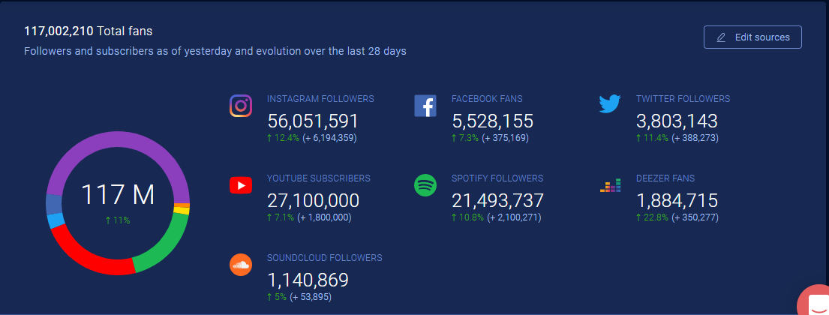
By the numbers...
* as of February 28th via soundcharts.com

Slide 4
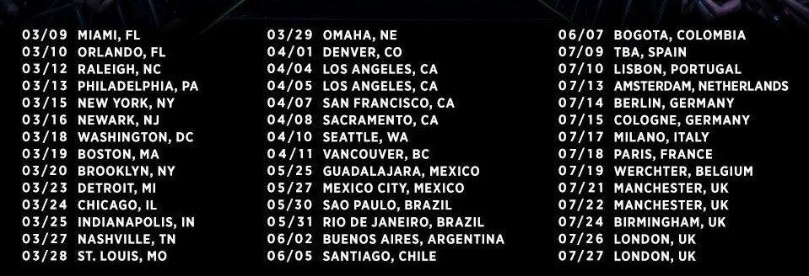
Tour Dates Included: *Note: There is a third LA show in before the two shown below.

Slide 5
Purpose
The goal of this model is to predict the minimum resale ticket price for a concert in Billie Eilish’s North American stadium tour.
Disclaimer: This model is meant to be used by concert goers, not scalpers. It should also be noted that the best method of buying concert tickets is through presale tickets.

Slide 6
Variables & Data

Slide 7
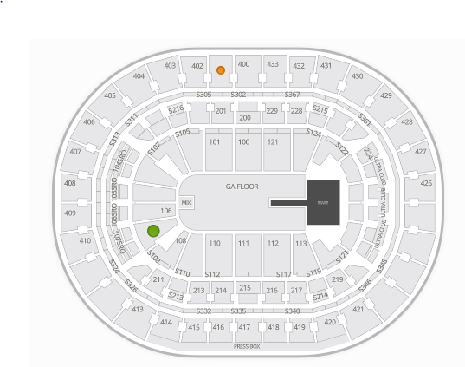
Seating Variable
Type Rank = integer representing a section type’s desirability
Type Rank | Section Type | Description
10 | PIT | Immediately around stage. Can cover whole floor level.
9 | Floor | On ground floor of arena but not immediately around stage
8 | 100A | First floor seating on sides - usually first 4 sections per side
6 | 100B | Remaining first floor seating across arena
7 | SuiteA | Luxury suites or club section suites between 1st & 2nd floor - usually first 4 sections per side
5 | SuiteB | Remaining luxury suites or club section suites. If more than one level of suites, contains anything on 2nd level of suites.
4 | 200A | Second floor seating on sides - usually first 4 sections per side
3 | 200B | Remaining second floor seating
2 | 300A | Third floor seating - usually first 4 sections per side & anything above the 200s.
1 | 300B | Third floor seating - remaining sections & anything else above 200s.

Slide 8
Time Variables
Days Until = the number of days until the concert
Day Rank = non-sequential rank of the day of the week the concert date is scheduled for
wasn’t significant in initial regression and thus will not be used
Day Rank 2 = sequential rank of the day of the week the concert date is scheduled for
Day of Week | Day Rank | Day Rank 2
Monday | 1 | 1
Tuesday | 2 | 2
Wednesday | 3 | 3
Thursday | 4 | 4
Friday | 6 | 5
Saturday | 7 | 6
Sunday | 5 | 7

Slide 9
Social Media Variables
Interested = the number of people who are interested in attending a given concert on Facebook
Radio Plays = the number of radio plays for the last 28 days
Data taken from soundcharts.com on February 28th
Note: Los Angeles data was used for Inglewood
Corona = a measure of COVID-19’s effect on concert-goers
On March 12th, the State and the City of Illinois mandated that public concerts exceeding 1,000 individuals are postponed or canceled for the next 30 days. Also, encouraged that concerts of 250 people or more should be cancelled or postponed until May 1.

Slide 10
Health Variable
Corona = a measure of COVID-19’s effect on concert-goers
On March 12th, the State and the City of Illinois, acting in the public interest, mandated that all public concerts exceeding 1,000 individuals are postponed or canceled for the next 30 days. Additionally, the State and the City are encouraging that concerts of 250 people or more should be cancelled or postponed until May 1. (via email from The Vic Theatre)
Date | Corona Rank | Description
Before 3-Mar | 0 | Coronavirus deemed insignificant to concert-going population
3-Mar | 1 | U.S. approve widespread testing
4-Mar | 2 | First U.S. small music festival cancelled
10-Mar | 3 | Coachella postponed
11-Mar | 4 | Pandemic, sports leagues suspended/cancelled
12-Mar | 5 | Concerts suspended/cancelled, schools close & shift to online

Slide 11
Pricing Variable
Face = the original face price value of a given ticket
Estimates were used given Facebook ticket price ranges and based on the other venues pricing. This affects the following venues:
Madison Square Garden (New York City)
Prudential Center (Newark)
Capital One Arena (Washington D.C.)
TD Garden (Boston)
The Forum (Inglewood)
Since this is a stadium tour, the ticket price ranges are close to standardized, so Face will be included in the model.

Slide 12
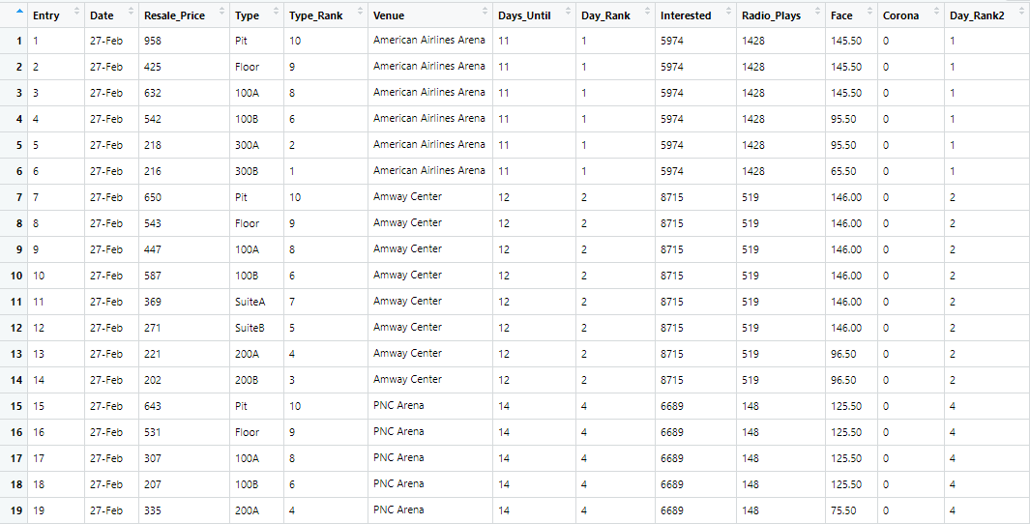

Slide 13
Variable | Minimum Value | 1st Quartile | Median | Mean | 3rd Quartile | Maximum Value
Resale_Price | $ 53.00 | $ 213.00 | $ 296.00 | $ 302.50 | $ 356.00 | $ 1,045.00
Type_Rank | 1.0 | 3.0 | 6.0 | 5.7 | 8.0 | 10.0
Days_Until | 0.00 | 8.00 | 14.00 | 15.47 | 23.00 | 38.00
Day_Rank2 | 1.000 | 2.000 | 4.000 | 3.737 | 5.000 | 7.000
Interested | 1063 | 2851 | 7567 | 6003 | 8177 | 9451
Radio_Plays | 2.0 | 401.0 | 519.0 | 841.4 | 1205.0 | 2162.0
Face | $ 34.40 | $ 59.50 | $ 125.50 | $107.40 | $ 149.50 | $ 149.50
Corona | 0.0000 | 0.0000 | 2.0000 | 1.551 | 2.0000 | 5.0000

Slide 15
First Regression Model

Slide 16
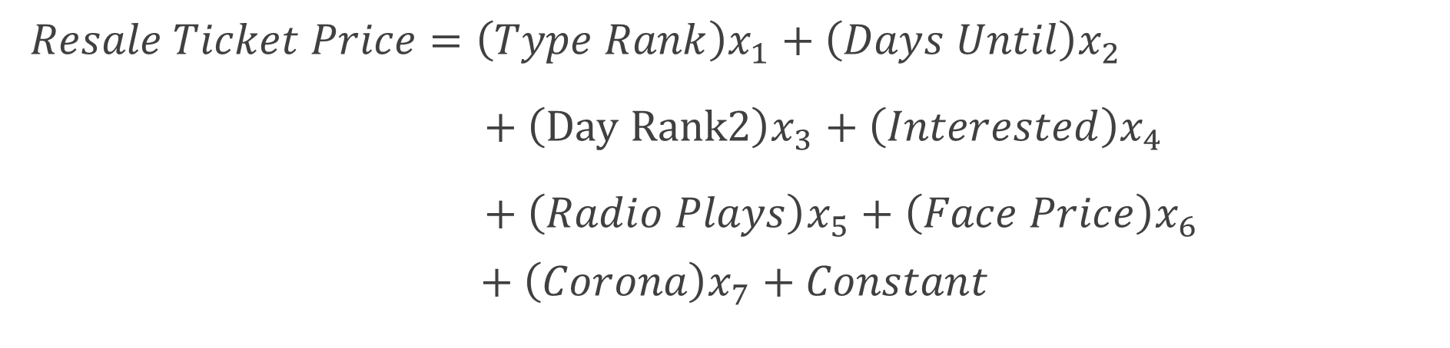
First Regression Model
$$Resale Ticket Price=\left(Type Rank\right)x_{1}+\left(Days Until\right)x_{2}$$
$+ \left(Day Rank2\right)x_{3}+\left(Interested\right)x_{4}$
$+ \left(Radio Plays\right)x_{5}+\left(Face Price\right)x_{6}$
$$+ \left(Corona\right)x_{7}+Constant$$

Slide 17
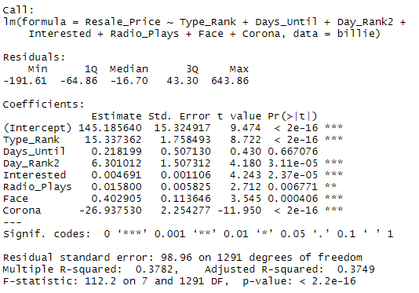
Quick Hits:
Days_Until could be removed from the model due to its high p-value (> .05).
Radio_Plays and Interested do not have a significant effect on resale price
Corona is highly significant to concert attendance
Low R-Squared

Slide 18
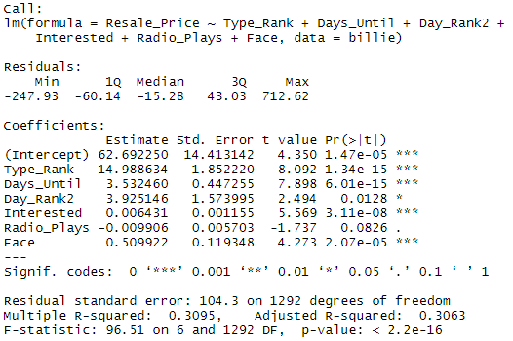
Comparing Models with and without Corona
The model was a better predictor of resale price with Corona, which can be seen by comparing the R-Squared values.
Notes:
Introduction of COVID-19 variable may have encapsulated the effect of the Days_Until variable.

Slide 19
Multicollinearity
VIF = Variance Inflation Factor:
Since none of the explanatory variables have a VIF > 10 (still not greater than 5 if that’s what you use), multicollinearity will not be influencing the least square estimates. Thus, none of the variables will be excluded from the model.

Slide 20
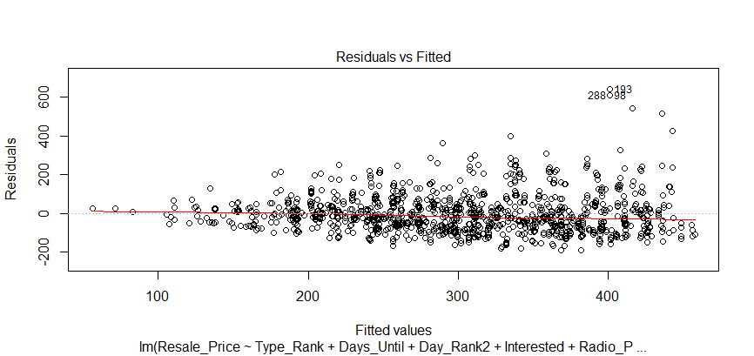
Linearity Check: Since the red line indicates a downward pattern, the model does not satisfy the linearity check.
*Note: the y-axis is scaled by 200’s.

Slide 21
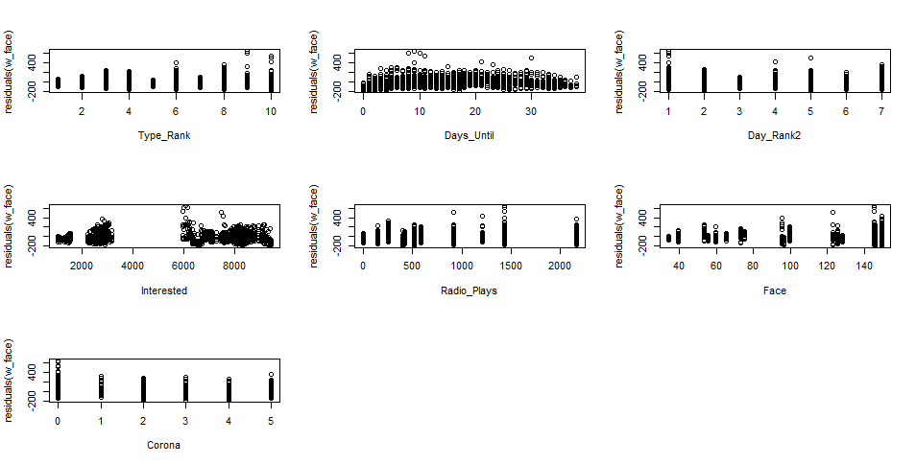
Predictor Variables plotted against Model Residuals

Slide 22
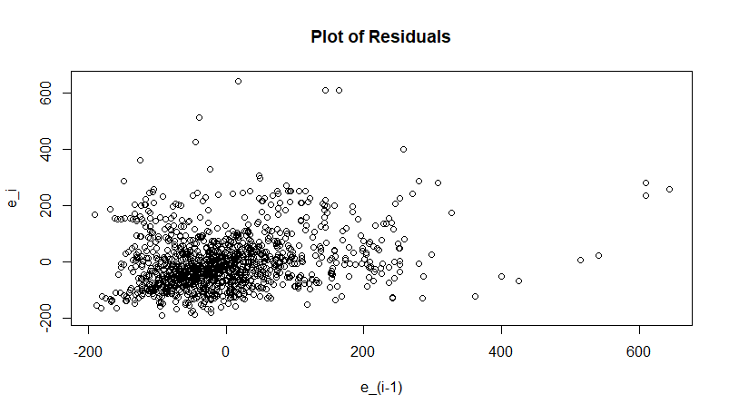
Check for Independence (of the Errors):
This assumption must be checked due to the time-series nature of the data set. Since there is no pattern, the independence check is satisfied.

Slide 23

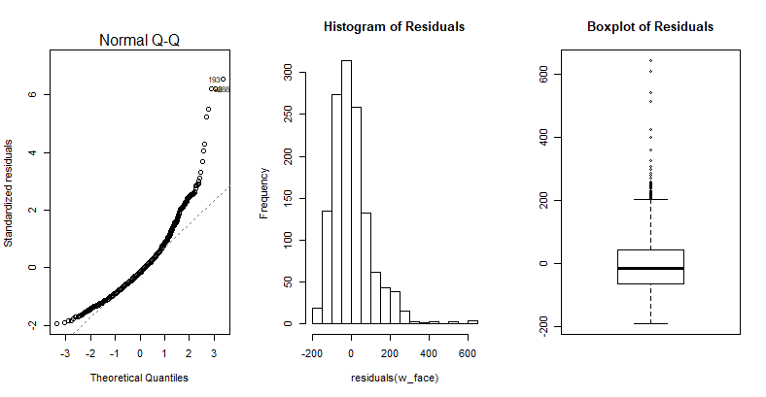
Check for Normally Distributed Errors:
Using a 0.05 significance level and the Shapiro-Wilk Test for Normality, we conclude that the model does not have normally distributed errors.
Notes:
Q-Q Plot may indicate a quadratic trend in the response
Histogram shows that the response is skewed right
Boxplot of Residuals has some extreme upper outliers

Slide 24
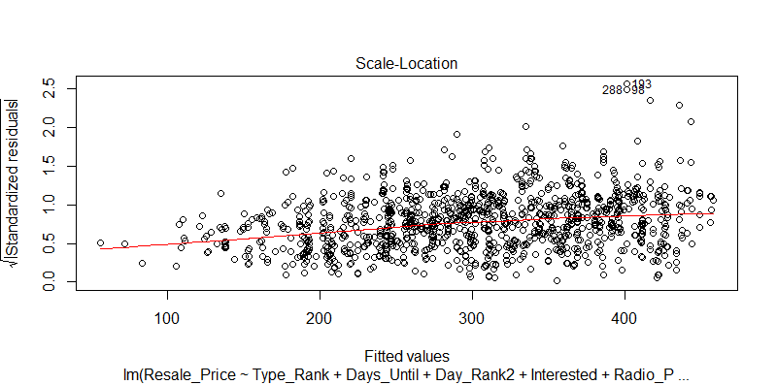
Check for Equal Variances (homoscedasticity): Since the graph does not depict a horizontal line with equally spread points, the model does not satisfy the test for equal variances.

Slide 25
Conclusion from Assumption Checks
Regression relation has unequal error variances and non-normal error terms, so we should transform Y (Resale_Price). If still nonlinear afterwards, may also require a transformation on X (predictor variables).
Since the regression assumptions were mostly violated, the forecasts and insights yielded by the regression may be inefficient, seriously biased, and/or misleading.
Besides assumptions, should also check for:
outliers = extreme values in Resale Price
high leverage points = extreme values in the predictor variables
http://www.sthda.com/english/articles/39-regression-model-diagnostics/161-linear-regression-assumptions-and-diagnostics-in-r-essentials/#regression-assumptions

Slide 26
Second Regression Model: Boxcox Transformation of Resale Price

Slide 27
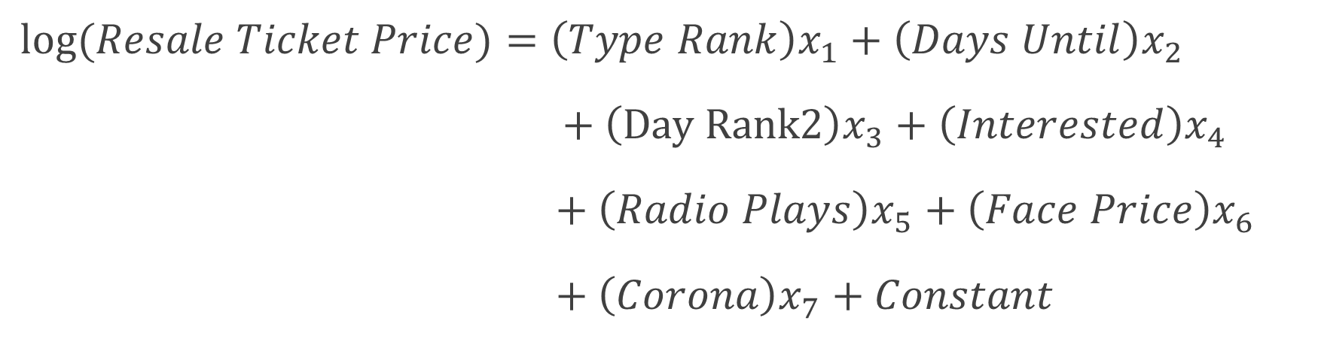
Second Regression Model
$$log⁡(Resale Ticket Price)=\left(Type Rank\right)x_{1}+\left(Days Until\right)x_{2}$$
$+ \left(Day Rank2\right)x_{3}+\left(Interested\right)x_{4}$
$+ \left(Radio Plays\right)x_{5}+\left(Face Price\right)x_{6}$
$+ \left(Corona\right)x_{7}+Constant$

Slide 28

Boxcox Transformation
Our calculated optimal λ = .1010... = 10/99, so we will use the convenient λ = 0.

Slide 29
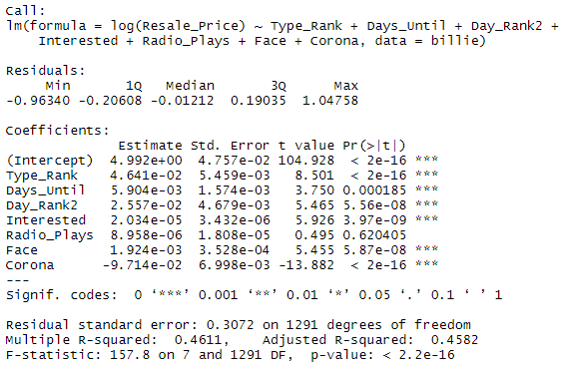
Quick Hits:
Radio_Plays could be removed from the model due to its high p-value (> .05).
R-Squared is much higher

Slide 30
Multicollinearity
VIF = Variance Inflation Factor:
Since none of the explanatory variables have a VIF > 10 (still not greater than 5 if that’s what you use), multicollinearity will not be influencing the least square estimates. Thus, none of the variables will be excluded from the model.

Slide 31
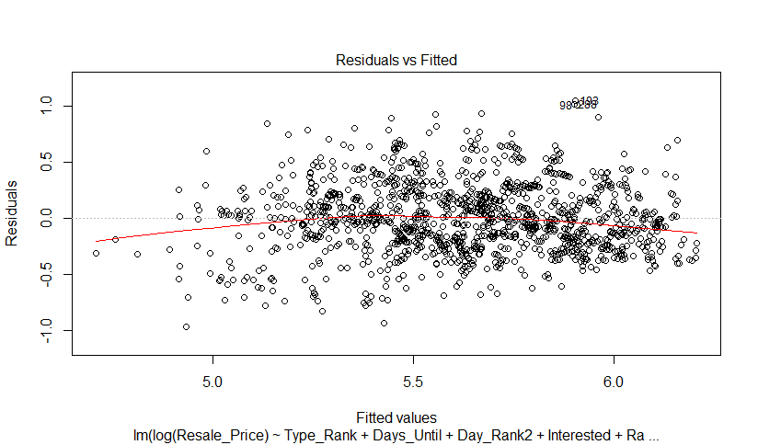
Linearity Check: Since the red line indicates a pattern, the model still does not satisfy the linearity check.

Slide 32
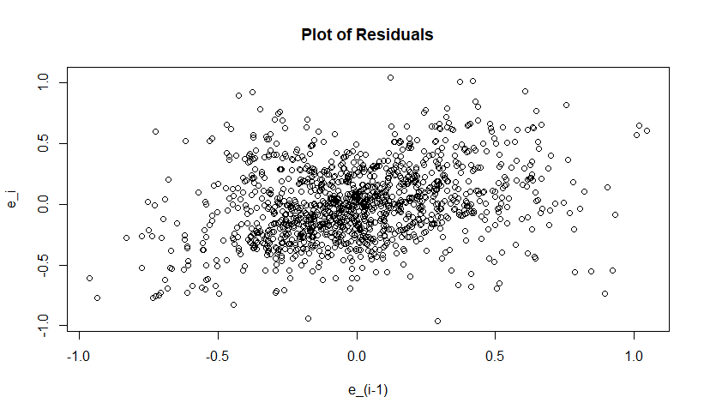
Check for Independence (of the Errors):
Since there is no pattern, the independence check is satisfied.

Slide 33

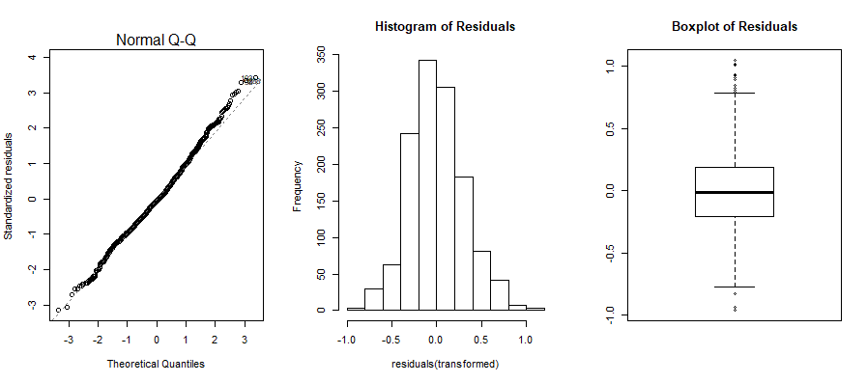
Check for Normally Distributed Errors:
Using a 0.05 significance level, we conclude that the model still does not have normally distributed errors, but the p-value is much closer to 0.05.
Notes:
Q-Q plot is less quadratic than the initial model
Histogram shows less skew and closer resemblance to the normal distribution.
Boxplot shows that the extreme upper outliers are much closer to Q3 than before.

Slide 34
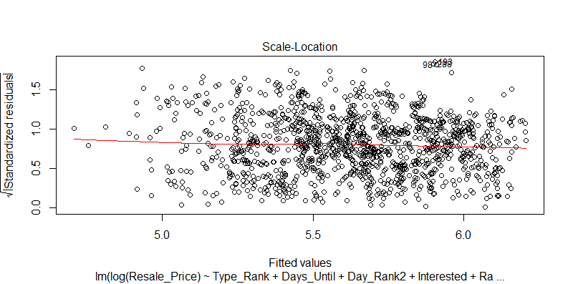
Check for Equal Variances (homoscedasticity): Since the graph does not depict a horizontal line with equally spread points, the model does not satisfy the test for equal variances, but it is closer.

Slide 35
Conclusion from Assumption Checks
The regression relation is still nonlinear with error approximately normal and approximately having constant variance, so a transformation on X (predictor variables) may be required.
The model is closer to having normally distributed errors and equal variances.
Forecasts and insights yielded by the regression still may be inefficient, seriously biased, and/or misleading.
Besides assumptions, should also check for:
outliers = extreme values in response variable
high leverage points = extreme values in the predictor variables

Slide 36
Further Model Attempts
Removing Radio_Plays slightly lowered R-Squared & slightly raised Adjusted R-Squared
Removing 9 highest outlier values (> $680) improved model significantly, but the regression relation now violates the independence of errors assumption.
If continued, would need to account for the time-series nature of the data
Combining the two methods above yielded lower R-Squared and adjusted R-Squared values
Attempts to transform X are in progress

Slide 37
Improvements Using Big Data

Slide 38
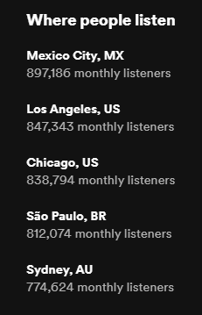
How Big Data ties in...
Face prices could be captured when the tickets are first released
Resale prices could be gathered from all resale platforms each day at the same time
Radio plays should be replaced by monthly streaming data of each city – Spotify only releases that info to the artists themselves
Social media – responses/interactions to artists’ tour posts could be recorded by location

Slide 39
Other considerations
Floor sections were combined with Pit sections during data collection, beginning on March 2nd
Face prices change for some sections after the first 5 rows, which wasn’t considered
Seat obstructions and accessibility were not considered
Difference of suite section locations were not considered
Ticket scarcity was not considered
Opener(s) were not considered

