Slide 1
EDA & Model Building – Spaceship Titanic
James Antony Das

Slide 2
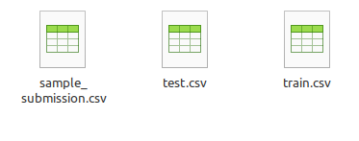
Kaggle Dataset
Training set
8693 rows
14 columns
Test Set
4277 rows
13 columns

Slide 3
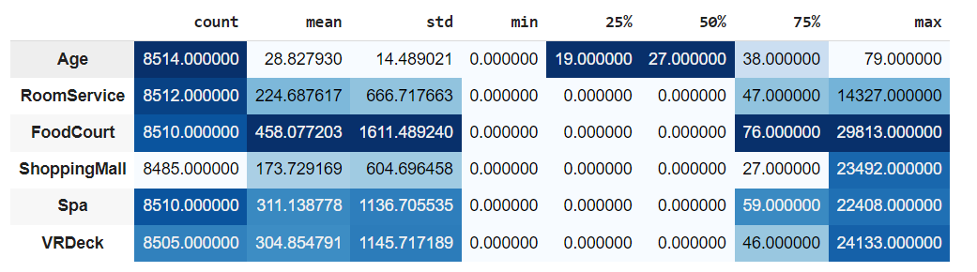
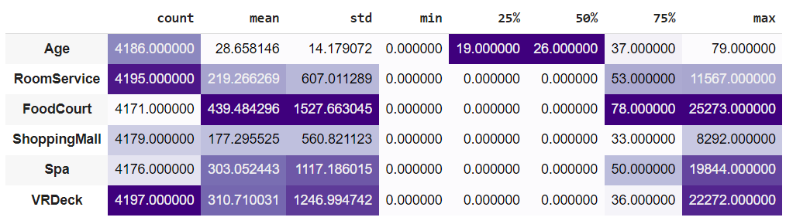
Training set
Testing set
5-point summary

Slide 4
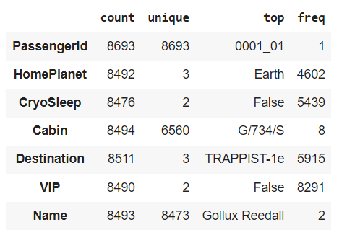
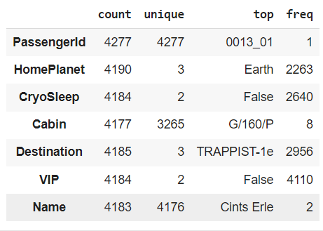
Training set
Test set
Object Columns

Slide 5
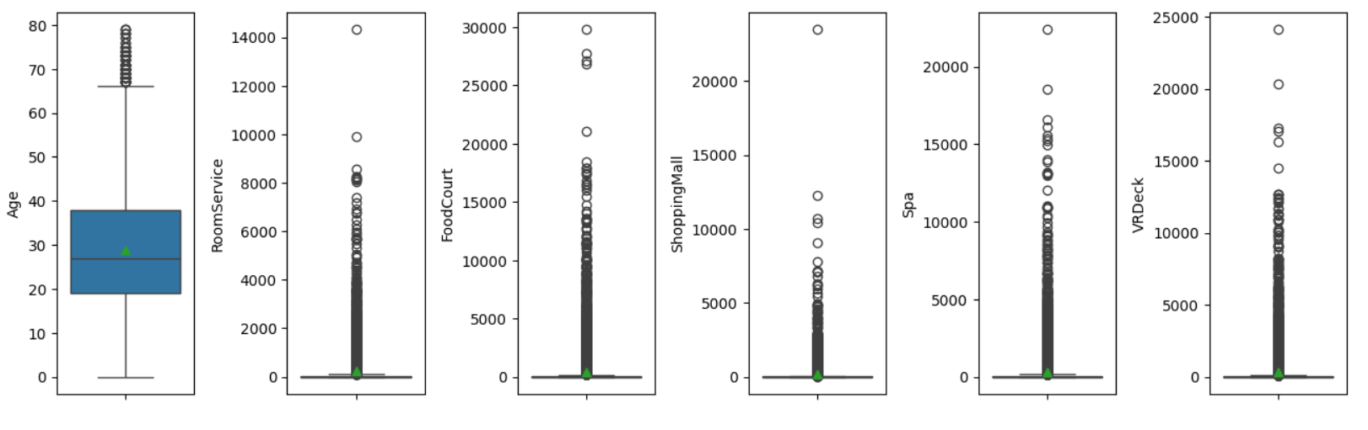
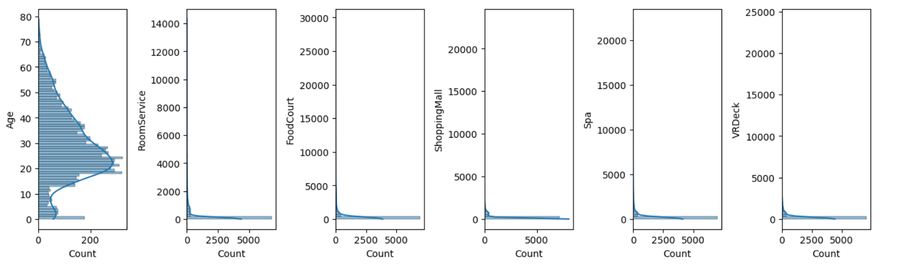

Slide 6
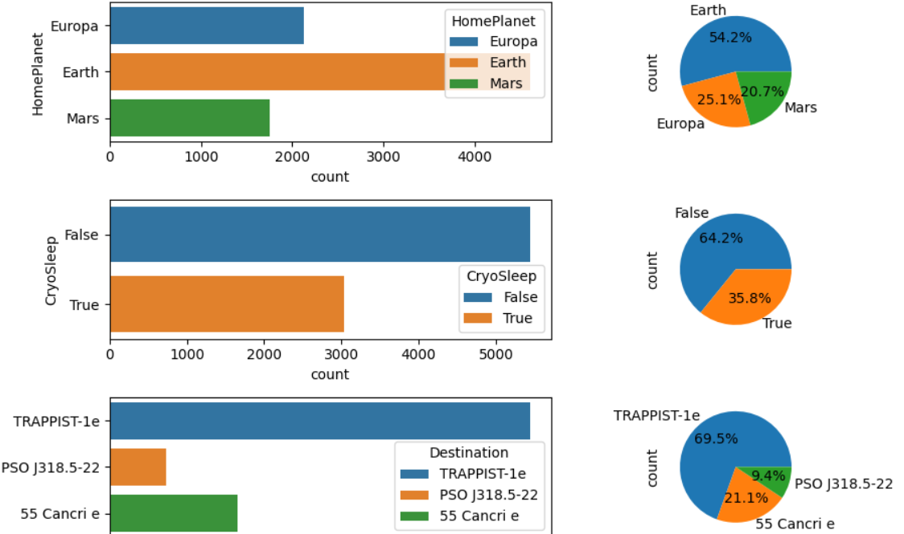

Slide 7
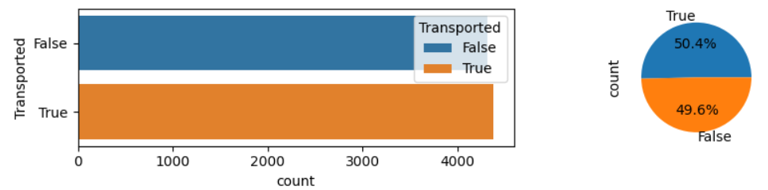
Target Variable

Slide 8
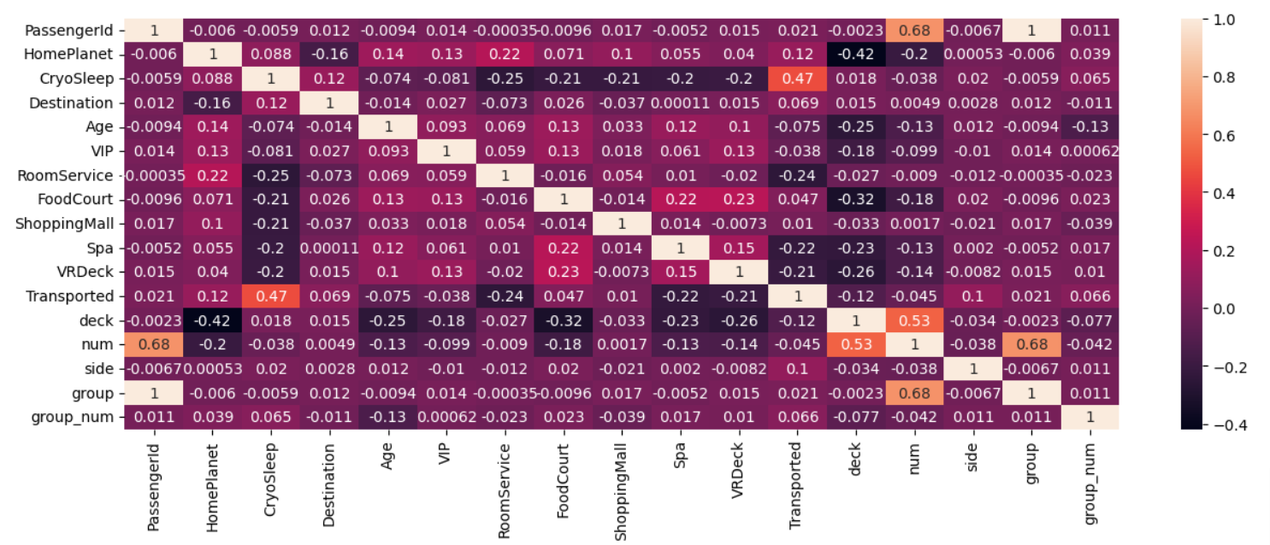
CORRELATION MATRIX

Slide 9
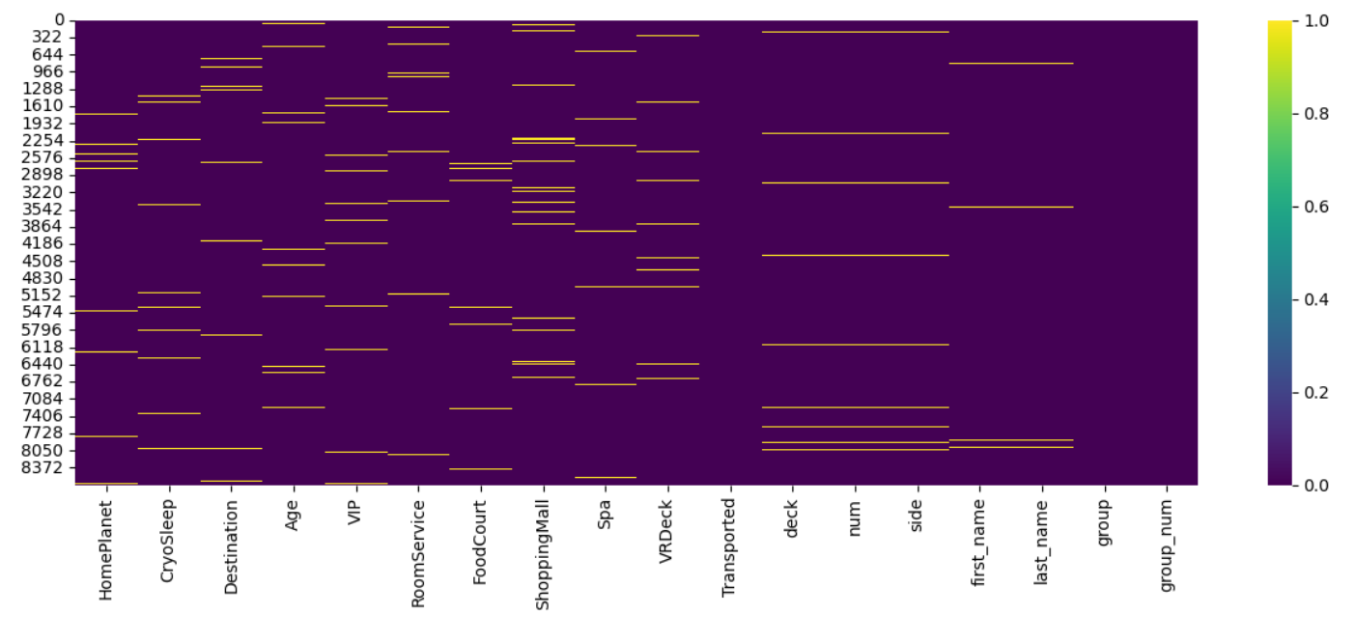
MISSING VALUES

Slide 10
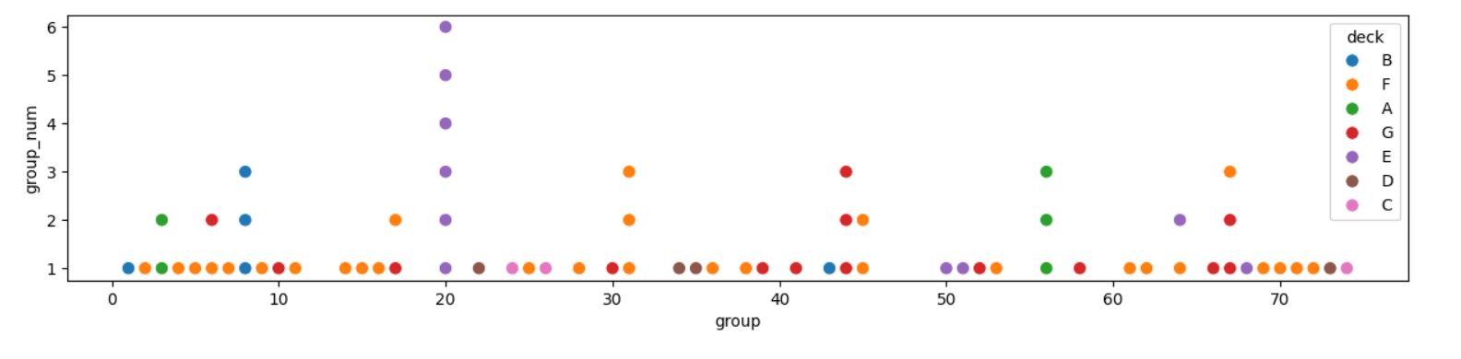
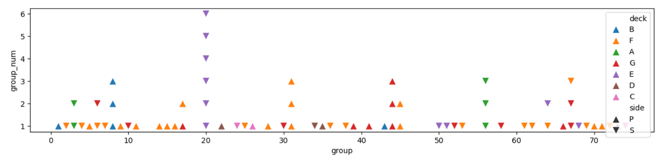

Slide 11
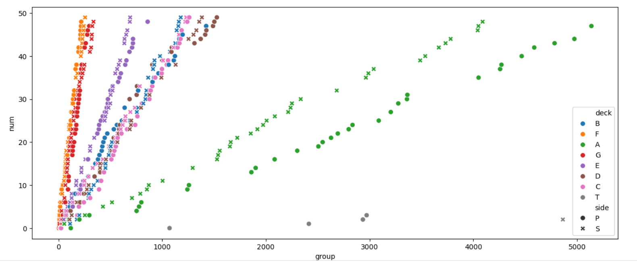
UN-USABLE LINEARITY

Slide 12
Pipeline
Splitting string
columns
Ordinal Encoding
(target variable)
One-Hot Encoding
Data type fixing
Label Encoding
(names)
Dropping
columns

Slide 13
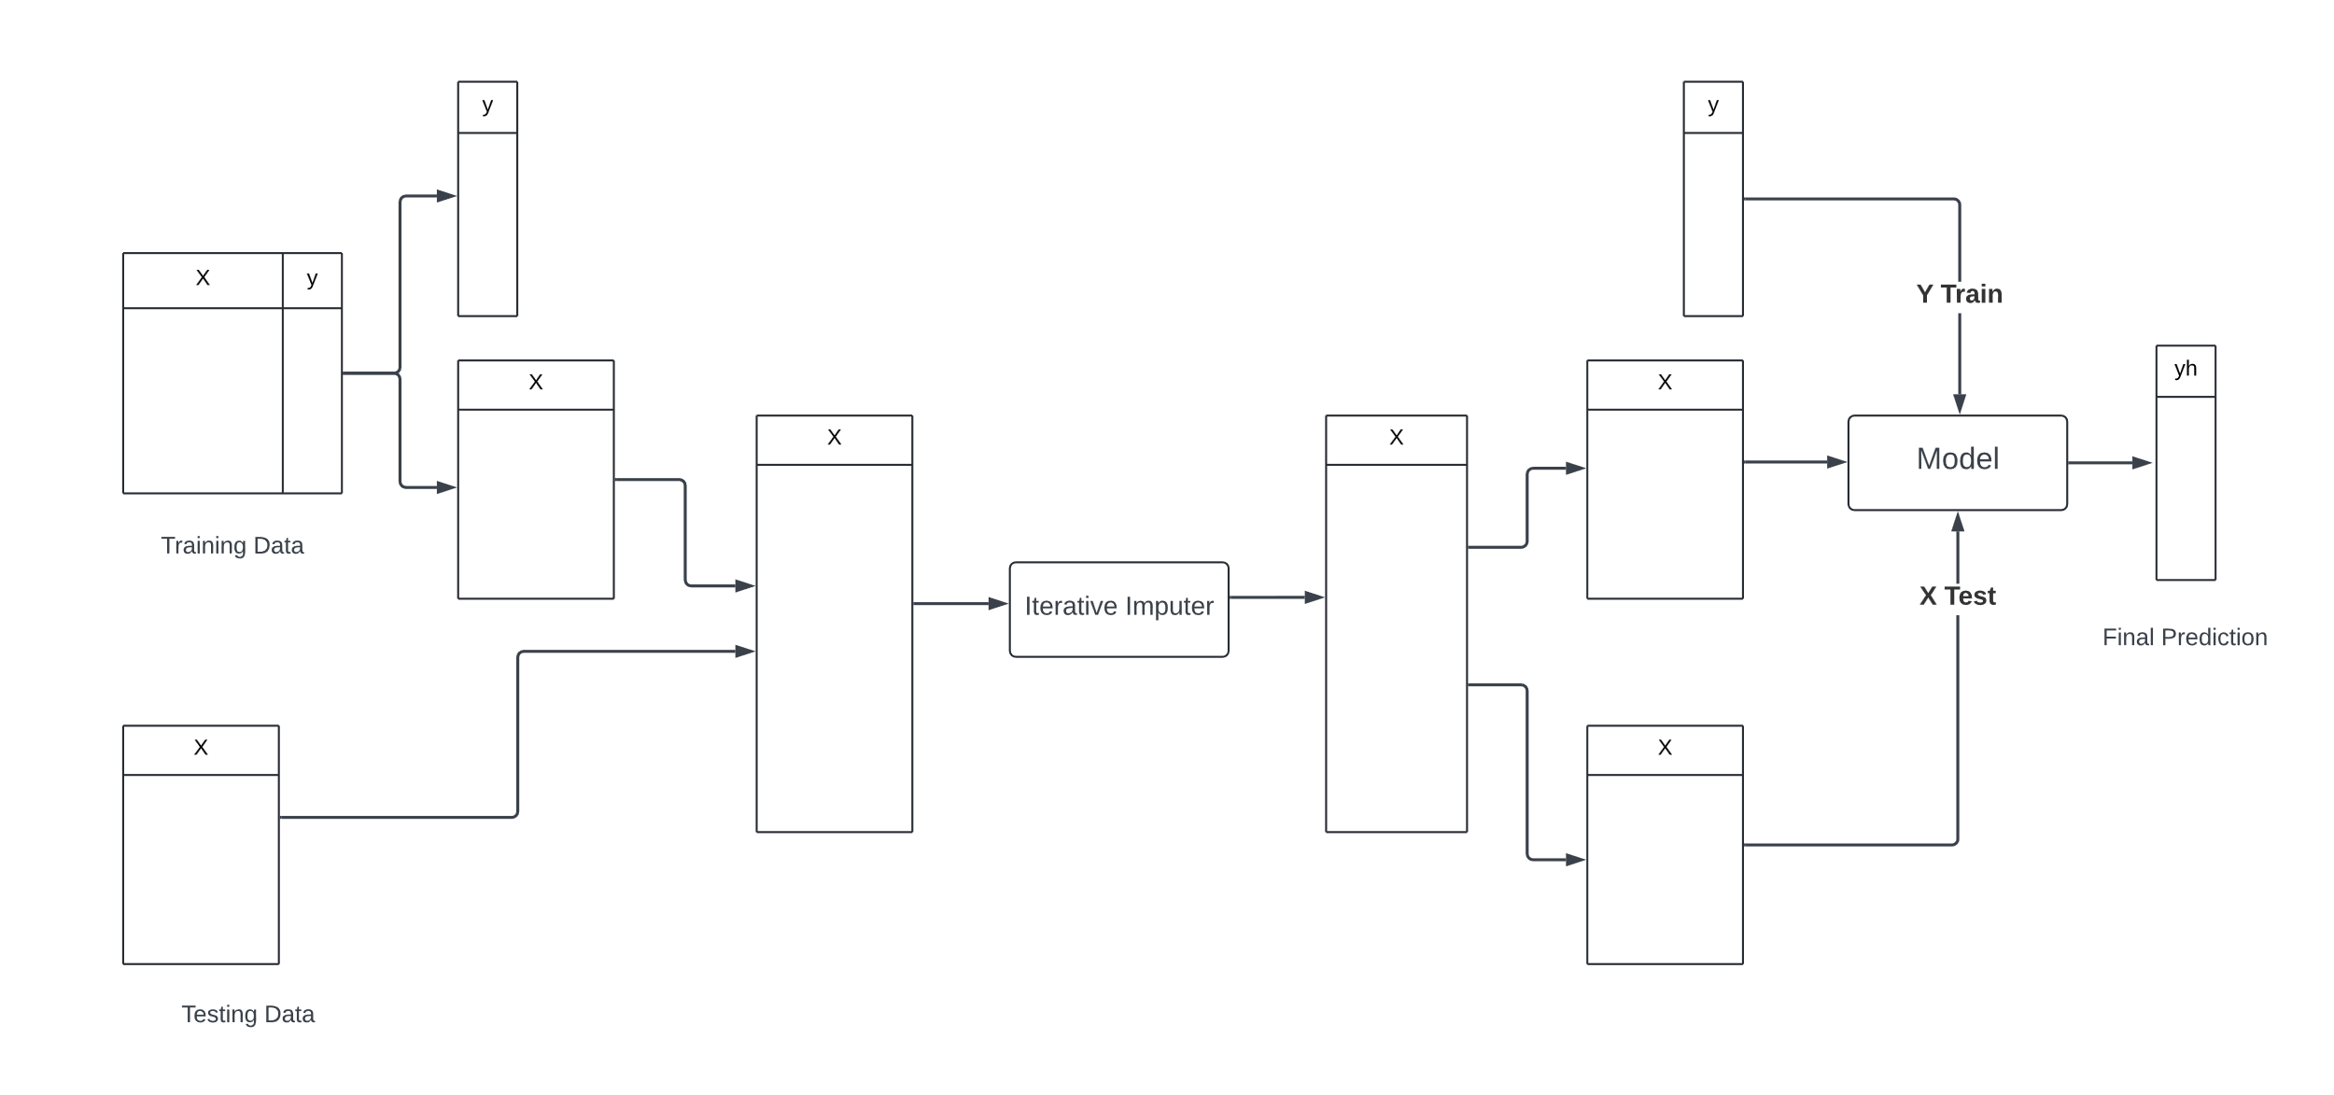
Idea for Imputing the missing values

Slide 14
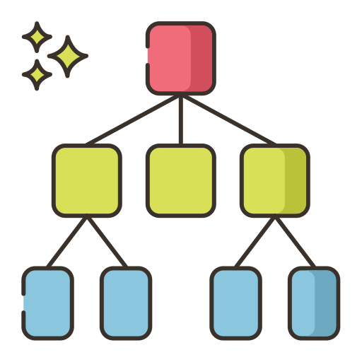
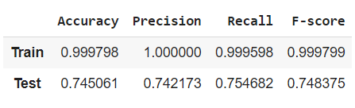
Decision Tree Classifier

Slide 15
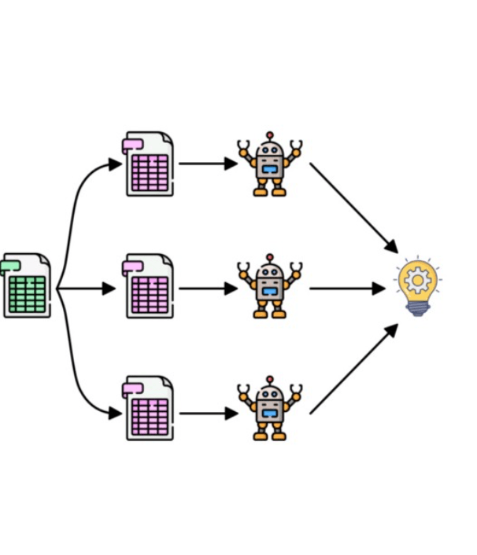
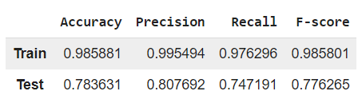
Bagging Classifier

Slide 16
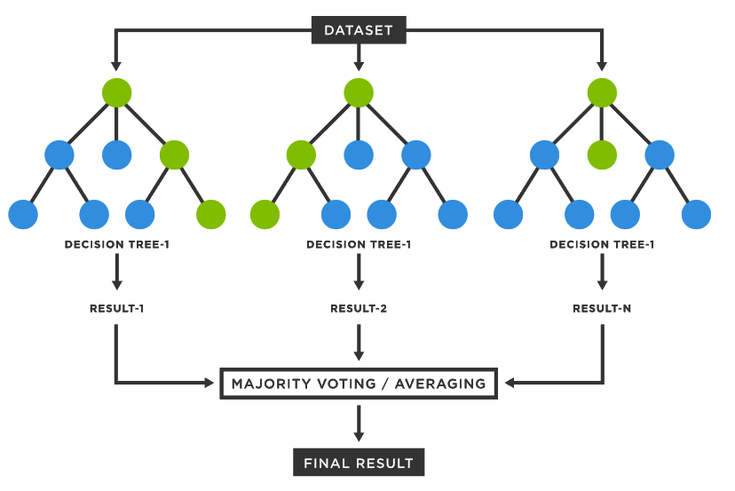
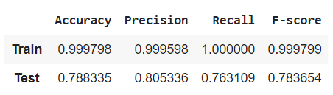
Random Forest Classifier

Slide 17

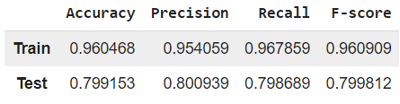
XGBoost Classifier

Slide 18

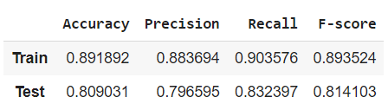
CatBoost Classifier

Slide 19
CatBoost Classifier
Hyperparameter Turing
GridSearchCV
'max_depth’ : [3,4,5]
'n_estimators’ : [100, 200, 300]

Slide 20
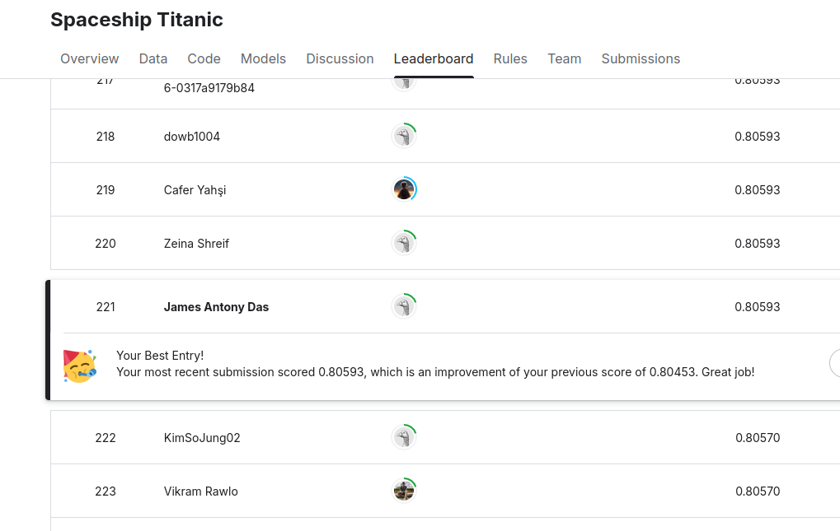
Kaggle Rank

