Slide 1
Natural Language Processing – NLP
James Antony Das

Slide 2
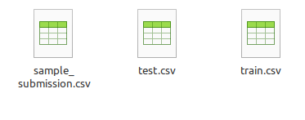
Disaster tweets prediction - Kaggle Dataset
Training set
7613 rows
5 columns
Test Set
3263 rows
4 columns

Slide 3
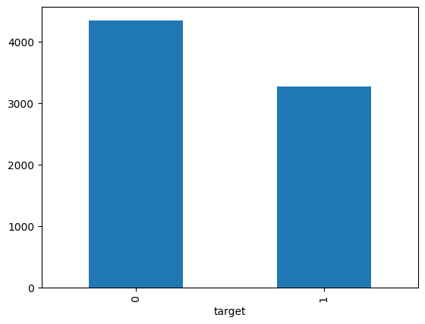
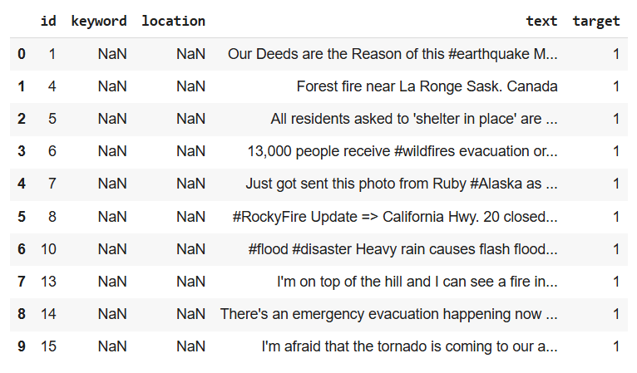
Target Variable
Data

Slide 4
Preprocessing
Data Cleaning
Text Vectorization
Model building
Word Lemmatization
Decomposition
Kaggle Submission

Slide 5
Text Vectorization
Vectorization
Techniques
Bag of words
TF-IDF
Word Embeddings
Loss of context
Requires high processing power

Slide 6
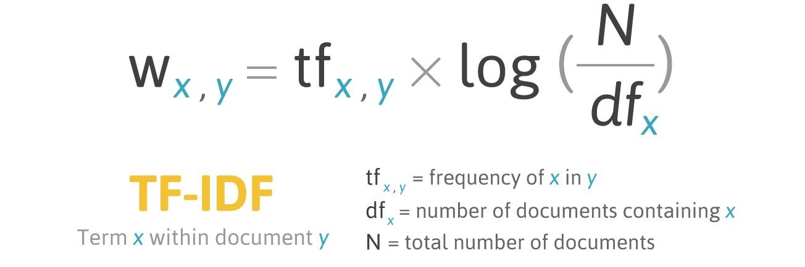
Term Frequency – Inverse Document Frequency (TF-IDF)

Slide 7
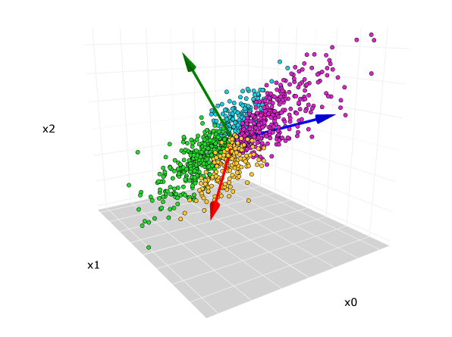
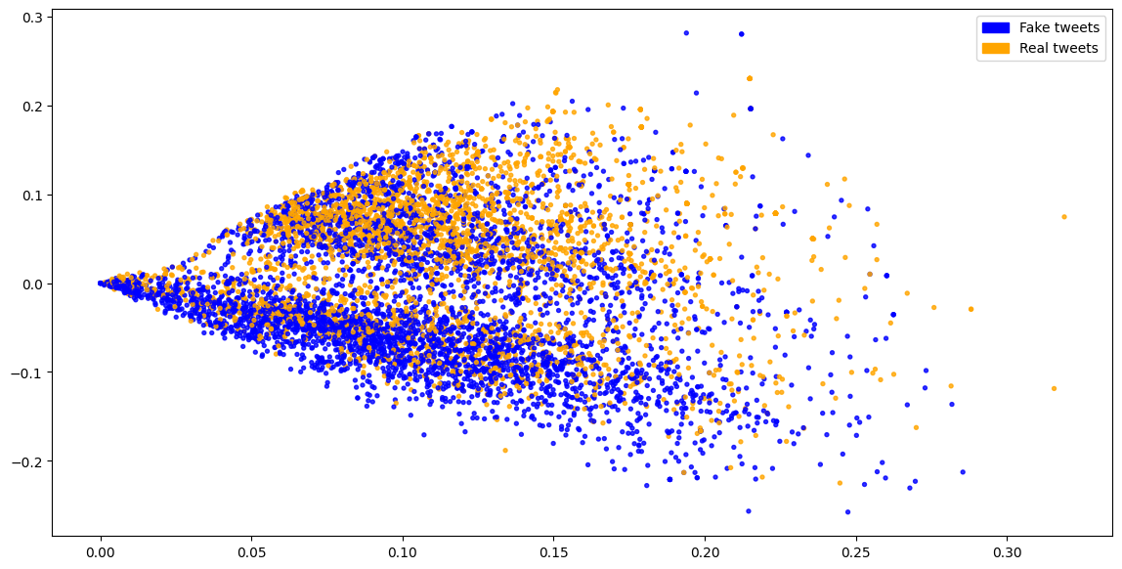
PCA / Truncated SVD

Slide 8
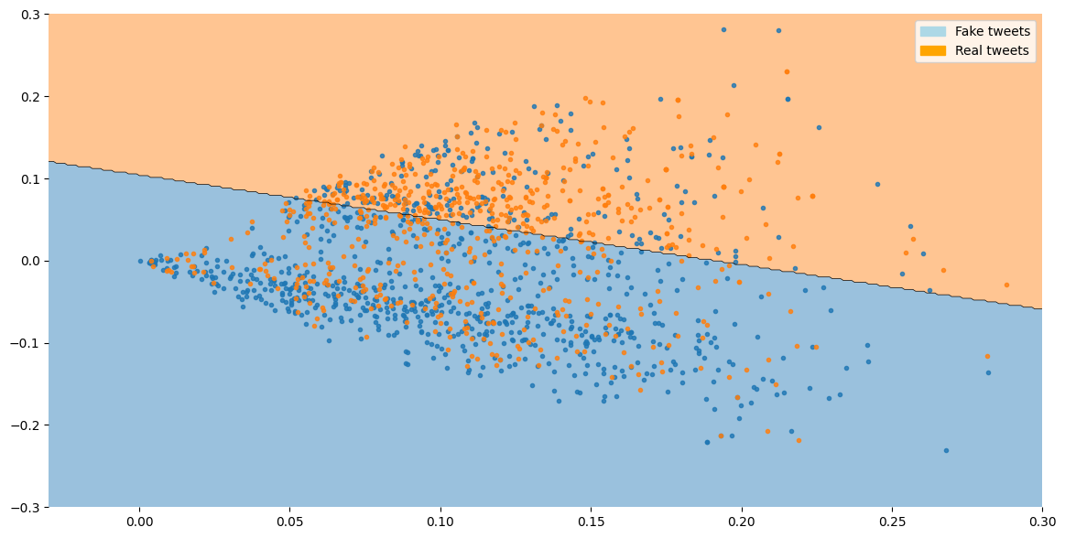
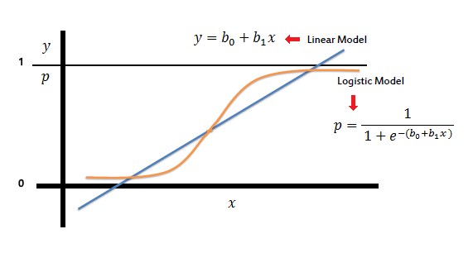
Logistic Regression
Accuracy: 0.645436

Slide 9
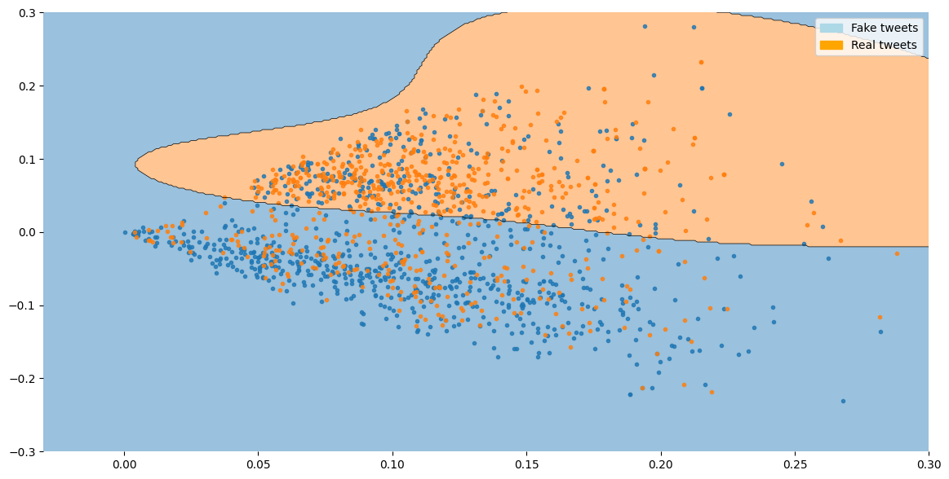
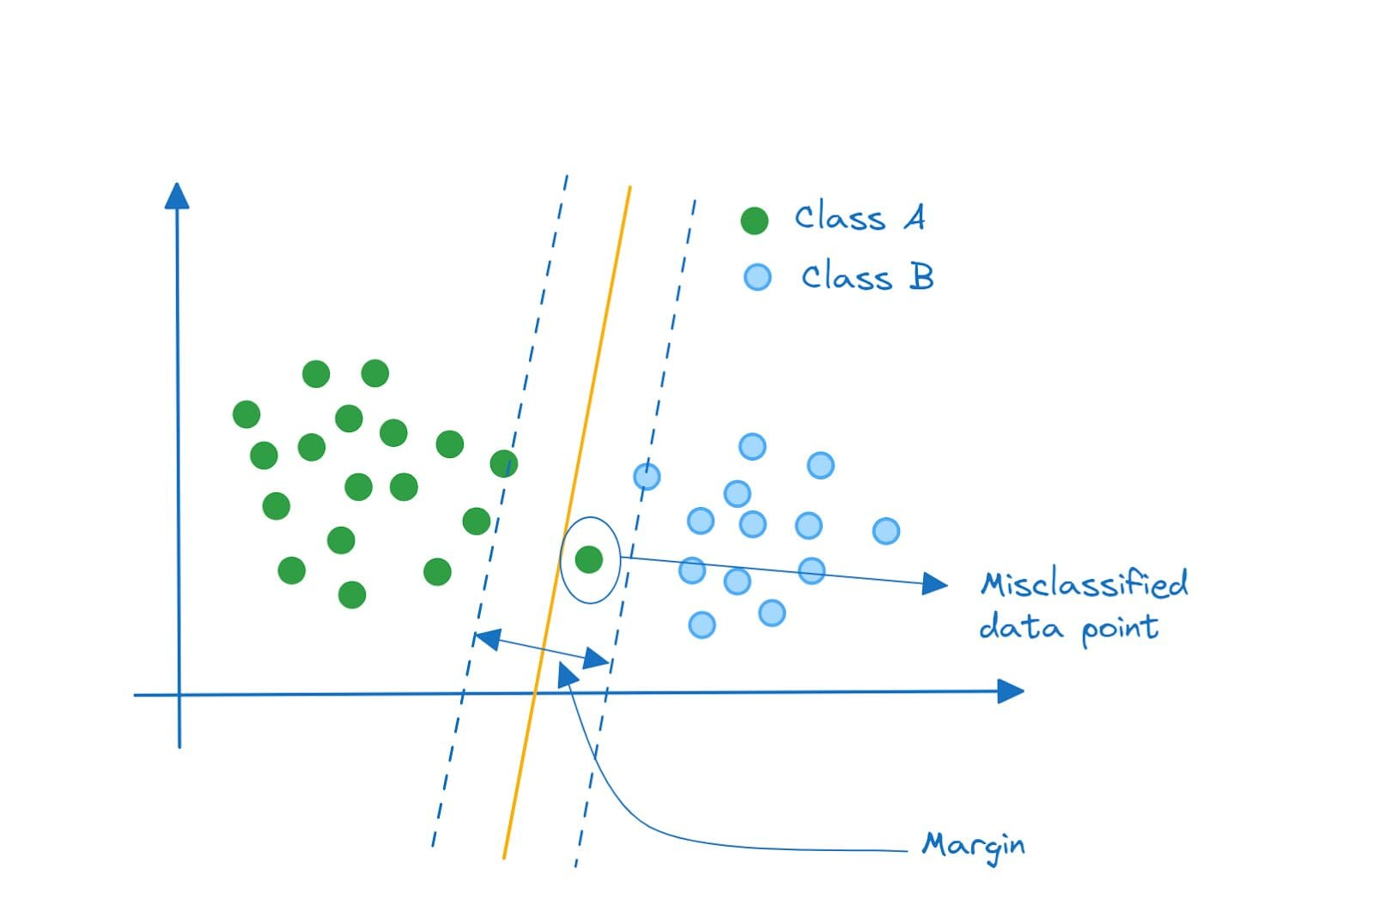
Support Vector Machine (SVM)
Accuracy: 0.652659

Slide 10
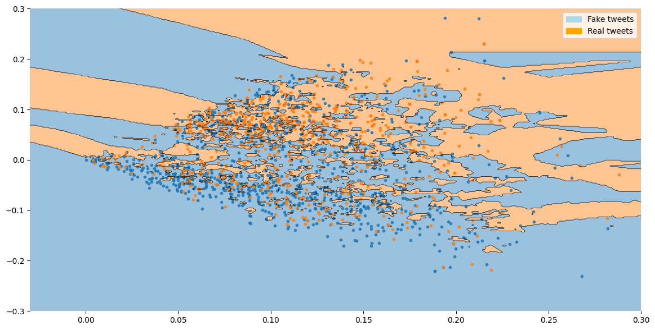
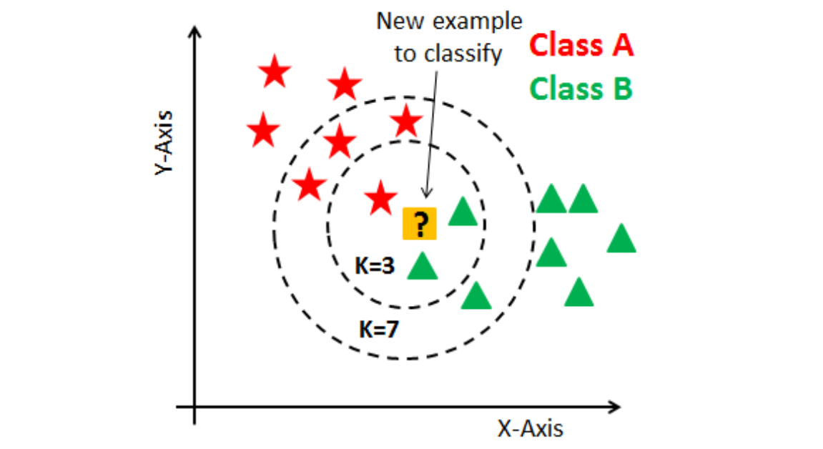
KNN Classifier
Accuracy: 0.631648

Slide 11
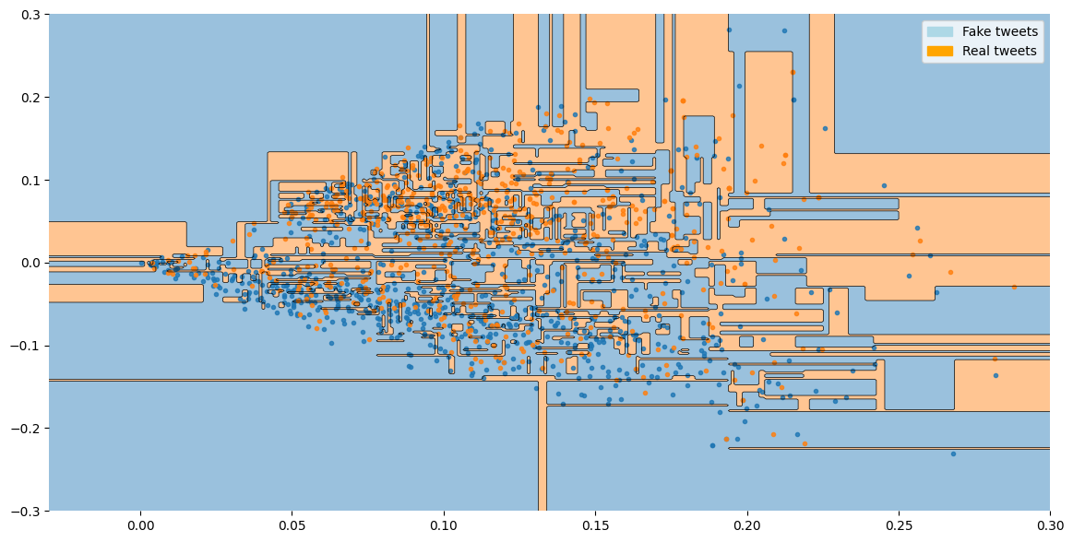
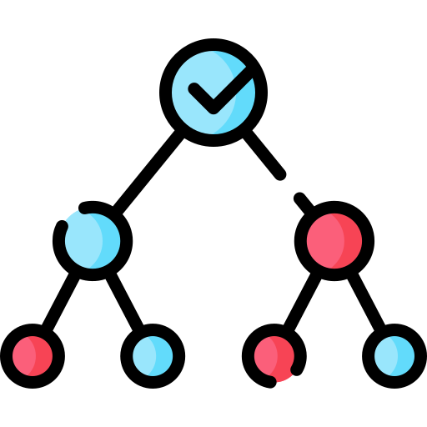
Decision Tree Classifier
Accuracy: 0.623768

Slide 12
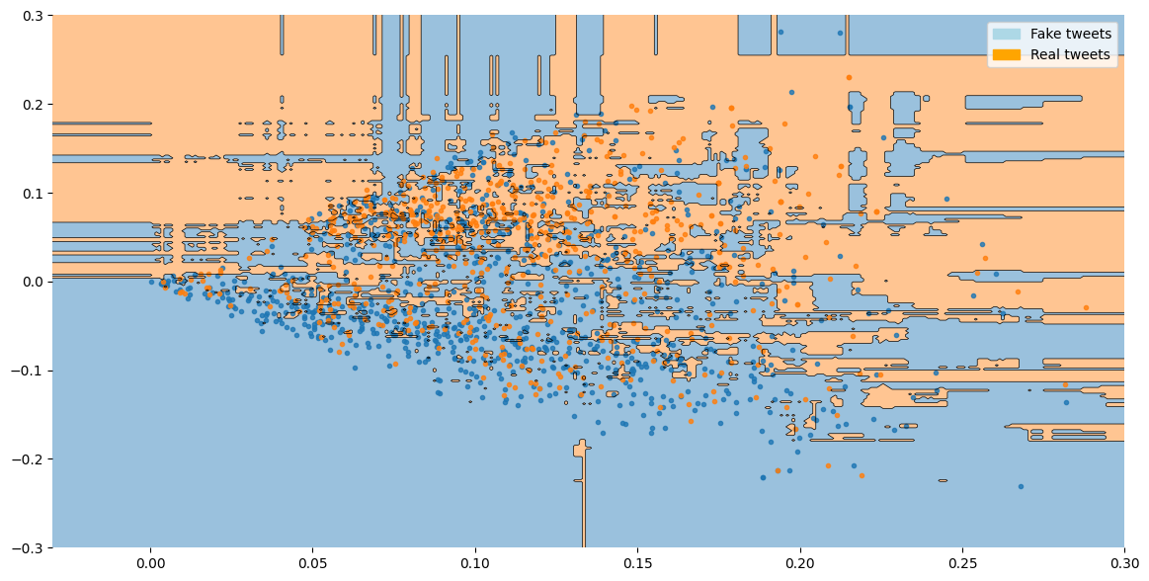
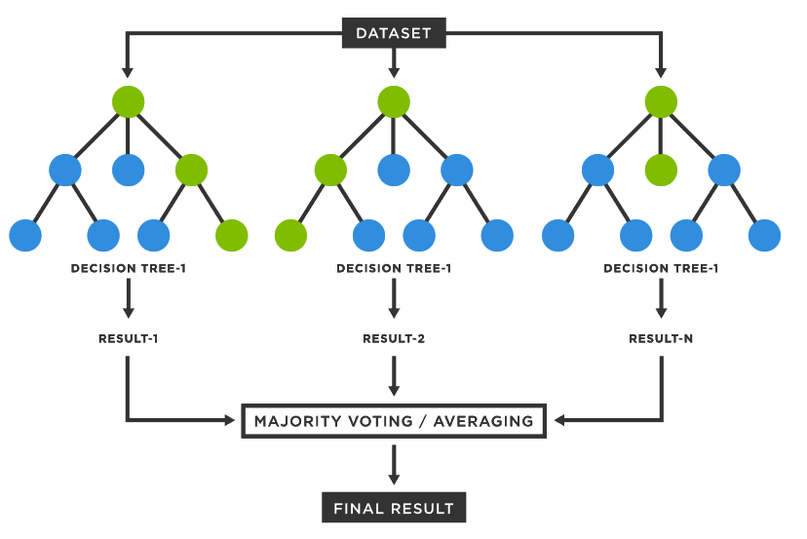
Random Forest Classifier
Accuracy: 0.642153

Slide 13
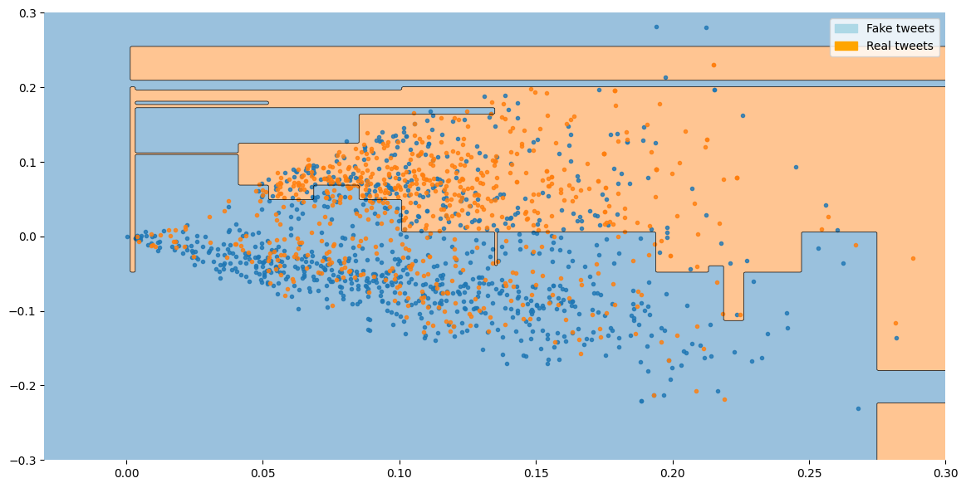
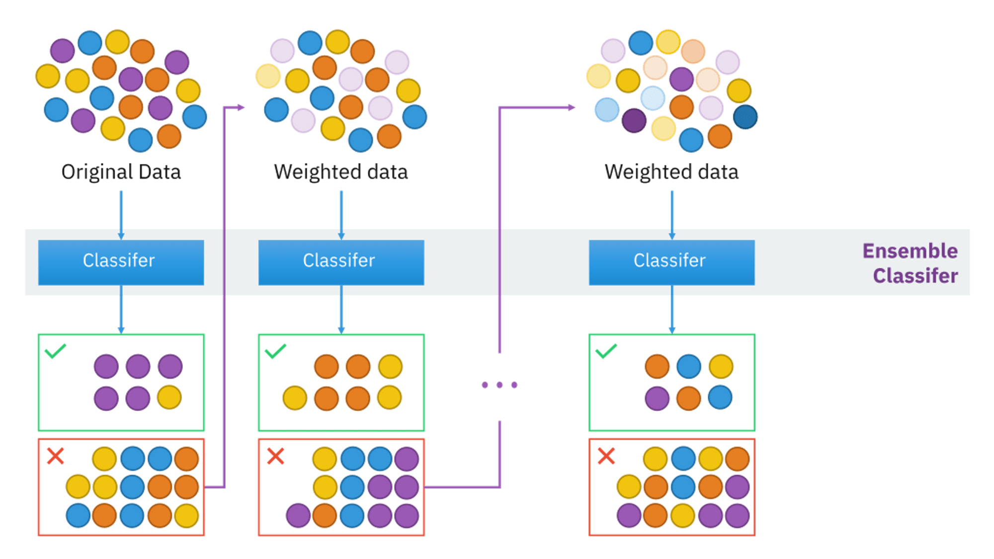
AdaBoost Classifier
Accuracy: 0.647406

Slide 14
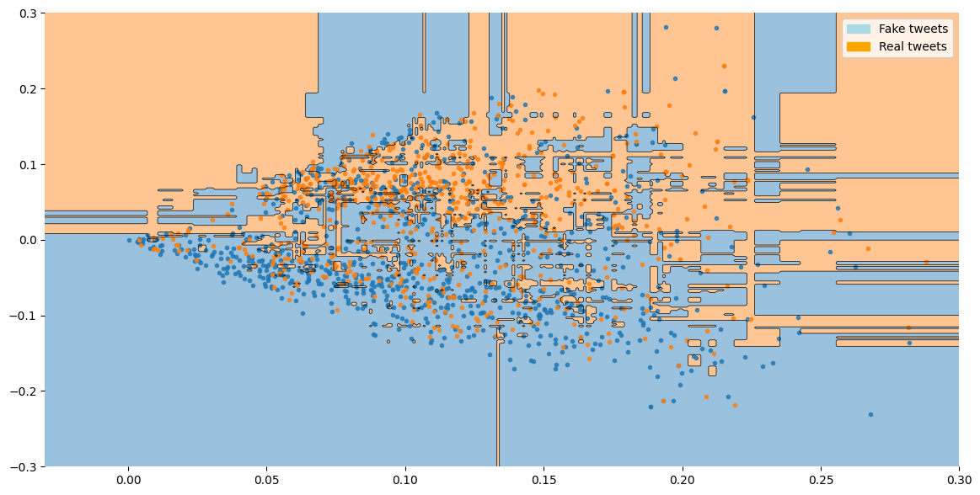

XGBoost Classifier
Accuracy: 0.655285

Slide 15
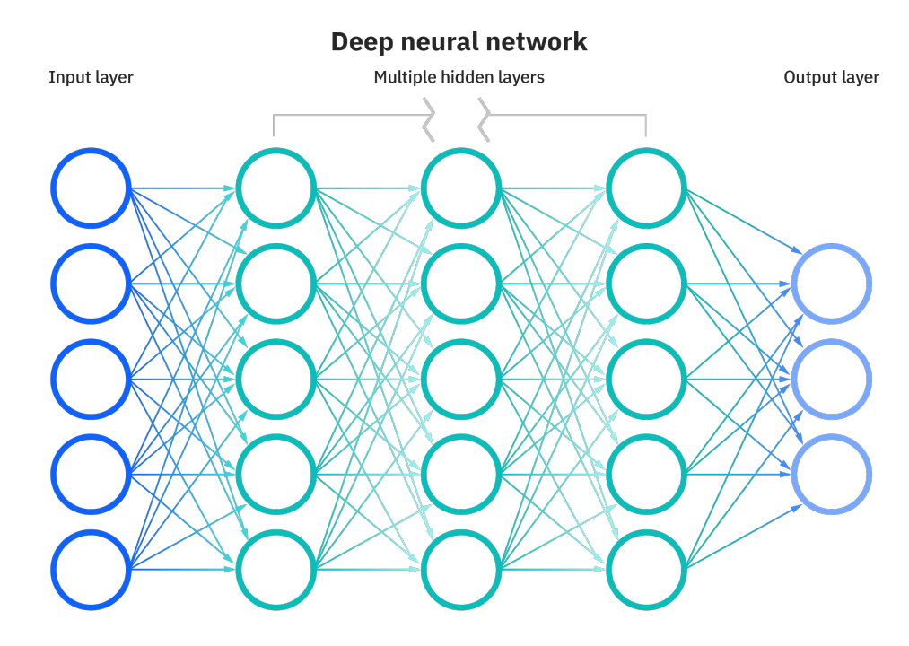
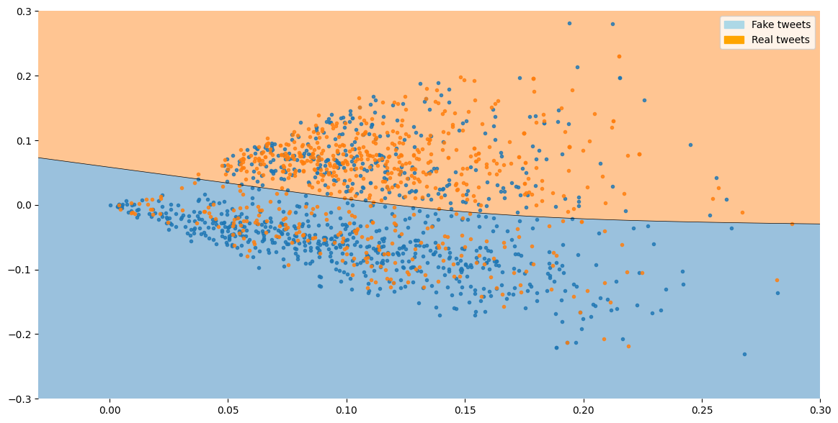
Deep Neural network
Accuracy: 0.65277

Slide 16
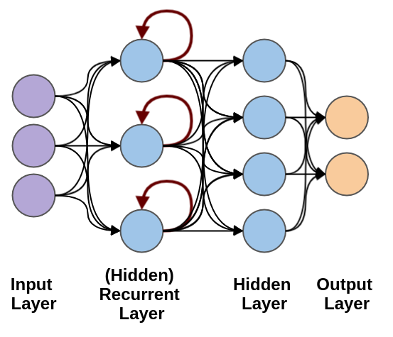
RNN - Recurrent neural network
Accuracy: 0.65461

Slide 17
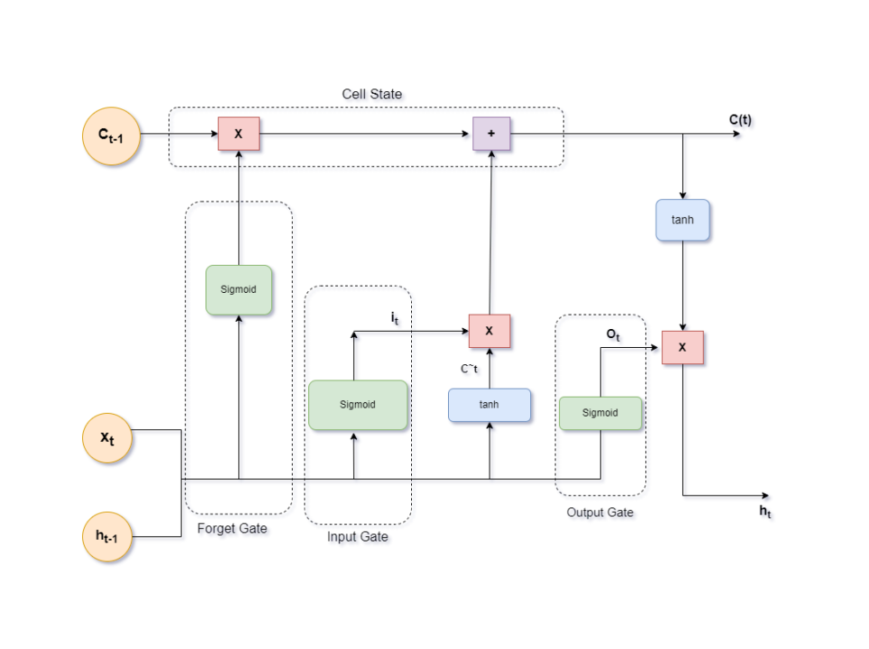
LSTM – Long Short Term Memory
Accuracy Score: 0.76279
Kaggle Rank: 823

Slide 18
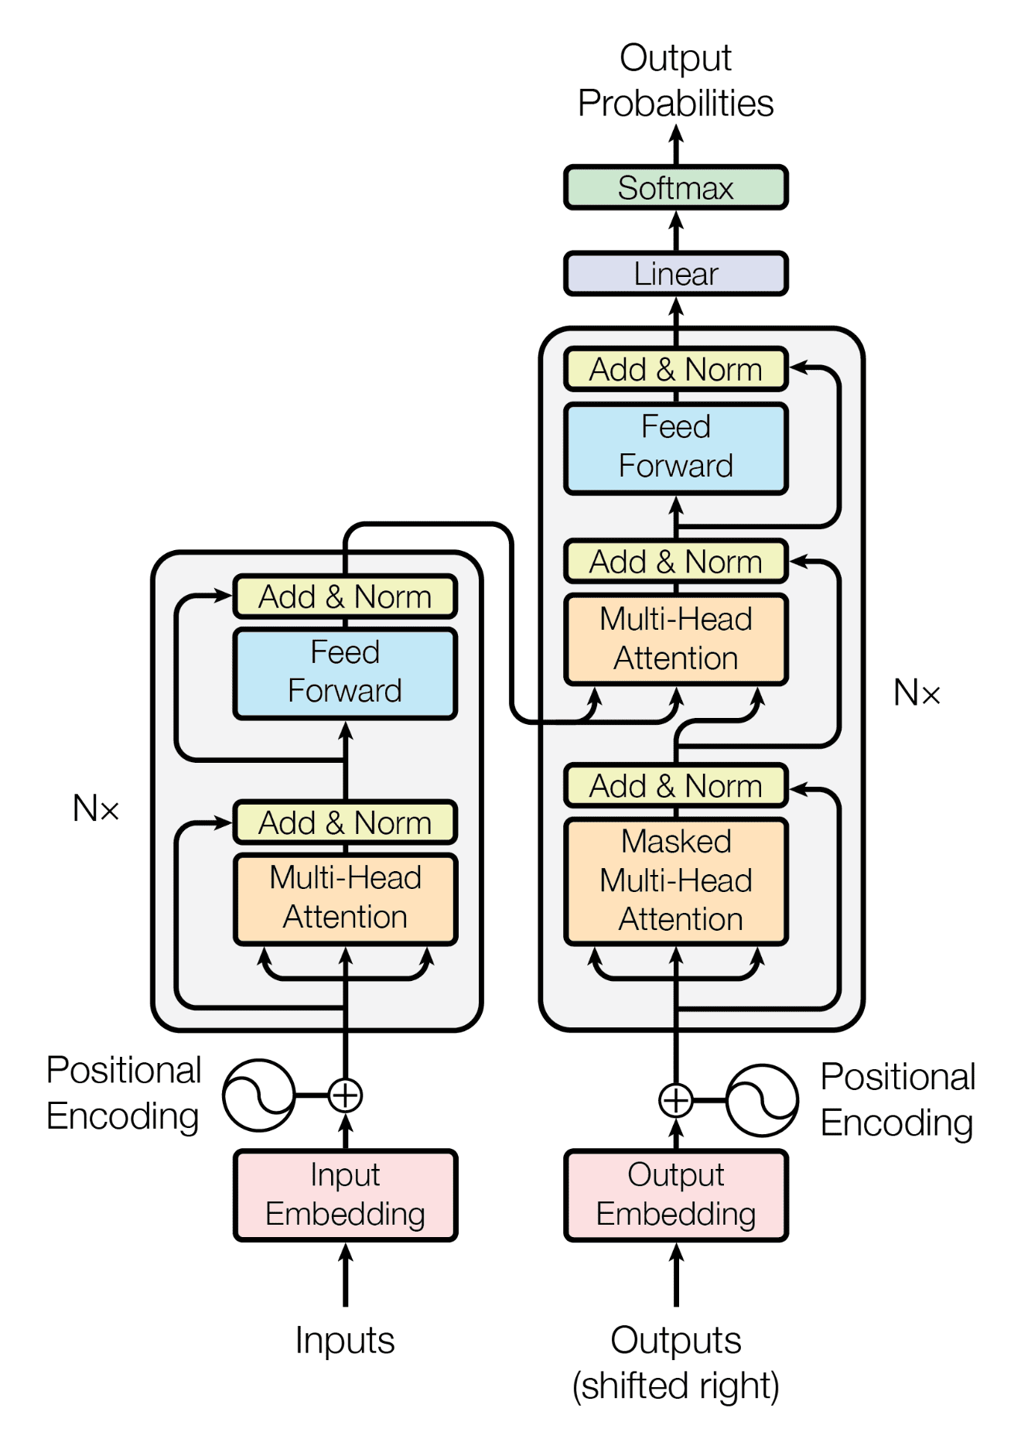
Bidirectional encoder representations from transformers (BERT)
Accuracy Score: 0.80723
Kaggle Rank: 319

Slide 19


Slide 20

Generative AI – Google Gemini 1.5 API
Accuracy Score: 0.99969
Kaggle Rank: 21

Slide 21
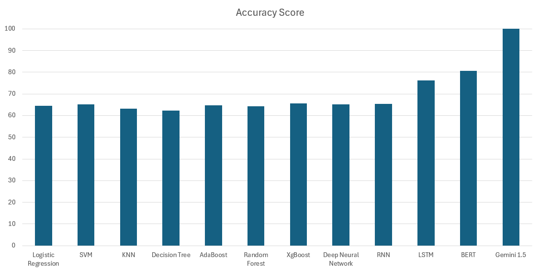

Slide 22
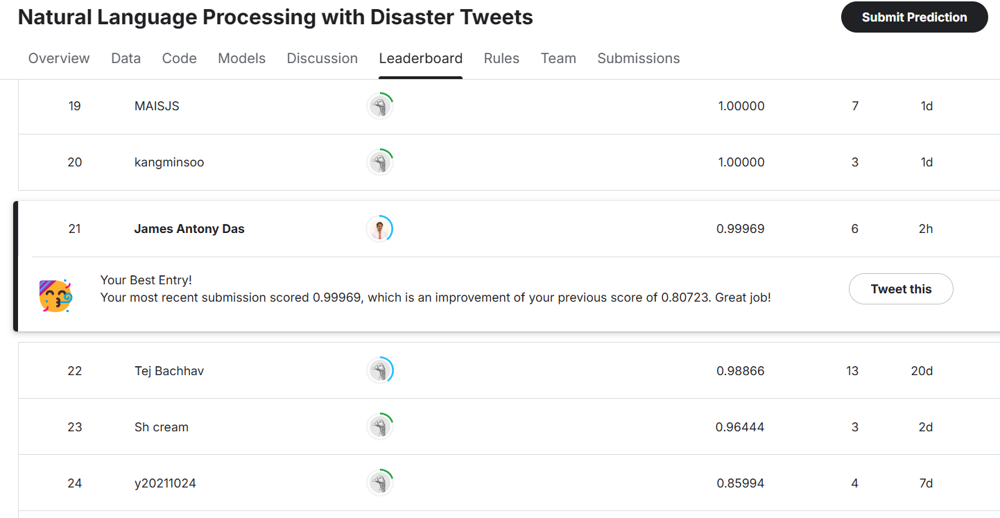
Kaggle Rank

