Slide 1
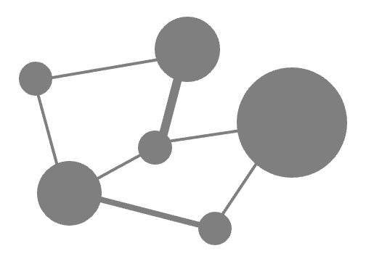
Tutorial on variability of functional and biodiversity responses to perturbations

