Slide 1

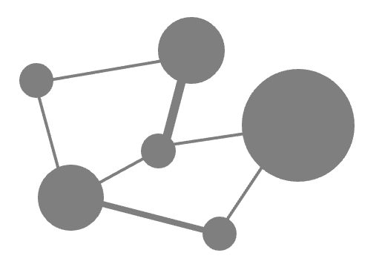
Tutorial on the variability of functional and biodiversity responses to perturbations

