Slide 1
Homework #3: due tomorrow 5:00 pm
Homework #4: due Monday, Sept. 26, 9:00 pm
Exam 1: Wednesday, Sept. 28
Grades will be posted in View’em (not Grades) for the rest of the semester.

Slide 2
Exoplanet Part I will be due 5:00 pm, Weds., Oct. 5
Files are Posted:
Exoplanetary_System_Project.pdf
Part.I Part.I.Guide.pdf
Part.I.SampleSubmission.pdf
Additional details to follow.
Meet with your group members!
Grades will be posted in View’em (not Grades) for the remainder of the semester.

Slide 3
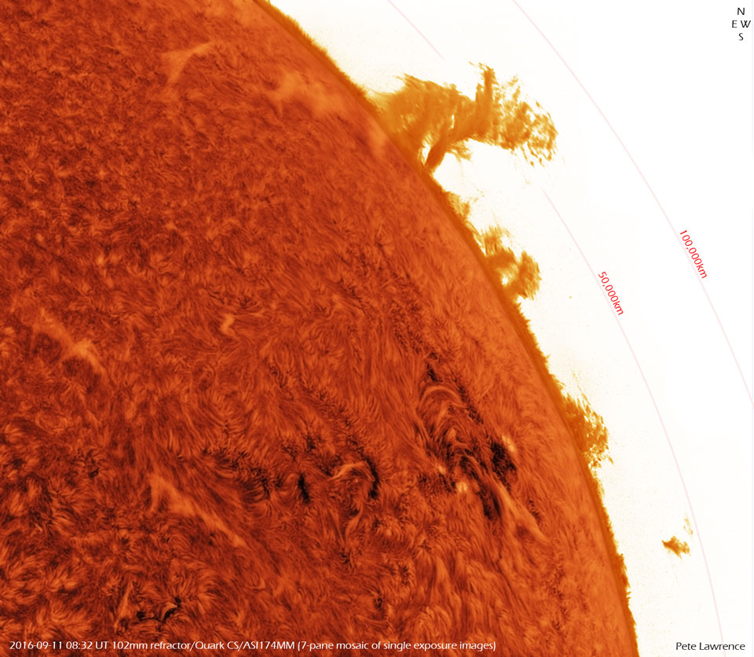
Notes:
NGC 1672 – barred spiral galaxy. Dust, young hot stars (blue), star forming regions (red “emission” nebula of glowing hydrogen gas. We are “star stuff”

Slide 4
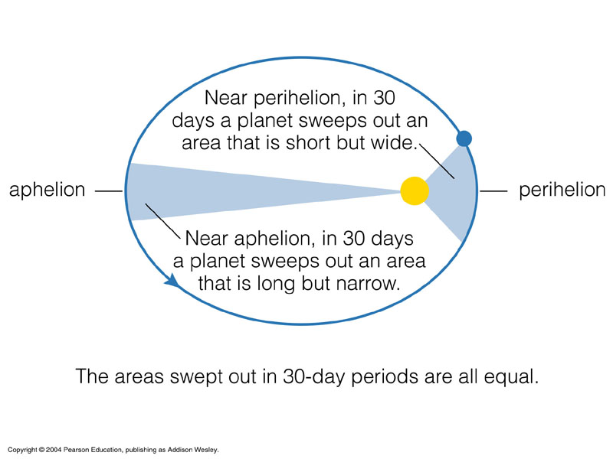
Orbits & Energy
Uphill
Maximum
Potential
Energy
Maximum
Kinetic Energy
Downhill
Conservation of energy

Slide 5
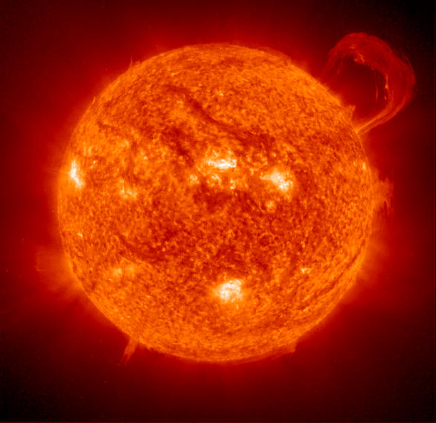
Radiative energy: energy carried by electromagnetic waves (light).

Slide 6
The Electromagnetic Spectrum Video
https://www.youtube.com/watch?v=UzI1z0u_700

Slide 7
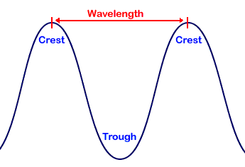
Properties of Waves
WAVELENGTH (λ): Distance between adjacent crests
FREQUENCY (f): number of crests that pass through a point each second - measured in hertz (Hz), the number of cycles per second.
SPEED (s,c): how fast a wave pattern moves. For any wave: s = f λ ; For light waves: c = f λ
The speed of light is a constant, s = c, regardless of the wavelength or the motion of the light source!

Slide 8

In the visible part of the electromagnetic spectrum, we recognize frequency (or wavelength) as color!
Shorter wavelength
Longer wavelength
Light can also be treated as packets of energy called photons
Shorter wavelength photons carry more energy

Slide 9
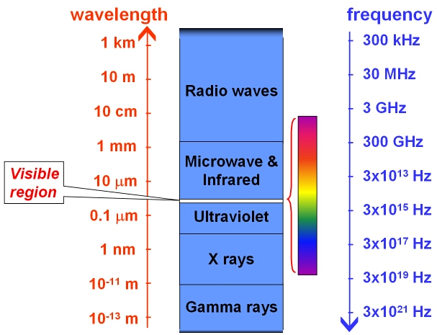
The Electromagnetic Spectrum
lower energy
higher energy

Slide 10
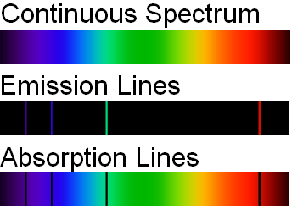
Spectroscopy: The quantitative analysis of spectra
Three types of spectra
Spectroscopic analysis of an objects spectrum can reveal the object’s:
Temperature
Composition
Velocity
(& Magnetic field)

Slide 11
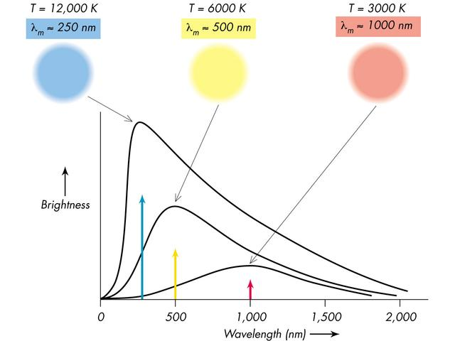
Thermal Emission
Opaque objects emit a continuous spectrum.
Hotter objects emit more total radiation per unit surface area.
Hotter objects have peak emissions at shorter wavelengths (they will appear “bluer”)
Energy per meter²
Wavelength

Slide 12
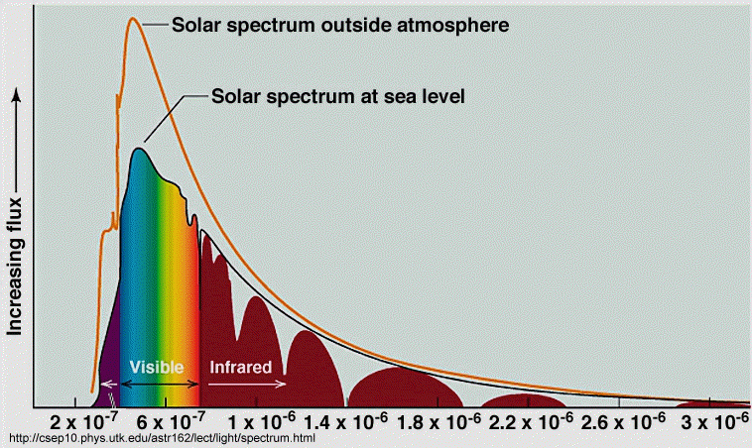
The sun’s peak radiation is in the same spectral region that the human eye has its maximum sensitivity. COINCIDENCE?
Notes:
This slide foreshadows our discussion of life and evolution.

Slide 13

At “room temperature”, or “body-temperature”, objects emit their peak radiation in the infrared. The surface of the Earth and all the planets emit radiation in the infrared.
infrared
visible
Extremely hot objects will emit most of their radiation in the ultraviolet, x-ray or even the gamma ray portion of the spectrum
Notes:
The heated iron bars illustrate thermal emission. Point out that the brightest portion of the bar is the yellowest. Both orange and red are also seen, but fainter, IR emissions are coming from everything in the picture.

Slide 14
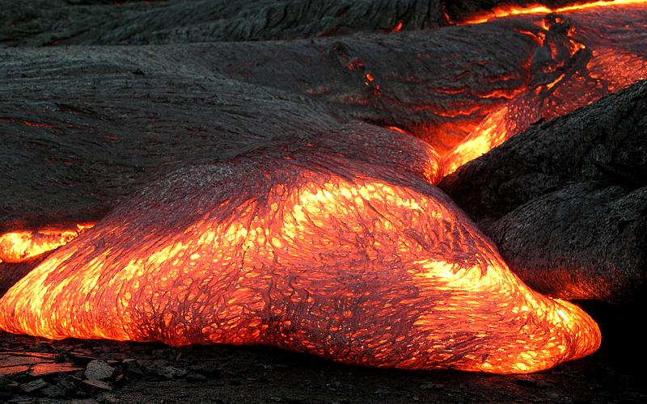

Slide 15
Demo Time

Slide 16

Absorption & Emission Line spectra
Each element emits or absorbs energy at only very specific wavelength characteristic of that element.
This emission or absorption line spectrum identifies the element

Slide 17
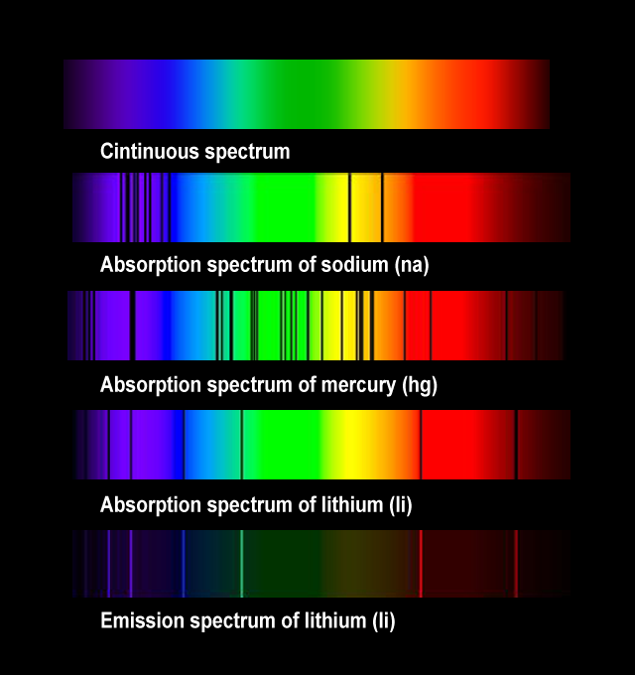
Continuous spectrum
Each element has its own distinctive spectrum
Absorption spectrum of sodium (Na)
Absorption spectrum of mercury (Hg)
The wavelengths that an element absorbs are the same that it emits
Absorption spectrum of lithium (Li)
Emission spectrum of lithium (Li)

Slide 18
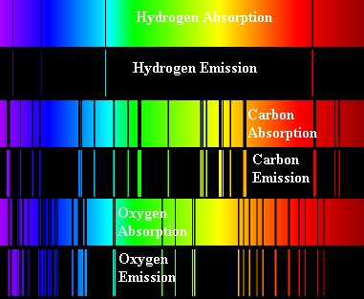

Slide 19
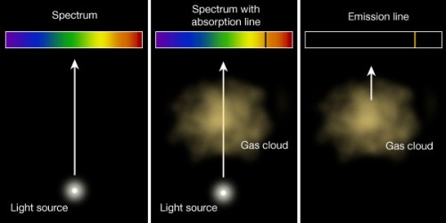
Spectrum with absorption line
Spectrum with emission line
Continuous spectrum
Gas Cloud
Gas Cloud
Light source
Light source
light passing through a cool gas will have light absorbed at specific wavelengths
hot, low density gas emits light of only certain wavelengths
An opaque object emits light at all wavelengths

Slide 20
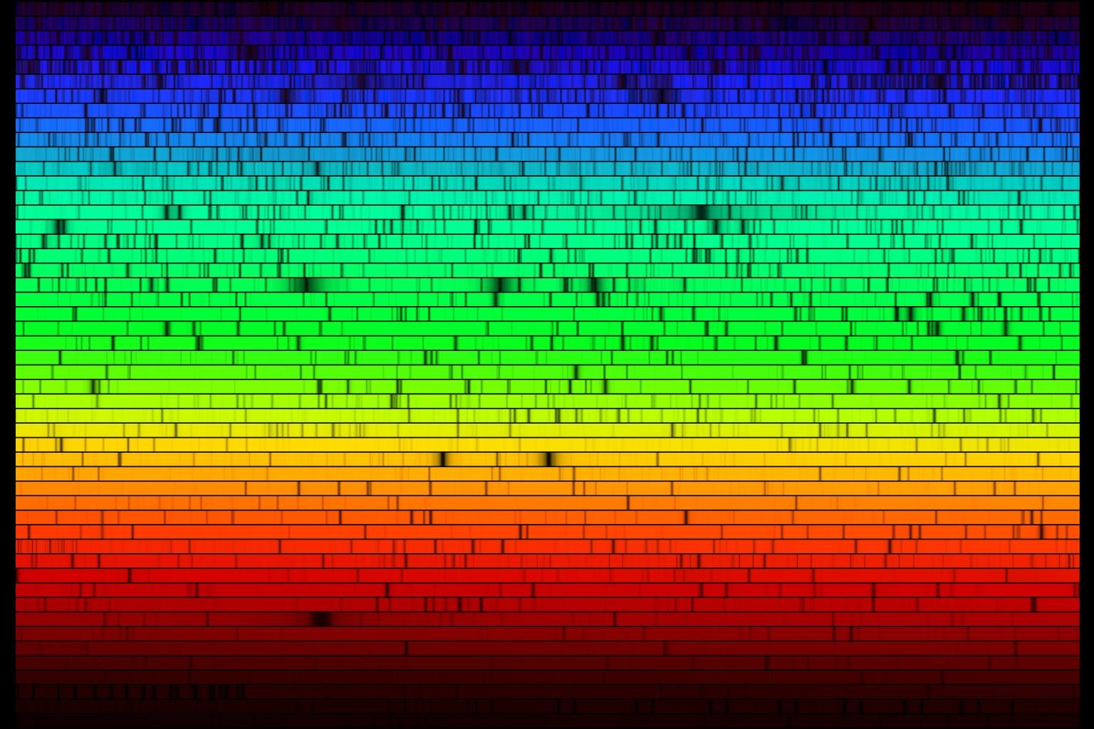
Solar Spectrum: Continuous spectrum coming from
sun’s hot opaque interior passes through cooler atmophere where light is absorbed at specific wavelengths.

Slide 21
The Doppler Effect Video
https://www.youtube.com/watch?v=h4OnBYrbCjY

Slide 22
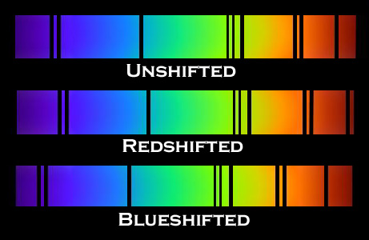
The Doppler Effect
Δλ v
λ c
=
Light emitted from an object moving towards you will have its wavelength shortened - BLUESHIFT
Light emitted from an object moving away from you will have its wavelength lengthened - REDSHIFT

Slide 23
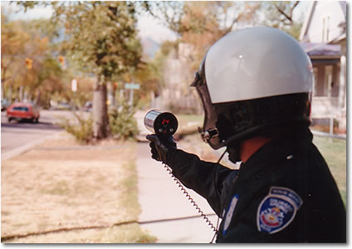
Several of you may have had direct experience with the Doppler effect (Doppler radar)

