Slide 1

Object-Oriented Programming Discussion, Lecture, & Lab Eric Pogue
Agenda for Tuesday, February 12th from 2 to 315pm CST:
Friendly Conversation Topic?
Sprint 3 Sprint Planning
Lab: FaceDraw
Discussion & Questions welcome at any time… please be present with no phones or email during our time together

Slide 2
Friendly Conversation Topic?

Slide 3
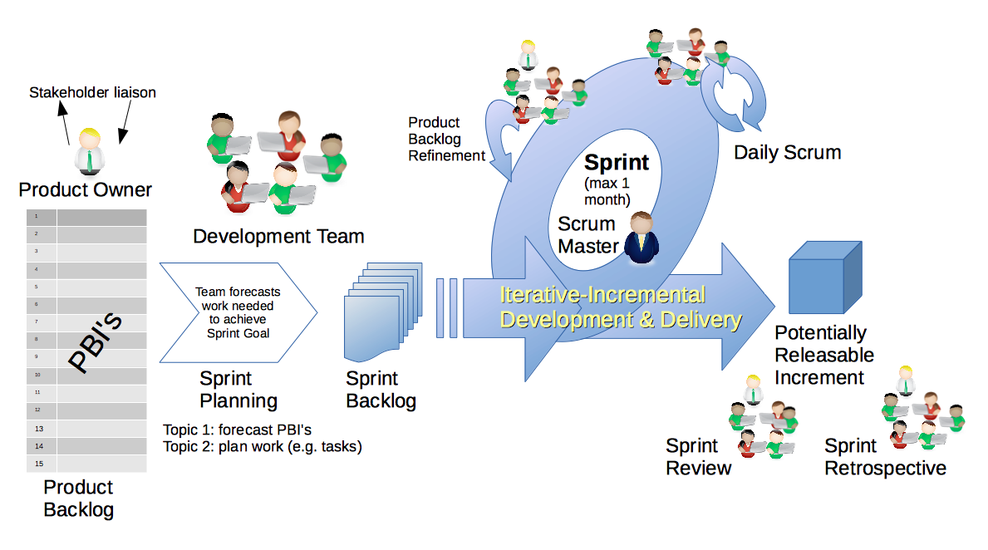
Scrum Process & Roles – Sprint Planning
By Dr ian mitchell - Own work, CC BY-SA 4.0, Link

Slide 4
Sprint Planning
Review:
Activities List
Programming Assignment
Quiz
Discussion Board
Notes:
Some people would say that binary files include all files, and that text files are just binary files that are being interpreted in a specific way.

Slide 5
Lab
As A Scrum Team:
Select a new Scrum Master
Take a team picture with your name tags visible
Review:
Activities List
Programming Assignment
Quiz
Discussion Board
FaceDrawLite & FaceDraw
Report Out at 3:10pm

Slide 6
Daily Scrum and Report Out starting at 3:10
Scrum Master stand up, give your name, your team name, and briefly answer the following questions:
What did you accomplish since the last meeting?
What will you working on until the next meeting?
Is the team committed to completing assignments? All/Most/Some
What is getting in your way or keeping you from completing the assignments?

Slide 7
End of Session

